Slide 1
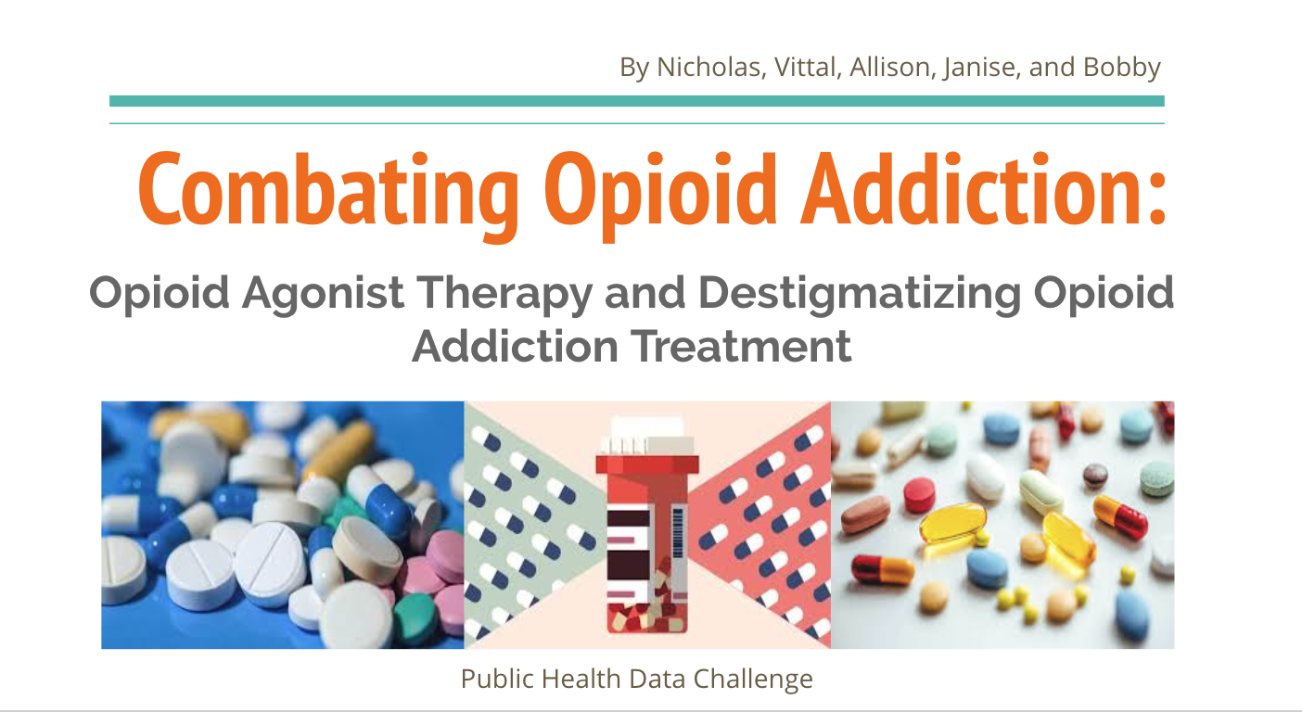

Slide 2
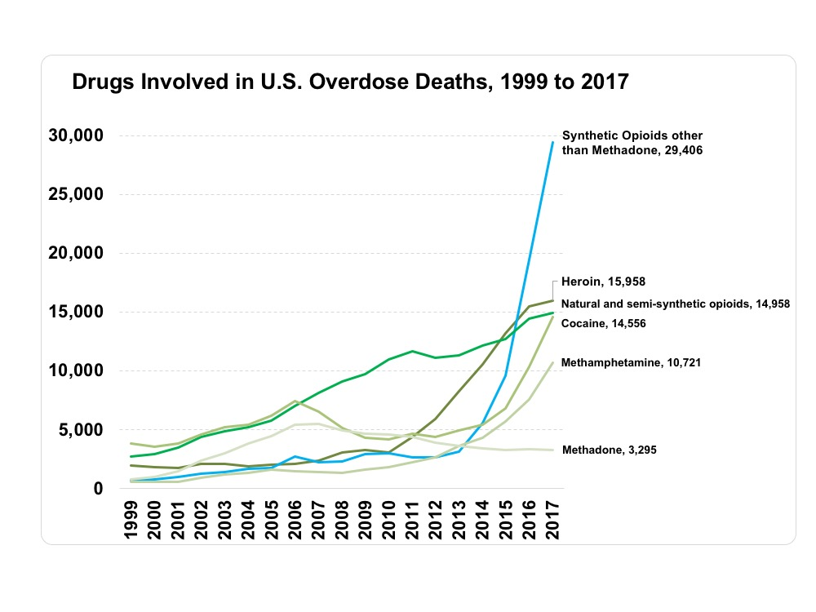
The Opioid Epidemic Explained
Drug overdose is the leading cause of injury death in the U.S.
The opioid epidemic has claimed the lives of more than 700,000 Americans since the late 1990s.
In 2016, more Americans lost their lives to opioid overdoses than car crashes.
To put this into perspective, there have been more deaths related to opioids than the population of moderately large U.S. cities such as Denver and Washington, D.C.

Slide 3
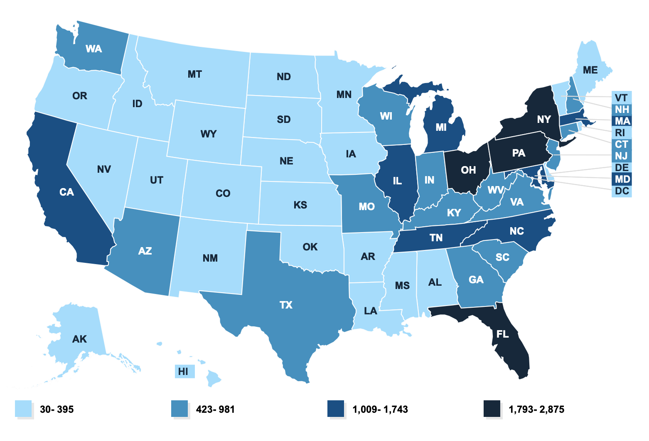
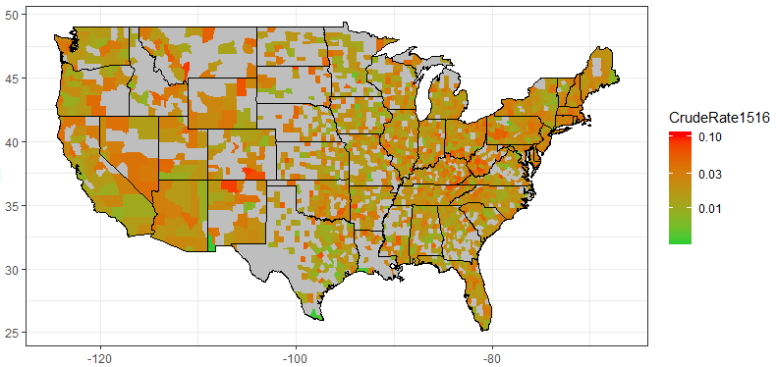
Opioid-Related Overdose Crude Death Rates
2016 Crude Rate (per ) By State
2015-2016 Crude Rate (per ) By County
The choropleth map above depicts the crude opioid-related death rate by state, calculated by dividing the number of deaths into the total population per state and then multiplying the result by . We can see an trend of higher overdose death rates towards the East and West coasts.
The choropleth map above depicts the crude opioid-related death rate by county, calculated by dividing the number of deaths into the total population per county and then multiplying the result by 10,000. Note that most heavily affected counties are located in CA, NM, and KY, and WV, all which have a moderate state death rate. Also note that there is insufficient data in the Midwest states, which have a less dense population distribution.

Slide 4
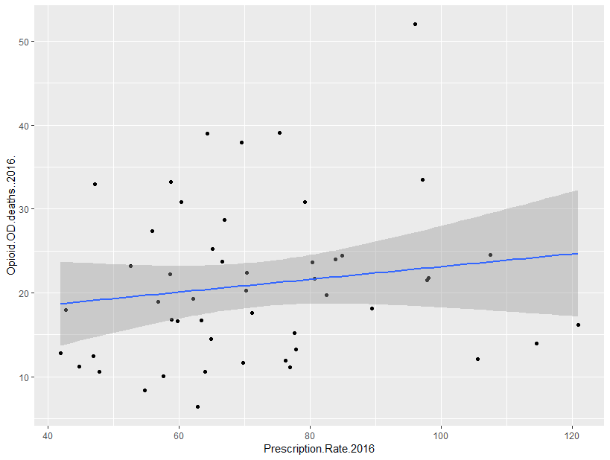
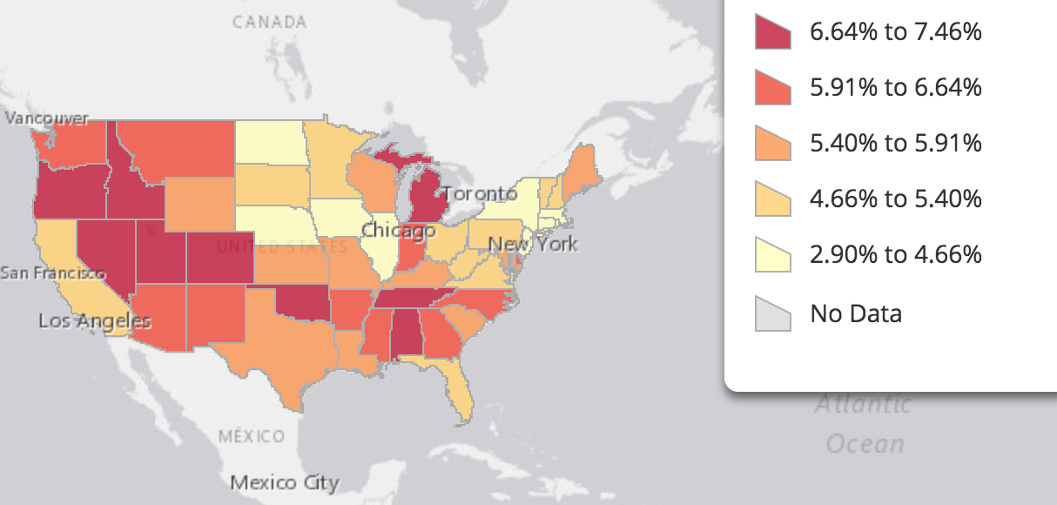
Correlation in Opioid Deaths
Overdose Death Rate vs. Prescription Rate
The overdose death rate vs. prescription rate scatterplot (log transformed) depicts a positive, weak, linear correlation between opioid-related deaths and prescription rate (R = 0.4796).
About 2.30% of the variation in the overdose death rate can be explained by the approximate linear relationship with the prescription rate (R-squared = 0.0230)
Overdose Death Rate (log scale)
Opioid Prescription Rate by State
Prescription Rate (log scale)
This is not what we expected. We expected that higher opioid prescription rates would likely correlate with more opioid overdoses, but there was very low correlation, perhaps due to factors which have a greater impact on death, such as access to hospitals/treatment or poverty rate.
In addition, the overdose rate from the CDC included overdoses from other types of drugs as well. We also believe there would be a stronger correlation between prescription rate and addiction rather than death.

Slide 5
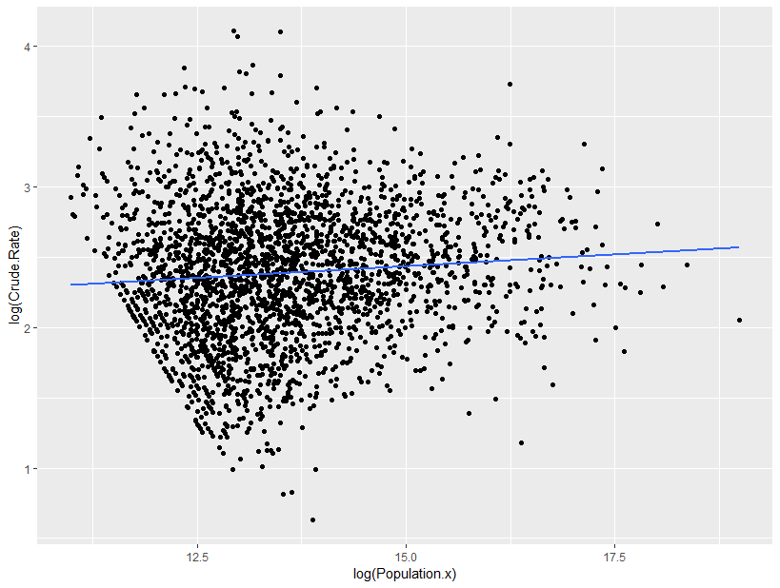
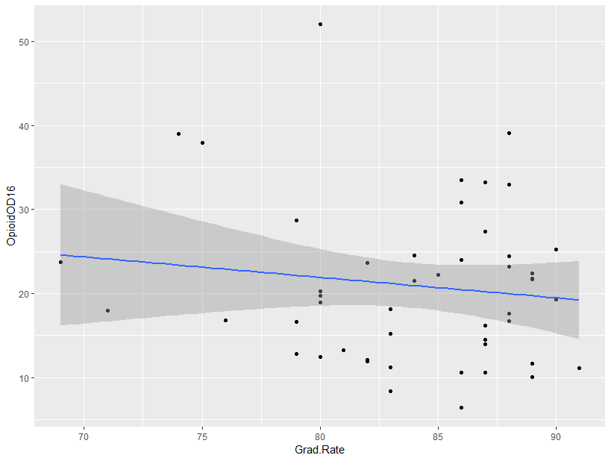
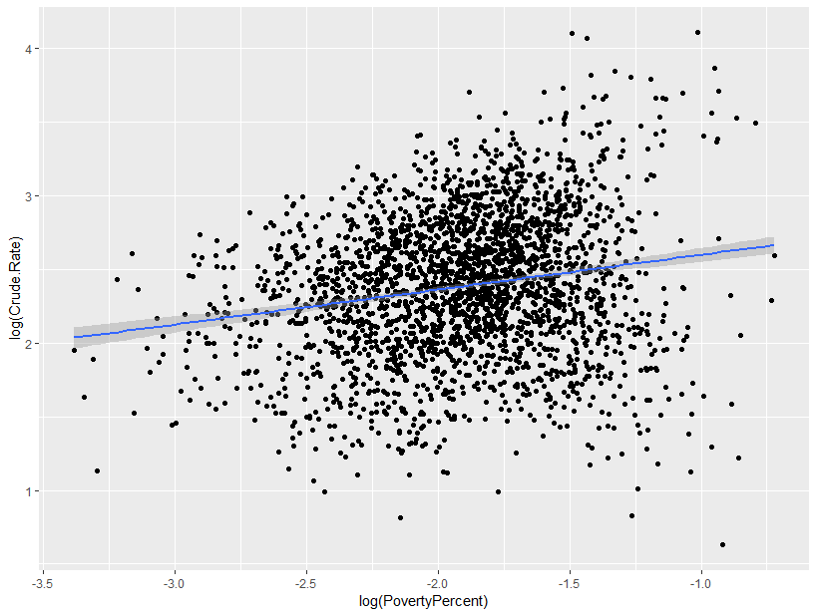
Multivariate Analysis
Overdose Rate vs. Prescription Rate
Overdose Rate vs. Population (log scale)
Analysis of each individual explanatory variable resulted in very weak correlation (R-squared < .10), so we decided to run a multivariate linear analysis. We took population, poverty, HS graduation rates, and naloxone access into account since we had county-level data for those variables. The following is our result:
OD = -2.62 + .16*log(PovRate) - 0.10*log(Pop)
- 0.54*(GradRate) - 0.15*(NarcanAvailability)
Positive correlation with Poverty Rate (decimal) and negative correlation with Population, Graduation Rate (decimal), and Availability of Over-the-counter Narcan (0 or 1). The strongest correlation was with population, so more rural areas were much more likely to have higher overdose rates.
R = 0.3428 (Positive, moderate correlation)
Overdose Rate vs. HS Grad Rate
Overdose Rate vs. Poverty (log scale)

Slide 6
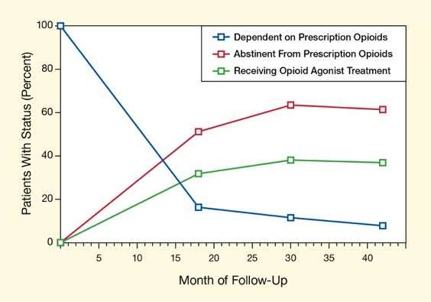
Improving Recovery: Opioid Agonist Therapy (OAT)
OAT involves taking opioid agonists, such as methadone or buprenorphine to prevent withdrawal symptoms and reduce cravings for opioid drugs.
People who are addicted to opioid drugs can undergo OAT to help stabilize their lives and reduce the harm related to their drug use. OAT decreases the cost and complexity of treating opioid addiction.
3 Step Implementation of OAT
Overcome societal stigma around OAT and encourage addicts to seek help through social media campaigns, news articles, and news segments to inform the American public about the cost-benefit and health benefits of OAT
Allocate federal funding to help fund OAT in specific areas that are at the highest risk. Funding hospitals and doctors through Medicare to decrease or even eliminate the cost of treatment.
Use extra federal funding and saved costs to expand opioid treatment to other areas that have lower opioid overdose death rates.

Slide 7
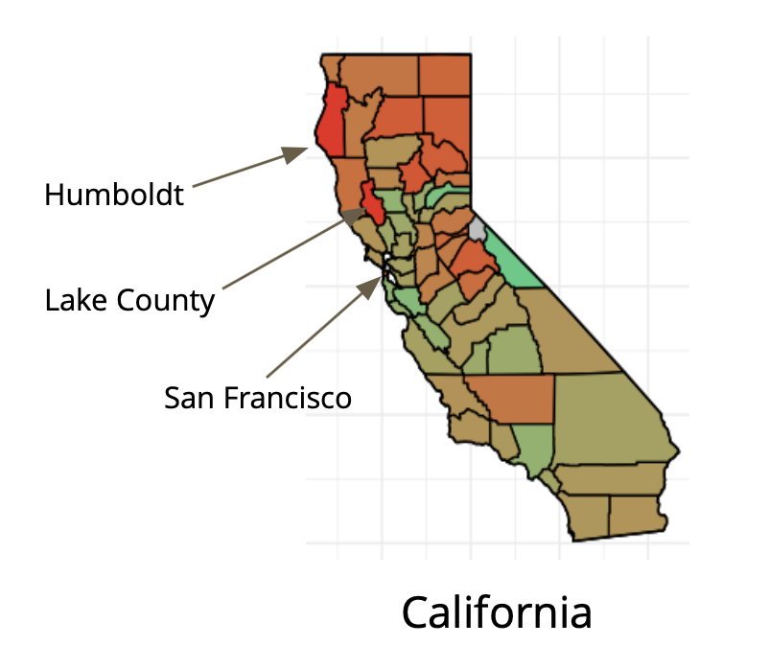
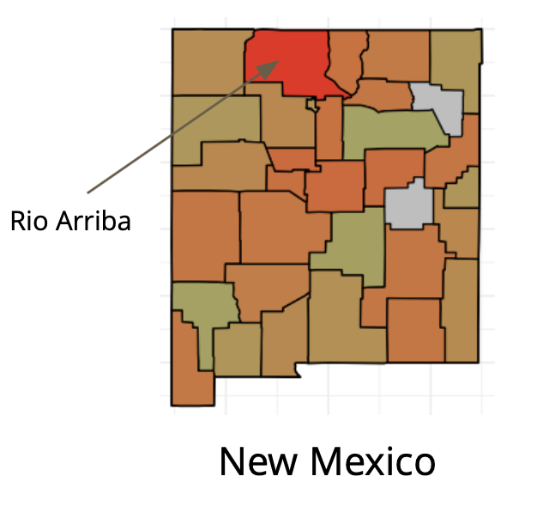
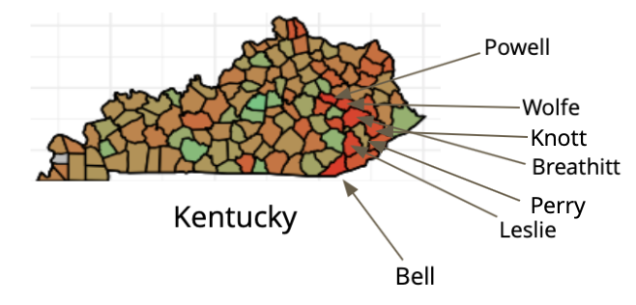
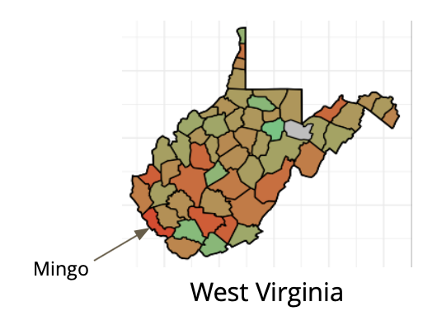
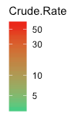
Need-Driven OAT
OAT can be focused in counties with high rates of opioid-related deaths such as Northern California, Northern New Mexico, Eastern Kentucky, and Southern West Virginia.
Furthering Research Through Funding
OAT has been shown to reduce costs, with a study suggesting that every additional dollar spent on OAT in the New England area would save $1.80 and better the treatment of individuals suffering from addiction.
The money saved from OAT could be used to expand OAT treatment as well as be spent on research to discover a less addictive long-term pain-killing medication that can revolutionize the pharmaceutical industry and help reduce or prevent addiction.

Slide 8


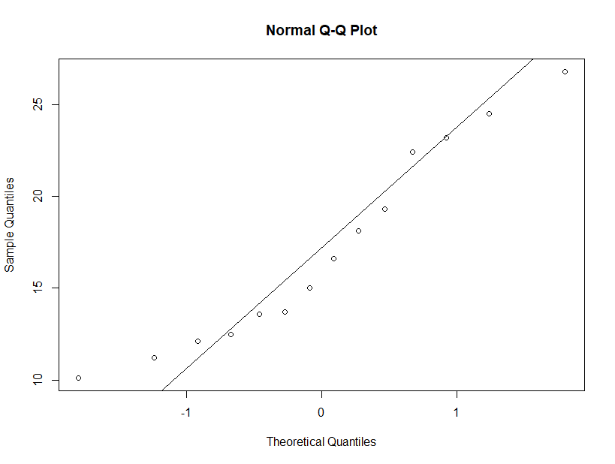
(Based on 2015-2016 data, the most recent available)
: States w/ over-the-counter Narcan access and those w/o access have the same opioid overdose rate.
: States w/ over-the-counter Narcan access have lower overdose rate than those with prescription-only access
States w/ prescription-only Narcan: x̄ = 22.69722
n = 36, s = 9.7918
States w/ Narcan over-the-counter: x̄ = 17.07857
n = 14, s = 6.5744803
t = 2.5813 df = 35.336
Since p-value = 0.004921 < α = 0.01, we reject .
Saving Lives Through Naloxone (Narcan)
We found a statistically significant difference in overdose rates between states allowing over-the-counter or prescription-only purchase of Naloxone, a life-saving opioid-inhibiting drug which can potentially reverse an overdose.
We know that correlation doesn’t necessarily imply causation, since states with higher OD rates would be more likely allow easier access to Narcan. However, Naloxone is vital to saving lives, as indicated by the Naloxone Administration data.
Therefore, we suggest not only to expand and provide easier access to Naloxone but also to inform citizens of at-risk-counties on how to use Naloxone and their legal protection in using Naloxone to save someone else’s life.
Based on the data collected, there is sufficient evidence to conclude that states with over-the-counter Narcan access have lower overdose rate than states with prescription-only access.
OD Rates for states w/ over-the-counter Narcan, Normality Plot
Notes:
=

Slide 9

Tackling the Opioid Crisis: A Multi-faceted Solution
Improving Recovery, Saving Lives, and Furthering Research
The best way to prevent opioid deaths is to prevent addiction, but currently there is not a strong alternative solution to opioids.
After learning this, we developed a coalition of solutions which should decrease death rates immediately, decrease addiction overall, and fund research for opioid alternatives.
Our solution will not only help decrease the cost of treatment, but more importantly help families and communities who are faced with loss of a loved one and the suffering of emotional and non-fatal physical trauma.

Slide 10
Works Cited
CDC WONDER, Prescription Opioid Overdose Deaths and Death Rate per 100,000 Population (Age-Adjusted).” The Henry J. Kaiser Family Foundation, The Henry J. Kaiser Family Foundation, 19 June 2018
CDC WONDER & National Institute on Drug Abuse. “New Mexico Opioid Summary.” NIDA, NIH: National Institute on Drug Abuse, 28 Feb. 2018
Chooper. “Chooper's Guide ... the Internet's Most Comprehensive Substance Abuse Treatment, Prevention and Intervention Resource Directory.” Addiction Professional Types, Chooper's Guide, 2012, choopersguide.com/content/naloxone-laws-by-state-map.html.
“Morbidity and Mortality Weekly Report (MMWR).” Centers for Disease Control and Prevention, Centers for Disease Control and Prevention, 9 Aug. 2018, www.cdc.gov/mmwr/volumes/67/wr/mm6731a2.htm.
National Institute on Drug Abuse. “How Much Does Opioid Treatment Cost?” NIDA, National Institute on Drug Abuse, June 2018, www.drugabuse.gov/publications/research-reports/medications-to-treat-opioid-addiction/how-much-does-opioid-treatment-cost.
Price, Mark, and Estelle Sommeiller. “Top Incomes since 1917.” Top Incomes since 1917, 6 July 2018, www.epi.org/files/2018/top-incomes-since-1917_vs2015.xlsx.
Small Area Income & Poverty Estimates Program, and Census Bureau. “Small Area Income & Poverty Estimates (SAIPE) Main Page.” Census Bureau QuickFacts, United States Census Bureau, 2016, www.census.gov/data-tools/demo/saipe/saipe.html s_appName=saipe&map_yearSelector=2016&map_geoSelector=aa_c.
The American Journal of Medicine. “Using Science… Opioid Agonist Therapy Saves Lives.” The AJM 2016, https://www.amjmed.com/article/S0002-9343(16)30073-0/pdf
United States, Congress, Office of Elementary and Secondary Education. “SY 2015-2016 Consolidated State Performance Report.” SY 2015-2016 Consolidated State Performance Report, Office of Elementary and Secondary Education, 2017.

