Slide 1
People Counter using Thermal Tripwire Sensor
Team 8: Janis Intoy and Emily Lam
April 19th, 2017

Slide 2

Problem Statement
Thermal Camera
The efficiency of HVAC (Heating Ventilation & Air Conditioning) systems can be improved by making them adaptive to the number of people in a room.
In order to estimate a room’s occupancy level, the Occusense Senior Design team has created a reliable, thermal sensor system to capture the motion of people through doorways.
We aim to develop a reliable, real- time algorithm to detect the direction of motion of people passing through in order to track the number of people in the room.
Person Enter?
Person Exit?
Room Occupancy
Heating
Ventilation
Cooling

Slide 3
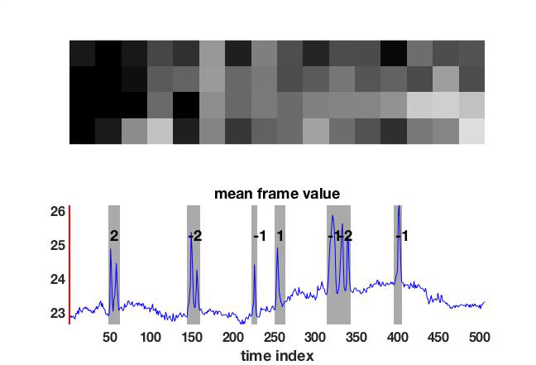
Assumptions and Constraints
Background has slow temporal dynamics
Data starts with some number of background-only frames
Only vertical velocity matters
IN
OUT

Slide 4
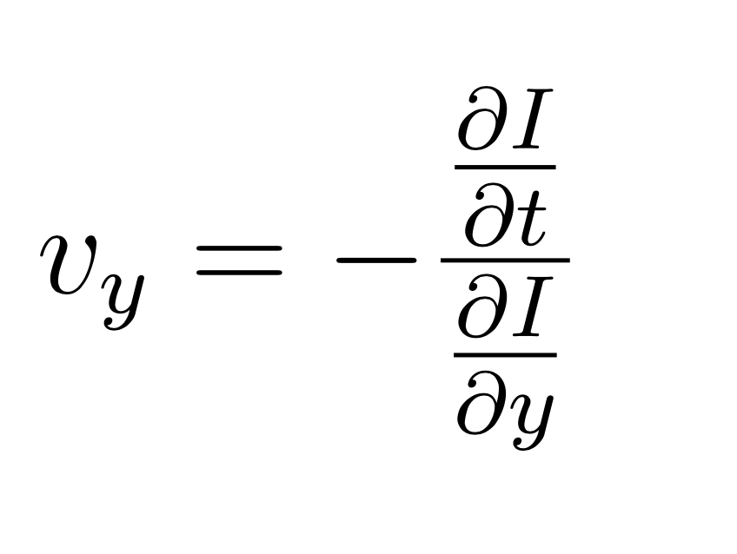
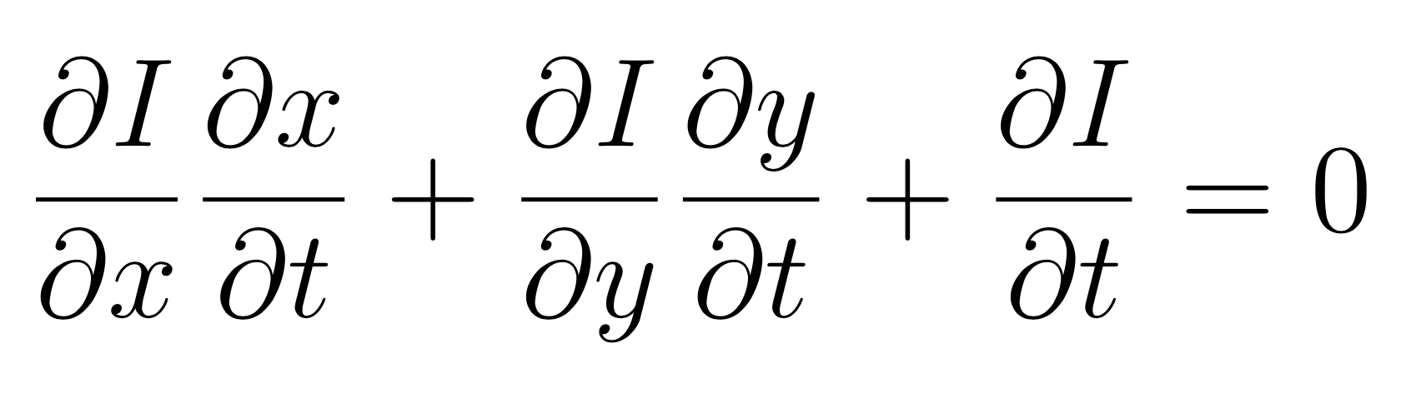
Three-step Approach
Our approach breaks the problem into three parts:
detect a person in the doorway
background subtraction methods
determine the direction of motion of the person
Gradient based optical flow algorithm
People counter

Slide 5
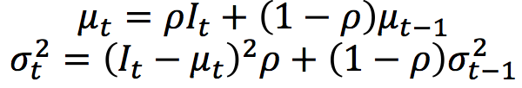
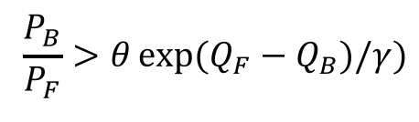
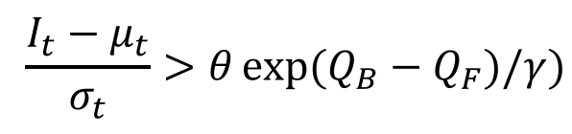
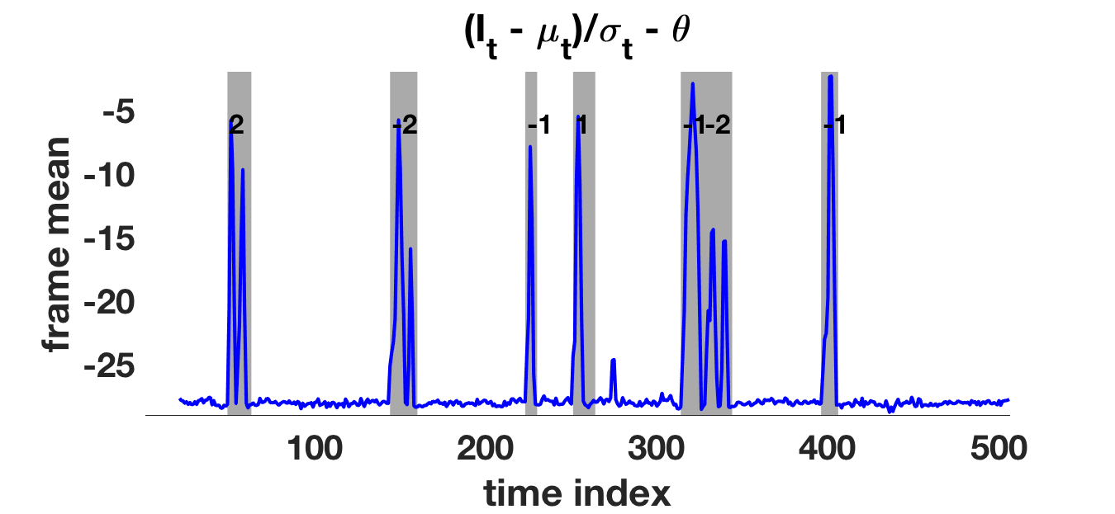
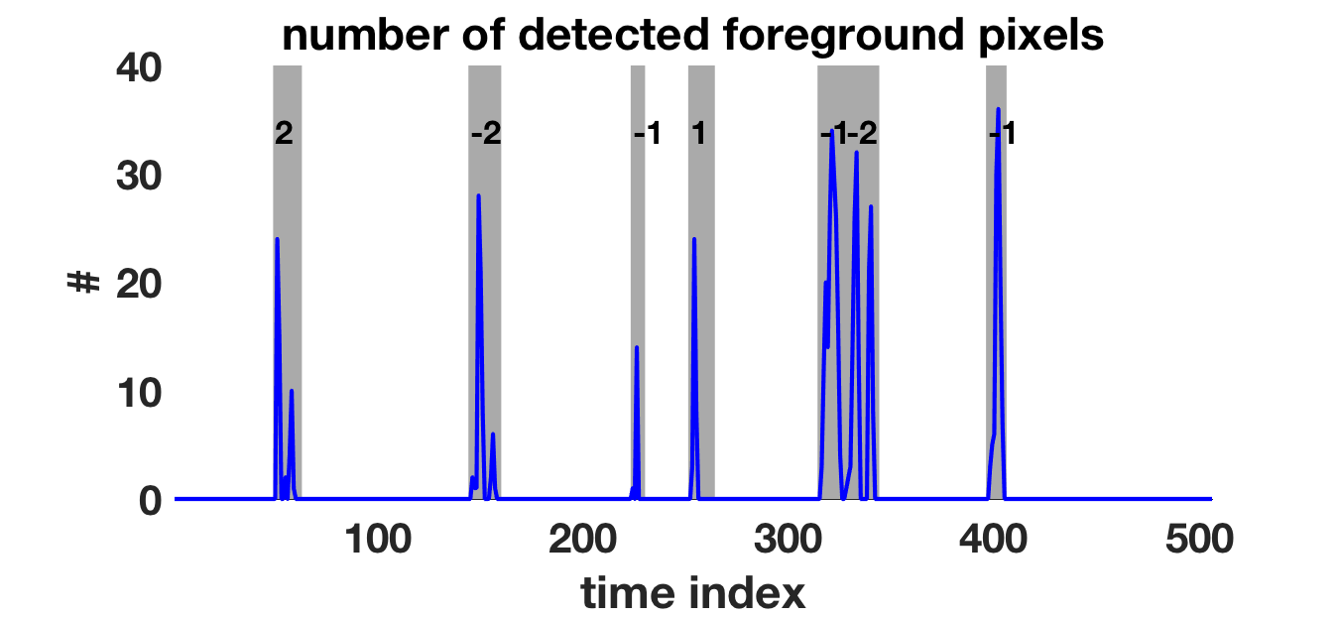
Background Subtraction
Running Gaussian average
(with adaptive threshold)
background at each pixel
Foreground:
Foreground-adaptive
(McHugh et al., 2009)
Kernel density estimation of background and foreground models
Foreground:

Slide 6
Optical Flow

Slide 7
Implementation Details
Background Subtraction
Algorithm
[insert foreground mask frame photo]
Foreground Mask
Data
Optical Flow
Algorithm
Velocities
People Count
[insert quiver of optical frame photo]
Classifier

Slide 8
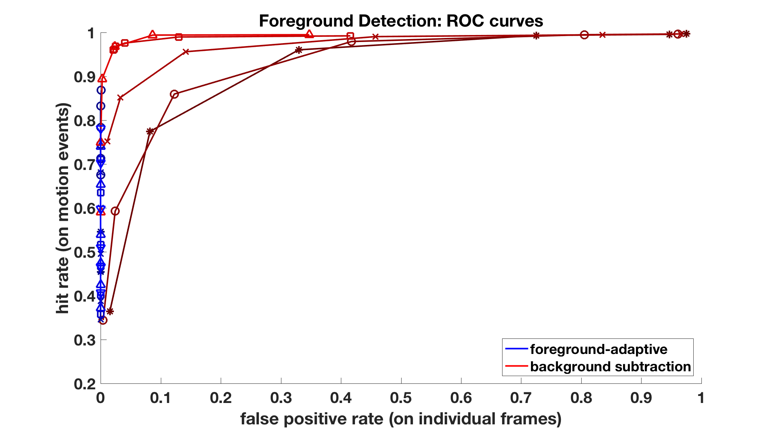
Person Detection Results
Adaptive method has less hits but never identifies background noise as a person

Slide 9
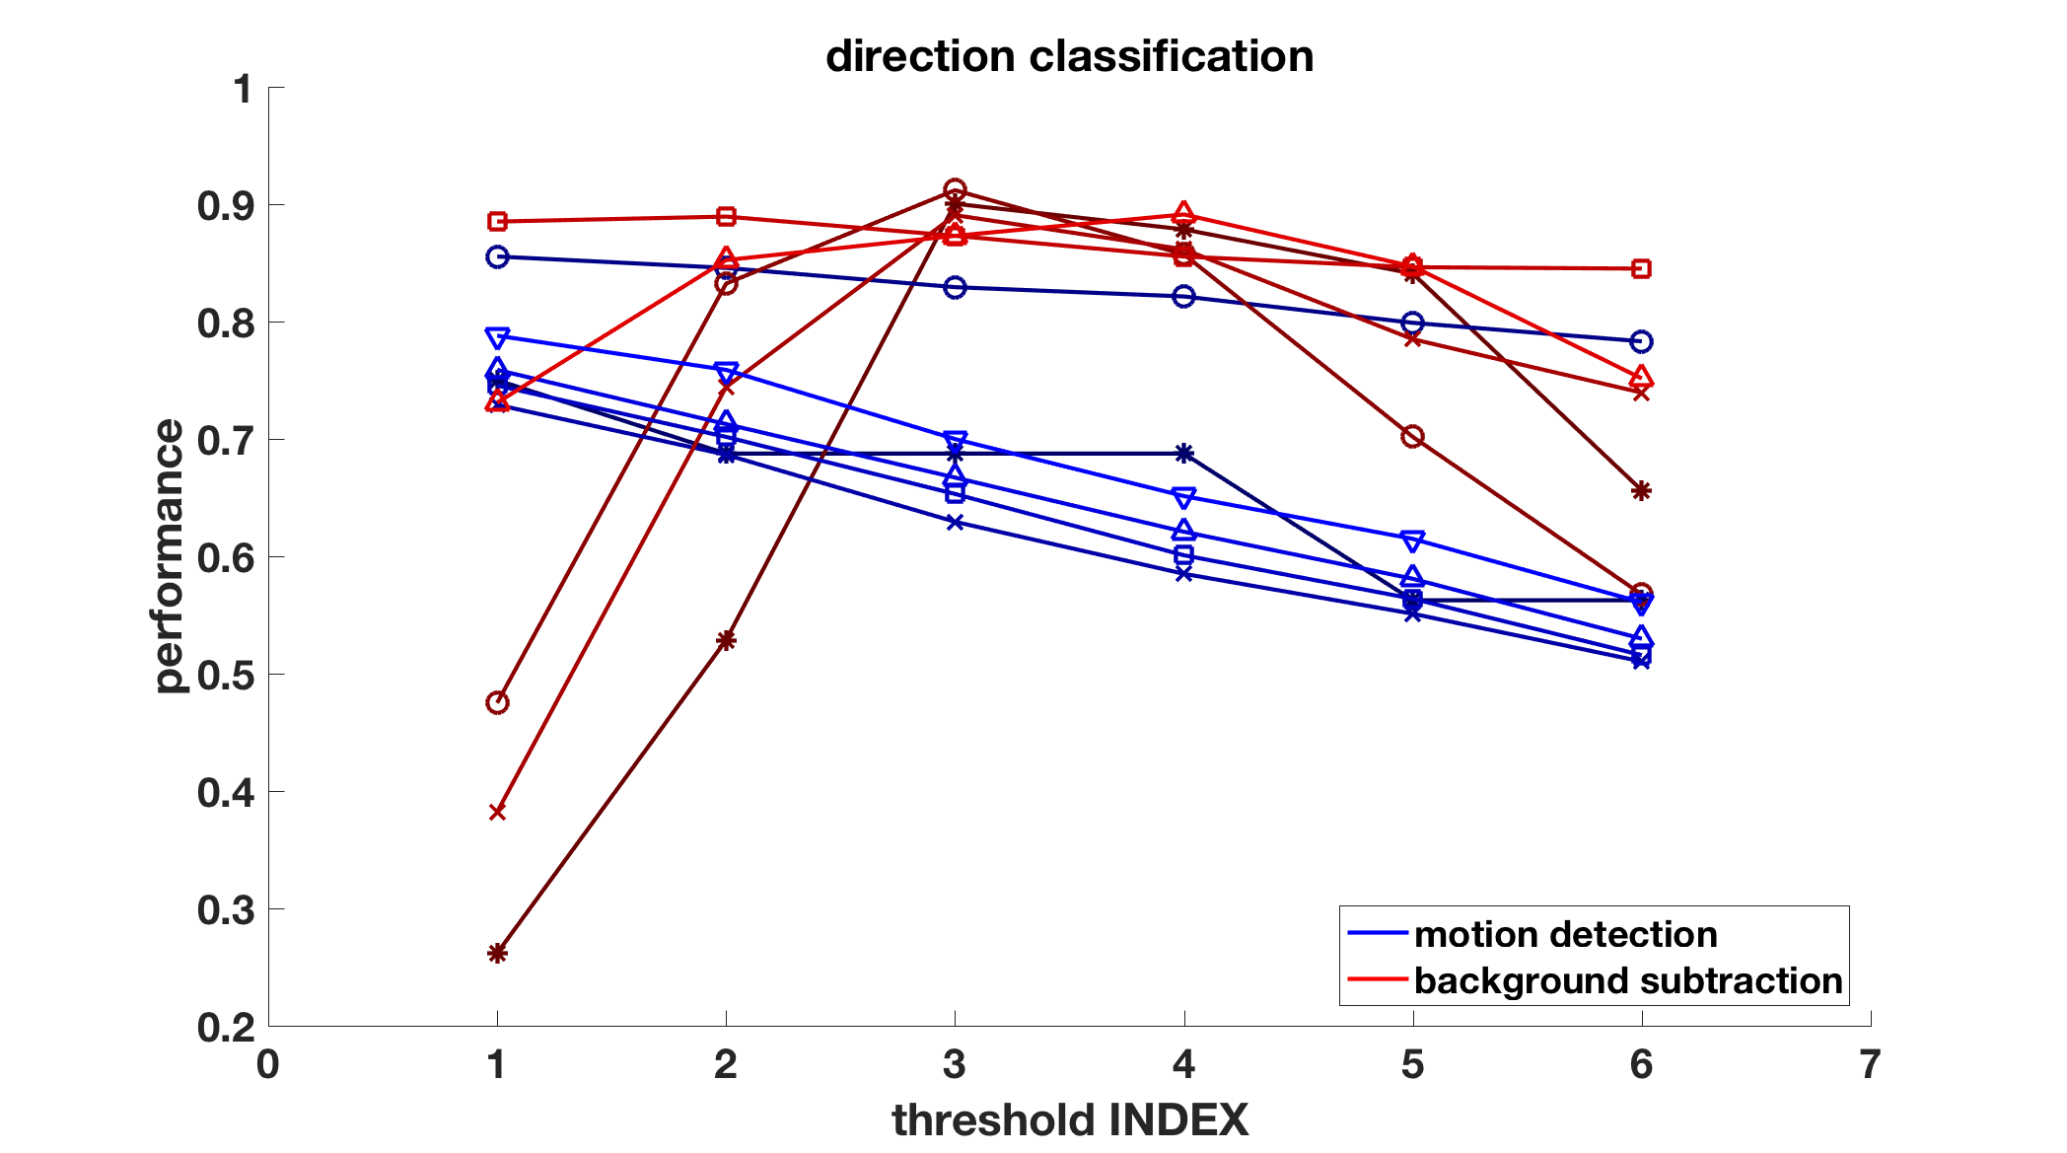
Direction Classification Results

Slide 10
Final Results

Slide 11
Conclusions and Future Work
90% accuracy
Integrate with senior design team

