Slide 1
People Counter using Thermal Tripwire Sensor
Team 8: Janis Intoy and Emily Lam
April 19th, 2017

Slide 2
Problem Statement
The efficiency of HVAC (Heating Ventilation & Air Conditioning) systems can be improved by making them adaptive to the number of people in a room.
In order to estimate a room’s occupancy level, the Occusense Senior Design team has created a reliable, thermal sensor system to capture the motion of people through doorways.
We aim to develop a reliable, real- time algorithm to detect the direction of motion of people passing through in order to track the number of people in the room.

Slide 3
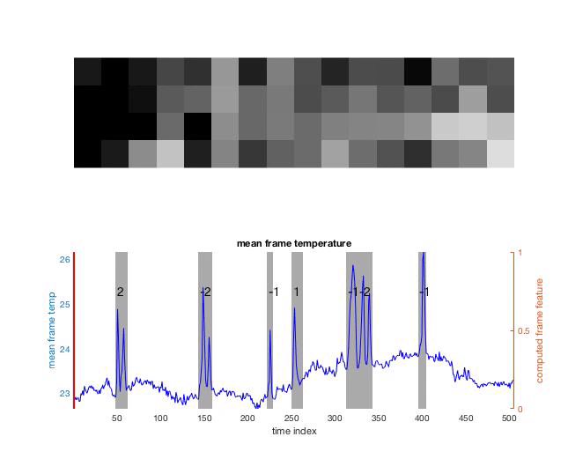
Assumption and Constraints
Assumptions:
background has slow temporal dynamics
data starts with some number of background-only frames
Assumptions:
only vertical velocity matters

Slide 4
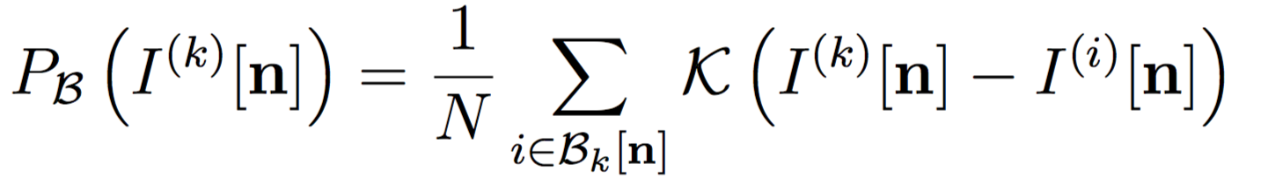
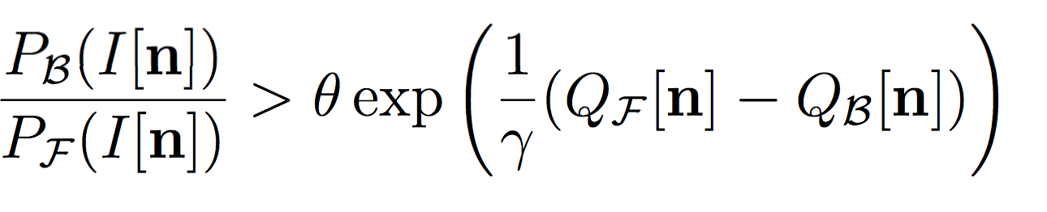
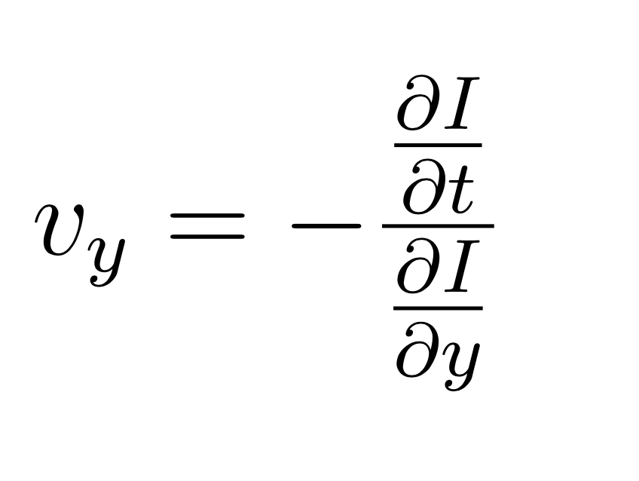
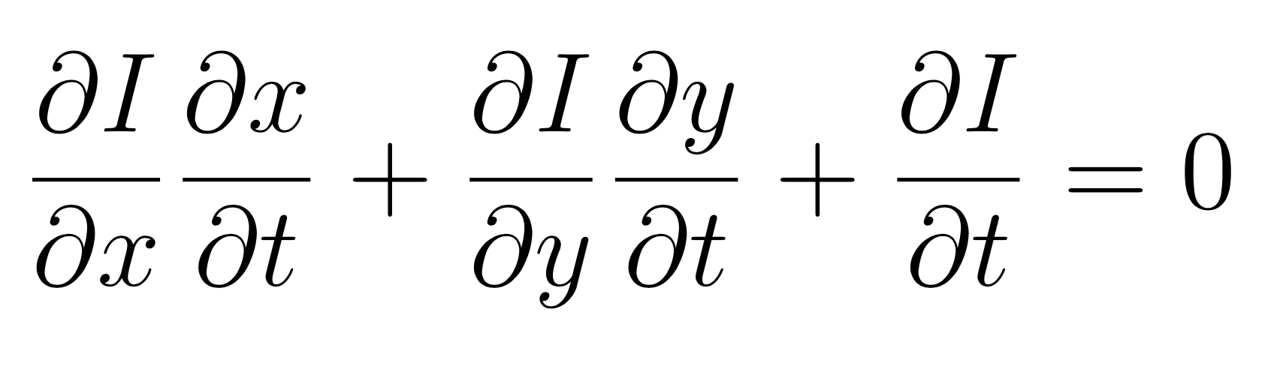
Two-step Approach
Our approach breaks the problem into two parts:
detect a person in the doorway
foreground-adaptive background subtraction
determine the direction of motion of the person
Gradient based optical flow algorithm

Slide 5
Background Subtraction

Slide 6
Optical Flow

Slide 7
Implementation Details
Background Subtraction
Algorithm
[insert foreground mask frame photo]
Foreground Mask
Data
Optical Flow
Algorithm
Velocities
People Count
[insert quiver of optical frame photo]
Classifier

Slide 8
Intermediate Results

Slide 9
ROC

Slide 10
Classifier Performance

Slide 11
Final Results

Slide 12
Conclusions and Future Work
90% accuracy
Integrate with senior design team

