Slide 1

“BitTales”
"Connecting generations through the power of storytelling"
Domains: bittales.tech, carecamp.tech, hackhappy.tech

Slide 2
Our Team
Aabha Bothera
Saurabh Srivastava
Janit Bidhan
MS CS
The Magician
PHD CS
The Realist
BS CE
The Innovator

Slide 3
Different but Connected Apps
01
02
03
Impart Knowledge
Companion App
Health Track
BITTALES
CARECAMP
HACKHAPPY

Slide 4
Target Audience
A
B
C
Kids
Working Parents
Elderly
Notes:
Change girl

Slide 5
—Maya Angelou
“You can't know where you're going until you know where you've been.”

Slide 6
Introduction
Enables parents to tell stories to their children using their own voices.
Provides a unique family experience.
Allows older adults to share their knowledge and stories with the next generation.
Provides a fun and engaging platform for families to enjoy stories together.

Slide 7

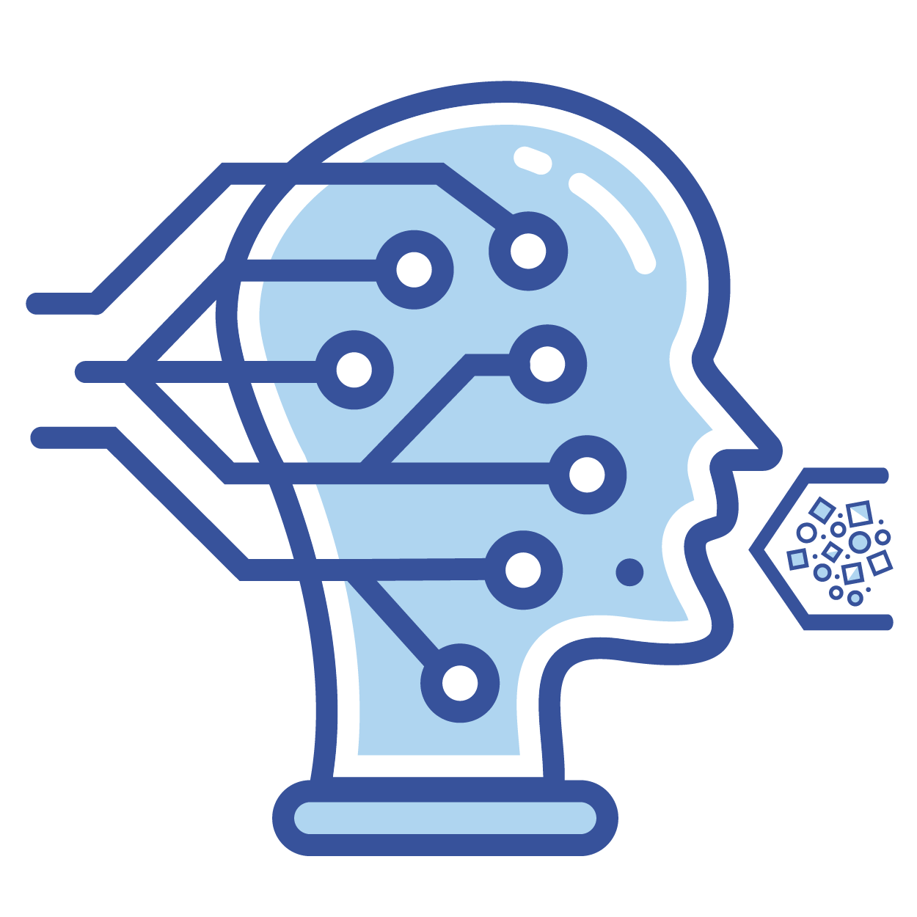
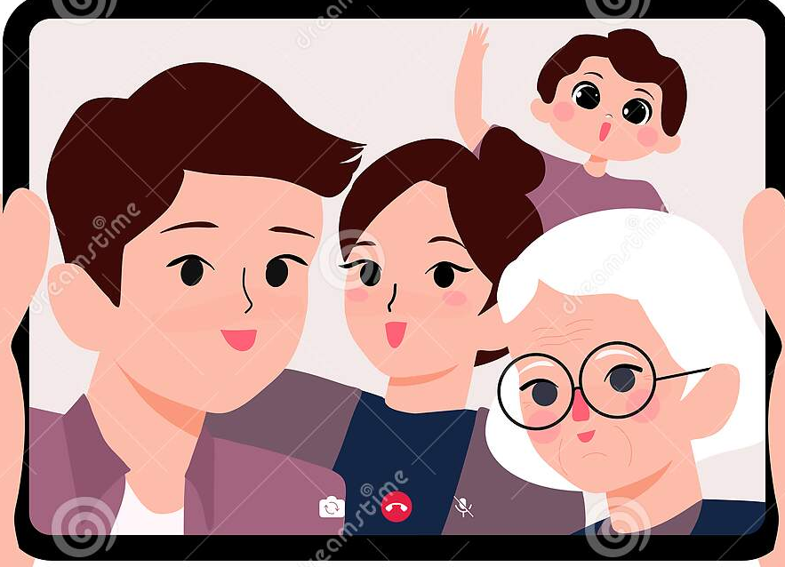
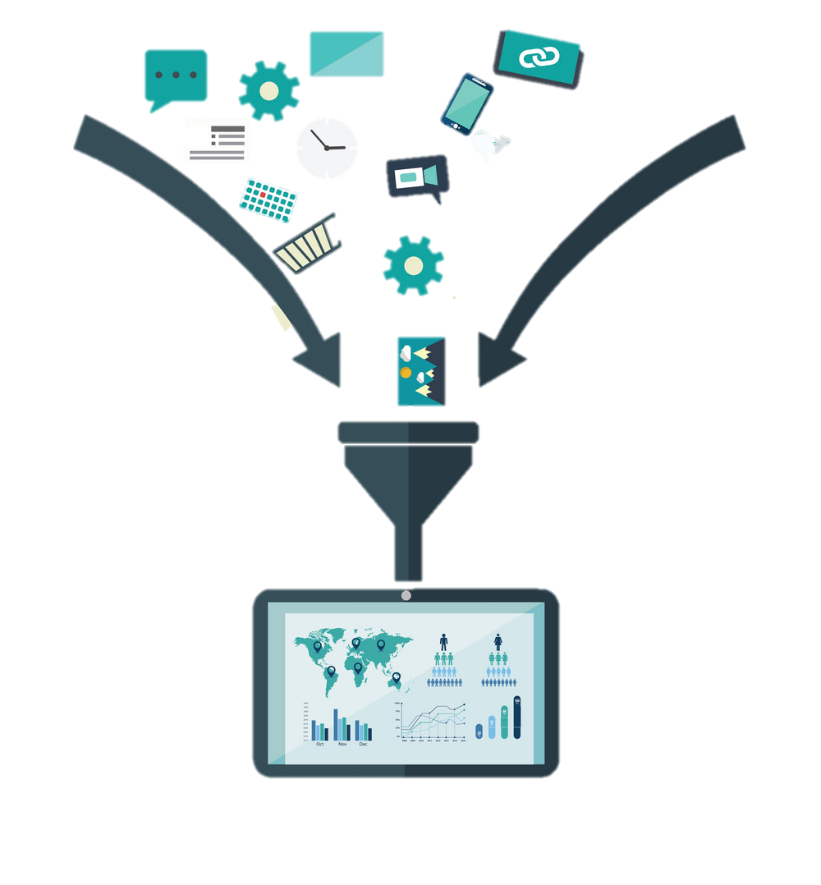
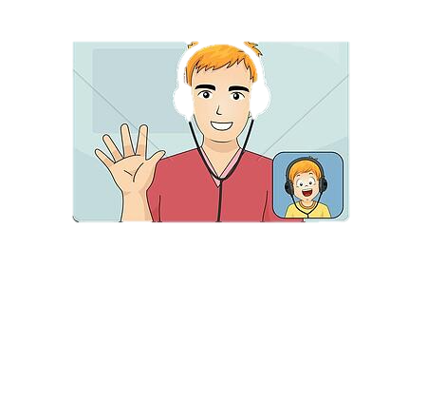
Knowledge Flow
Parents
Voice Modeling
bitTales
Stories in Parents Voice
Listens More
Children
Talks back and health records
Talks More
Elders
carecamp
Machine Learning Model and Filters

Slide 8
Need:
Valuable Learning
Distractions
“Every individual's life story is valuable and deserves to be shared”
“In a age of TikTok, Insta, Human connection is missing ”
Mental Health
Connecting Generation
“Helping to alleviate feelings of loneliness, isolation and depression”
“Connecting younger generations with the experiences and wisdom of the elderly”

Slide 9
Highlighting Key feature:
A
B
C
Interactive Story Telling
Learning from seniors
Voice Cloning
D
Mental Health Tracking and Personalization
E
Gamification

Slide 10
970,000,000

Slide 11
Care for Mental Health
According to WHO “1 in every 8 people are living with mental disorder”.
We are using machine learning models and a range of mental health resources to provide a safe and supportive space for seniors to share their experiences and feelings.

Slide 12
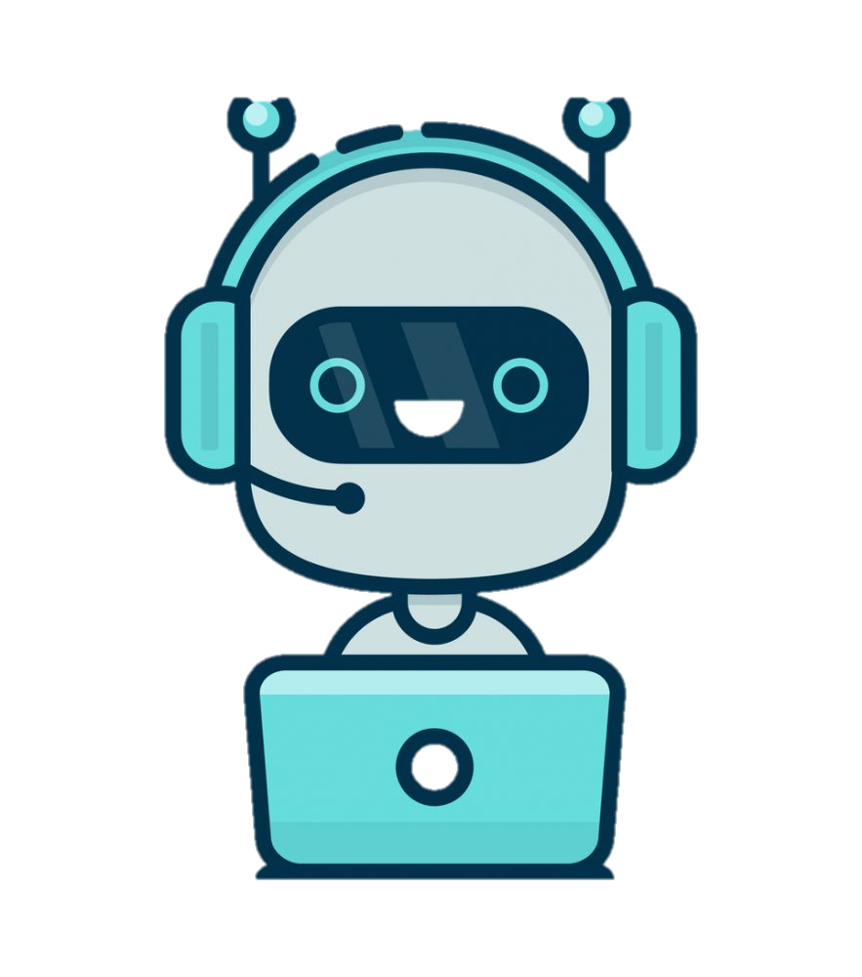
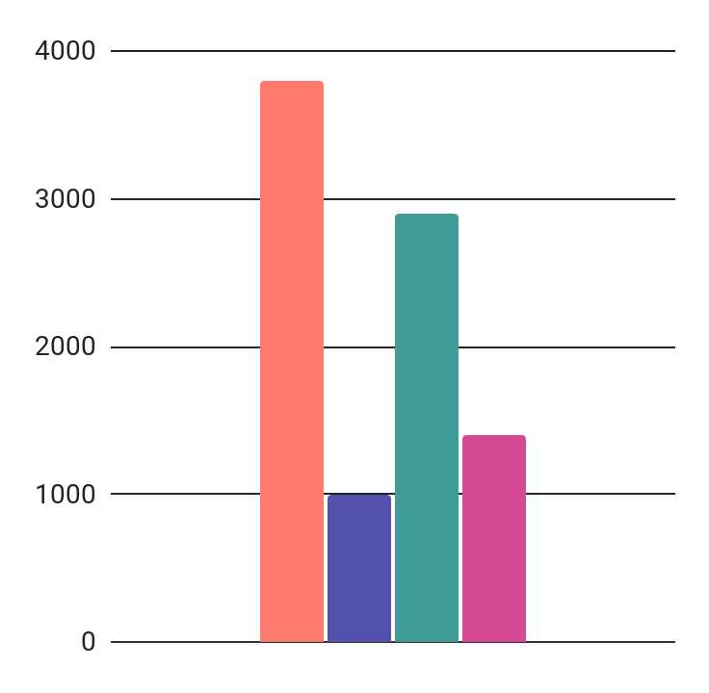
Machine Learning Models
Text to Speech
Speech To Text
Emotion Analysis
Voice Cloning
GPT 3.5
Notes:
Accuracy daalna hai

Slide 13





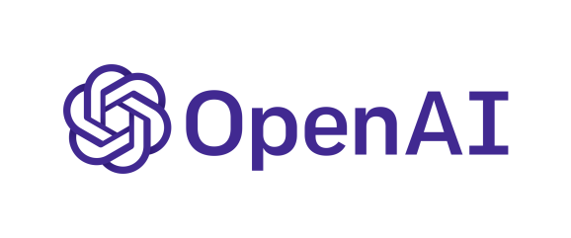

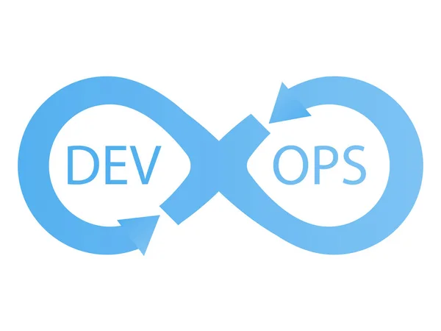
Architecture
User Login
Bittales API
Carecamp API
NLP/ASR Engine
Spring Boot Main Controller
Hackhappy aPI
Text-to-Speech
Others…
Voice Cloning
ML MS
Emotion Detection
Speech-to-text
PROGRESSIVE WEB APP
Kubernetes
Jenkins
GitHub
Domain.com

Slide 14
Tools
UI
AI
DB
BE
Frontend
Machine Learning
HTML, CSS, JS, CanvaJS and Bootstrap, JQuery
PyTorch, Flask, Hugging Face, Transformer, Open Ai
Database
Backend
Cockroach DB, Azure Cloud, Google Cloud
Java, Spring Boot, Docker

Slide 15
Future Plan
Partnering with educational institutions
Going Multilingual
Collaborating with mental health professionals

Slide 16
Thank you!

