Slide 1
On the Origin of Digital Species
Jan-Benedikt Jagusch
Tedx IST Alameda
Lisbon, Portugal
Saturday, April 14, 2018

Slide 2
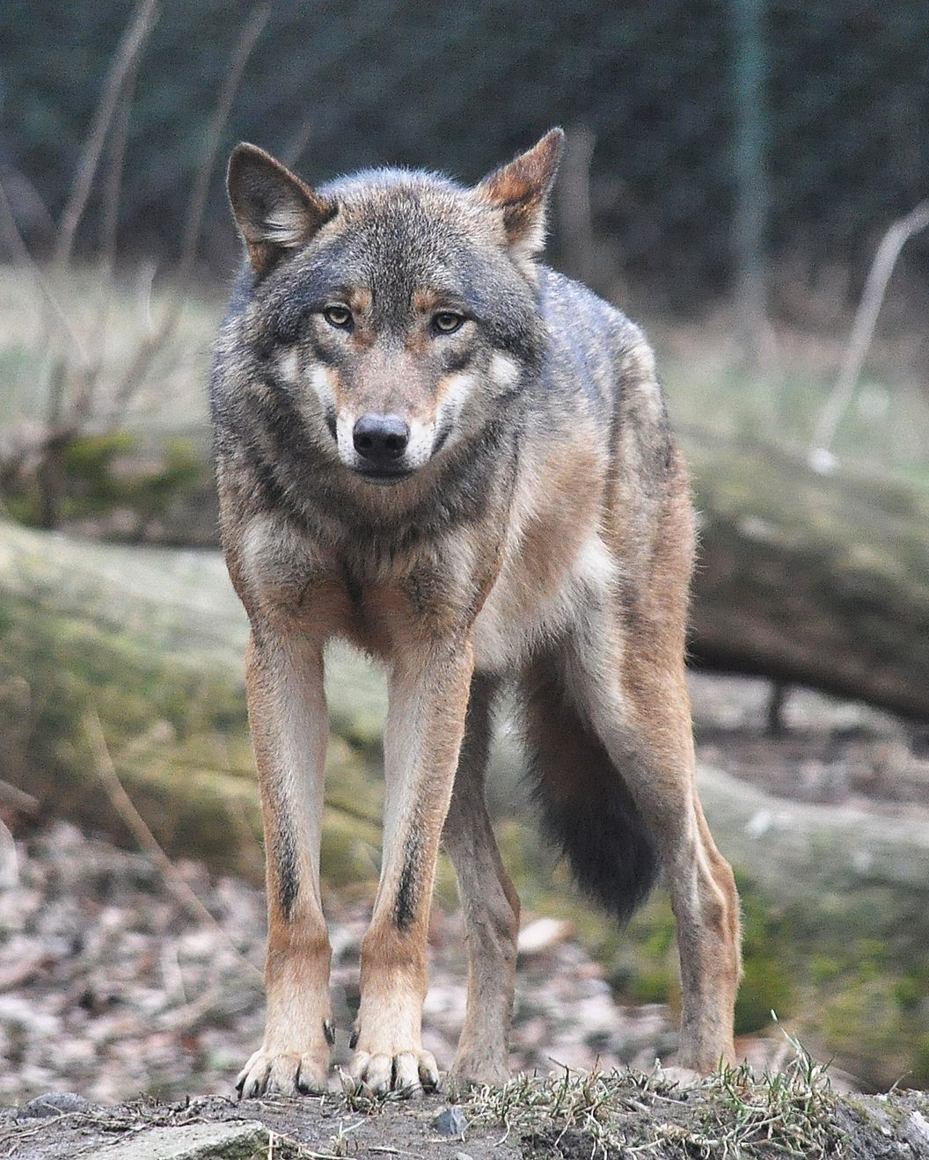
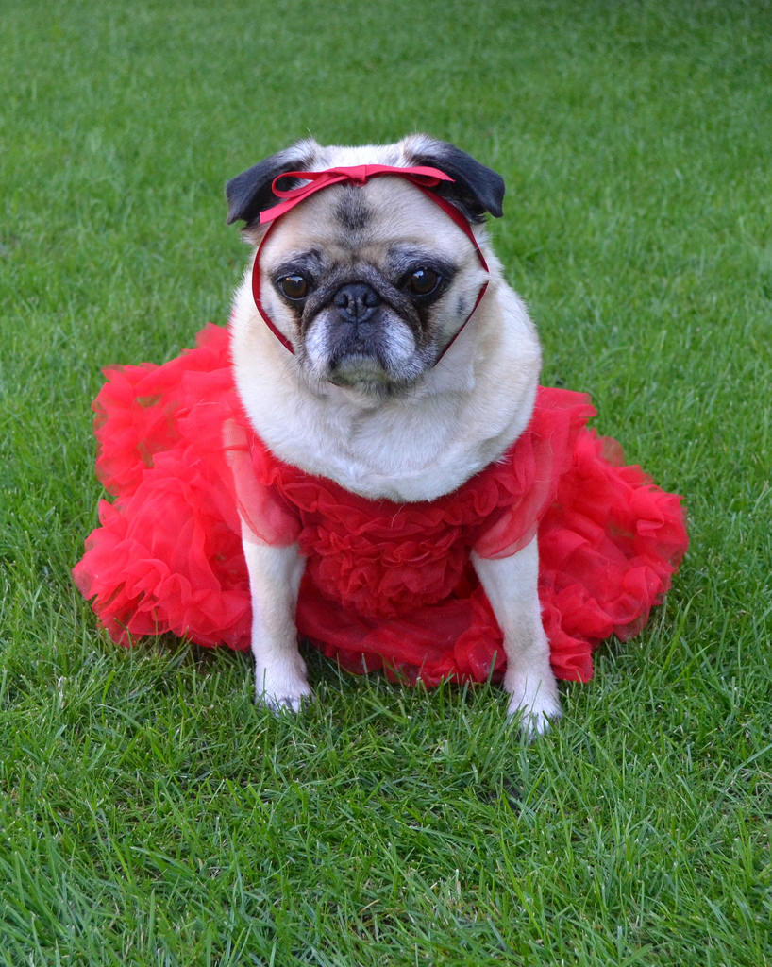
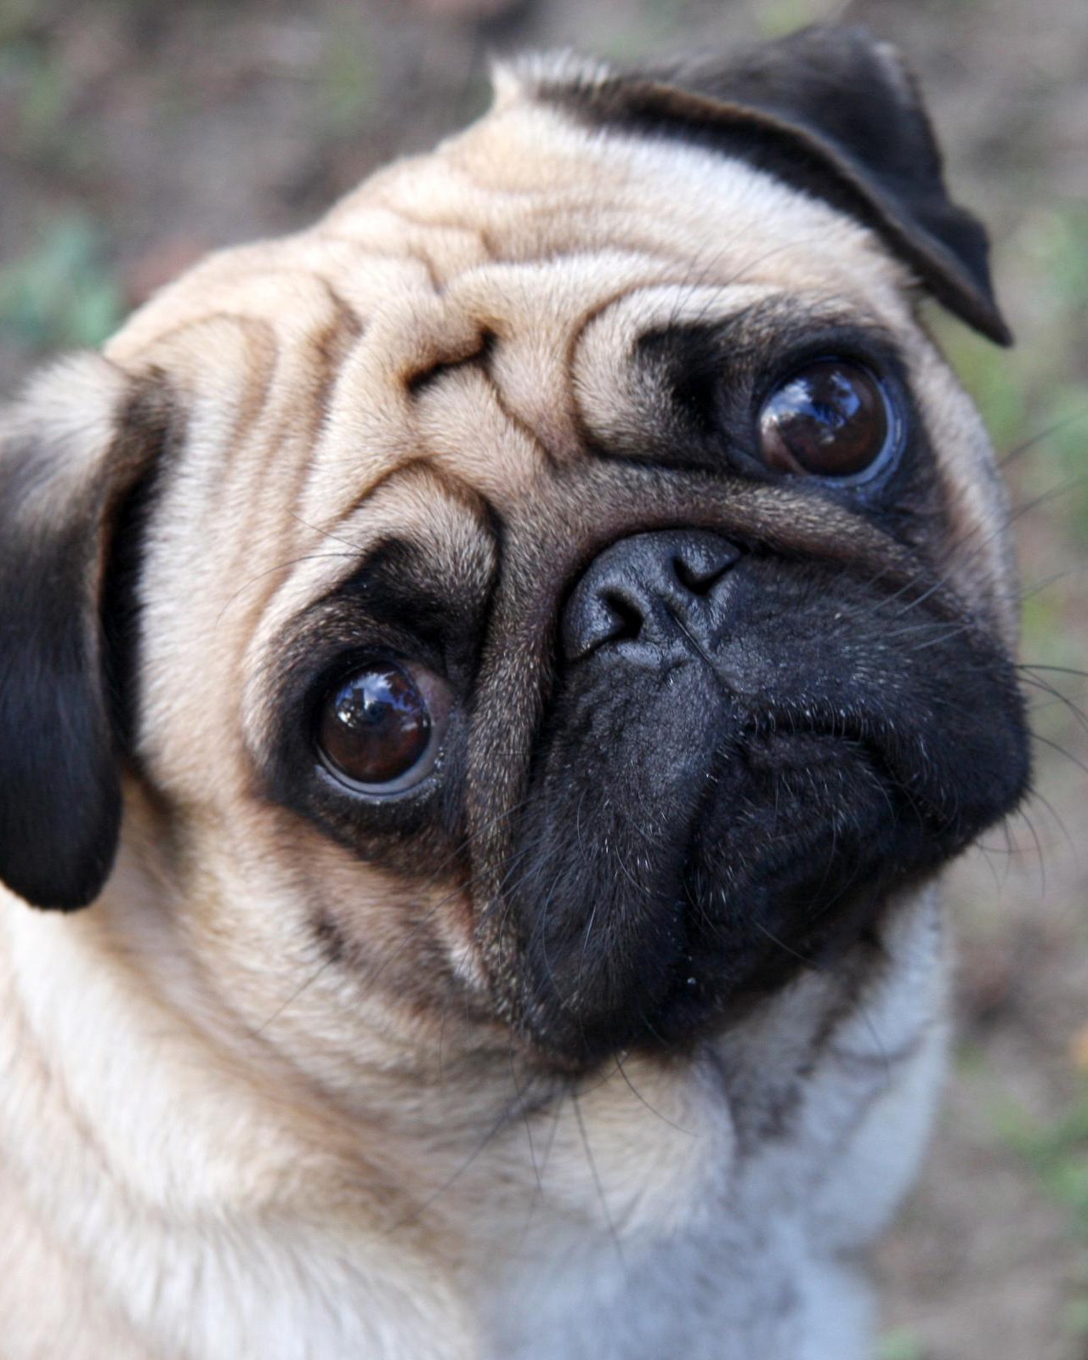

Slide 3



Slide 4
Darwin‘s Evolution
Every Creature HAS A UNIQUE DNA
THE DNA DETERMINES THE CHARACTERISTCS
THE CHARACTERISTCS DETERMINE THE SURVIVAL
THE DNA IS PASSED RANDOMLY TO THE NEXT GENERATION

Slide 5
DIGITAL Evolution
Every PROGRAM HAS A UNIQUE DNA
THE DNA DETERMINES THE PERFORMANCE
THE PERFORMANCE DETERMINES THE REPRODUCTION RATE
THE DNA IS PASSED RANDOMLY TO THE NEXT GENERATION
1.00
0.45
0.73
0.96
0.26
0.00
0.14
0.00
0.43
0.22
0.00
0.06
0.21
0.17
0.41
0.51
0.85
0.30
0.78
1.00
000
260
7%
93%
0.00
0.26
0.47
0.57
0.34
0.26
0.50
0.15
0.61
0.95

Slide 6



Slide 7


Slide 8
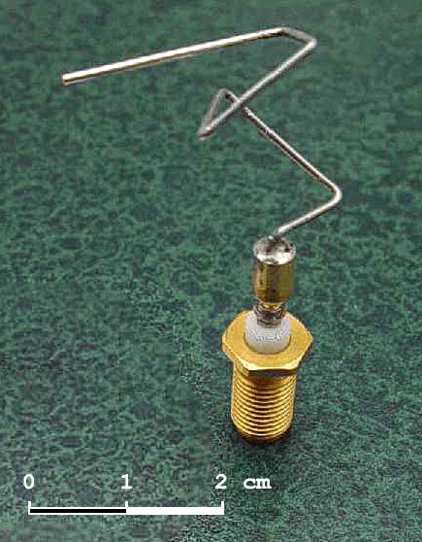

Slide 9
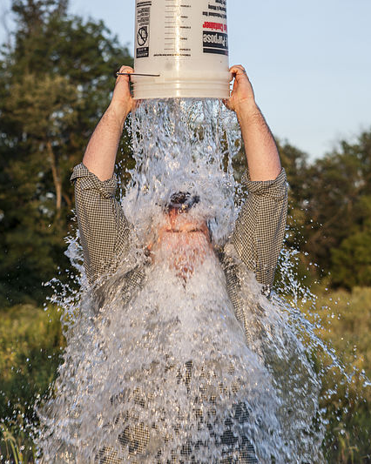

Slide 10
On the Origin of Digital Species
Jan-Benedikt Jagusch
Tedx IST Alameda
Lisbon, Portugal
Saturday, April 14, 2018
GITHUB: https://github.com/jbj2505

