Slide 1
Week 1 — Reproducible Research Foundations (with R)
Core idea: Good science isn’t just getting results — it’s making sure you or someone else can reproduce those results months or years later.
By the end of this class students should be able to:
organize a research project
write analyses in scripts
reproduce an analysis from raw data
track code with GitHub

Slide 2
Learning Goals
You will learn how to:
Structure a computational research project
organize folders for data, scripts, outputs, and documentation
Use R scripts instead of point-and-click analysis
write analyses as code that can be rerun
Build a reproducible workflow
start with raw data
run scripts
regenerate results and figures
Track and share code using GitHub
create a repository
connect RStudio to GitHub
push their first project
Understand how reproducibility enables collaboration
future self
lab mates
reviewers

Slide 3
Why Reproducibility Matters
The Problem
Six months later you cannot reproduce your own analysis!
A collaborator asks – “How did you generate that figure?”
A reviewer comments - ”Authors should deposit code as SM or make public ally available”

Slide 4
Bad Workflow
data_final2.csv
analysis_new_v3_final.R
plot_new_final.png

Slide 5
Good Workflow
project/
data/
scripts/
figures/
docs/

Slide 6
The Reproducibility Triangle
Data
Code
Documentation

Slide 7
Manual vs Scripted Analysis
Manual: Excel, clicking menus, hard to repeat
Scripted: R scripts, reproducible, shareable

Slide 8
Why RStudio Projects Matter
Stable working directory
Organized analysis
Portable across computers
Better collaboration

Slide 9
Version Control
Git tracks changes
GitHub shares code
Commit = snapshot
Push = upload

Slide 10
Future You
Your most important collaborator is your future self.

Slide 11
Today in Class
Build a research project
Write an R script
Generate figures
Push your first GitHub repository

Slide 12
The 4 Levels of Computational Maturity in Research Labs
Level 1 — Chaos
Data scattered across desktops, USB drives, and email attachments.
Level 2 — Organized Chaos
Some folder structure and scripts exist, but analyses are hard to reproduce.
Level 3 — Reproducible Lab
Structured projects, scripts recreate analyses, and figures regenerate automatically.
Level 4 — Scalable Science
Version control, shared repositories, automated pipelines, and fully reproducible research.

Slide 13
Set-up for Today
Install R & Rstudio
https://posit.co/download/rstudio-desktop/
Install Git
https://git-scm.com/downloads
Create GitHub account
https://github.com

Slide 14
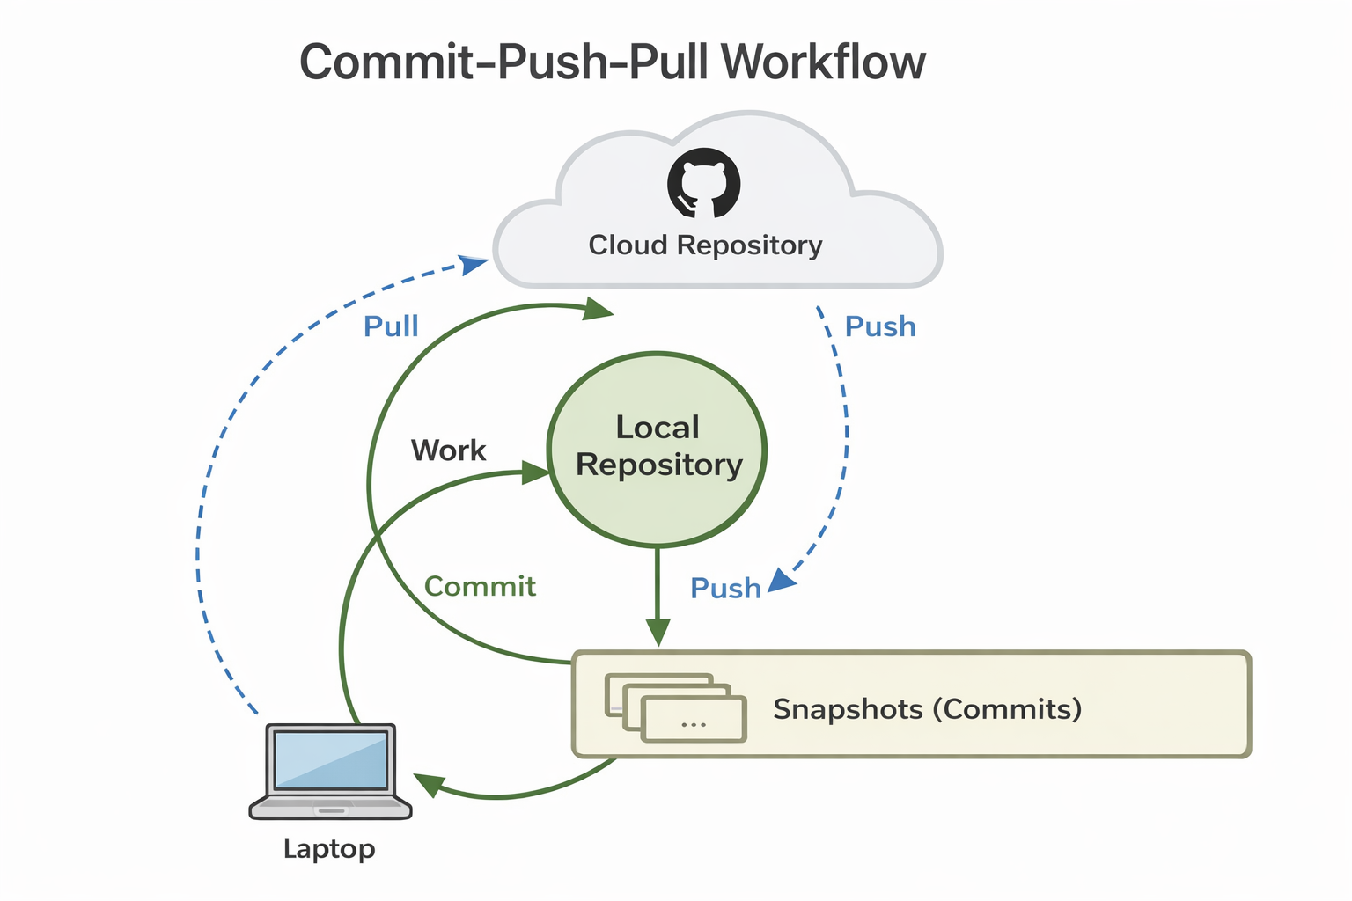

Slide 15
RStudio
Make a New Project on a new directory

