Slide 1
Significant pay gap between genders is observed, most often in Tech industry, while women on data related positions are paid better

Slide 2
In most cases managers with Asian origin are paid better for every year of experience than white people, maybe due to their outstanding skills?

Slide 3
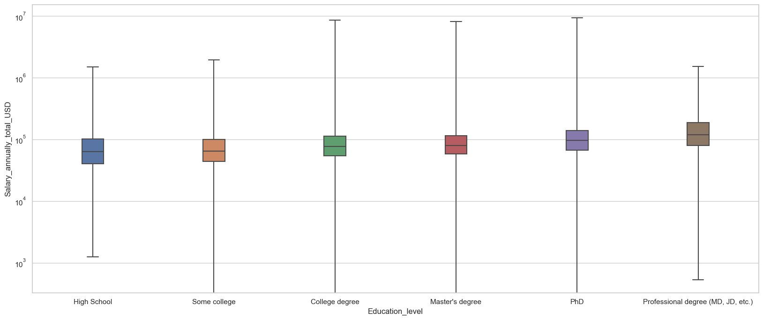

Slide 4
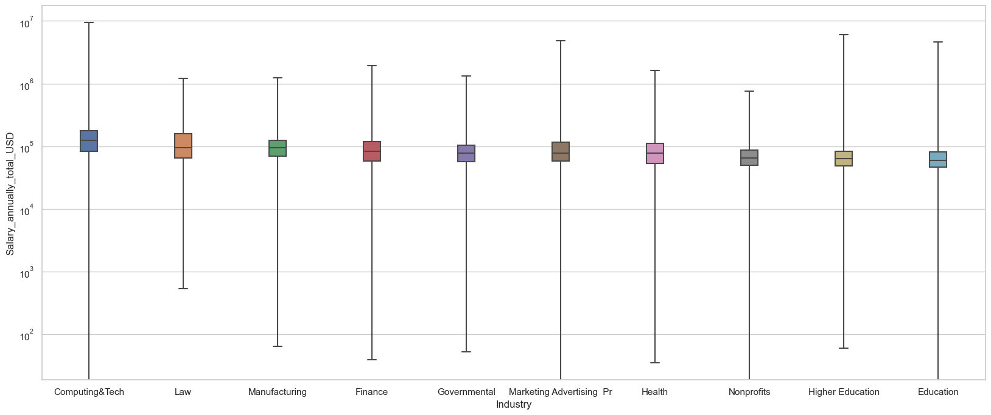
In tech emploees earn the most but distribution is much more spreaded comparing to other top industries

