Slide 1
Individual Project Week 5
Jan Jindra

Slide 2
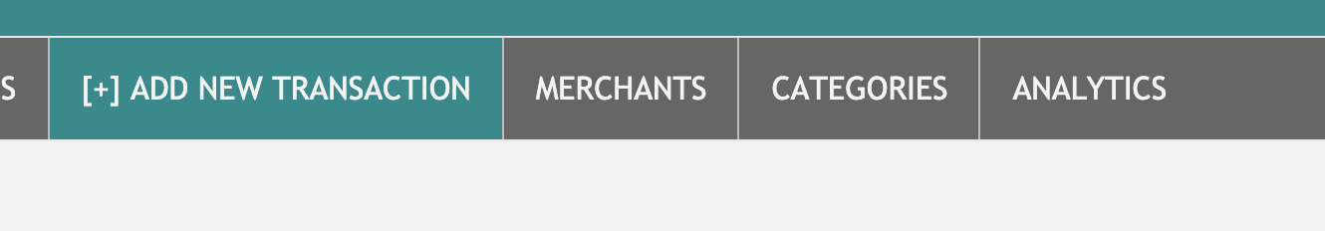

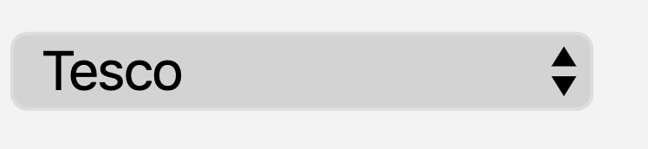
OVERVIEW
PLANNING
APP DEMO
A PIECE OF CODE
LEARNING POINTS
Planning
App Demo
A Piece of Code
Learning Points
CodeClan | February 2020 | Jan Jindra

Slide 3
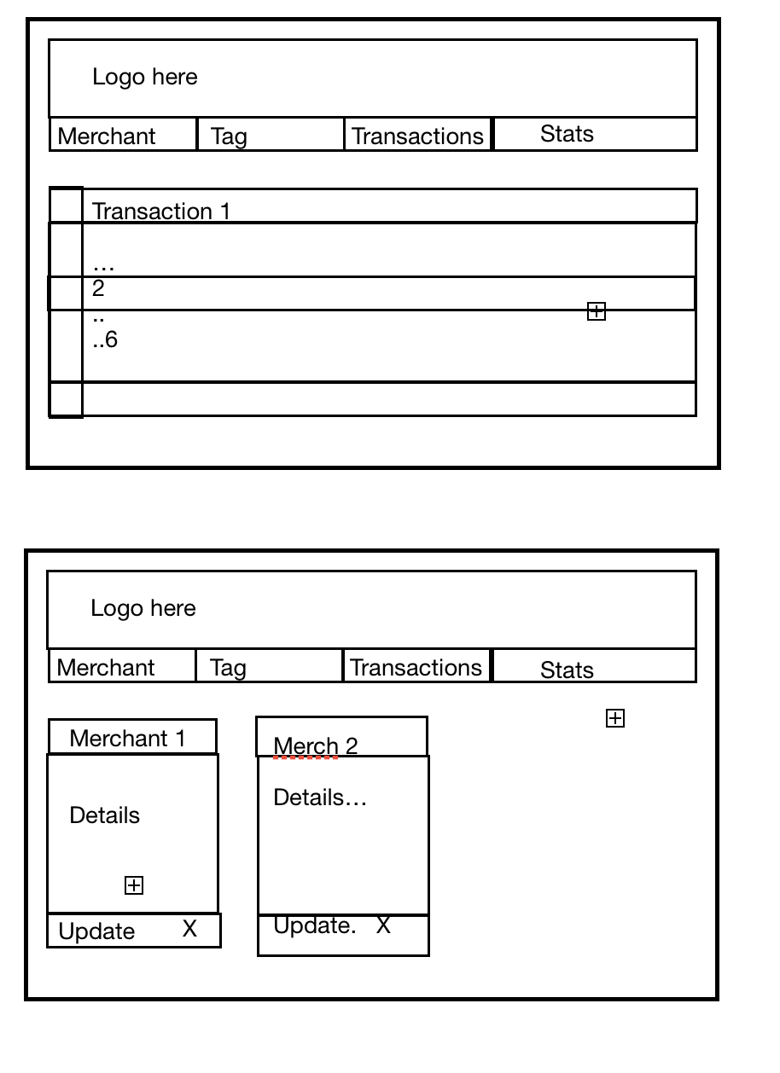
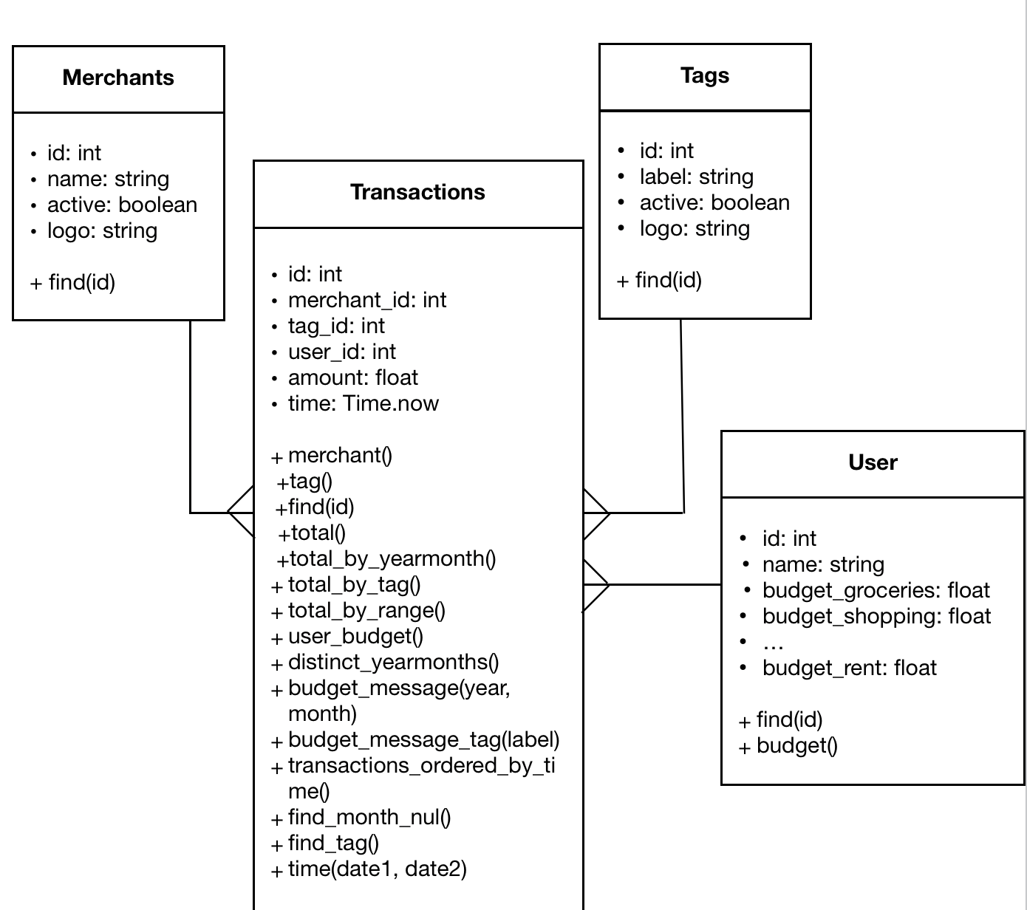
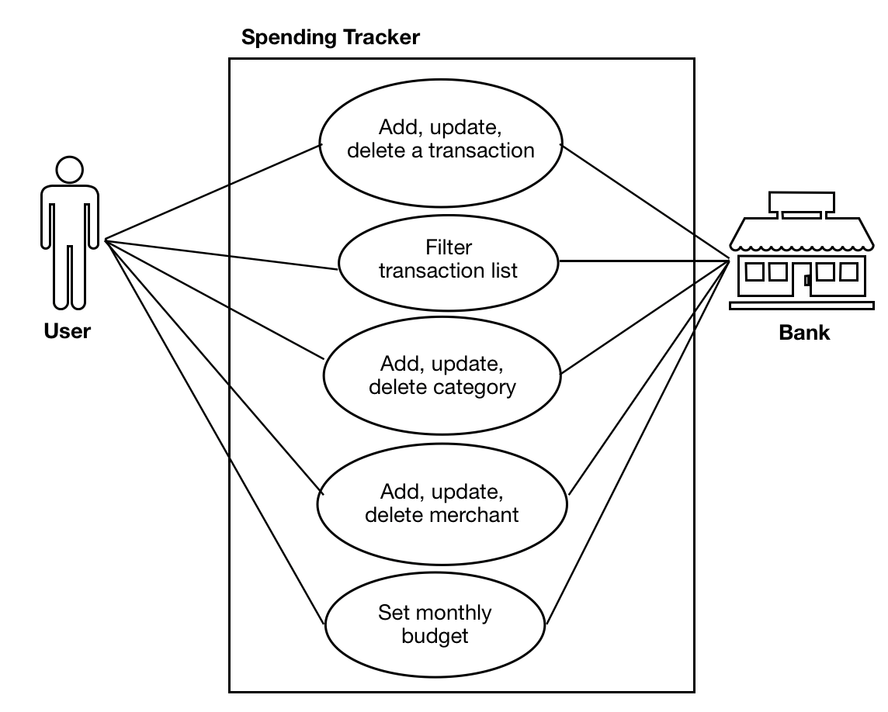
OVERVIEW
OVERVIEW
PLANNING
PLANNING
APP DEMO
APP DEMO
A PIECE OF CODE
LEARNING POINTS
Class diagram
Wireframes
Use case diagram
CodeClan | February 2020 | Jan Jindra

Slide 4

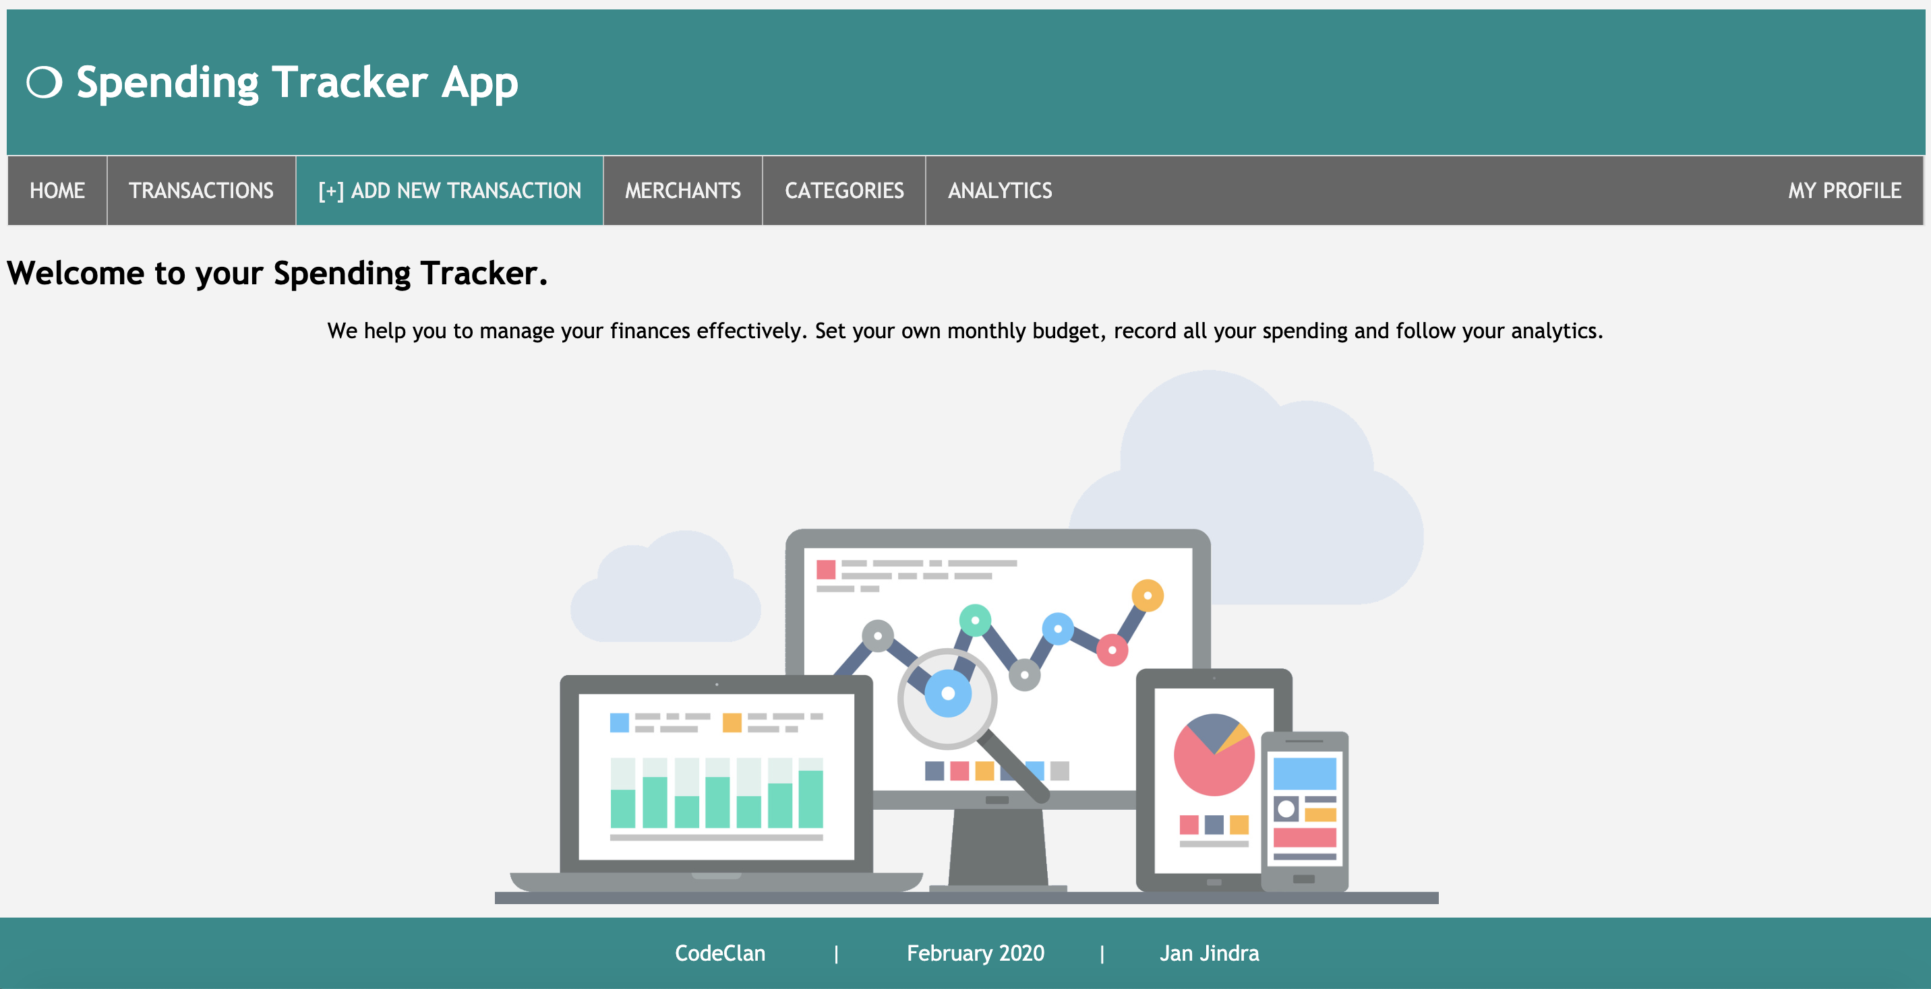
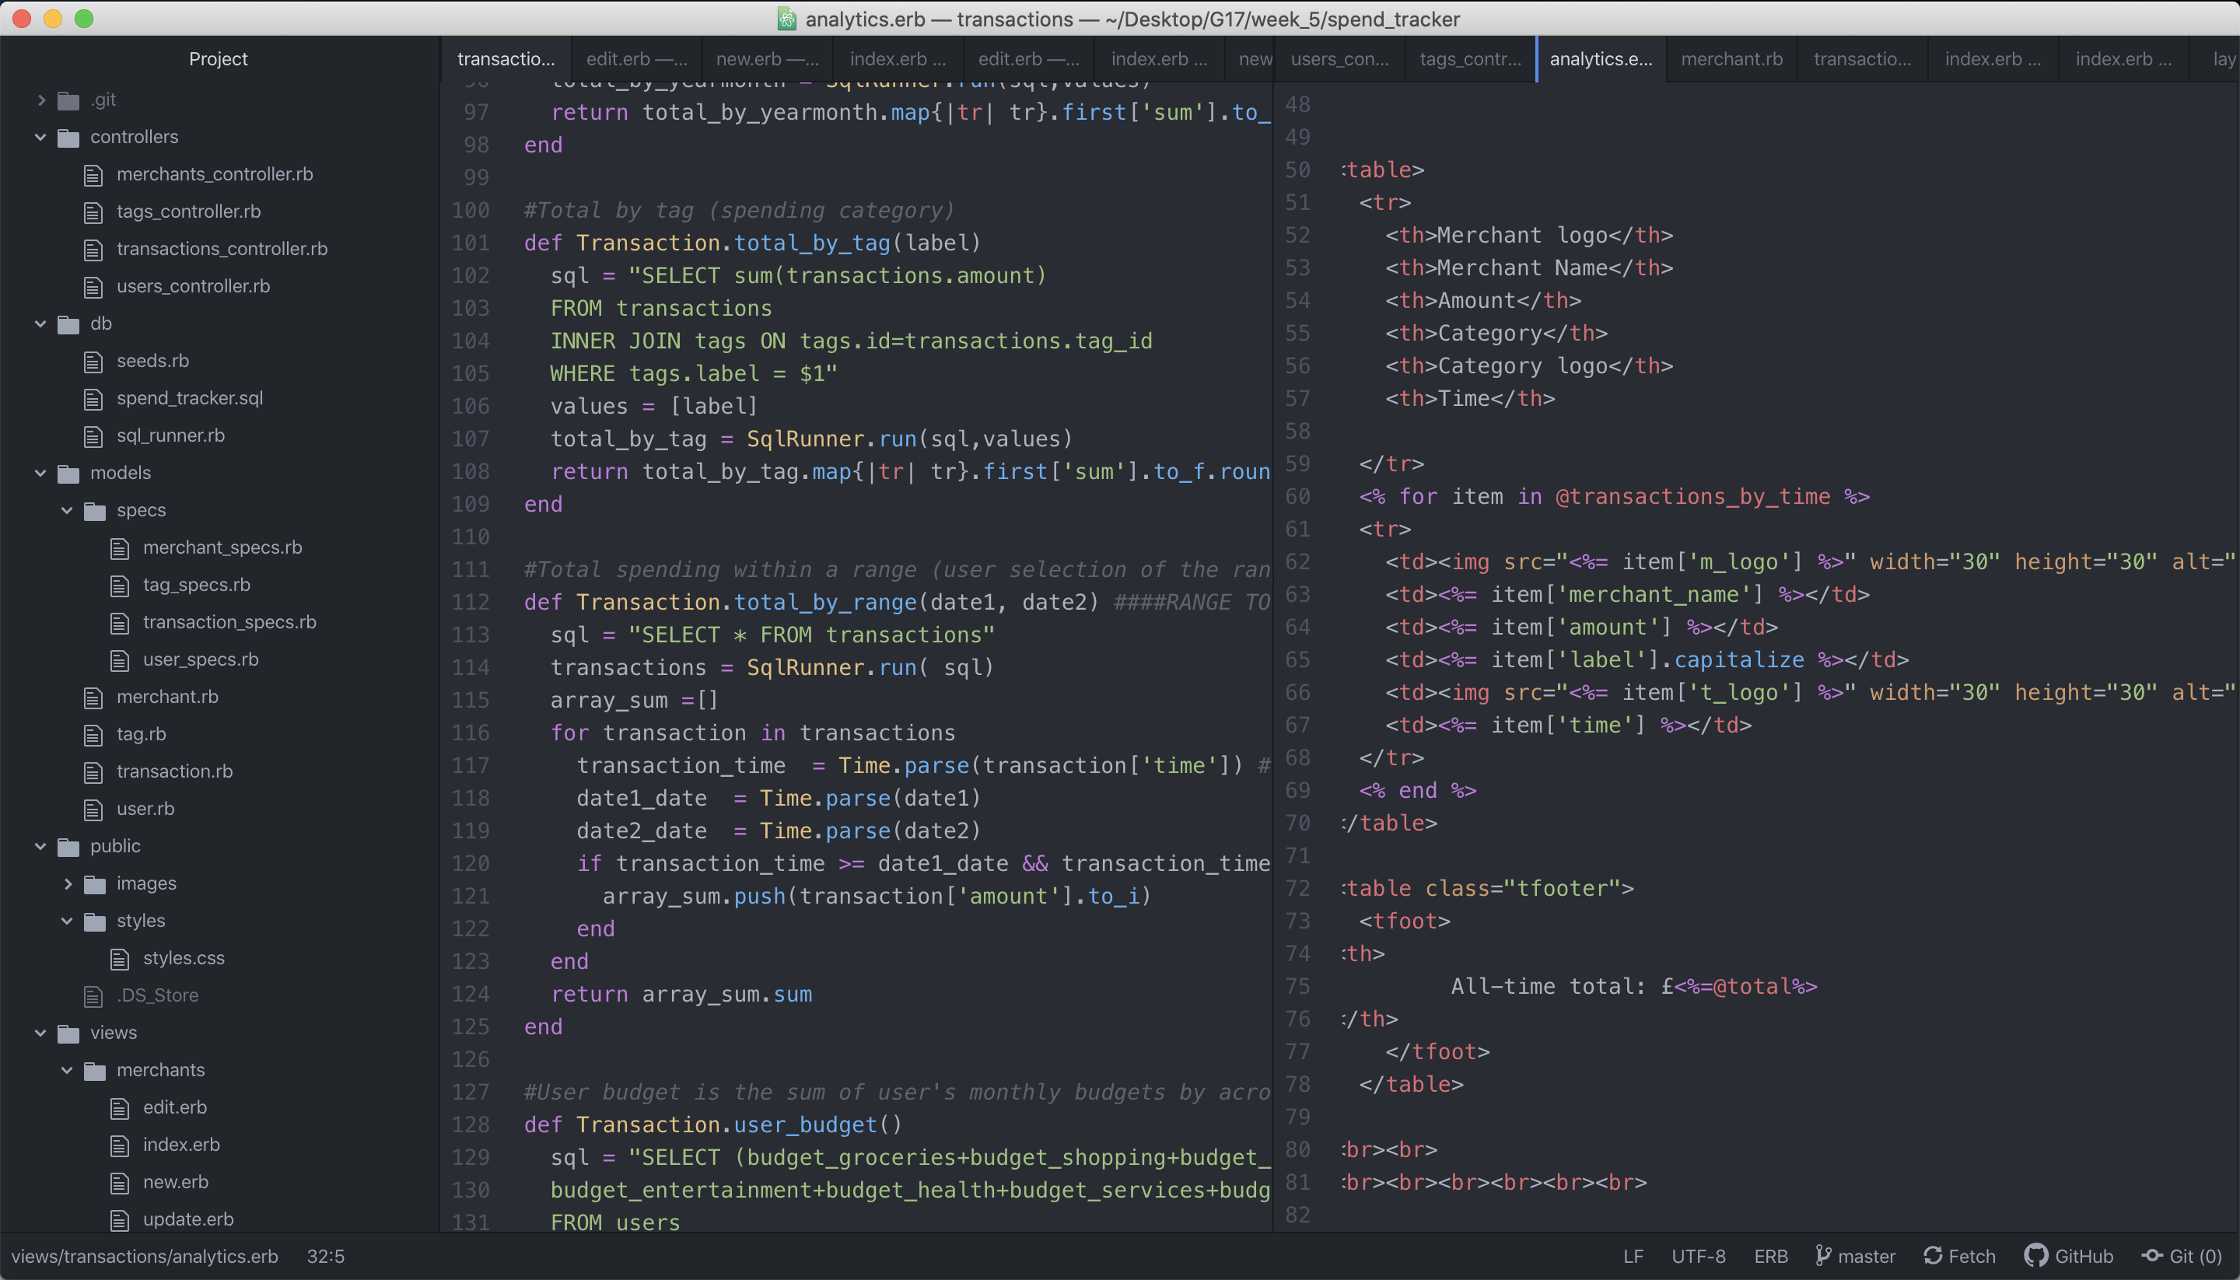
OVERVIEW
OVERVIEW
PLANNING
PLANNING
APP DEMO
APP DEMO
APP DEMO
A PIECE OF CODE
LEARNING POINTS
CodeClan | February 2020 | Jan Jindra

Slide 5
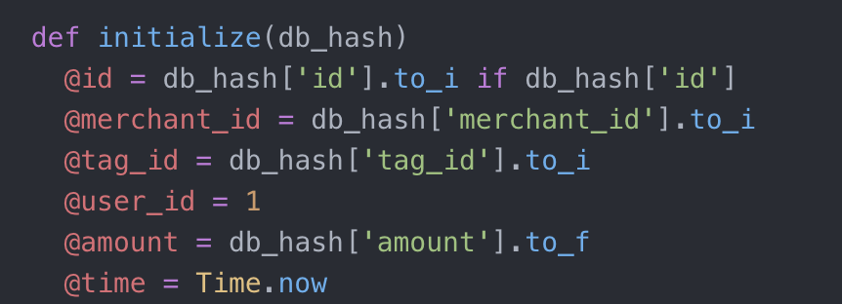
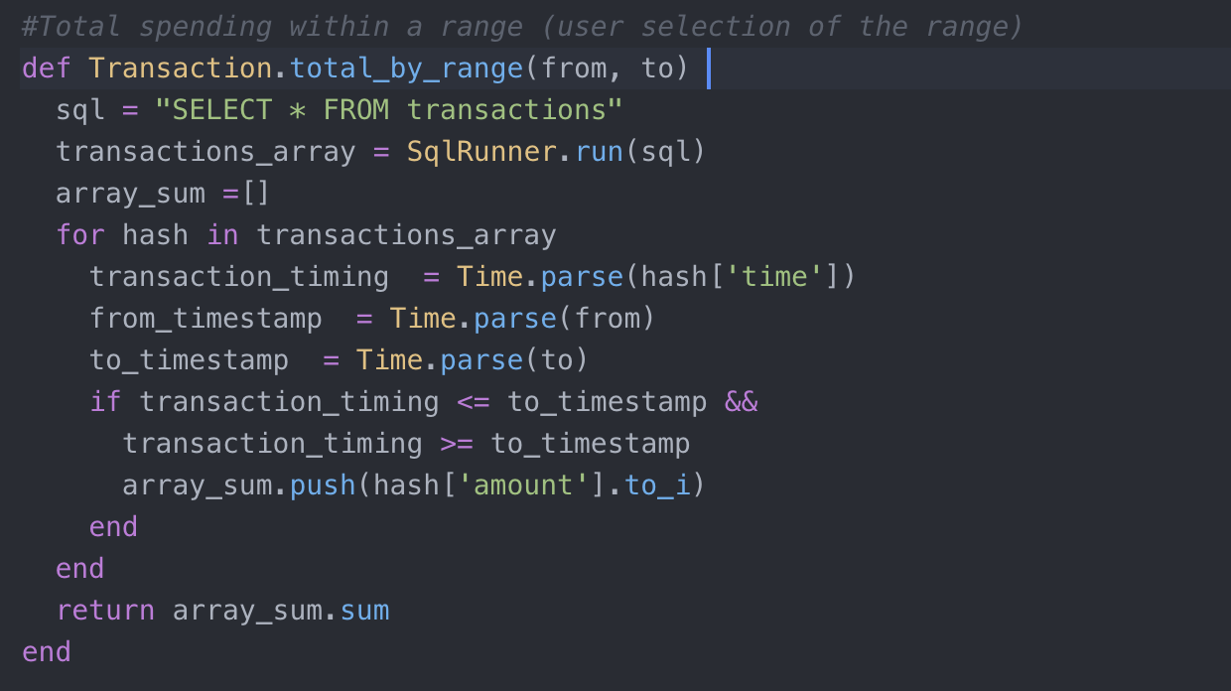
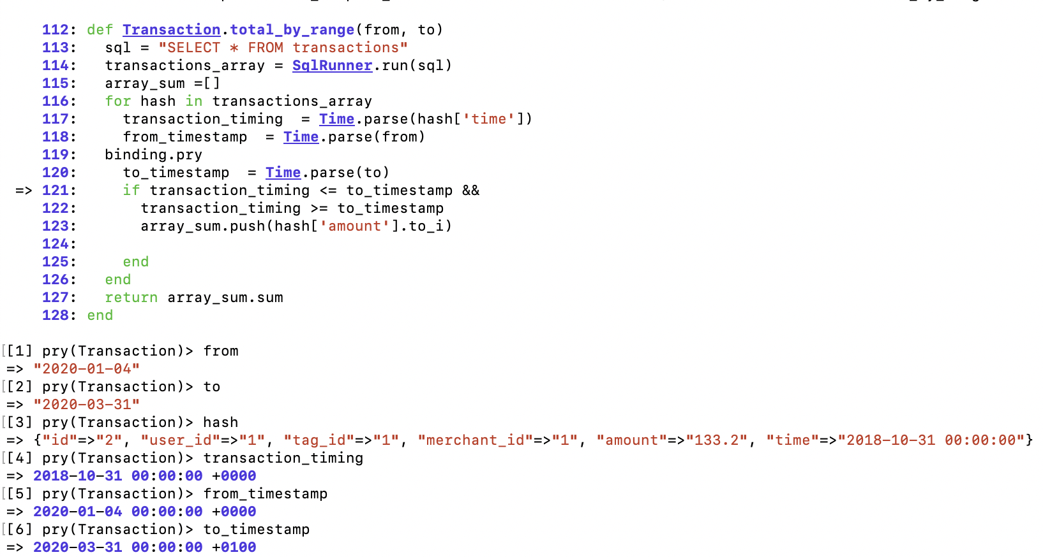
OVERVIEW
OVERVIEW
PLANNING
APP DEMO
LEARNING POINTS
A PIECE OF CODE
LEARNING POINTS
A PIECE OF CODE
CodeClan | February 2020 | Jan Jindra

Slide 6

OVERVIEW
OVERVIEW
PLANNING
APP DEMO
LEARNING POINTS
A PIECE OF CODE
LEARNING POINTS
Handling timestamps
More confident in GET/POST and in how they work
Pomodoro technique clearly does not work for me…
CodeClan | February 2020 | Jan Jindra

