Slide 1
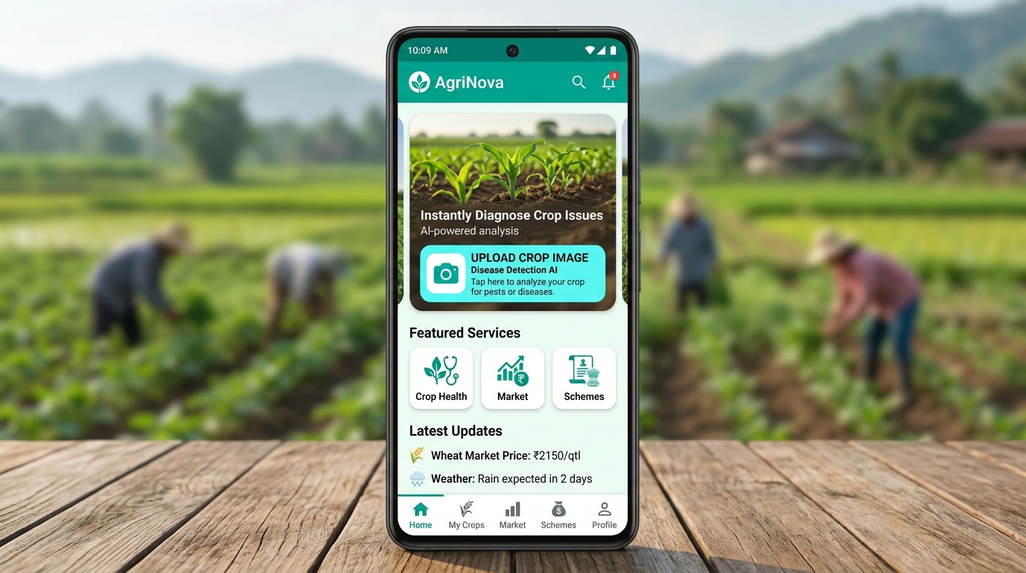
AGRINOVA
AI-Powered Agriculture Platform
Empowering Farmers with Smart Technology
Disease Detection • Market Access • Government Schemes
Flutter • FastAPI • TensorFlow • Cohere LLM
2024 | Academic Final Year Project

Slide 2
Abstract
AGRINOVA
▸ Agrinova is an AI-driven, multilingual mobile application designed to transform rural agriculture in India.
▸ The app enables farmers to detect crop diseases instantly via smartphone camera using deep learning models trained on plant disease datasets.
▸ A conversational AI assistant powered by Cohere LLM provides personalised crop, fertilizer, and yield recommendations in Telugu, Hindi, and English.
▸ An integrated marketplace allows farmers to buy/sell machinery, hire labour, and procure fertilizers — with built-in AI price negotiation.
▸ Real-time government scheme discovery and one-click application bridging the digital divide for rural farmers.
▸ Built on Flutter + FastAPI + TensorFlow stack, the platform is cross-platform (Android/iOS) and deployable on cloud infrastructure.

Slide 3
Existing Solution & Its Drawbacks
AGRINOVA
▸ Farmers rely on manual visual inspection for crop disease diagnosis — prone to high error rates and late detection.
▸ Extension services and agricultural officers are limited in reach; many remote farmers get no expert advice at all.
▸ Crop price information comes from middlemen, creating information asymmetry and unfair pricing for farmers.
▸ Fragmented apps for market, schemes, and advice mean farmers juggle multiple platforms in an unfamiliar language.
▸ Government scheme portals are English-only, require internet literacy, and involve complex paper-based processes.
▸ No unified, intelligent system exists that combines disease detection, recommendations, market, and schemes in one place.

Slide 4
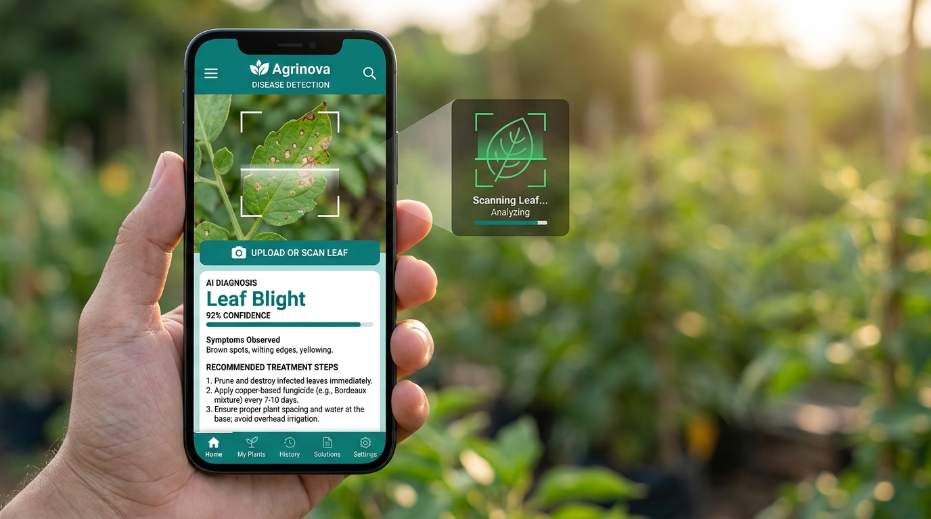
Proposed Solution — Agrinova
AGRINOVA
▸ Instant AI crop disease detection using TensorFlow CNN models — results in under 10 seconds from image upload.
▸ Smart crop and fertilizer recommendation engine using Scikit-learn models trained on soil, rainfall, and season data.
▸ Multilingual AI assistant (Telugu, Hindi, English) powered by Cohere LLM for natural language queries.
▸ Integrated marketplace for machinery rental, labour booking, and fertilizer purchase with AI-assisted price negotiation.
▸ Automated government scheme discovery filtered by farmer profile, state, and crop type — with direct application links.
▸ Offline-capable local data caching via Hive and push notifications via Firebase Cloud Messaging.

Slide 5
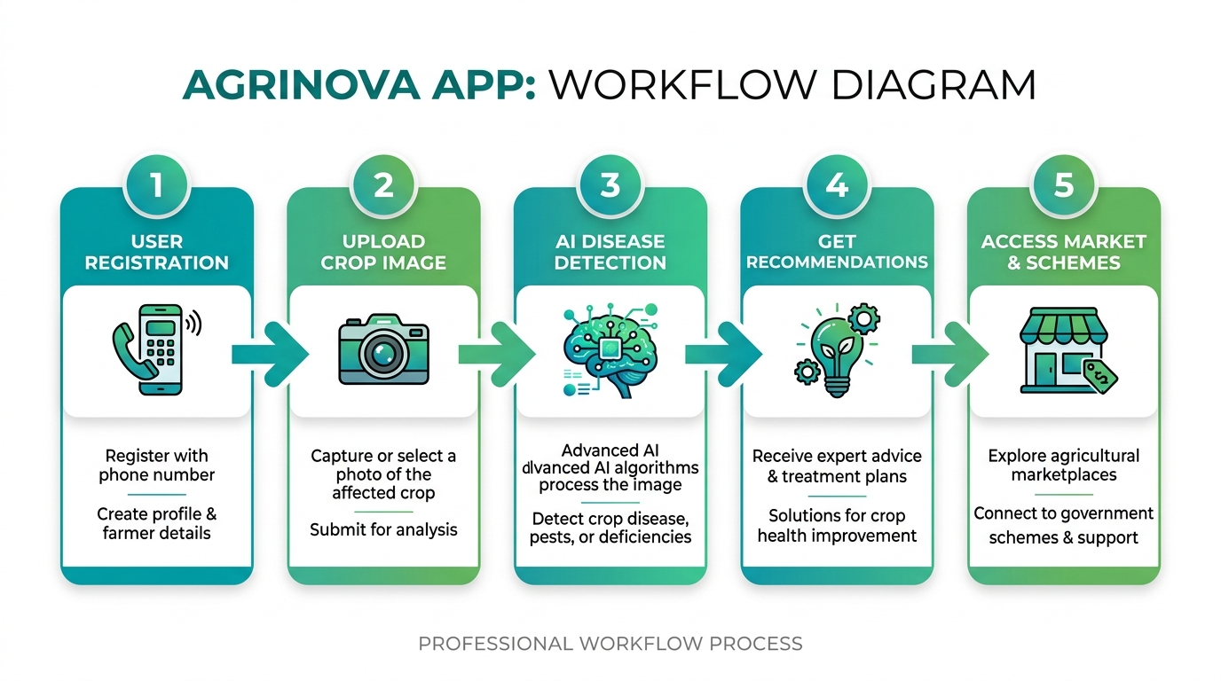
Working Model — User Flow
AGRINOVA
Sequential 5-step user journey: Register → Upload Image → AI Detection → Recommendations → Market & Schemes

Slide 6
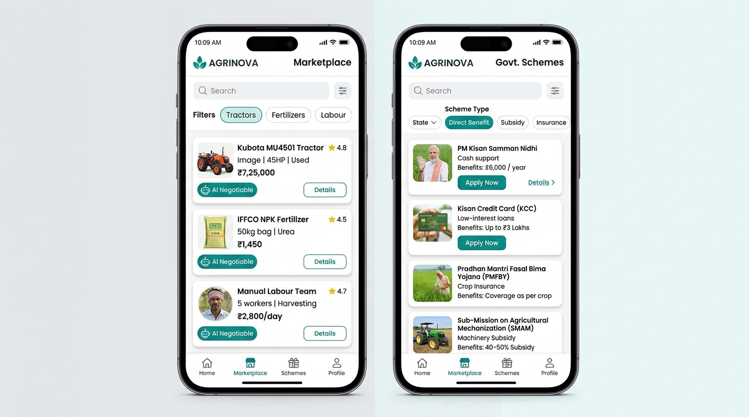
Working Model — App Screens
AGRINOVA
🏠 Home Screen – Crop Upload & Quick Navigation
🛒 Marketplace & Government Schemes Screen

Slide 7
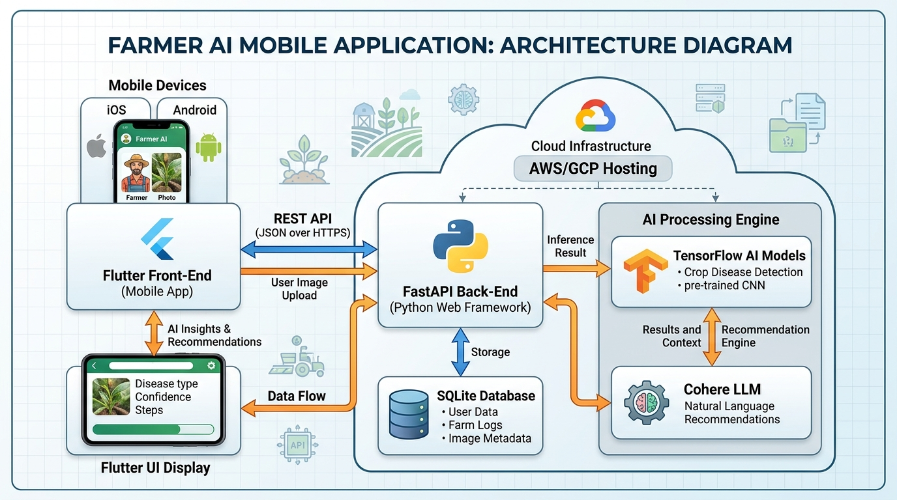
System Architecture
AGRINOVA
Flutter Frontend ↔ FastAPI Backend ↔ TensorFlow AI Engine & Cohere LLM ↔ SQLite Database | Cloud Hosted
Agrinova | AI-Powered Agriculture Platform | 2024

Slide 8
Technology Used
AGRINOVA
📱 Frontend
⚙️ Backend
🤖 AI / ML
🔗 Integrations
Flutter (Dart)
FastAPI (Python)
TensorFlow (Disease CNN)
data.gov.in Market API
Google Fonts
SQLite Database
Scikit-learn (Crop Rec.)
Firebase Cloud Messaging
Provider State Mgmt
Render Cloud Hosting
Cohere LLM (NLP Chat)
Google Maps SDK
Hive (local DB)
REST API (JSON/HTTPS)
Custom Trained Models
Government Scheme APIs
Firebase Messaging
Docker Container
Pickle Model Serialization
Agri Weather Data API
Agrinova | AI-Powered Agriculture Platform | 2024

Slide 9
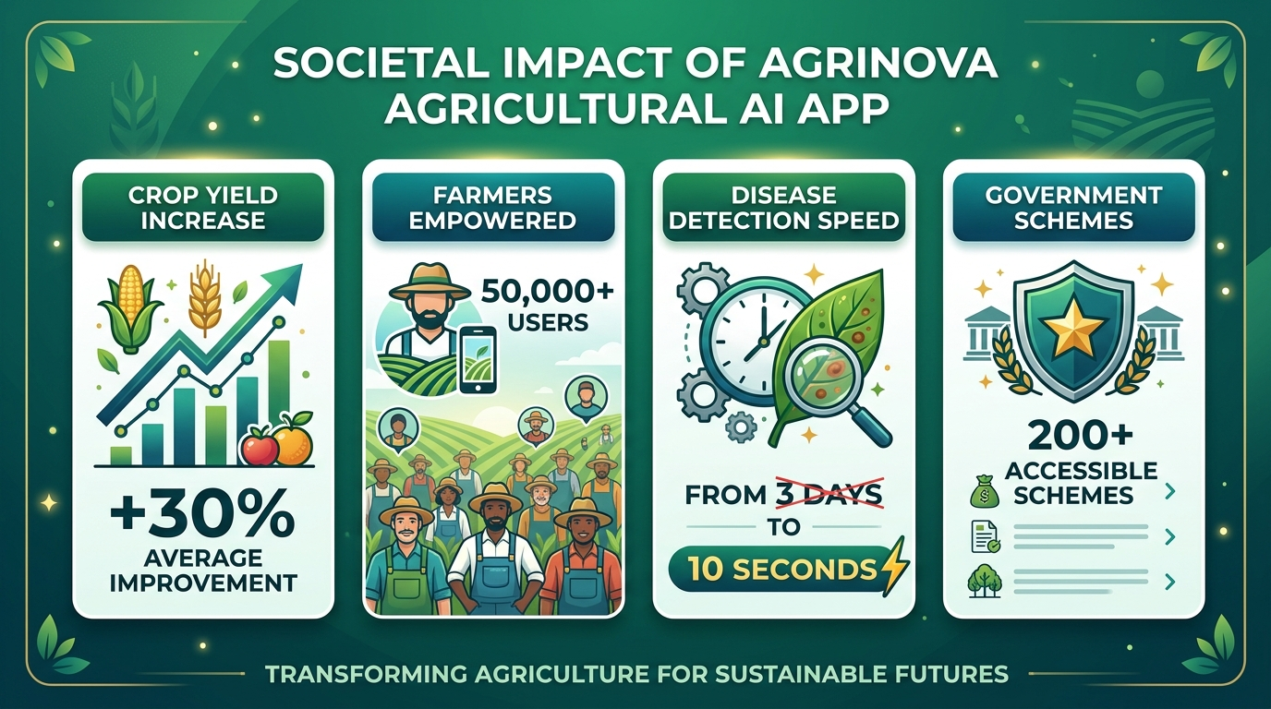
Impact on Society
AGRINOVA
+30% Crop Yield • 50,000+ Farmers Empowered • Disease Detected in 10s • 200+ Government Schemes Accessible
Agrinova | AI-Powered Agriculture Platform | 2024

Slide 10
Conclusion & Future Scope
AGRINOVA
▸ Agrinova bridges the gap between cutting-edge AI technology and India's rural farming communities.
▸ Early disease detection, personalised recommendations, and transparent market access directly improve farmer income.
▸ Multilingual support (Telugu, Hindi, English) ensures inclusivity across diverse farming regions.
▸ The platform has potential to scale nationally, integrating with UIDAI (Aadhaar) for farmer identity verification.
▸ Future Scope: IoT sensor integration for real-time soil monitoring, satellite imagery for field analysis, and drone advisory services.
▸ Agrinova stands as a complete, production-ready agricultural intelligence platform for India's 140 million farming households.
Agrinova | AI-Powered Agriculture Platform | 2024

