Slide 1
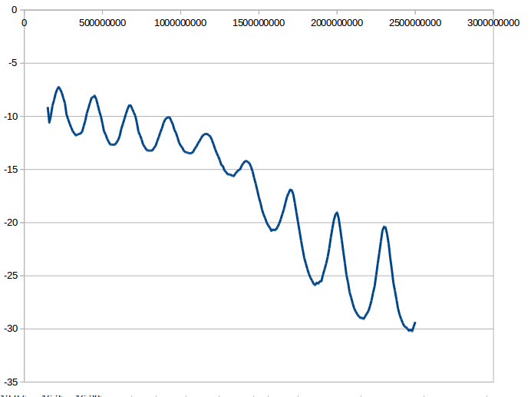
150MHz to 2.5GHz
18.75MHz
25MHz 0dbm
Mixer1
RFFC5072
Mixer2
RFFC5072
18.75MHz
Bandpass
ADC
LT2247
FFT
STM32F7
SignalGen
DG1022Z
25MHz Referenz
ADC Signal vs. IF Frequenz:

