Slide 1
E-Conference Manager
Internal Guide:-
Mr. Ravi Patel
External Guide:-
Mr. Umang Salot
Presented By:-
Patel Ankita K.(090780107047)
Patel Disha R. (090780107008)
Patel Harbi N. (090780107033)
Developed At:-
Global India Technologies

Slide 2
Flow of Presentation
Introduction
Characteristics
Goal
Functionality
How it is unique?
Our development technology
Advantages
Data dictionary
Flow diagram
Screen shots

Slide 3
Introduction
E-Conference manager is a system in which people can talk, share and learn from the particular topic.
Online registration
People can submit their papers and experts gives the reviews for the topic.

Slide 4
Characteristics
The E-Conference Manager system is used for paper submission process.
It contains all the information like paper submission,paper displaying,paper updating,paper handling,etc.
All the process of paper handling and paper submission is done in this system.

Slide 5
It also shows the new organized conference systems at national and international level for submitting the paper.
It also displays the updating dates related to paper and conference system.

Slide 6
Main characters in our system:
Admin
Author
Reviewer

Slide 7
Goal
Our system believe that conference or organization is more than registration.
Our system helps you with the marketing of your event from beginning to end.

Slide 8
Functionality
Login
Create an account
Add paper abstract
Upload the paper model
Submit paper
Logout
Organize event
Comment on reviewed paper

Slide 9
Add reviewer
Add track coordinator
Download accept papers
Paper review
Select paper
Reject paper

Slide 10
How It Is Unique?
Most other companies provide only ONLINE registration services.
We at E-Conference Manager believe that conference or event organization is more than registration.
Our system helps you to manage better conference from beginning to end.

Slide 11
Our Development Technology
Front End: Asp.net
Back End: Sql server
Tools:Ajax
Internet Explorer 7.0
Google Chrome
Operating System : Windows 7

Slide 12
Advantages
E-ConferenceManager saves you time
E-ConferenceManager saves you money
E-ConferenceManager helps you to organize a better conference
Single solution for all (for participants as well as for organizers)
No communication gaps
Saves lots of human efforts and time

Slide 13
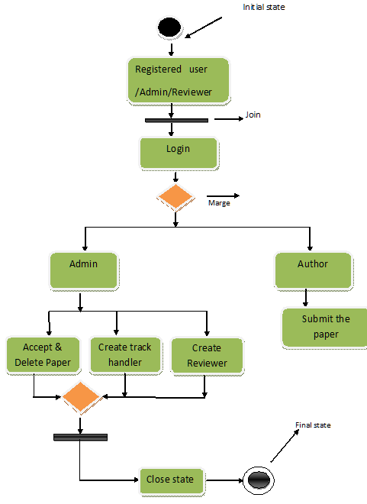
Activity Diagram

Slide 14
User

Slide 15
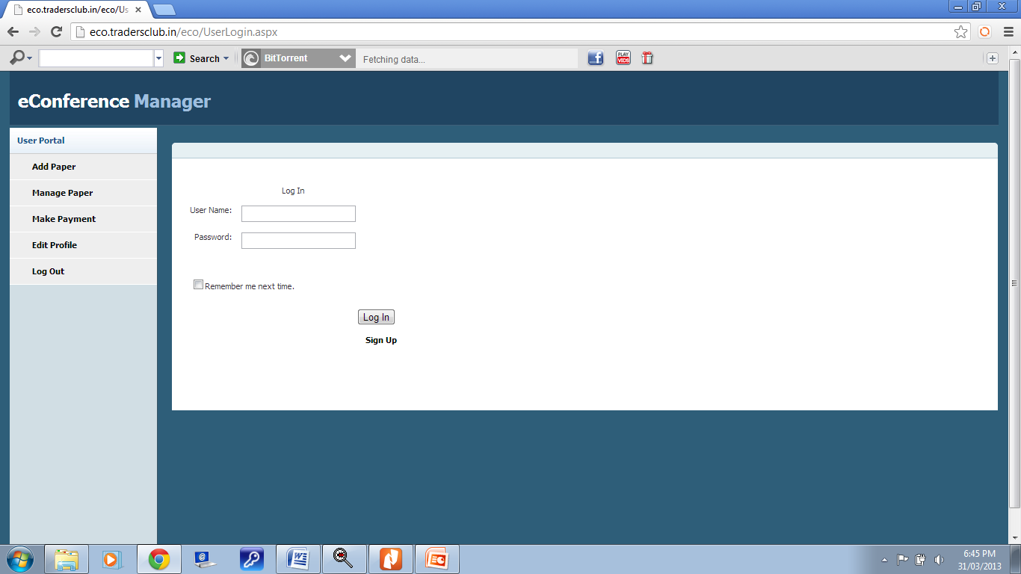

Slide 16
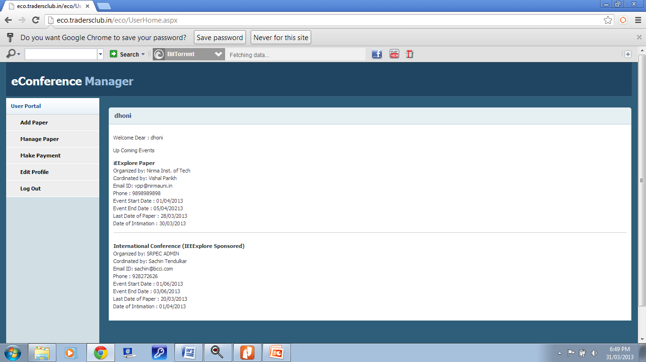

Slide 17
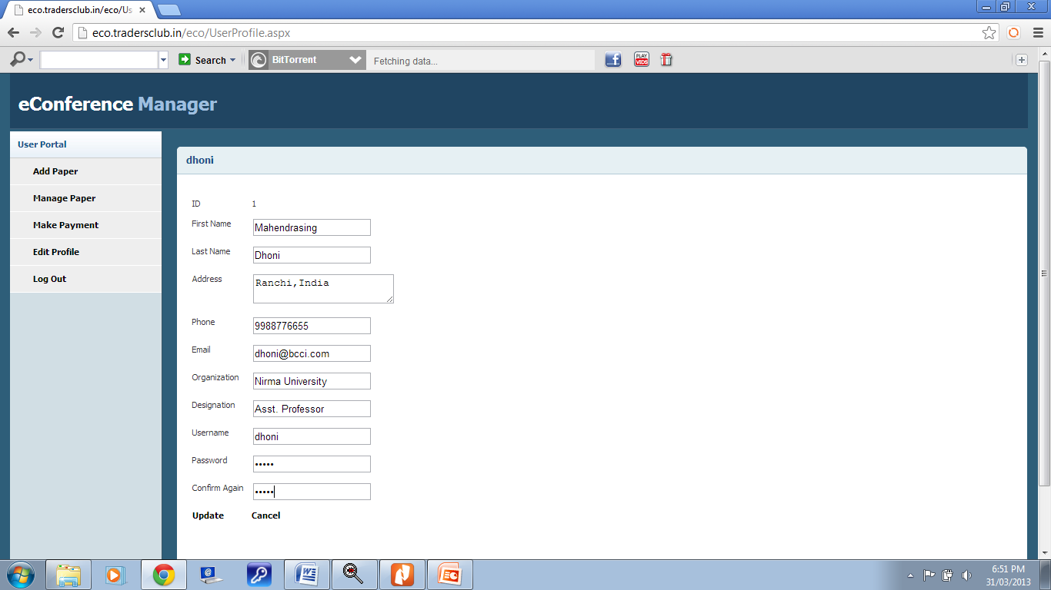

Slide 18
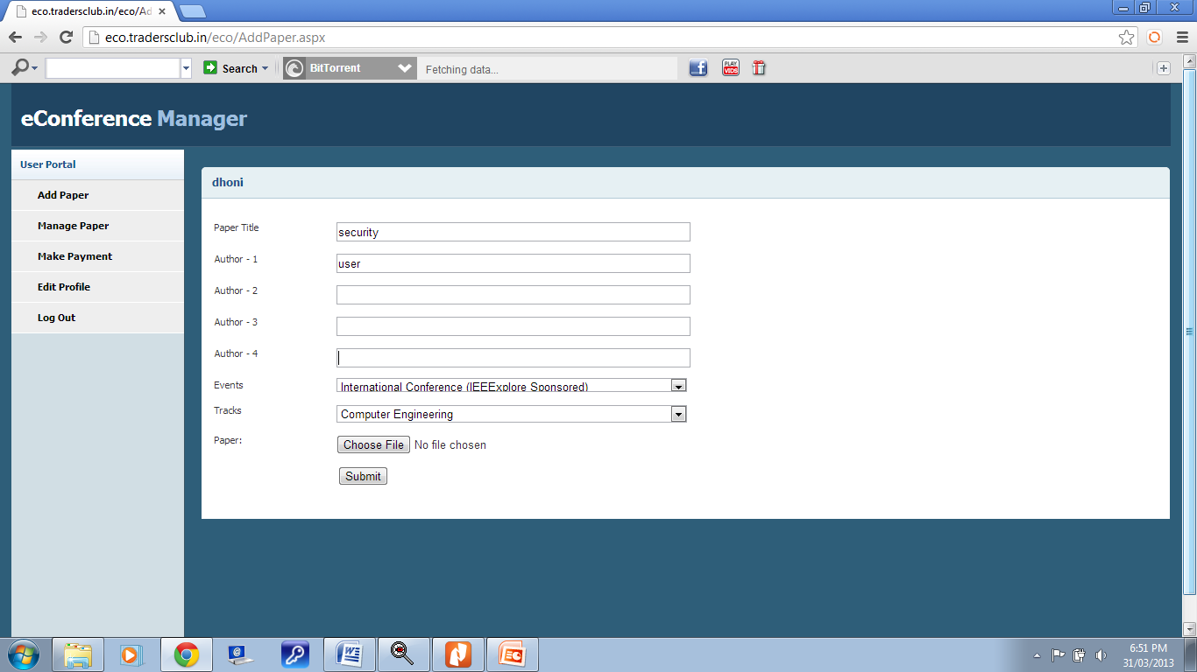

Slide 19
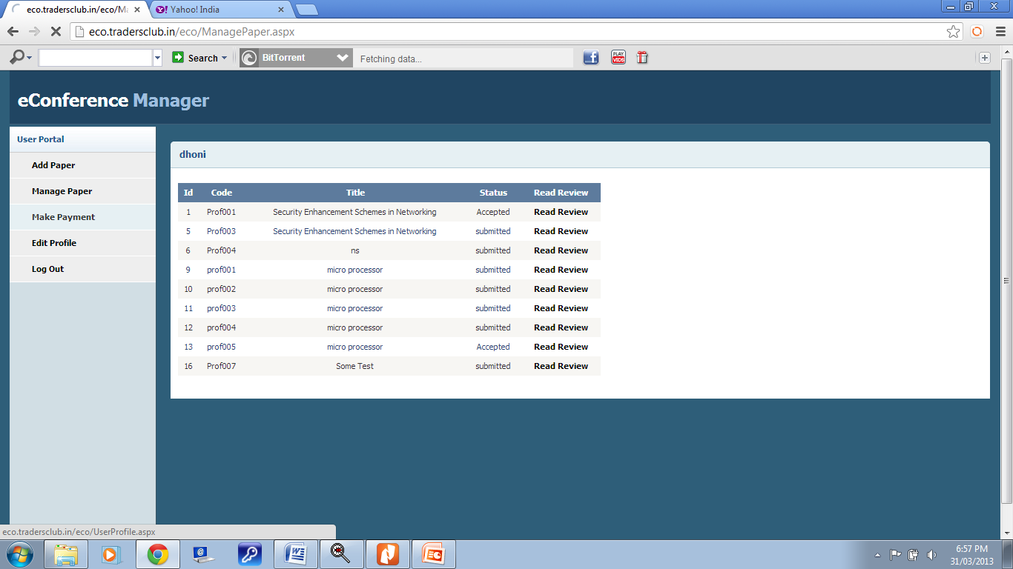

Slide 20
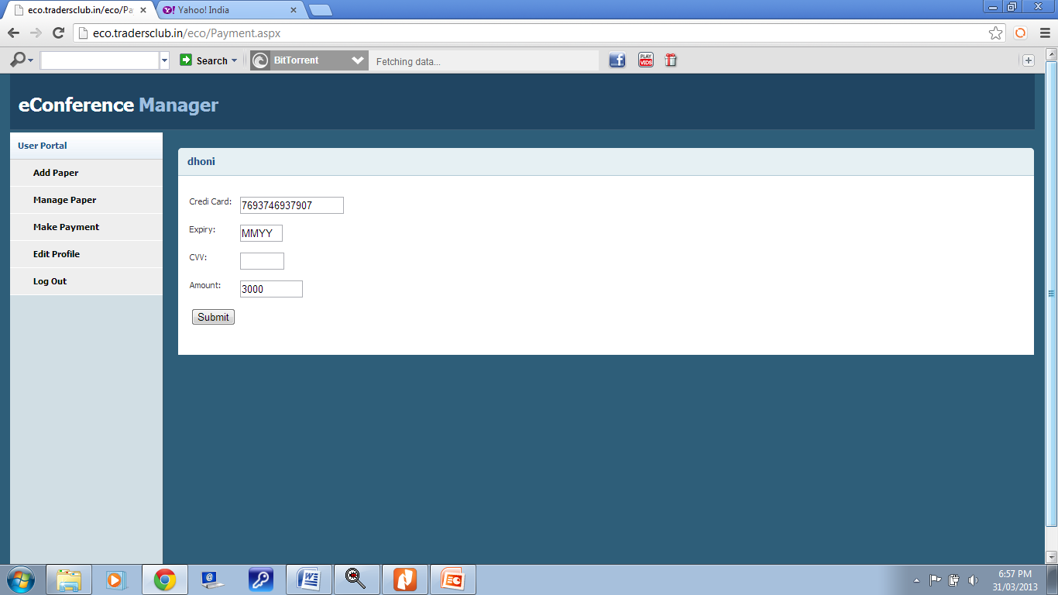

Slide 21
Admin

Slide 22
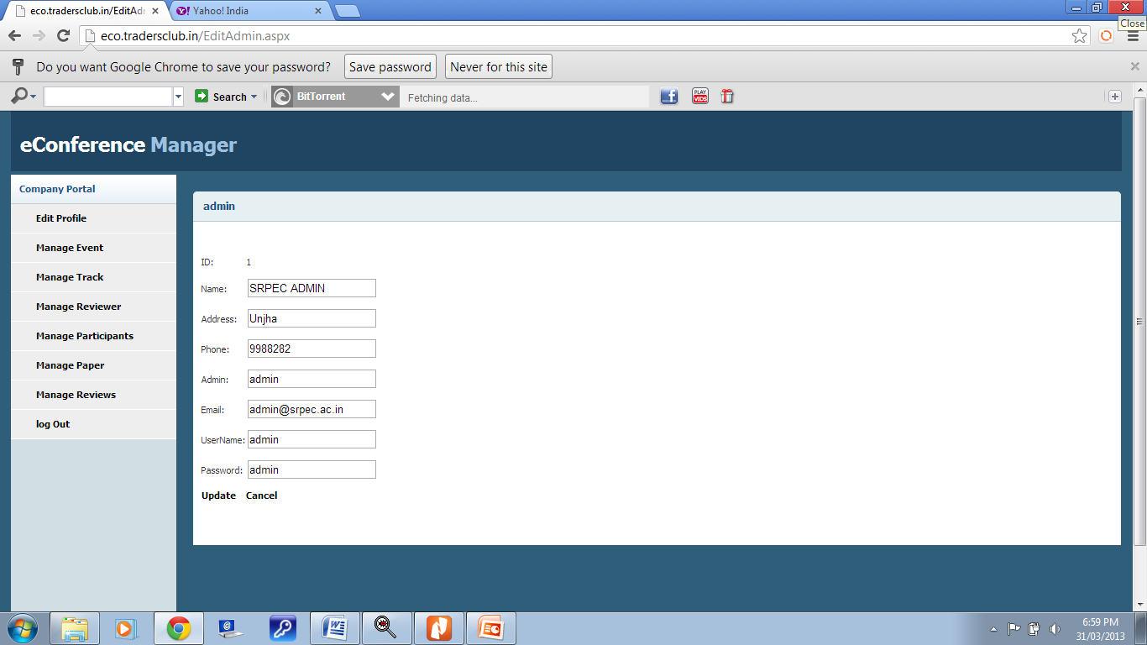

Slide 23
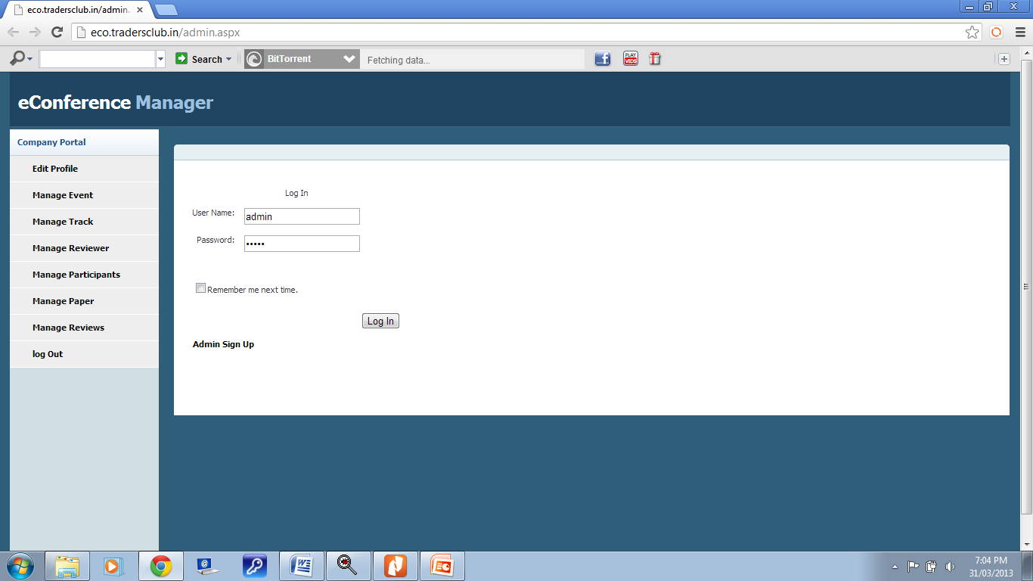

Slide 24
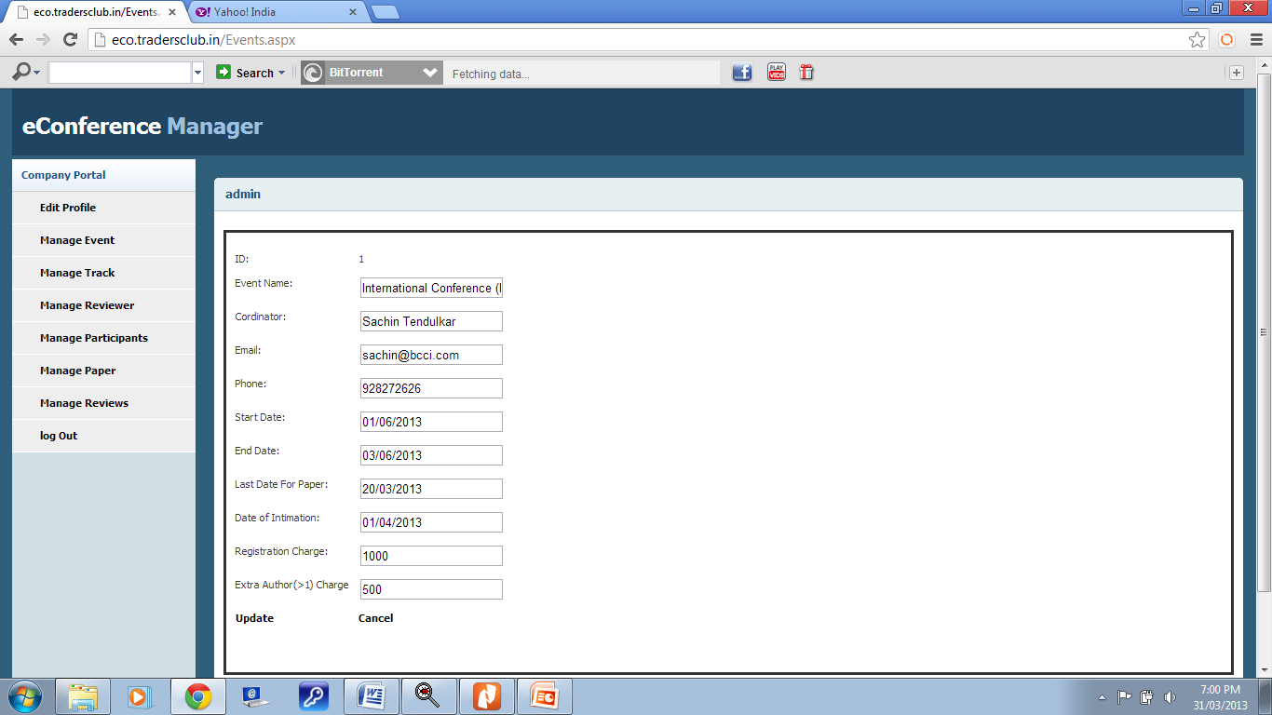

Slide 25
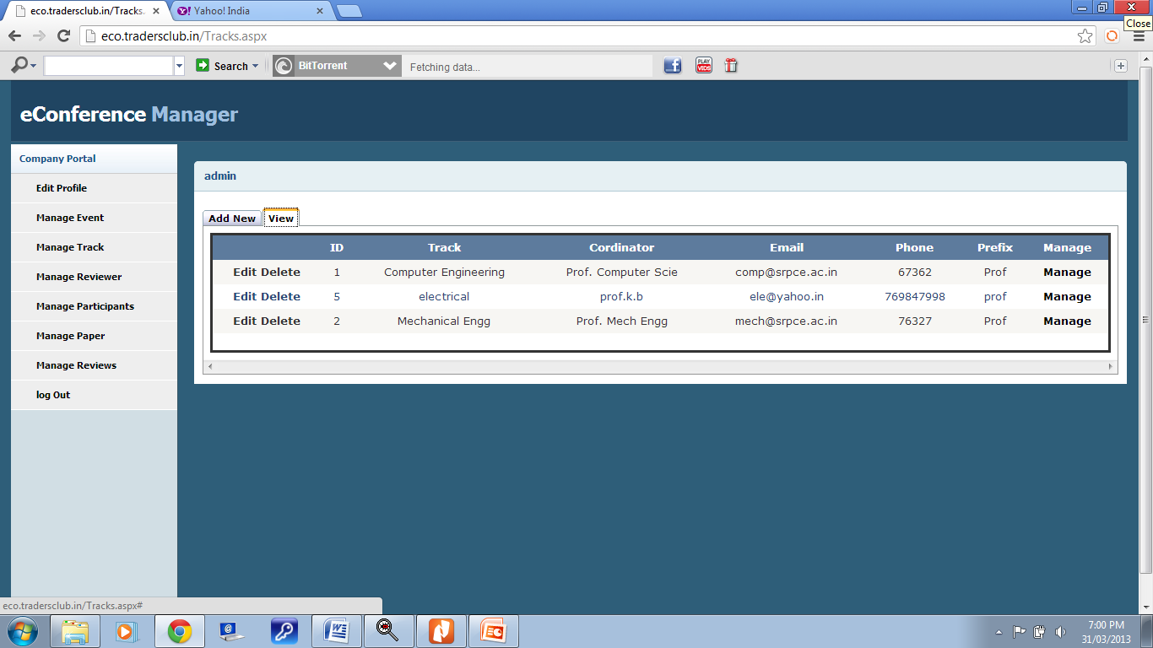

Slide 26
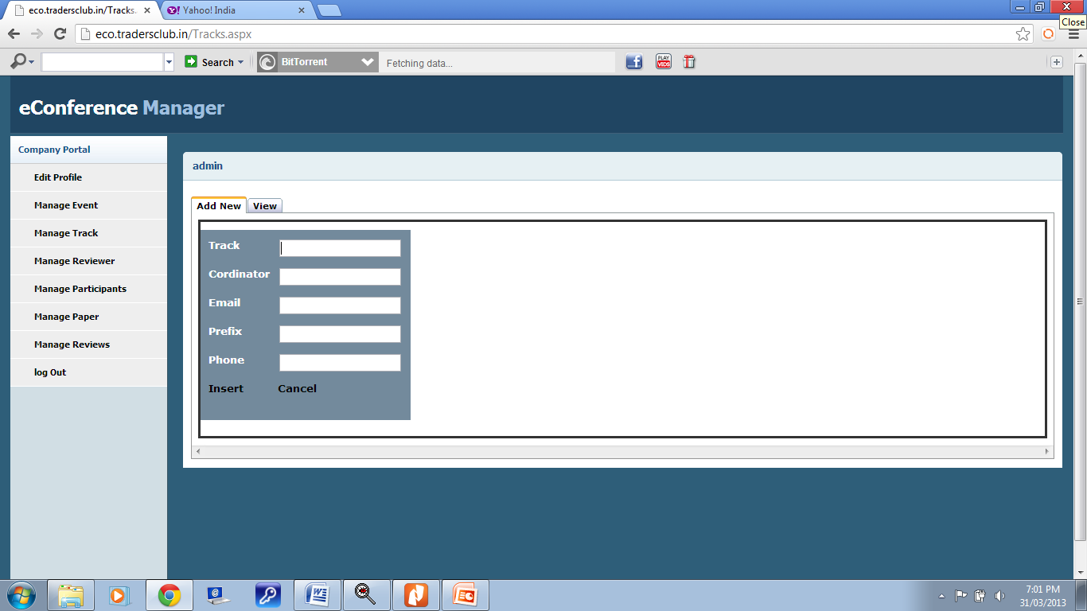

Slide 27
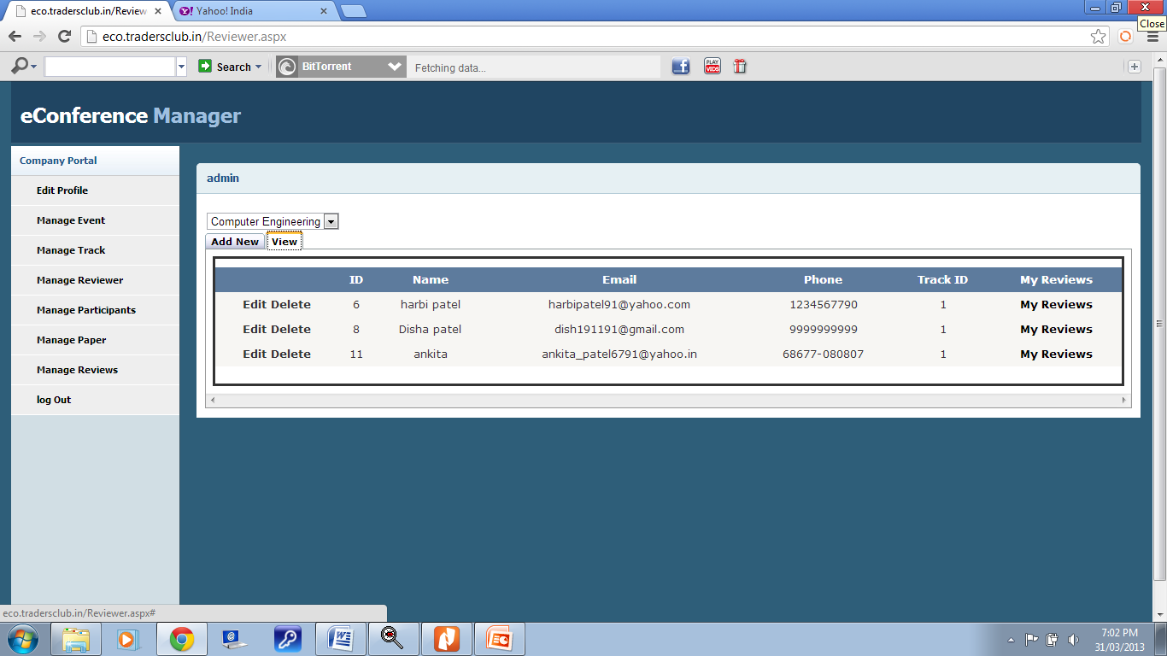

Slide 28
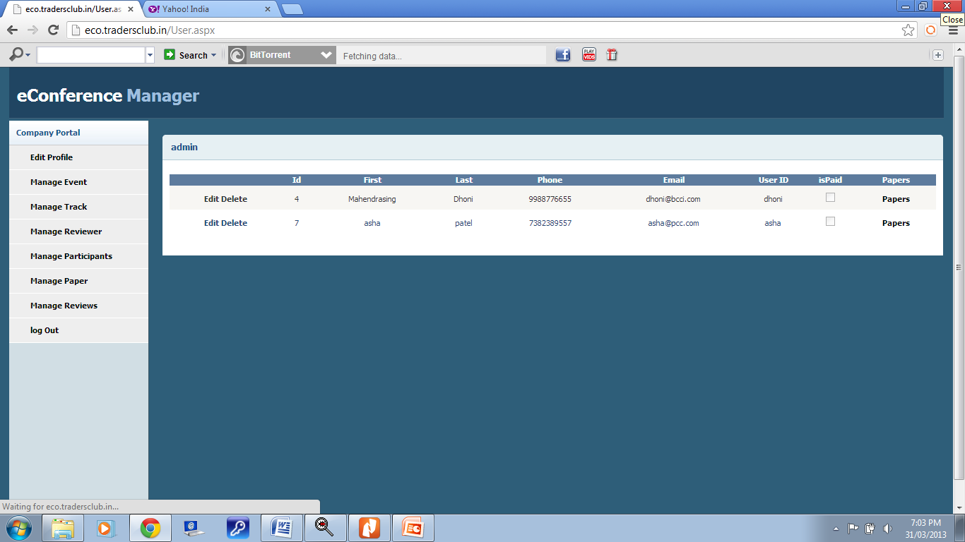

Slide 29
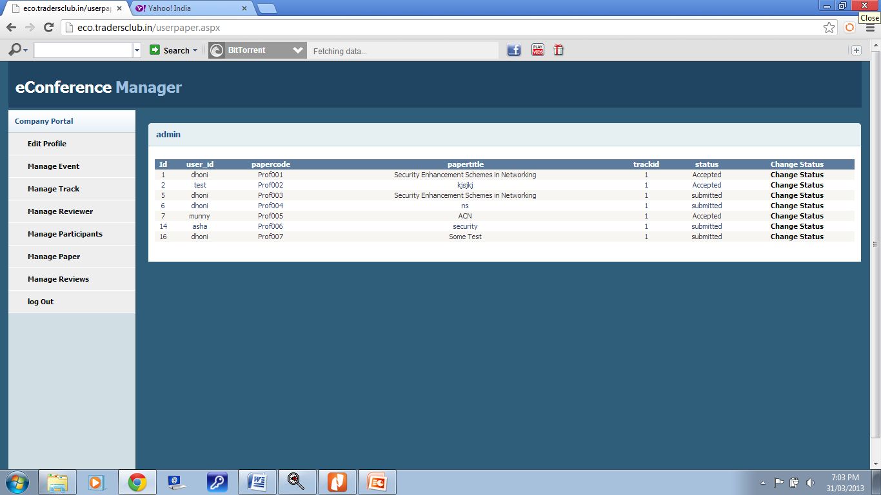

Slide 30
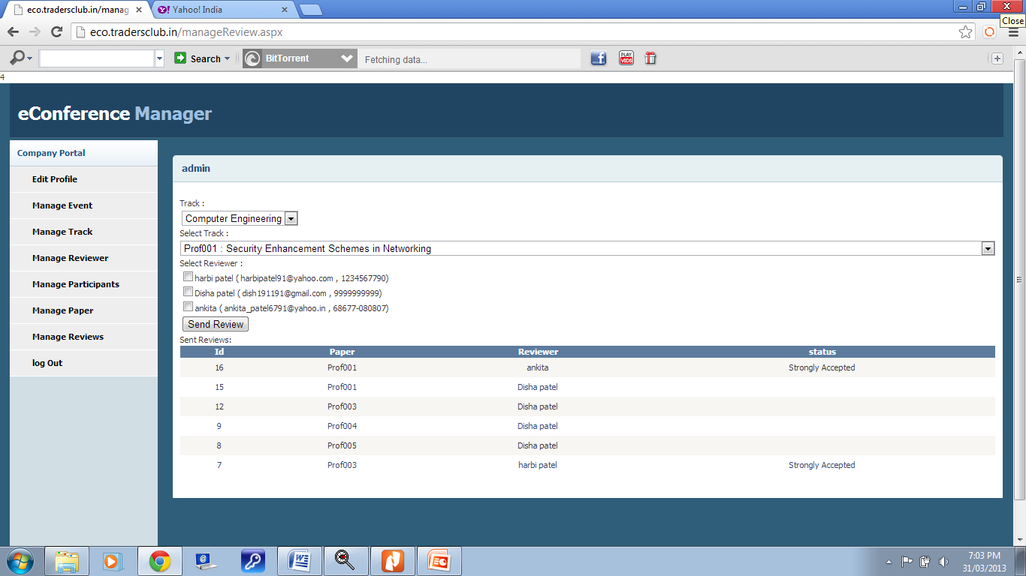

Slide 31
Reviewer

Slide 32
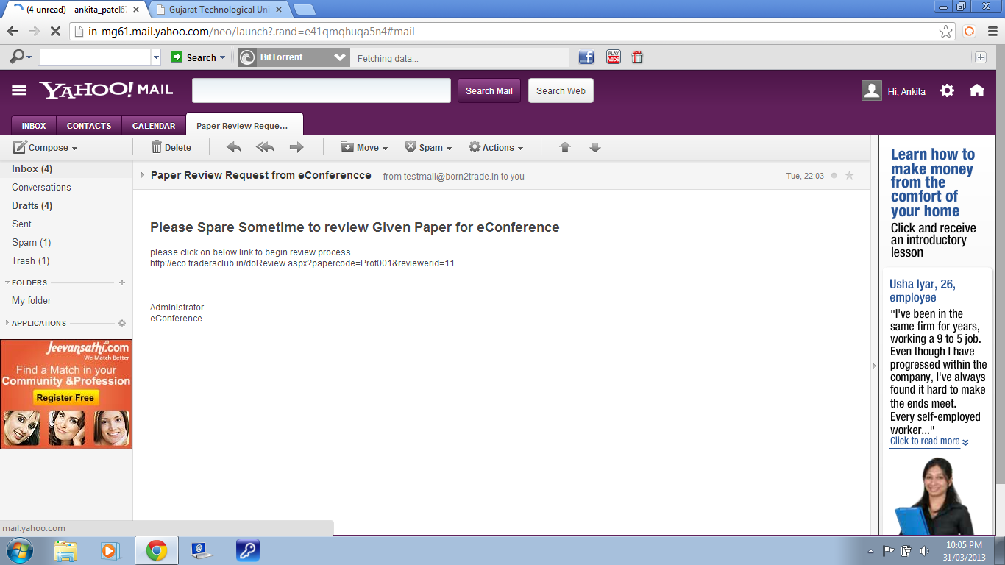

Slide 33
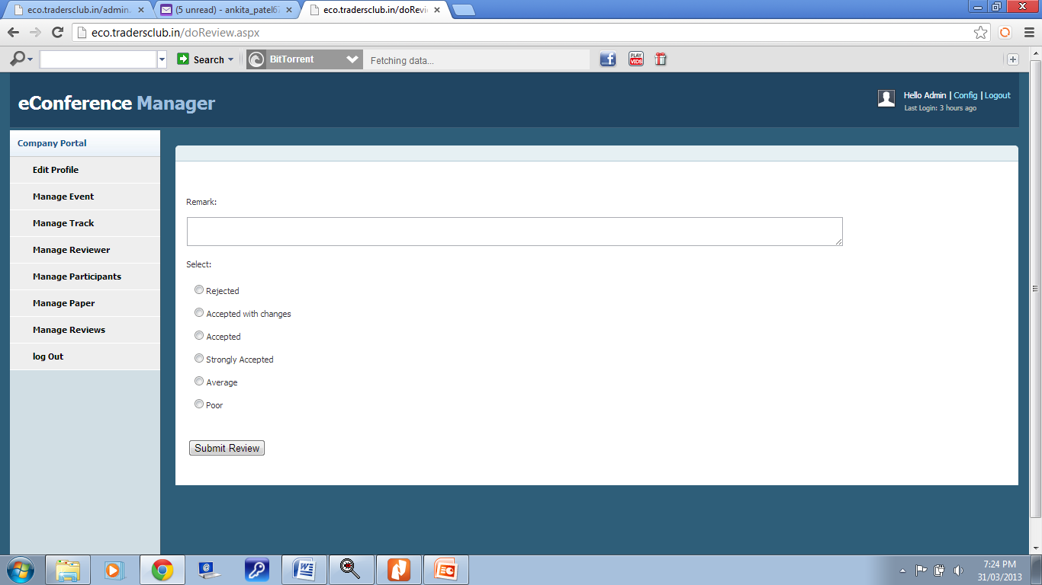

Slide 34
Thank you

