Slide 1
CLAYTRONICS
Presented by :
JANKI .PATEL
D11CE01

Slide 2
CLAYTRONICS
Abstract future concept
Combines nano scale robotics & computer science
Create nano meter scale computers called claytronics atoms-catom

Slide 3
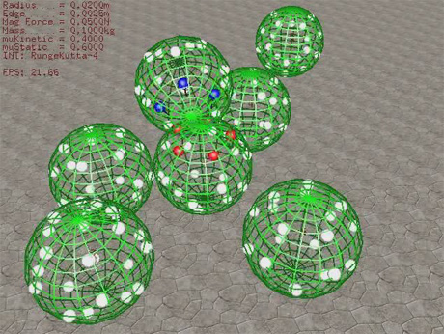
CATOMS
Individual components of claytronics
Small scale robots
Sub-millimeter computers

Slide 4
ABILITIES OF CATOMS
Locomotion
Communication
Change its colour
Adhesion
Compute state information
Morph into any shape

Slide 5
PROPERTIES OF CATOMS
Each catom is a self-contained unit, contains
CPU
energy store
Network device
Video output device
Sensors
A means of locomotion
Mechanism for adhesion

Slide 6
MAIN GOALS CLAYTRONICS
Primary goal
New media type – Pario
Long term goal
Synthetic reality

Slide 7
PARIO & SYNTHETIC REALITY
More realistic communication
Aural, visual & physical sensation
Able to hear, see & touch
Help for education, health care & entertainment

Slide 8
To render physical artifacts with high fidelity
Creation of a new environment
Interact with others computer generated artifacts as if they were the real thing

Slide 9
Not to transport objects nor to recreate the chemical composition of the object
Creates the physical artifact of the object
That mimic the shape, movement, visual appearance , sound & tactile qualities of the original object

Slide 10
CLAYTRONIC SYSTEM
Collection of catoms
Interact with other catoms
Adhere with other catoms
Morph into different shapes when instructed by the software to do so

Slide 11
EXAMPLE STUDY
Synthesis of physical copy of a “person”
Catom would first localize themselves with respect to the ensemble
Form a hierarchical network in a distributed fashion
A series of “snapshots” are broadcast to the catoms

Slide 12
Compilation of the specification would give the shape
At this instant the catoms starts to move around each other using magnetic or electrostatic force
Adhere to each other using nano - fiber mechanism
Display an image, which gives the color and texture characteristics of the source object

Slide 13
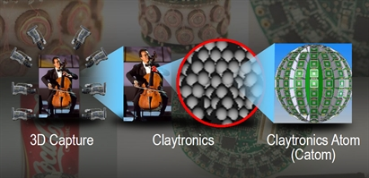
When the source object begins to move description of movements are broadcast to catoms
Catoms update the position

Slide 14
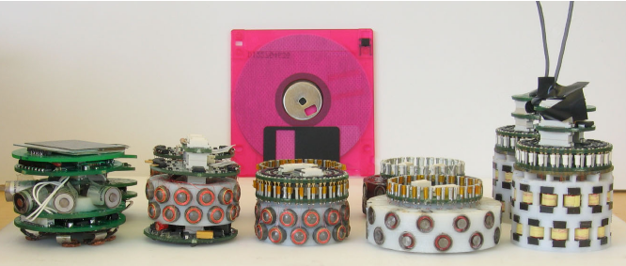
PROTOTYPE OF CATOM
Developed by Carnegie Mellon university
44 mm diameter cylinders

Slide 15
24 electro magnets are arranged in series of stacked rings
Movement is achieved by enabling or disabling the magnets
One magnet is energized at a time
Movement to another point & re-coupling requires 10 ms
Power is supplied using pick up feet
Each catom has an LED or LCD display

Slide 16
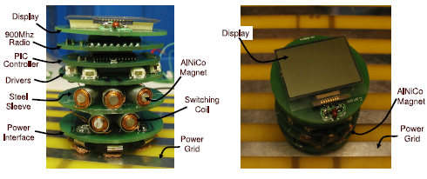

Slide 17
DESIGN PRINCIPLES
Each catom is self contained unit
Efficient routing of power
The coordination of catoms should be performed via local control
Should not contain moving parts

Slide 18
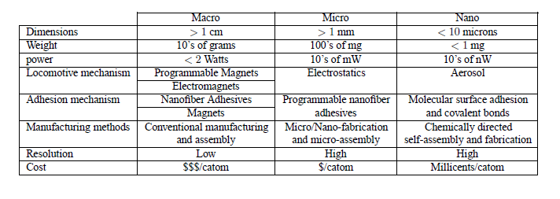
DESIGN TYPS

Slide 19

CURRENT DESIGN
These catoms are able to move in 2D
Developed by Carnegie Mellon university

Slide 20

FUTURE DESIGN
Form 3D structure
Goal is to develop millimeter scale 3D catoms

Slide 21
AREAS OF BENEFIT
Pario & Synthetic reality
Medicine-surgery on enlarged replicas of organs
Helpful for scientists for the efficient management of networks of millions of computers
Entertainment

Slide 22
THANK YOU

