Slide 1





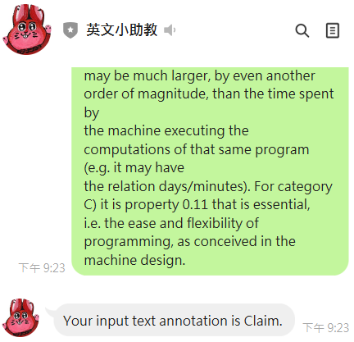

Running inside the
Workstations…
Line Cloud
Backend
Webhook callbacks
收到有人texting
By line apps
分類結果
Ngrok agent
分類結果
http://127.0.0.1:5000/callback
Tunneled WebAPI
Our TA local flask Apps
TA_Server.py

