Slide 1
Diet Manager Project Presentation
GROUP G1
Amra Rrahi, Arian Vucelić, Ejup Elezi, Roko Hafner, Janko Leskovac

Slide 2
OUTLINE
Diet Manager in Action
Diet Manager Explained
Final Notes
Part of the Solution We Are Most Proud of
What Could Have Been Done Better?

Slide 3
Diet Manager in Action

Slide 4
Diet Manager Explained

Slide 5
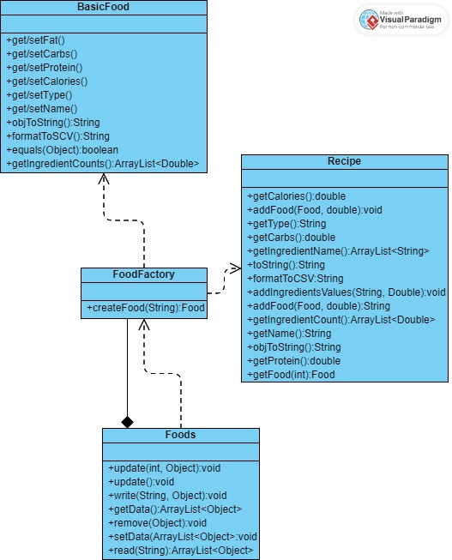
System Overview – Factory Pattern

Slide 6
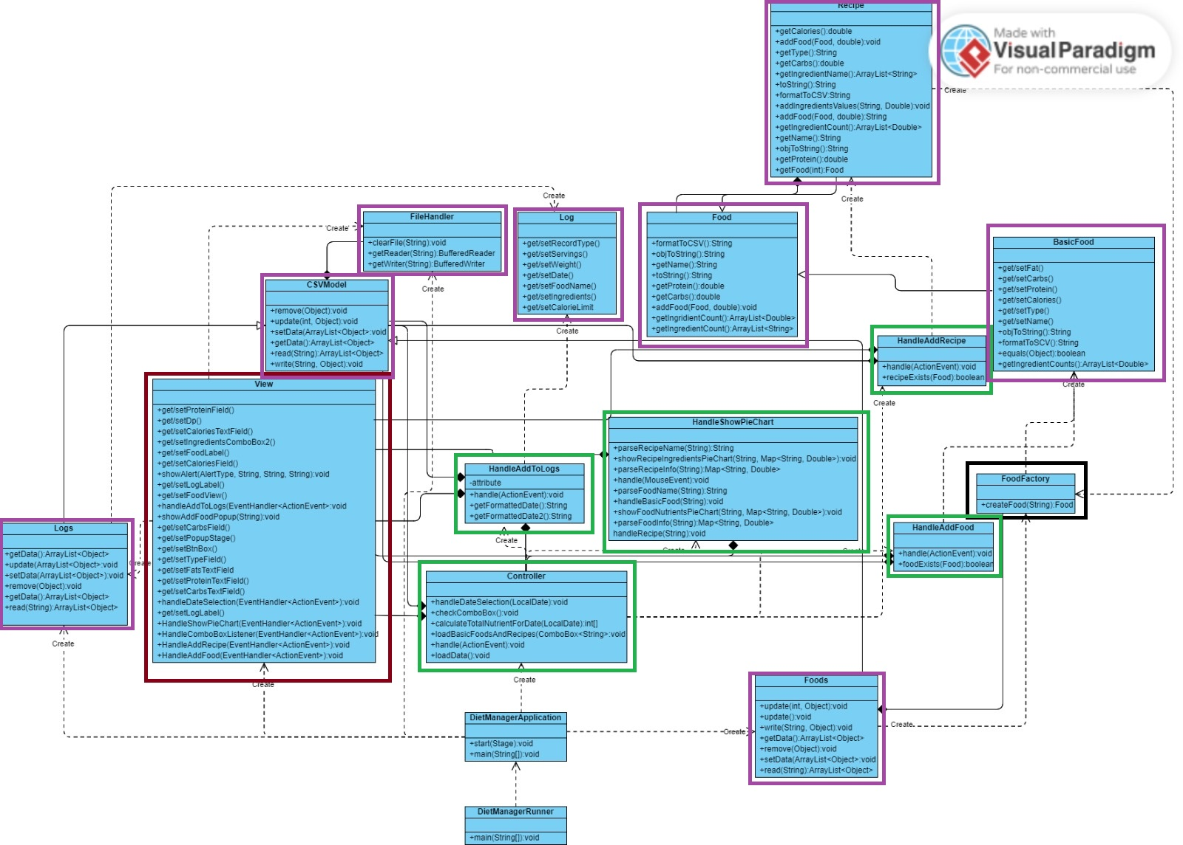
System Overview – MVC Pattern
Purple -> Model
Red -> View
Green -> Controller
Black -> Factory

Slide 7
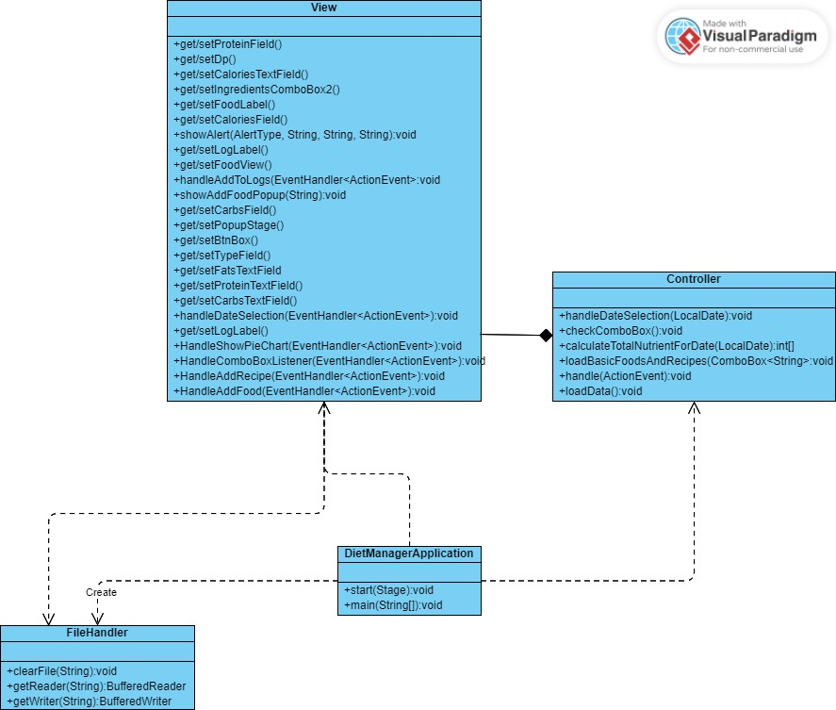
System Overview – View Subsytem

Slide 8
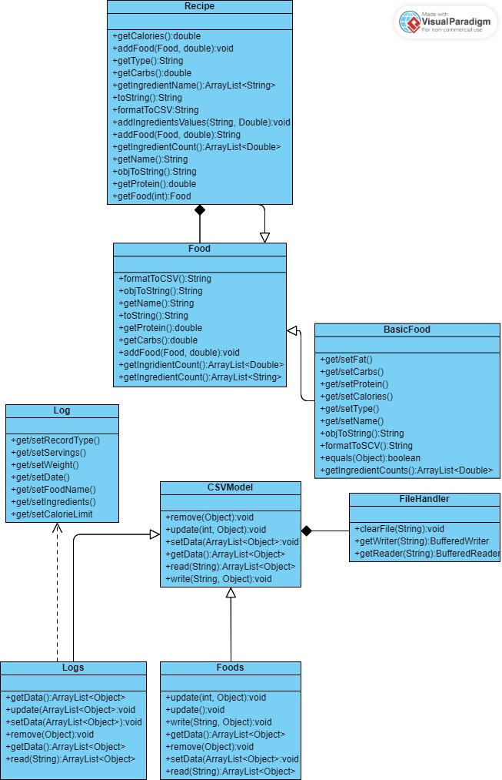
System Overview – Model Subsytem

Slide 9
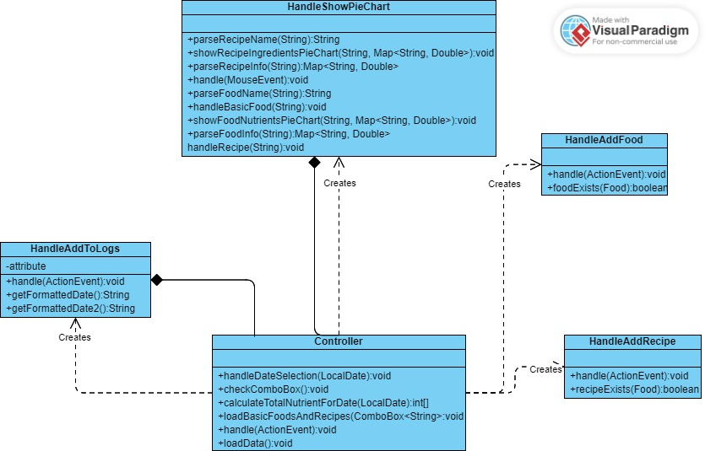
System Overview – Controller Subsytem

Slide 10
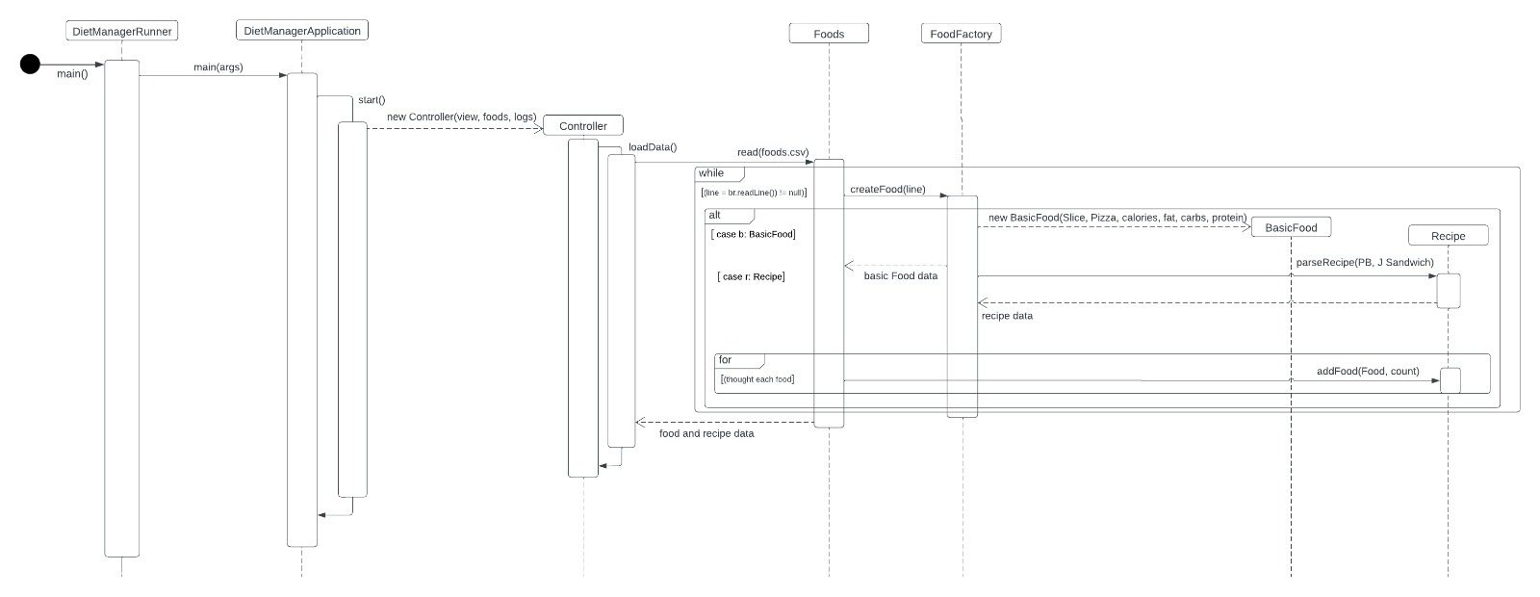
Loading data for 1 basic food (Pizza Slice) and 1 recipe (PB+J Sandwich)

Slide 11
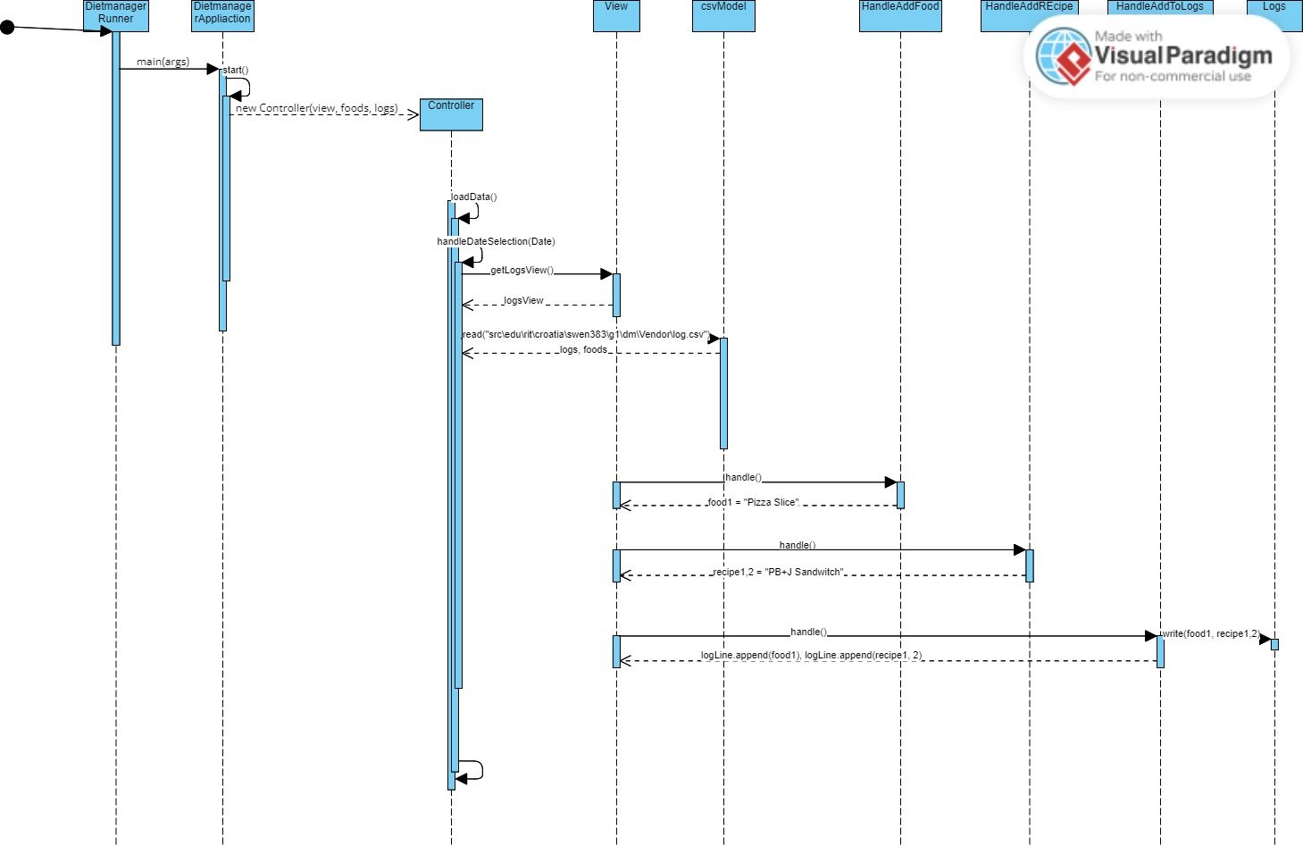
Adding 1 serving of the Pizza Slice & 2 servings of the PB+J Sandwich to the log entry for the current date.

Slide 12
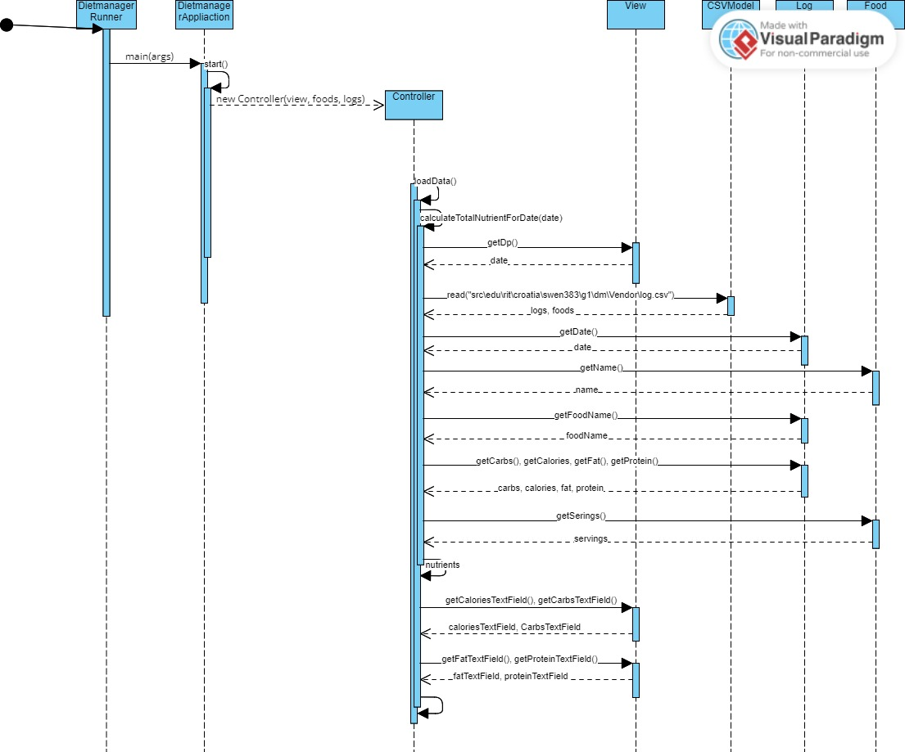
Computing the total number of calories for the current date.

Slide 13
Final Notes

Slide 14
Final Notes
Part of the Solution We Are Most Proud of
What Could Have Been Done Better?

