Slide 1
Diet Manager Project Presentation –V2
GROUP G1
Amra Rrahi, Arian Vucelić, Ejup Elezi, Roko Hafner, Janko Leskovac

Slide 2
OUTLINE
Diet Manager in Action
Diet Manager Explained
Final Notes
Part of the Solution We Are Most Proud of
What Could Have Been Done Better?

Slide 3
Diet Manager in Action

Slide 4
Diet Manager Explained

Slide 5
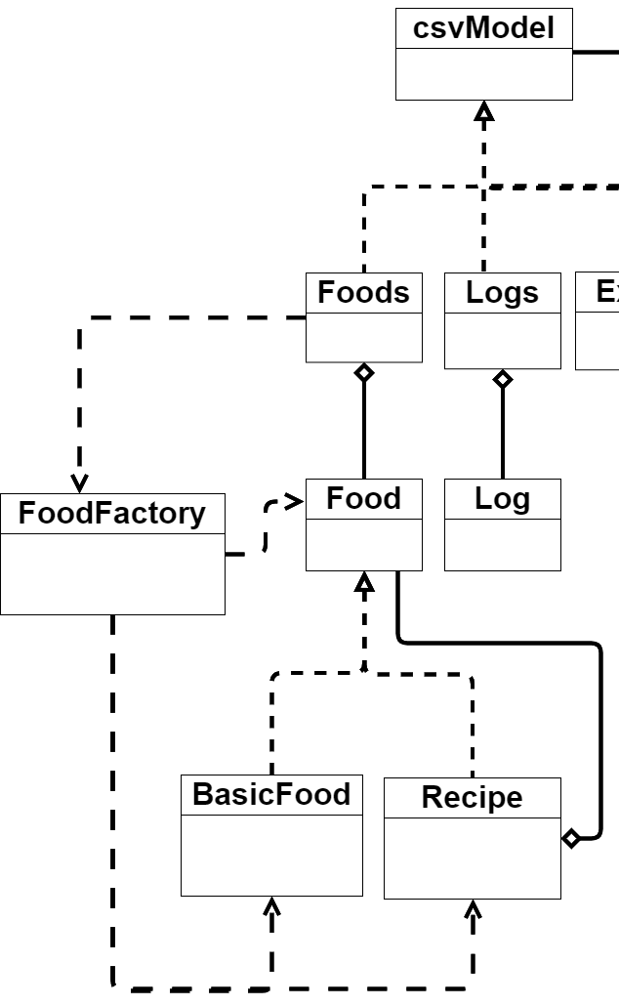
System Overview – Factory Pattern

Slide 6
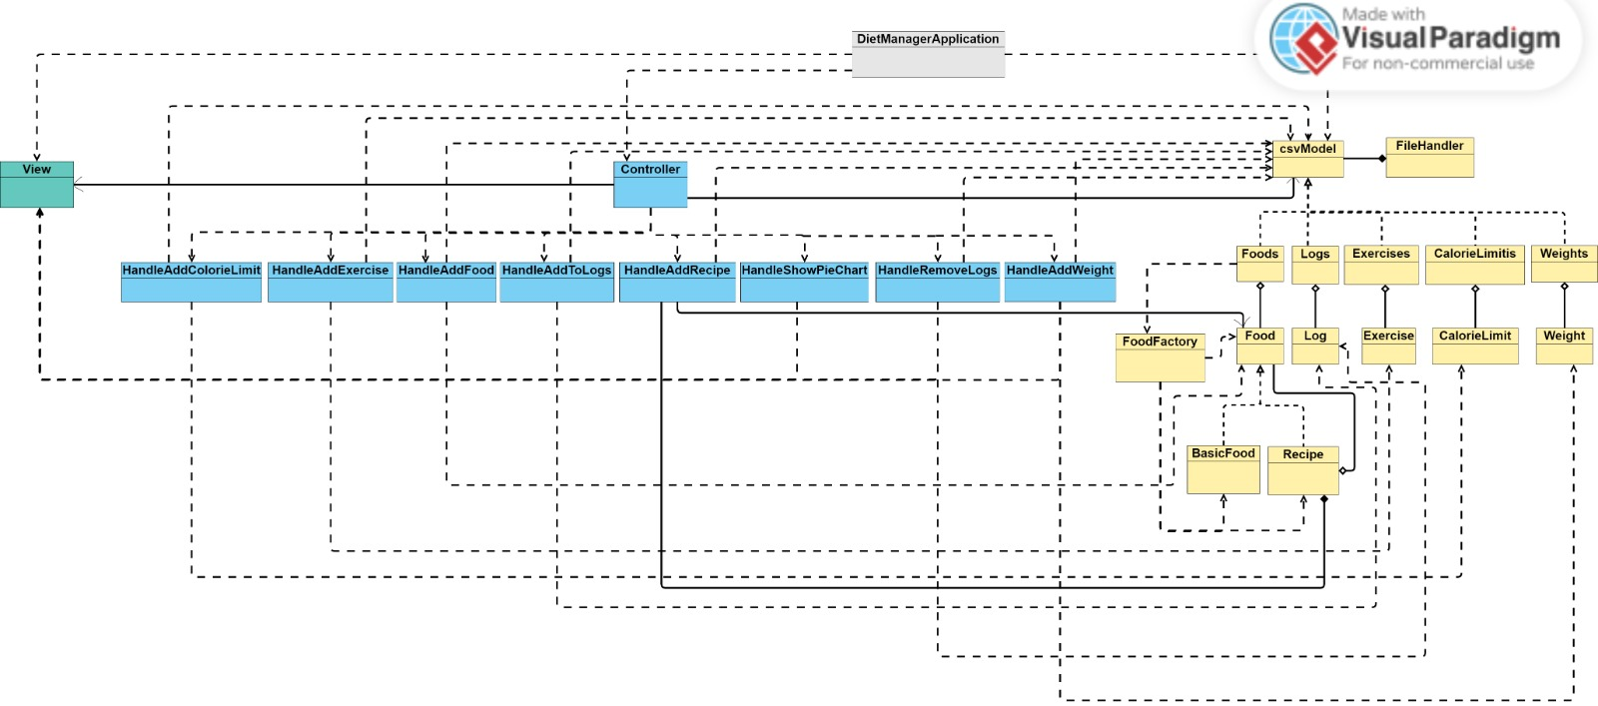
System Overview – MVC Pattern
Yellow -> Model
Green -> View
Blue -> Controller

Slide 7
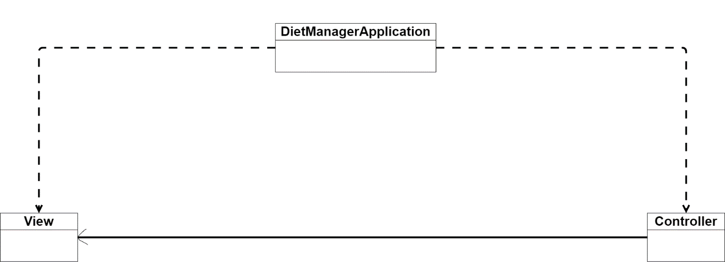
System Overview – View Subsytem

Slide 8
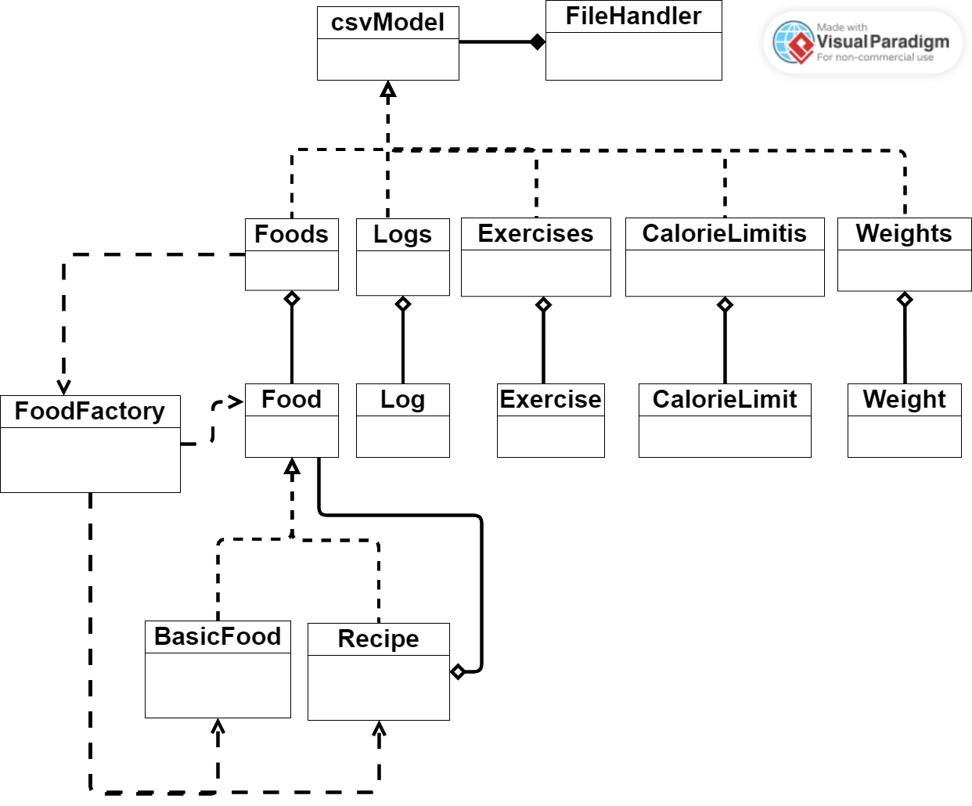
System Overview – Model Subsytem

Slide 9
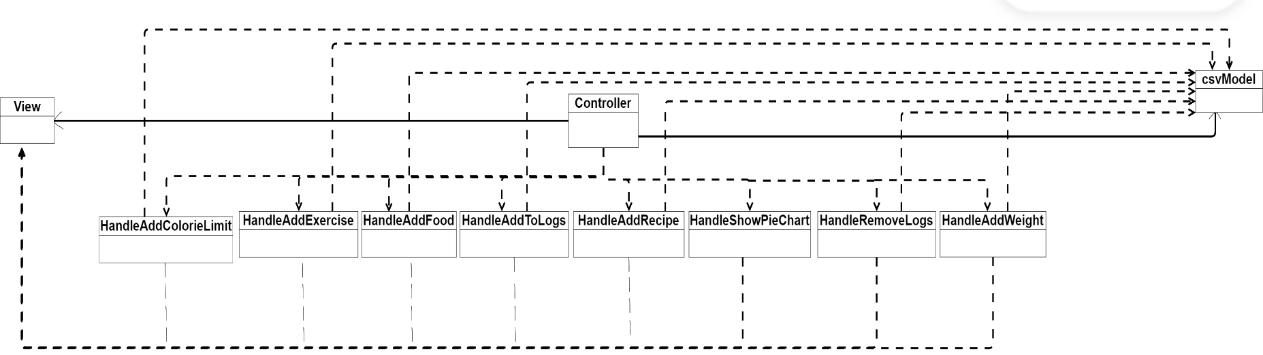
System Overview – Controller Subsytem

Slide 10
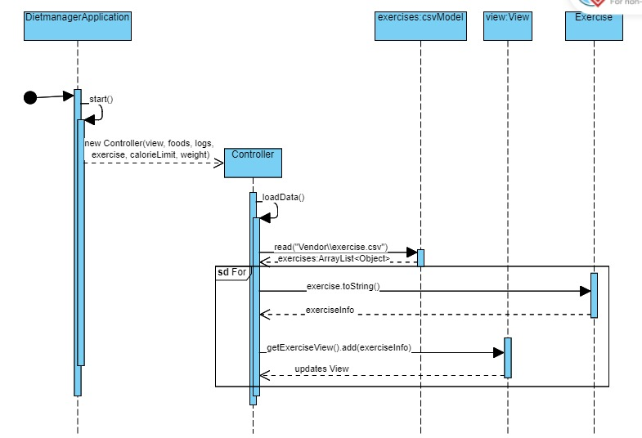
Sequence Diagram 1 – Shows how exercise records are loaded from the exercise.csv file into the internal data structure (model).

Slide 11
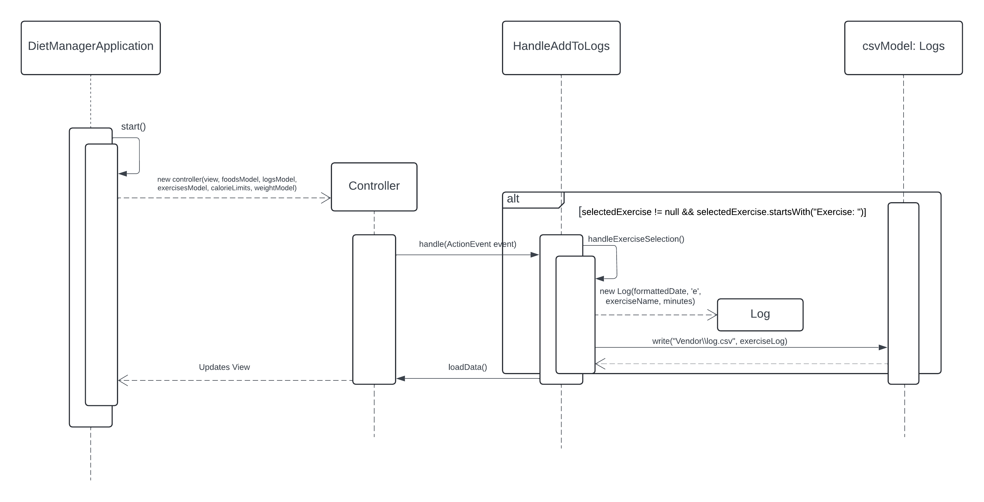
Sequence Diagram 2 – Shows how an exercise is selected and recorded into the log.csv file.

Slide 12
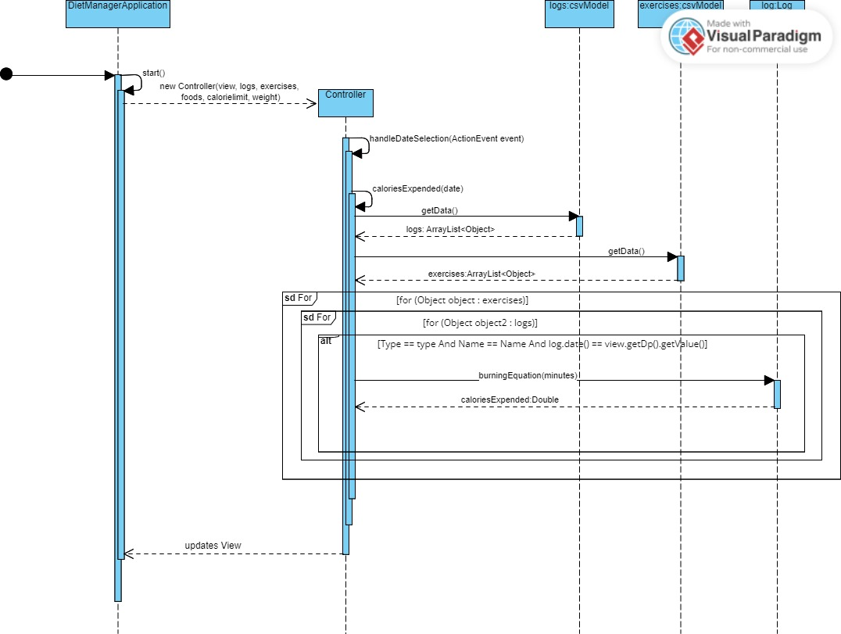
Showing how the log view is updated in relation to the calories expended via the exercise

Slide 13
Final Notes

Slide 14
Final Notes
Part of the Solution We Are Most Proud of
What Could Have Been Done Better?

