Slide 1

WebM8s
Mobile application to find new friends

Slide 2

App Vision
Our vision for WebM8s is to create an app designed to help people find groups of friends. Our target audience includes individuals of all genders and age groups, though we expect that most of our users will be between the ages of 14 and 24.
According to the AACAP data teens spend up to 9 hours of free time looking at screens, and everyone needs someone to share that time with. Unfortunately, for many reasons, a lot of people lack online friends, and this is where our app comes in to help.
We want every user of our app to feel comfortable and find people who match their personality.

Slide 3





Scope
Thanks to our personality tests and character assessments, users will be able to create detailed profiles and use them to search for new groups of friends. These groups will be suggested based on their interests, preferences and needs.
Our app will not include matchmaking or pairing features, nor will be a platform for sharing photos, whether in profiles or conversations.
We are focusing primarily on fostering virtual connections and will limit the facilation of in-person meetings, mainly for safety reasons.
Make a test
Let our AI develop your profile
Choose the best community
Have fun with new friends!

Slide 4

Why WebM8s?
Our application adressses three key user needs:
Meeting New People: The app facilitates meeting new
groups of people based on userdata.
Groups and Subcultures: Users can join interest-based
groups or subcultures and participate virtually, creating a sense of belonging in aligned with their passions.
Online Entertainment: The app provides spaces where users
can engage in gaming, quizzes, and digital entertainment together, integrating tools for online social activities.

Slide 5

User Personas
Michael
Andrzej
Anastazja
Michael is 16 years old, lives in London, and is a high school student. Although he’s an introvert, he has a few close friends; however, they don’t enjoy playing the same game as he does—League of Legends. While he’s not looking for new friends to meet up with in person, he is interested in finding people to form a team with for online gameplay. While searching for an app to find gaming buddies, Michael comes across Web8s.
Andrzej is a 42-year-old from Poland who has recently begins treatment for his alcoholism. His doctor recommended that he find a sobriety support group, but there’s nothing like that in the area near his small village . A few weeks ago, however, Andrzej’s cousin, Mariusz, told him about an app where he could connect with people from around the world. Andrzej decides to give it a try.
Anastazja, a 26-year-old woman, recently decided she wants to develop a deeper interest in cinema. She would like to learn how to analyze films in a more meaningful way, but she doesn’t know where to start—she struggles to apply what she’s read online in practice. Anastazja would love to discuss films with people who are knowledgeable and learn what to pay attention to while watching movies through real examples. She decides to try the app after seeing an advertisement.

Slide 6
Use Cases
Michael
Andrzej
Anastazja
Michael decides to give WebM8s a try, generates his profile, and starts searching for his new team. After just a few minutes of browsing, he forms a new group by pairing up with one person, and within an hour, their group grows to four people who not only fit perfectly into the needed roles for the game but are also incredibly fun to chat with. After a few hours of messaging with his new friends, Michael decides to add them in-game, where they continue their conversations over voice chat.
After installing the app, Andrzej quickly sets up his profile thanks to the simple interface. Within five minutes of searching, he finds a small group of eight people. Everyone in the group is very friendly, sharing daily updates about their day, how they’re feeling, and what helps them in their recovery journey. This shared support makes it easier for everyone in the group, including Andrzej, to navigate their treatment. Andrzej decides to tell his cousin on the other side of the family about the app.
Anastazja was initially skeptical, but after creating her profile and finding one of the groups, her attitude shifted instantly. She enjoyed the app so much that she decided to join several more groups. Now, she engages daily in conversations with other group members and has noticed that she increasingly understands the deeper insights of directors and screenwriters.

Slide 7

Testing Plan
The WebM8s testing plan will follow a clear strategy to make sure the app’s main features work well, are reliable, and easy to use. This plan will include test cases for key features like finding groups, chatting with others, and managing accounts. We’ll describe the different types of tests needed, the tools we’ll use, and a schedule that explains when each test will happen, how long each test will take, and who will be responsible for it.

Slide 8
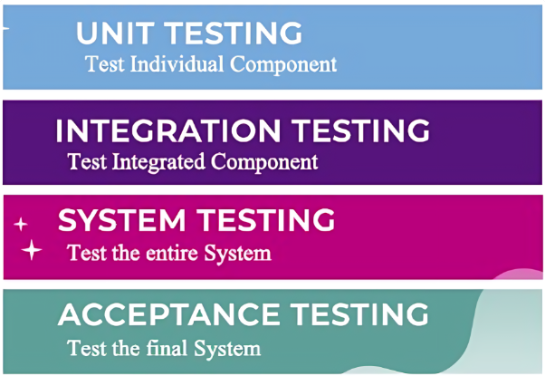
Test Types
Unit Testing
Purpose: We ensure that each small part of the app works correctly on it own.
Scope: Testing small functions like creating a user profile, filtering age, games and selected topic.
Integration Testing
Purpose: We confirm that all parts of the app work well together.
Scope: For example, we test how features like user registration and saving data connect seamlessly.
System Testing Purpose: Ensure WebM8s functions as a complete, integrated system, verifying performance, security, and reliability.
Scope: Test the full application for defects, end-to-end workflows, and requirement compliance to prepare for User Acceptance Testing.
User Acceptance Testing (UAT) Purpose: Validate that WebM8s meets user needs by testing usability, functionality, and real-life performance.
Scope: Launch the beta version to prove customer requirements are met. UAT lasts two months or until 20,000 users register.

Slide 9




How will user acceptance tests work in WebM8s?
Testing real-life scenarios
Users will go through typical workflows, such as:
Logging in and generating profiles.
Searching for groups that match their interests and joining them.
Participating in chat conversations and utilize the app's features..
Focus areas
Ease of use: Is the app simple, intuitive and safe for users?
Performance: Does it work fast, reliably and as intended?
Engagement: Does the app create fun and welcoming experience?
Gathering feedback
Testers will share their experiences on app store reviews and social media: What they loved, what was a cumber or felt confusing, and what needs to be improved.
Their insights will help us adjust the app to better meet user expectations.
Selecting real users
We’ll encourage with advertisements people of our target audience – gamers, community seekers, chat enthusiasts. We want to acquire 10,000 test users.

Slide 10

Delivery Process and Organization
Our project will use the Kanban methodology, focusing on visualizing work, limiting tasks in progress (WIP), and continuously improving processes. This approach allows the team to adapt quickly to changes and efficiently manage tasks. Kanban provides the flexibility our small team needs, supporting smooth collaboration and effective project goal alignment. We have planned weekly meetings to review progress and make necessary adjustments. Tasks will be handled individually, following WIP limits.

Slide 11


Tools
Canva Board
Github Repository
We are going to use the canva board to spread task and visualise our work
We will use the Github repository to keep our project code

