Slide 1
MapDB
Taking java collections to next level
www.mapdb.org

Slide 2
Me
Jan@Kotek.net
@JanKotek
Independent consultant
I took over MapDB in 2010
(it started in 1999 under name JDBM)
Last 3 years I work on MapDB full time

Slide 3
MapDB
MapDB is embedded database engine
  ACID, isolation etc..., this talks only covers
  in-memory mode with transactions disabled
Apache 2 licensed
Maps and other Java collections
Flexible component architecture
Very fast
  Speed comporable to Java Collections
  No degradation by Garbage Collection
600 KB jar, no deps, pure java

Slide 4
Hello World
DB db = DBMaker
.memoryDB()
.make();
Map<Long,UUID> map = db
.treeMapCreate("map")
.keySerializer(Serializer.LONG)
.valueSerializer(Serializer.UUID)
.nodeSize(64)
.make();

Slide 5
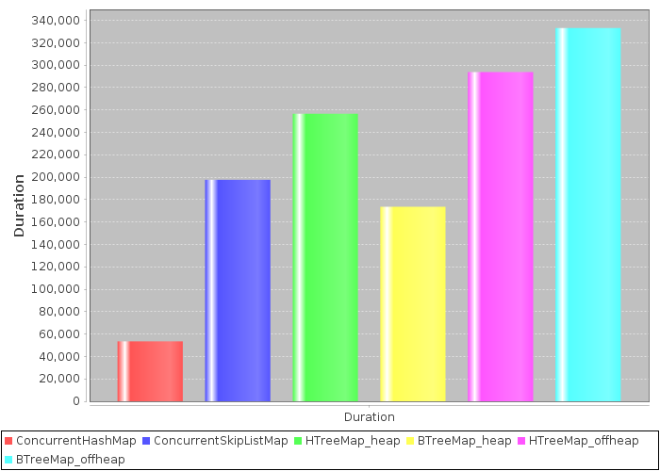
Random Map<Long,UUID>.put() performance
Time to update 100M random keys on Map with 100M entries (smaller is better)

Slide 6
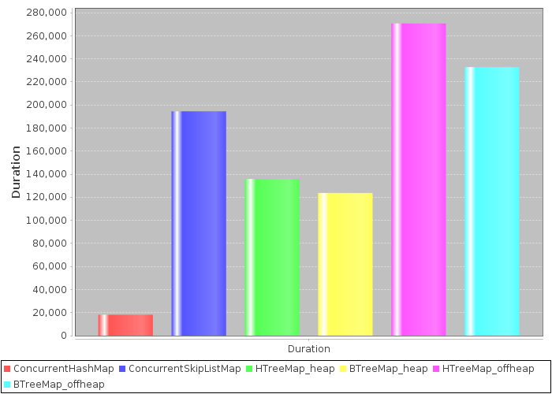
Random Map<Long,UUID>.get() performance
Time to get 100M random keys on Map with 100M entries (smaller is better)

Slide 7
HashMap
Hashtable is tree with upto 3 levels
  (no fixed sized array)
  No rehashing and no reinsert on grow or shrink
  Empty hash position does not use space
Concurrent, 16 segments with separate locking
Expiration
Modification Listeners

Slide 8
HashMap - expiration
Expiration based on TTL, memory limit and number of entries
Aproximate expiration (+- 100 entries) for better performance
Concurrent, 16 separate segment, each with separate queue and lock
Map map = db
.hashMapCreate("cache")
.expireMaxSize(1000000)
.expireAfterWrite(30, TimeUnit.HOURS)
.expireAfterAccess(10, TimeUnit.HOURS)
.make();

Slide 9
TreeMap
Full ConcurrentNavigableMap implementation
  (only alternative implementation I know about)
Transparent specialized keys
  Long → long
  Strings → byte[] or char[] depending on encoding
B-Link Tree ( Yehoshua Sagiv 1986)
  Highly concurrent
  No locks on read, one Lock per node on update
  On delete empty nodes are not removed :-(
Modification listeners

Slide 10
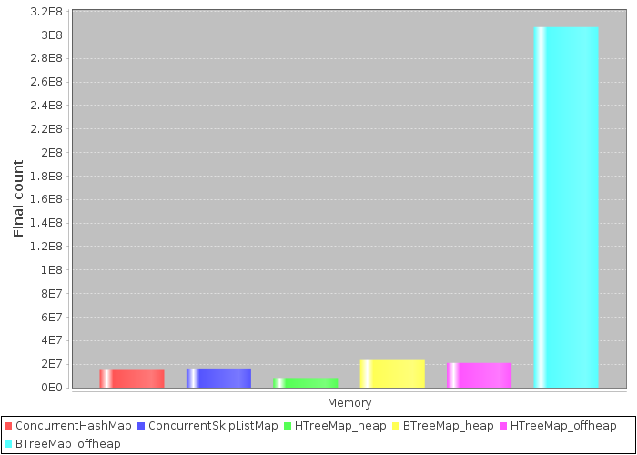
TreeMap<Long,UUID> – number of entries in 1GB memory

Slide 11
TreeMap – Key Representation
class LeafNode{ Object[] keys, Object[] values}
Data interpretation such as array size, binary search, update, split... is done in plugable serializer
Array of keys and values can be represented in many ways
  Object[]
  long[]
  char[][] → char[]
Delta compression
  [ 6001, 6001, 6002 ] stored as [ 6000, 1, 1 ]
  → only 4 bytes in packed longs
Common prefix compression
  [ “New Orleans, “New York” ] stored as
  [ “New “, ”Orleans”, ”York”]

Slide 12
TreeMap - Data Pump
Imports TreeMap very fast
First creates Leaf Nodes, than builds Tree Nodes on top
Insert only operation, no random updates
Inserts millions of entries per second
Insert speed is constant, no degradation with large sets
  1B (1e9) entry map is created overnight on slow rotating HDD

Slide 13
Bind
Collections provide Modification Listeners
Bind is utility on top of listeners which binds two collections together
Secondary collection is automatically modified by changes in first

Slide 14
Bind – secondary Map
HTreeMap<Long, String> primary =
DBMaker.memoryDB().make().hashMap("test");
// secondary map will hold String.size()
Map<Long,Integer> secondary = new HashMap();
//Bind maps together
Bind.secondaryValue(primary, secondary,
{ (Long key, String value) =>
return value.lenght()});
primary.put(111L, "just some chars");
secondary.get(111L) => 15

Slide 15
Bind – overflow to disk after expiration
// slow large collection on disk
HTreeMap onDisk = db.hashMap("onDisk").make();
// fast in-memory collection with limited size
// its content is moved to disk after it expires
HTreeMap inMemory = db
.hashMapCreate("inMemory")
.expireAfterAccess(1, TimeUnit.SECONDS)
// register overflow
.expireOverflow(onDisk, true)
.executorEnable()
.make();

Slide 16
Current status
MapDB 1.0 is out
MapDB 2.0 release is coming soon
  At this point its faster and more stable than 1.0
Issues with on-disk mode and recovery after crash ('kill -9' unit test fails now)
MapDB 2.1 will follow soon
  It will improve concurrency
  Will have long term support for couple of years (API, format)

Slide 17
Conclusion
Better memory usage
Reasonable performance
Extra features such as expiration
I hope you will find it useful :-)
Resources
  www.mapdb.org
  github.com/jankotek/mapdb

