Slide 1
LEARNING AKKA Italian style
JAVA-10

Slide 2
TABLE OF CONTENTS
01
02
Project structure
Actors
03
Demo
04
Review

Slide 3
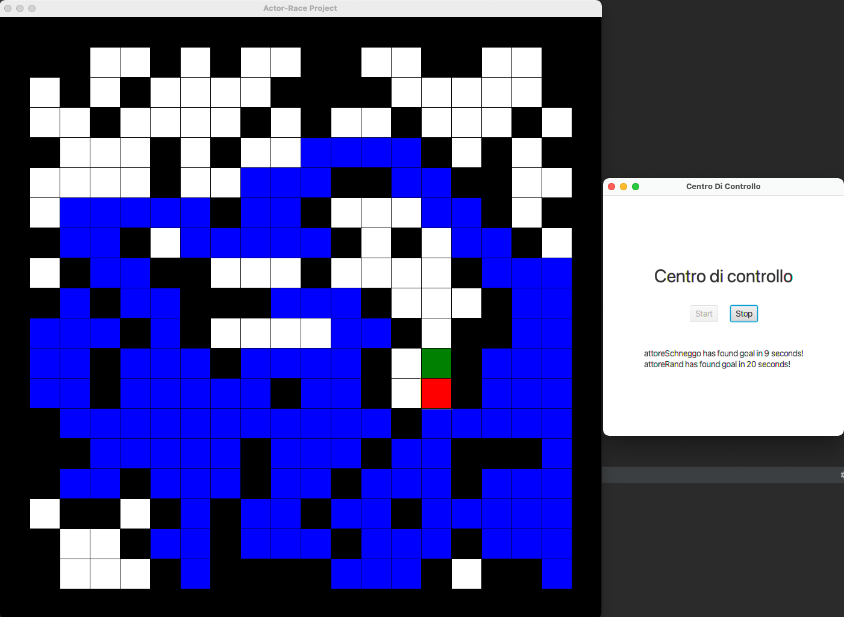
Introduction

Slide 4
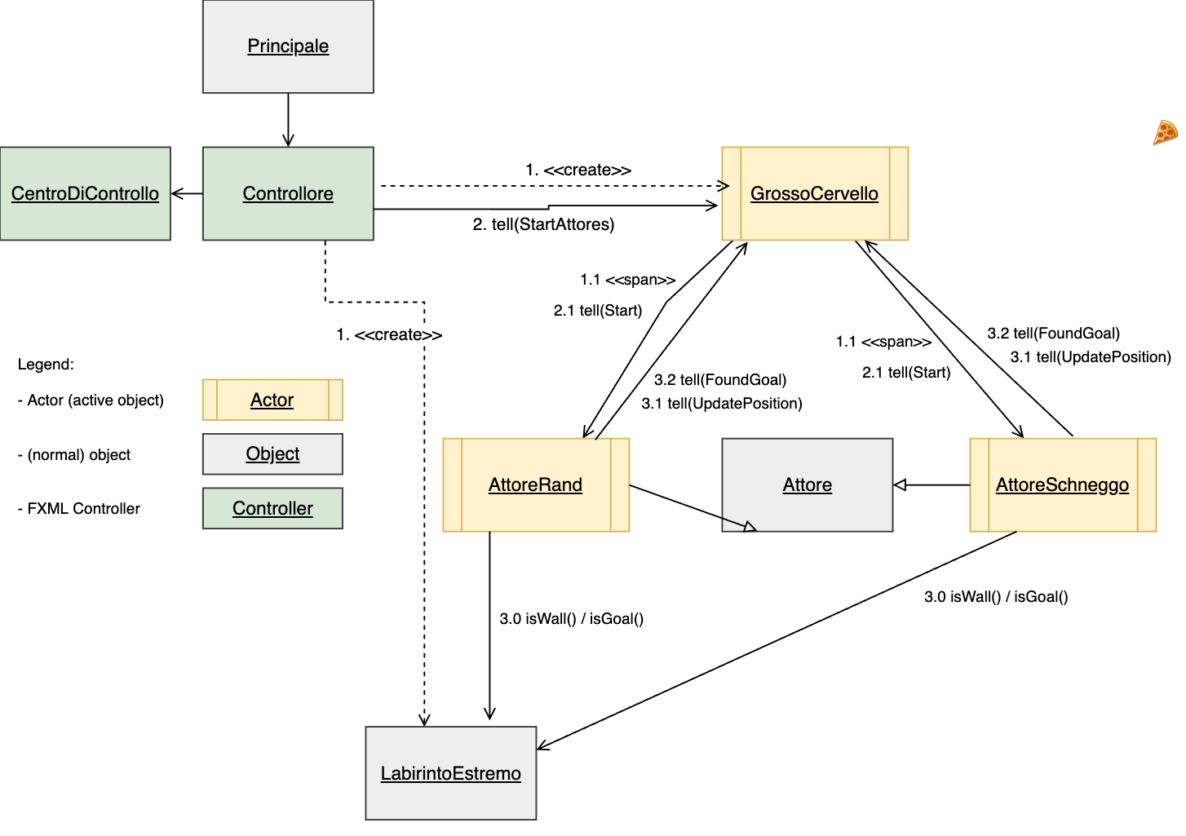
Sequence Diagram

Slide 5

GrossoCervello
Starts Actors
Gives actors a reference to itself and LabirintoEstremo
Receives updates of actors when they make a move
Receives message from actors when they found the goal

Slide 6

AttoreRand
Chooses moves randomly
Sends chosen move to GrossoCervello
Sends position of goal to GrossoCervello if found

Slide 7

AttoreSchneggo
Has ist own empty labyrinth field
Remembers previous paths
Can go back to previous move if no move is found
Sends chosen move to GrossoCervello
Sends position of goal to GrossoCervello if found

Slide 8
FXML GUI
the main-class (Principale) starts a stage with the main controller Controllore -> this is the representation of the LabirintoEstremo
Additionally a second controller CentroDiControllo with control buttons is started
after each movement, the Attores tell the GrossoCervello there new position. GrossoCervello calls then a update-Function in the main-controller, which reloads the GUI

Slide 9
GitFlow & Application
DEMO

Slide 10
Conclusion

Slide 11




Learnings
don‘t fear git rebase anymore
can write any sort of algorithm
understands now threads & akka
is now FXML pro

Slide 12
GRAZIE!
Do you have any questions?

