Slide 1
The Gang of Four (GoF) Design Patterns in Perl
The Abstract Factory Pattern

Slide 2
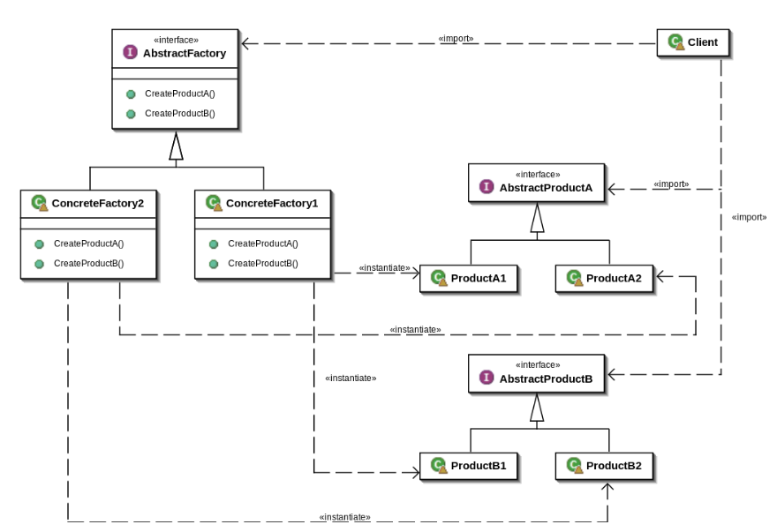
Class Diagram for Abstract Factory Pattern
No interfaces in Perl, use abstract classes instead
How to use Abstract Factory
Create a factory ($factory)
Instantiate an instance of that factory (ie ConcreteFactory2, $LinuxFactory}
Create “products” {$LinuxButton}
UML diagram from
https://en.wikibooks.org/wiki/Computer_Science_Design_Patterns/Abstract_Factory

Slide 3
Using TDD to create Abstract Factory pattern
Create a base test script (t/Abs1.t)
Create your module script (lib/Abs1.pm)
Create your abstract Factory (AbstractFactory)
Create your concrete Factories (LinuxFactory, WindowsFactory, MacFactory) to inherit from AbstractFactory
Create Abstract products and their associated methods
Create the concrete product classes to inherit from the abstract product class.
Test each method of each concrete class.

Slide 4
What is TDD?
TDD, Test Driven Development, is testing your program before, during and after writing it.
Write the test first, which of course fails, as the code does exist
Write just enough code to pass the test.
Refactor this code so that it passes this and all tests. Only write enough to support the tests.
Add more tests for edge cases.
Repeat, repeat, repeat until the program or module is completed.

Slide 5
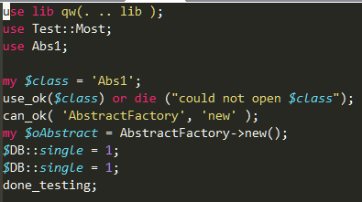
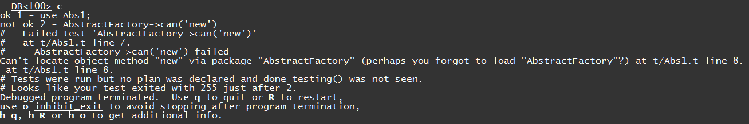
Getting started
Create a file called t/Abs1.t
Open your debugger in another window
Create all the class stubs and run inside the debugger
Open your debugger in another window
Run your script inside the debugger with perl –d t/Abs1.t
Voila … a lot of noise just to say there is no code. Remember, TDD … “tests before code!”

Slide 6
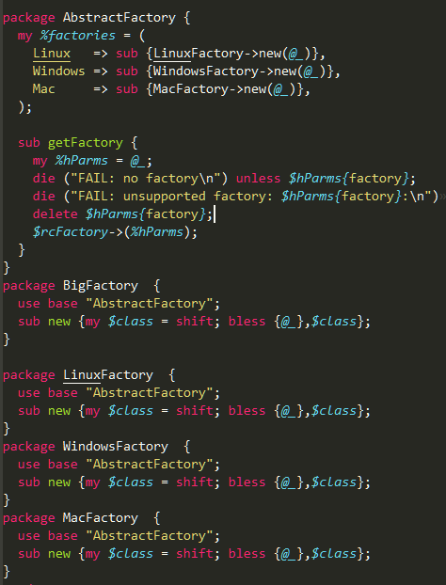
Next Steps, write stubs and test code
We go straight to a dispatch table and bypass the if ladder (just like the previous Factory pattern).
These will be concrete classes for AbstractFactory.
These are concrete’s for each major “Family” of objects

Slide 7
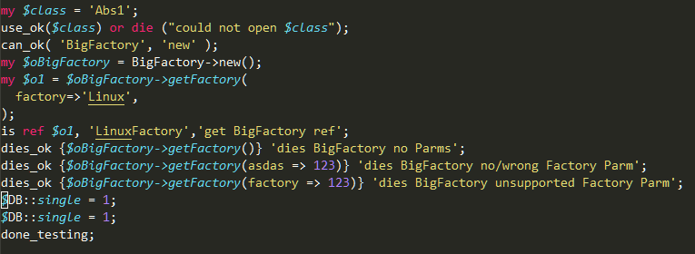
The supporting test code
Verify we can instantiate a LinuxFactory
Test edge conditions

Slide 8
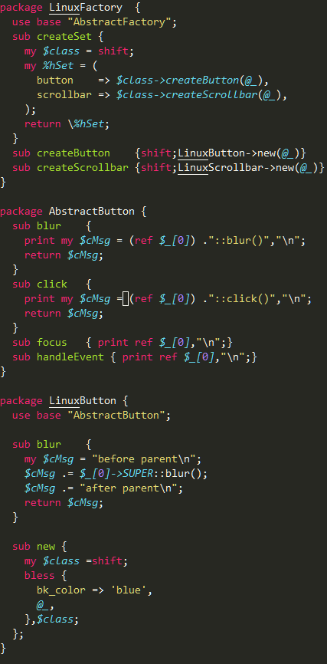
Add some products to the LinuxFactory
Create another AbstractClass LinuxFactory. Have methods to create individual products as well as collections of products, createSet()
Create an another abstract class for each product. Setup blur() and click() to return values…We want those for testing
LinuxButton Concrete Class for AbstractButton. Notice blur() overrides the parent but usercode can run before, during and after the original parent method. Notice the constructor adds a default “bk_color” property.

Slide 9
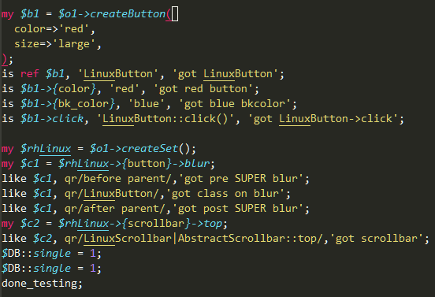
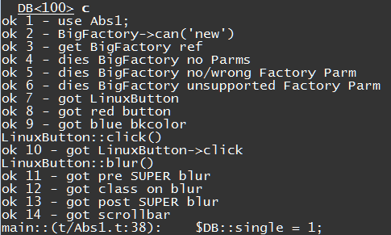
Update your tests for the button class
Instantiate button from factory $o1. Test attributes and method returns
Test the createSet(). Verify the pre and post method modifiers.
Debugger output from complete version of test script

Slide 10
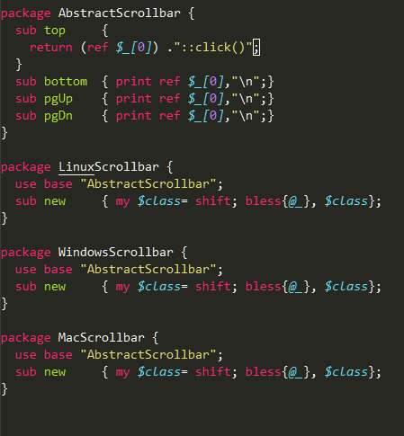
Add the Scrollbar abstract product and concrete classes
Create AbstractClass AbstractScrollbar.
Create some methods for testing
Create classes for each of the product families

Slide 11
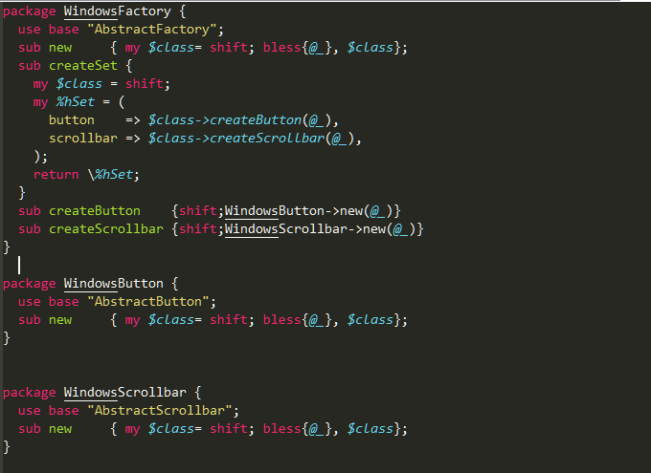
Create concrete Factory classes for Windows and Mac
Create Concrete Class WindowsFactory. For the most part you can cut’n’paste the LinuxFactory and replace all ‘Linux” with “Windows”. Just remember, cut’n’paste is considered by many to a code smell and is the source of many bugs… You have been warned!

Slide 12
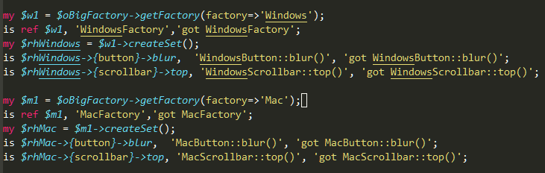
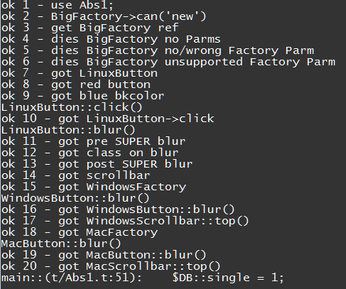
Update your tests for the Windows and Mac class
Each of the Windows and Mac classes are instantiated and tested. Careful cut’n’paste from the Linux classes will serve you well!
Debugger output from complete version of test script

Slide 13
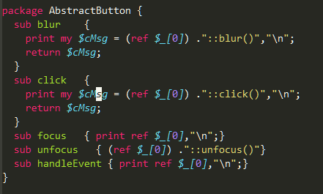

How well does this pattern handle change? Adding a method to an existing class
1. We add the unfocus() method to the AbstractButton class
3. Run test script and verify the output
2. Add the test code to the test script

Slide 14
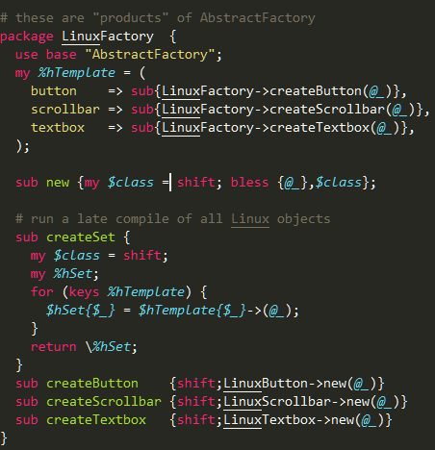
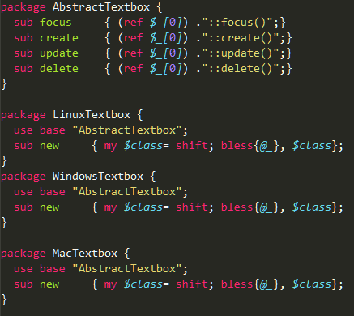
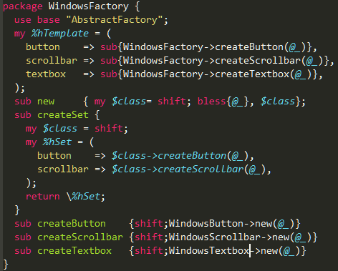
How well does this pattern handle change? Adding a textbox class for each factory
1. Create an AbstractTextBox class and add concrete stubs for each factory
2. Refactor each of the factories to separate data from code. Update createSet() for each factory with some mindful cut’n’paste. Now, you can add methods without touching existing code. Remember to update the test script.

Slide 15
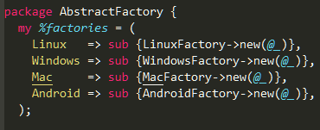
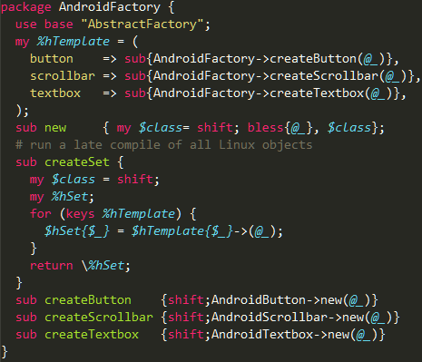


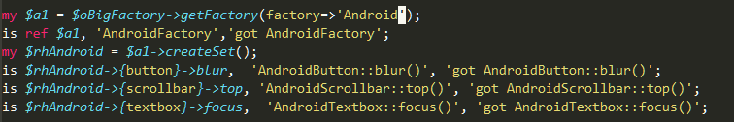
How well does this pattern handle change? Finally, Adding a new concrete Factory, Android
1.Add a new entry into %AbstractFactory::factories
2.Create a new concrete AndroidFactory
3. Create android specific concrete products
4. Update test script and verify

Slide 16
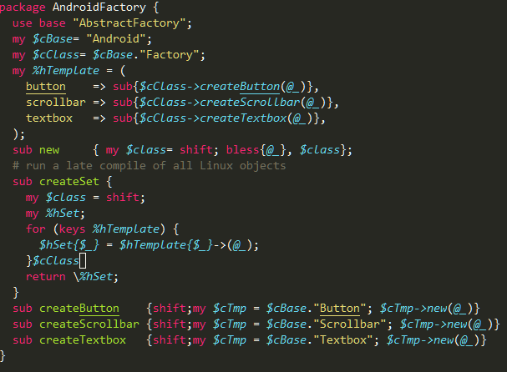
Refactoring AndroidFactory
Create a private var $cBase and build all class def’s from that. Only have to change this line when copying this class for the next factory. Of course, repeat this refactor for each concrete factory.
The beauty of this and TDD is you can make these changes and be confident if the tests pass, your changes worked and you can move on to the next fire.

Slide 17
Summary
Abstract Factory is useful to create individual concrete objects or suites of concrete objects based on their behavior and not their concrete instances
This pattern also honors all of the SOLID design principles. These principles are nicely summarized at https://stackify.com/solid-design-principles/
All code can be found https://github.com/janman27929/OOP_perl

