Slide 1
The Gang of Four (Gof) Design Patterns in Perl
The Factory Pattern

Slide 2
What is the Builder pattern
Builder pattern builds a complex object using simple objects and using a step by step approach. This type of design pattern comes under creational pattern as this pattern provides one of the best ways to create an object.
A Builder class builds the final object step by step. This builder is independent of other objects.
Note: pulled from https://www.tutorialspoint.com/design_pattern/builder_pattern.htm

Slide 3
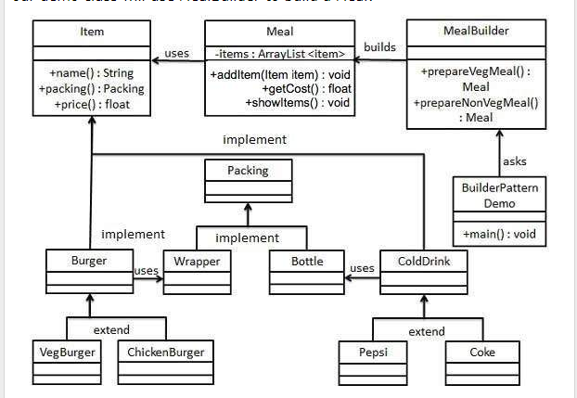
Note: pulled from https://www.tutorialspoint.com/design_pattern/builder_pattern.htm
The Builder Class Diagram

Slide 4
Background of OOP on Perl
Many of the OOP (Object Orintated Programming) examples we see use Java or C++ for their examples.
My goal it to show not just that it can be done in Perl but that it is also easier to use.
I hope to emphasize how flexible a Perl solution can be by introducing changes in many areas of the application.
I invite anyone to show the same changes in Java or C++ and we can do a head to head comparison.

Slide 5
Using Design Patterns
Design Patterns need to be selected before you start coding

Slide 6
Note: pulled from https://www.tutorialspoint.com/design_pattern/builder_pattern.htm
The Builder UML

