Slide 1
The Gang of Four (GoF) Design Patterns in Perl
The Factory Pattern

Slide 2
What is the Factory pattern
Factory pattern is one of the most used design patterns in Java. This type of design pattern comes under creational pattern as this pattern provides one of the best ways to create an object.
In Factory pattern, we create object without exposing the creation logic to the client and refer to newly created object using a common interface.
Note: This definition pulled from https://www.tutorialspoint.com/design_pattern/factory_pattern.htm

Slide 3
Implementation
We're going to create a Shape interface and concrete classes implementing the Shape interface. A factory class ShapeFactory is defined as a next step.
FactoryPatternDemo, our demo class will use ShapeFactory to get a Shapeobject. It will pass information (CIRCLE / RECTANGLE / SQUARE) to ShapeFactory to get the type of object it needs.

Slide 4
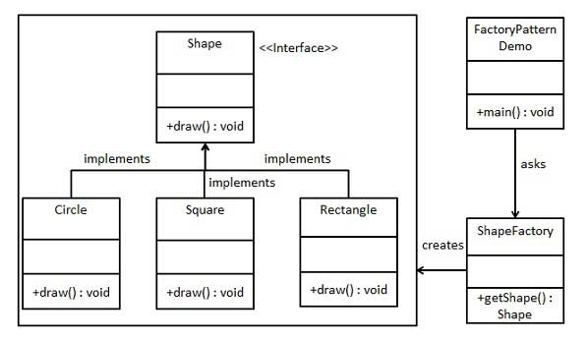
Class Diagram for Factory Pattern
No interfaces in Perl, use abstract classes instead
These are concrete classes

Slide 5
Steps to create Factory pattern
Create you driver script
Create your abstract class(s)
Create your concrete class(s)
Create the Factory class to instantiate selected concrete class
Test each method of each concrete class

Slide 6
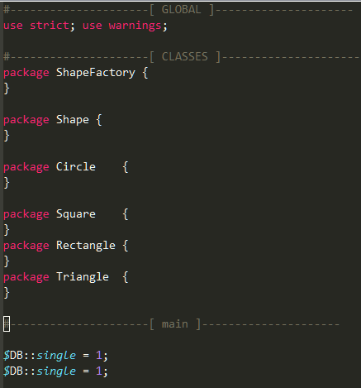
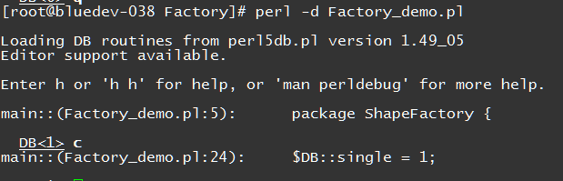
The first run
Create a file called Factory_demo.pl
Open your debugger in another window
Create all the class stubs and run inside the debugger
Open your debugger in another window
Run your script inside the debugger ..no errors! ..wooHoo

Slide 7
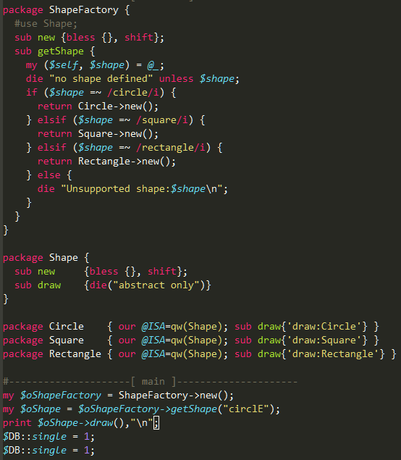
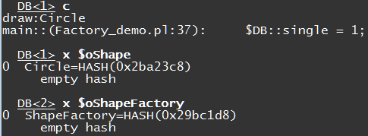
Building it out
Use R and c to reset and rerun your script. Note the type of $oShapeFactory and $oShape
Add an “if ladder” to create the desired object. We will refactor this later… let’s get it working first!
Note arrows in class diagram. Outbound arrows indicate inheritance (our @ISA) or inbound arrows for use. Currently, all the classes are in the same file, so they are in the symbol table and so they can be “used” directly.
Note Factory instantiation.
Note Shape instantiation and calling the draw method

Slide 8
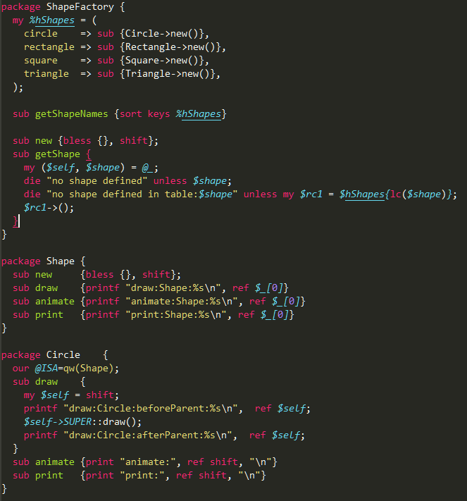
Refactoring
Always a good idea to separate data from code.
Further, encapsulate the data and only divulge whats needed
We can add as much data as we like and the code won’t change
Here we add functionality without modifying existing code..just cut’n’paste …mindfully!
This is an example calling the parent method and wrapping code before and after the parent method call.
Left these methods in..could easily just use the inherited methods too

Slide 9
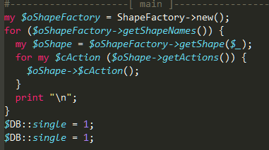
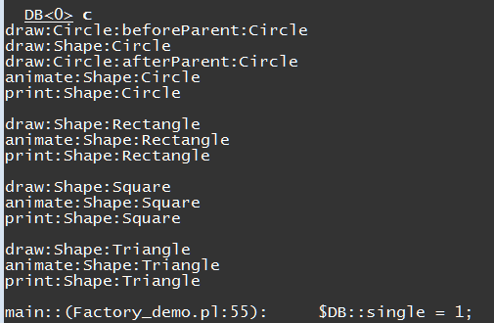
Refactoring – the driver section
Clean up the code. Call up hi level method of each “factory”. Just ‘cuz u can touch the details, doesn’t mean you should!
Rerun in the debugger, verify the output for all Shapes and Actions

Slide 10
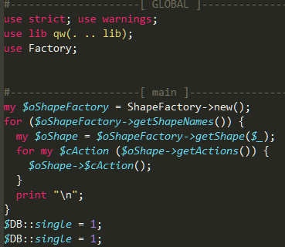
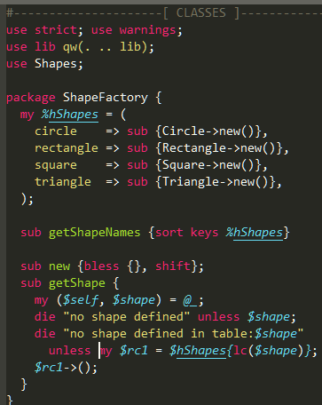
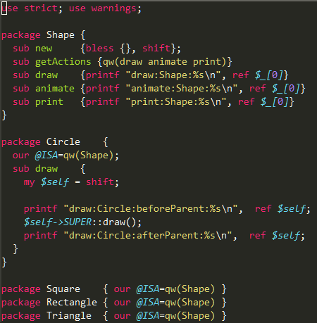
Putting this into Production
Edit Factory.pl
-Move all of classes and save to lib/Factory.pm.
-Update your lib path to include “lib”
-Run in the debugger to verify
lib/Factory.pm
Dump all classes except ShapeFactory to lib/Shapes.pm… use Shapes
Update your lib path and verify
lib/Shapes.pm
end of the chain …you are good to go .. No more modifications
Verify

Slide 11
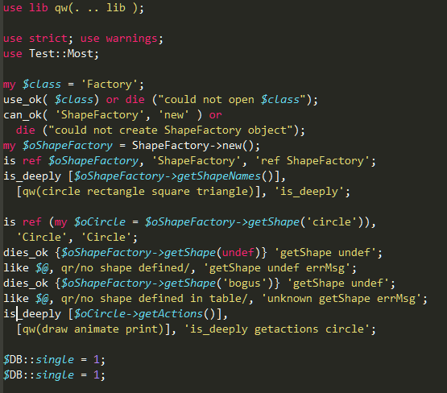
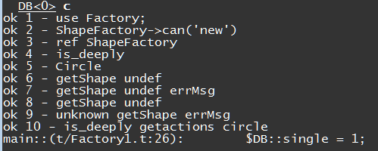
Trust but Verify – Testing your Code
Create a file t/Factory1.t
These are many of the test commands you will commonly use… there are many more. You will use 20% of the commands 80% of the time.. Plan accordingly!
This is output from perl –d t/Factory.t
This is from prove. Useful when you have many test files and want to run them all.

Slide 12
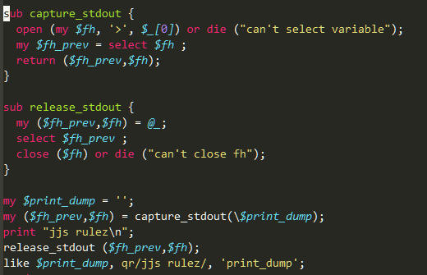
Trust but Verify – Testing your Code – Part 2
This is why you should not print messages inside your objects. These are the kinds of hoops you have to go thru to test STDOUT printing.
You are far better off returning a string and testing that. You can print that string inside the method, if you must!

Slide 13
Want the code ?
Search “OOP on Perl” in Youtube… this will be updated shortly… sorry,,, Building the plane while I am flying it!
This just in ..the YouTube link… https://youtu.be/t-IP5EtMa8A .. Woohoo, my first youtube!
I will be dumping all of the modules here including pptx, lib/ and t/ files
https://github.com/janman27929/OOP_perl
Should be able to dump to your favourite dir and hack away
Hurry Hurry, subscribe now and get in at the ground floor!
Please email me at janman27929@gmail.com if you have any questions.

