Slide 1

Surface quality prediction for FDM-printed parts using in-process material flow data
Jan Mayerª, Tra Bui Thi Thanhª , Turgut Caglarª , Hendrik Schulzª , Omar Ben Lallahomª , Dongxu Liª , Max Niemellaª , Burak Toptasª , Roland Jochemª
ªChair of Quality Science, Technical University of Berlin, Berlin, 10587, Berlin, Germany

Slide 2
Agenda
Initial situation and objectives
Methodology and experimental set-up
Results
Conclusion and outlook

Slide 3
Initial situation and objectives
Reproducability is a big issue in additive manufacturing
Holding a constant quality status is hard in 3D-printing
Micro factories have less connected and „smart“ equipment
Easy-to-use sensors must be involved
Overall:
Pre-controlling the process based on quality criteria is key for effectiveness

Slide 4
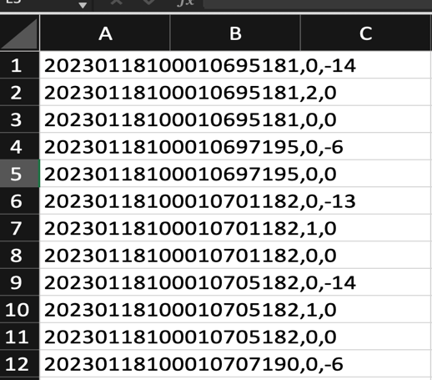
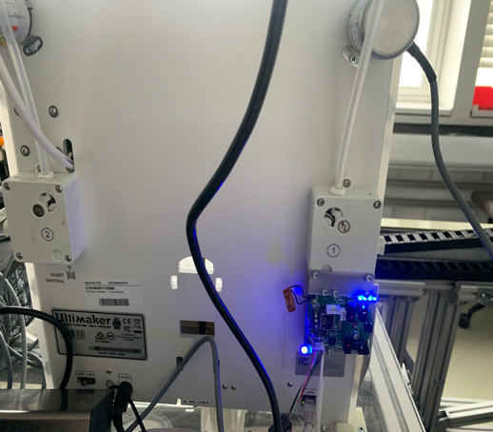
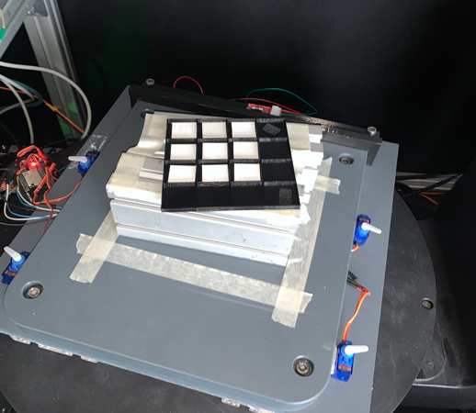
Initial situation and objectives
Use of low cost filament flow sensor to describe the dependency of filament flow and predicted surface quality
Fig.1: Raw filament flow
Fig. 2: Filament flow Sensor
Fig. 3: Scan of printed parts

Slide 5
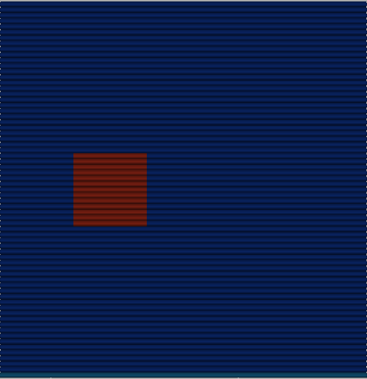
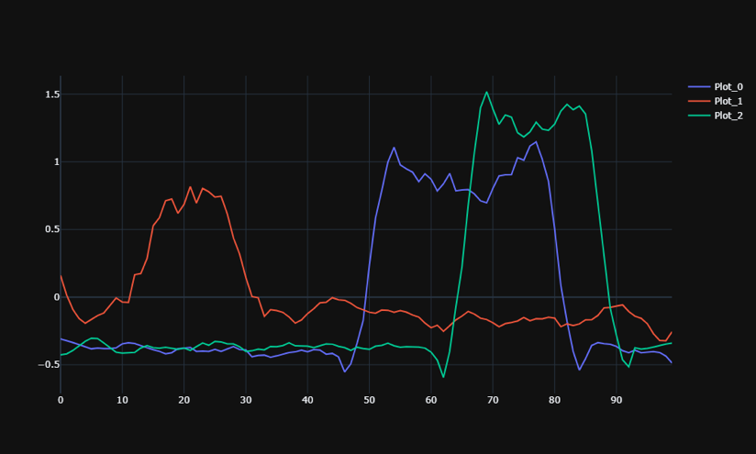


Methodology and experimental set-up
Analysis of filament flow with artificially made over extrusion
Data pre-processing with part mapped flow data
0.2
0.4
0.6
0.4
Fig. 4: Over extrusion with several factors
Fig. 5: Flow data processing

Slide 6
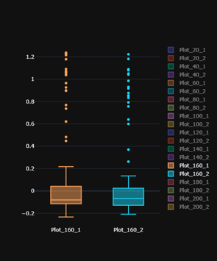
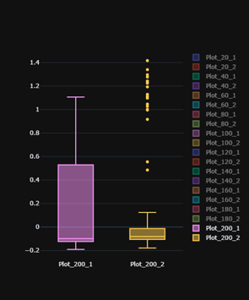
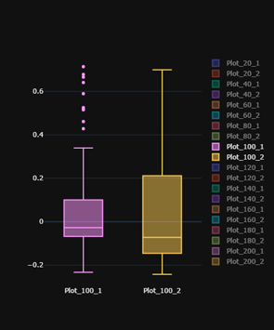
Methodology and experimental set-up
Analysis of filament flow with artificially made over extrusion
Results vary quite a lot indicates certain patterns for different flow rates
Fig. 6: Over extrusion 160 %
Fig. 7: Over extrusion 200 %
Fig. 8: Over extrusion 100 %

Slide 7
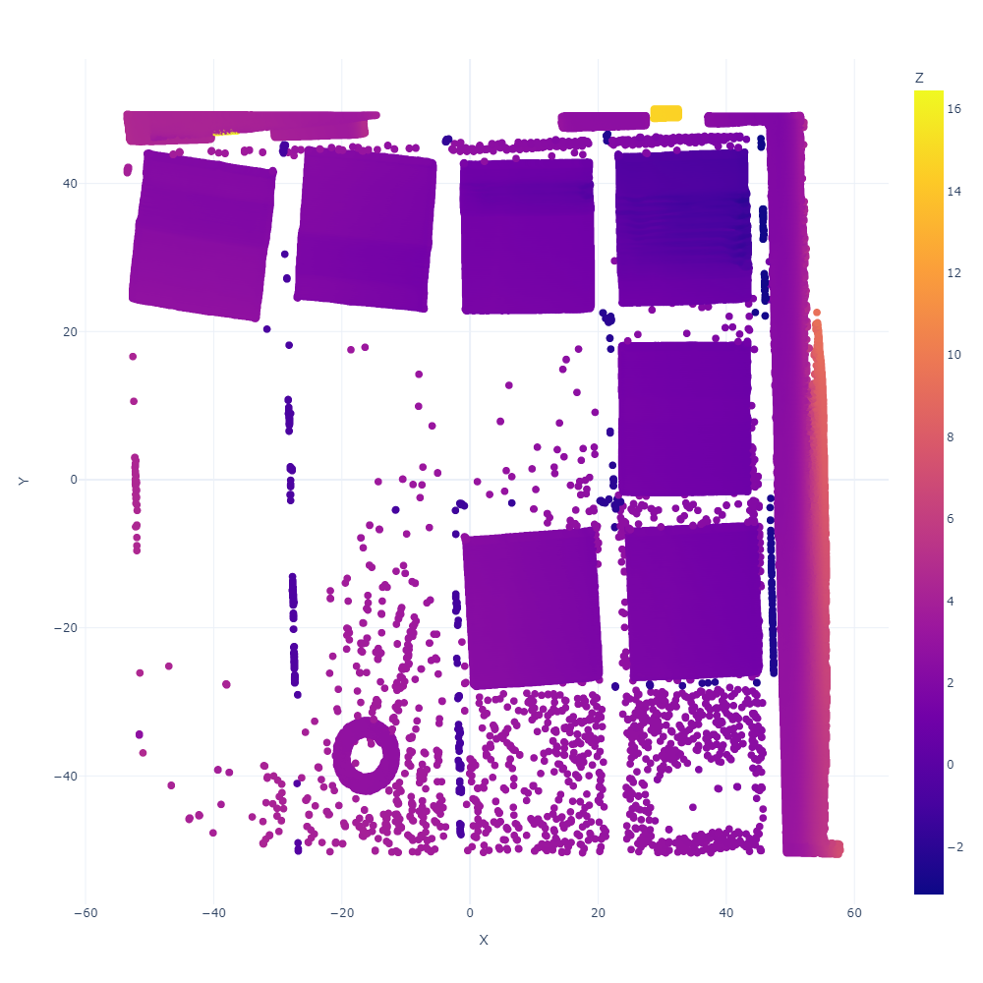
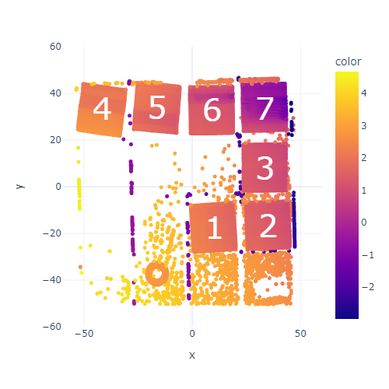
Methodology and experimental set-up
Scan, create point cloud and calcute deviation
In order to create data for each individual work piece, a scan file is processed to identify each printed part and afterwards normalized
Fig. 9: Scan of printed parts
Fig. 10: Create point cloud
Fig. 11: Identify and normlize work pieces

Slide 8
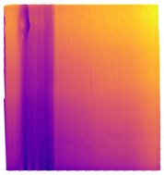
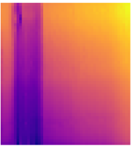
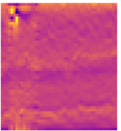

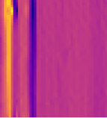
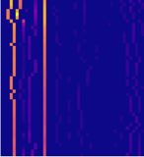
Methodology and experimental set-up
Scan, create point cloud and calcute deviation
Every identified work piece is then further processed to locate the occured failure
aggregate
filter
Max-Pool
sum
Max values
[y1 y2 y3 y4 y5 y6 … ]
[max1, max2]
[x1 x2 x3 x4 x5 x6 … ]
[max1, max2]
Fig. 12: Failure detection processing

Slide 9
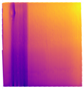
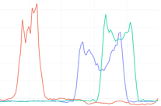

Methodology and experimental set-up
Usage of Machine Learning to generate accurate forecasts
LSTM, SVR and Linear Regression have both high accuracy and benefits in time series data
Prediction of labels
Training with labelled data

Slide 10





Results
G-Code Modifier
Surface quality can be well described by filament flow
Only 73 data points were enough to create accurate forecasts
LR and SVR achieve a RMSE of 0.1
LSTM achieves an RMSE of 0.12
G-Code
3D-Wall
Filament flow
Model
3D point cloud
Flow Analysis
Scan Analysis
Model data

Slide 11
Conclusion and outlook
Factors such as inconsistent data quality, limited extrusion range, and data acquisition time affected the prediction model's performance.
The model's average deviation accuracy of 10% indicates potential, but inherent inaccuracies necessitate further improvements.
Improvements to the prediction model are essential to reduce inaccuracy and increase reliability in predicting surface quality.
The developed application simplifies the surface quality prediction process, and can significantly benefit from additional data.

Slide 12
Surface quality prediction for FDM-printed parts using in-process material flow data
Jan Mayerª, Tra Bui Thi Thanhª , Turgut Caglarª , Hendrik Schulzª , Omar Ben Lallahomª , Dongxu Liª , Max Niemellaª , Burak Toptasª , Roland Jochemª
ªChair of Quality Science, Technical University of Berlin, Berlin, 10587, Berlin, Germany

