Slide 1
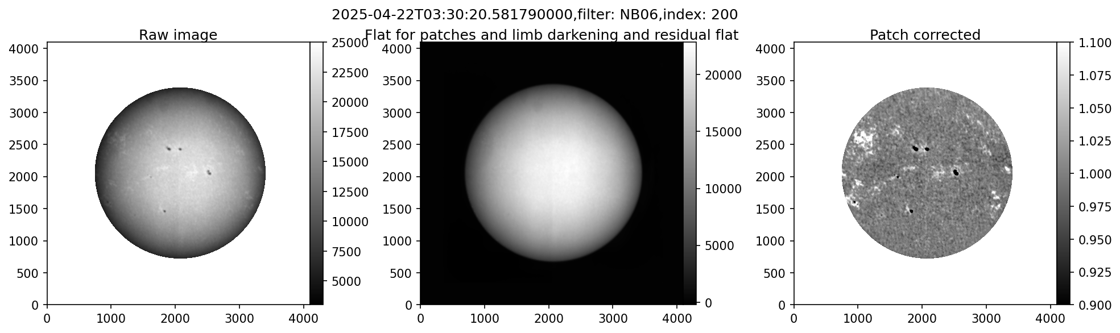
Patch and large scale correction
Purpose: SUIT Level 2 corrected data has some remnant contaminant (esp large patches), limb darkening and assymmetric scattered light remnant.
Images are aligned based on solar limb.
Median stacked image is blurred to preserve large patches and remove solar features.

Slide 2
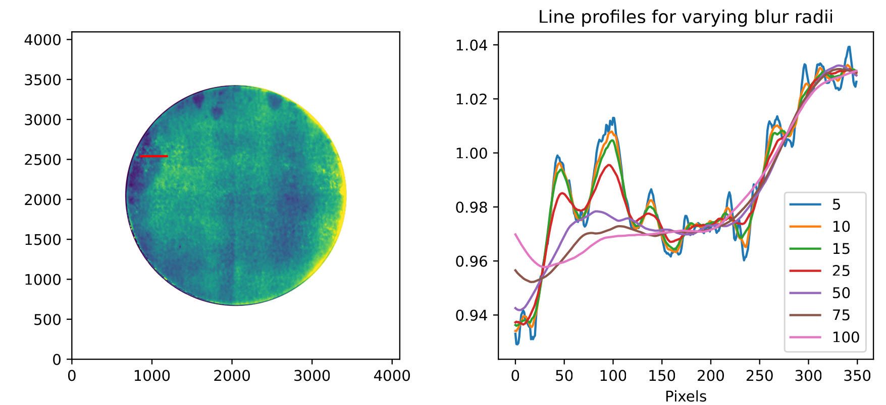
Purpose: Find optimal blur radius to remove solar features from calib frame- 50-75 px seems most optimal.

Slide 3
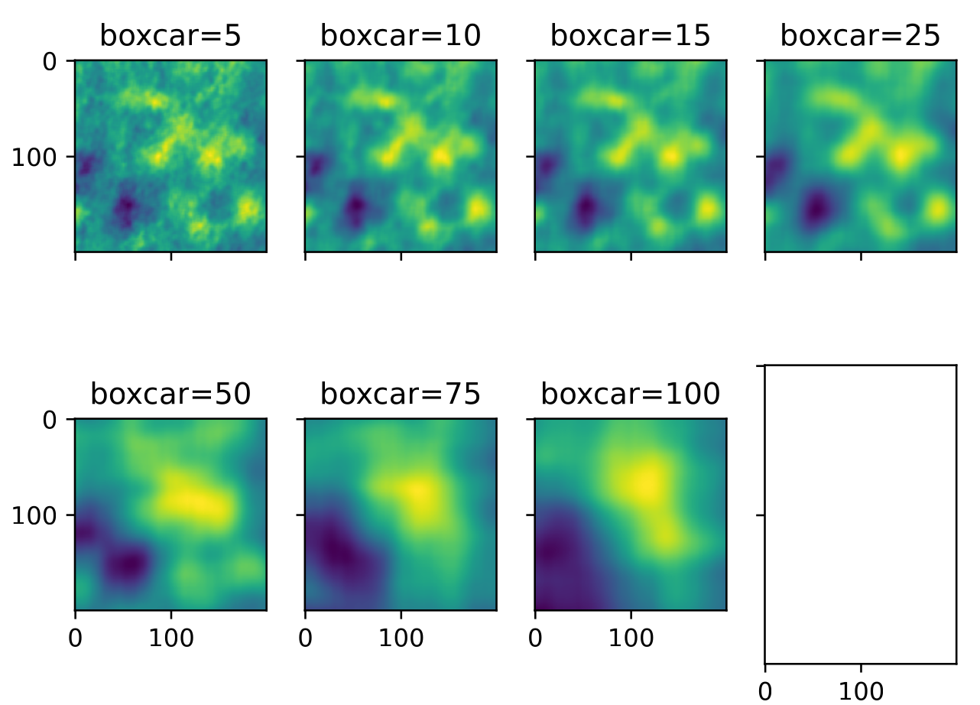
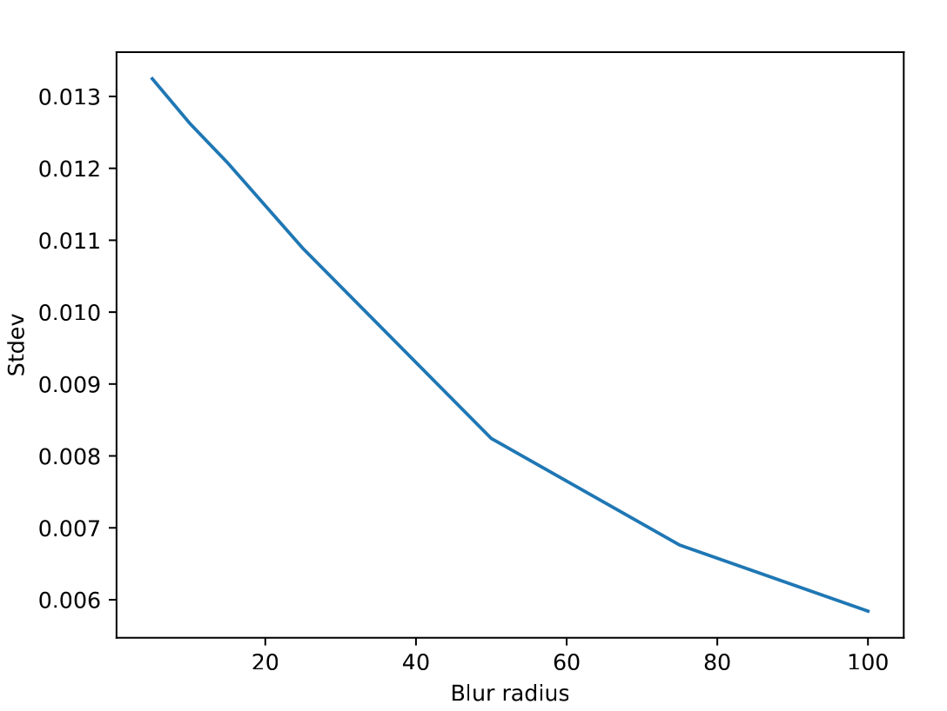
Standard deviation within a box at different levels of blurring

Slide 4
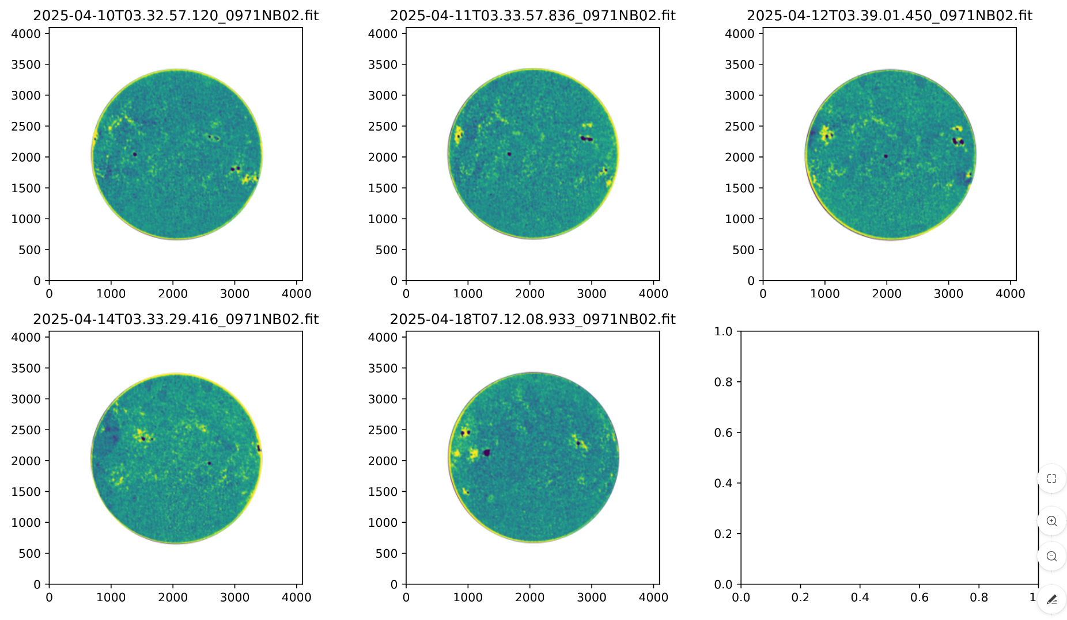
NB02
2026-07-29
Observations available for 2025-04-10,11,12,14,18
Big patches are visible whenever continuous observations are not available.
Some small scale contaminants are seen still.

Slide 5
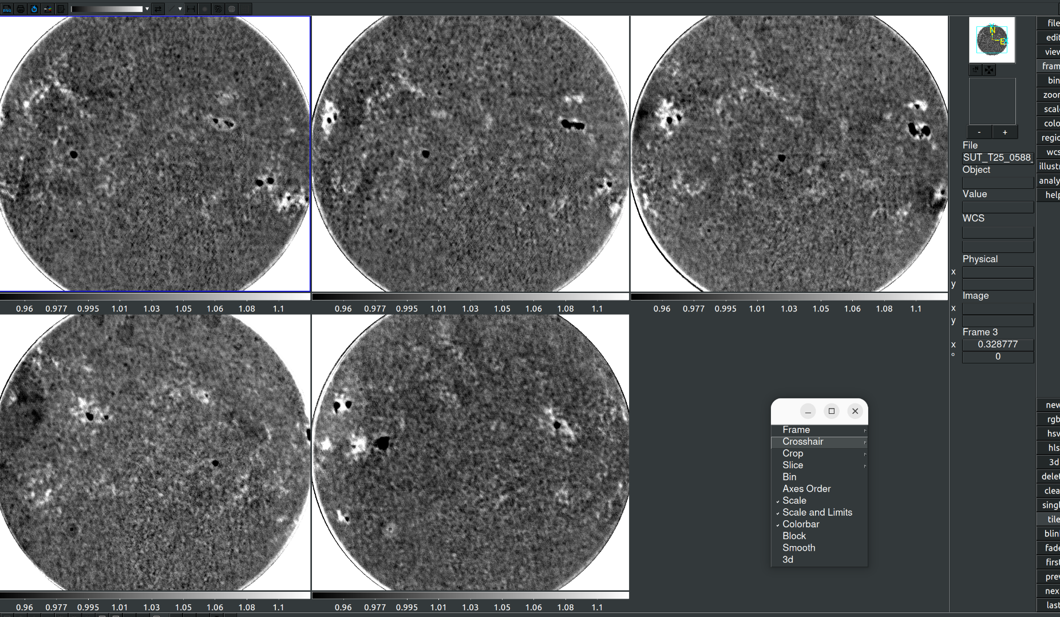
NB02: Same date range

Slide 6
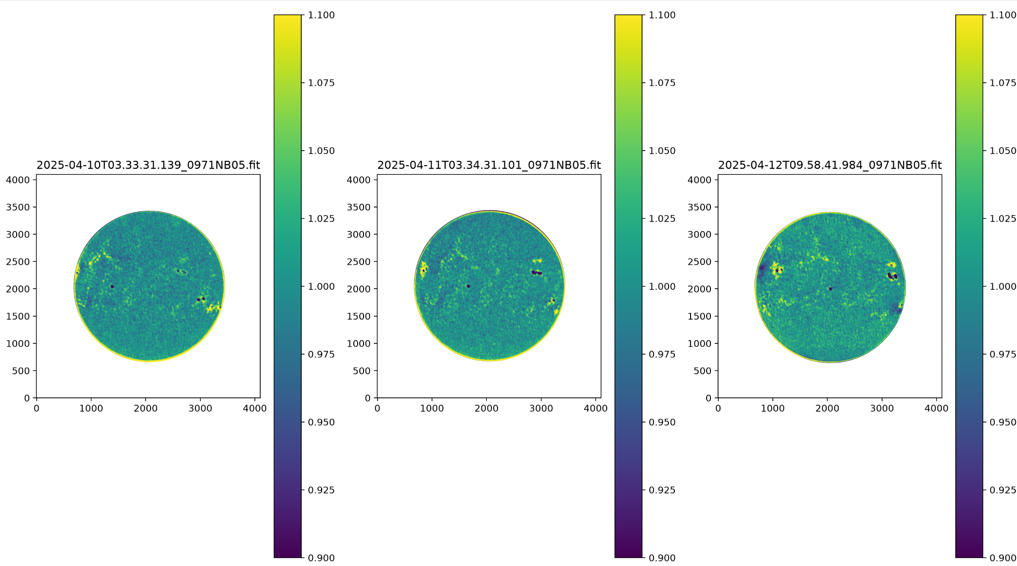
NB05
Larger patches are less prominent.
Small scale contaminants are seen in some places.

Slide 7
Issues faced and possible solutions
Larger patches are less prominent.
Small scale contaminants are seen in some places.
One reason for this could be that the contamination correction images are being made by aligning the Sun.
But this should not be done. That should help.
Also, the image is blurred by 50px. That too will take away all contaminant patches from the calibration frame.

Slide 8
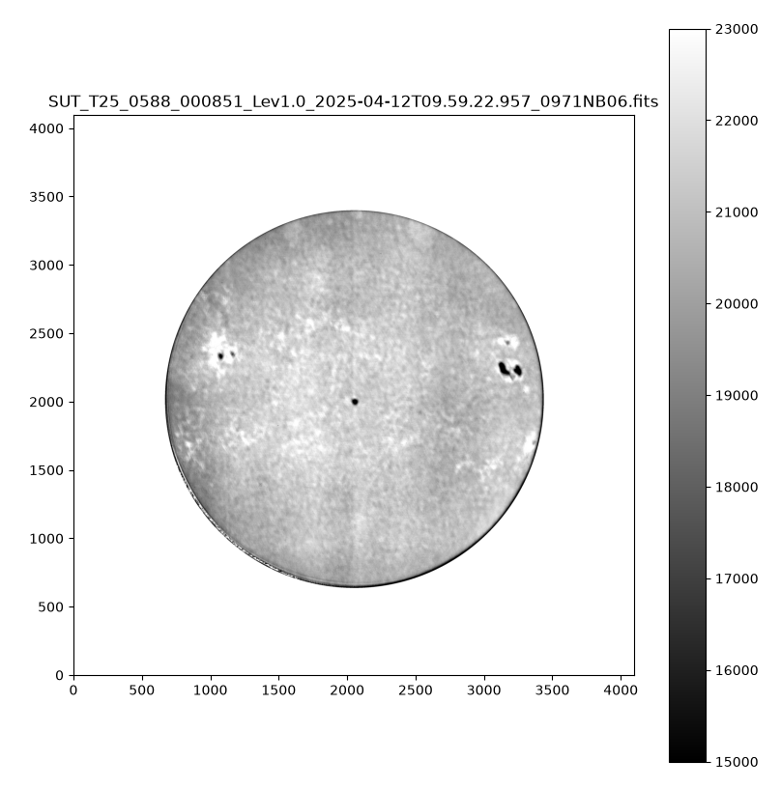
NB06 assymmetry profiles and NB06 limb darkeining profiles from Nived
2026-08-05
A large scale pattern is seen after correction.
This is not a contamination patch.
It has to be corrected from the data.
I_{data}= I_{sun} * I_{patch} * I_{assy} * I_{limbdkr} * I_{excess}
We have to Isolate I_{sun} which has only solar features.
We have to characterize I_{excess} in some way.
I_{patch} to be corrected by JJ
I_{assy}: Flat from Nived
I_{limbdkr}: From Nived

Slide 9
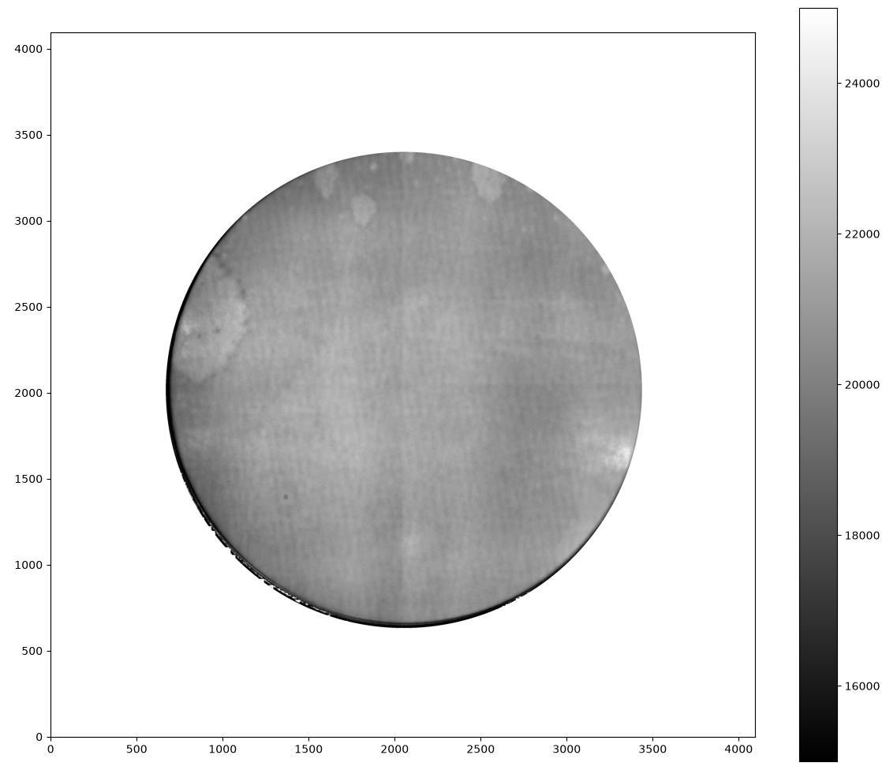
Median stack (NB06)
Median stack (NB06)
All data 10-12 Apr 2025
Limb darkening and large scale assymmetry included

Slide 10
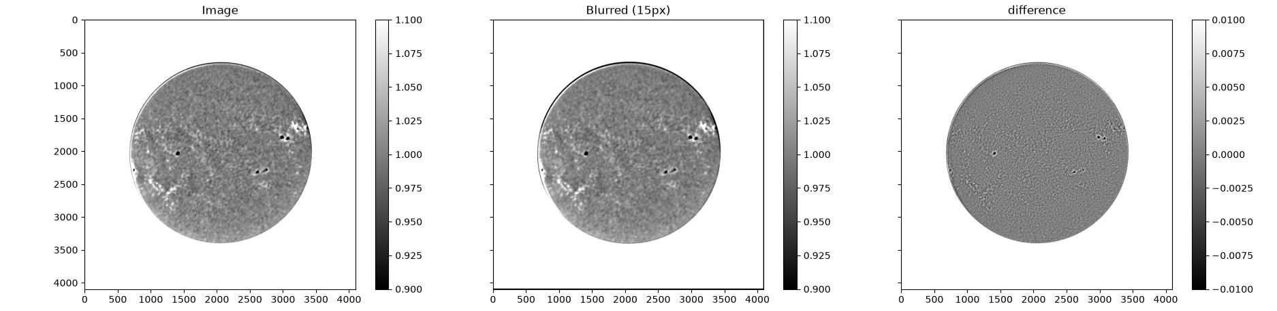
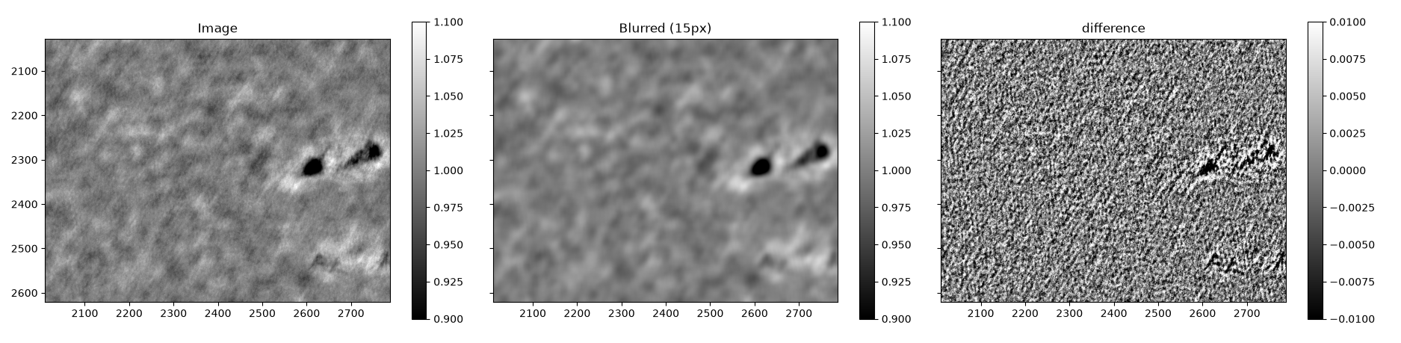
Post limb darkening correction-
Most of the diagonal stripes are gone. Major patches are gone. Small scale artefacts are still visible. Blurring 15px might help.

Slide 11
Solar features in calibration frames
The calibration frames are generated without masking any active regions.
Initial assumption was that the active regions will be covered by sufficient amount of QS.
A bracket of all NB06 images within 3 days are used for the calibration.
On going through the frames rapidly, it is clear that signatures of ARs exist in the calibration file.
Go to slideshow mode to play animation

Slide 12
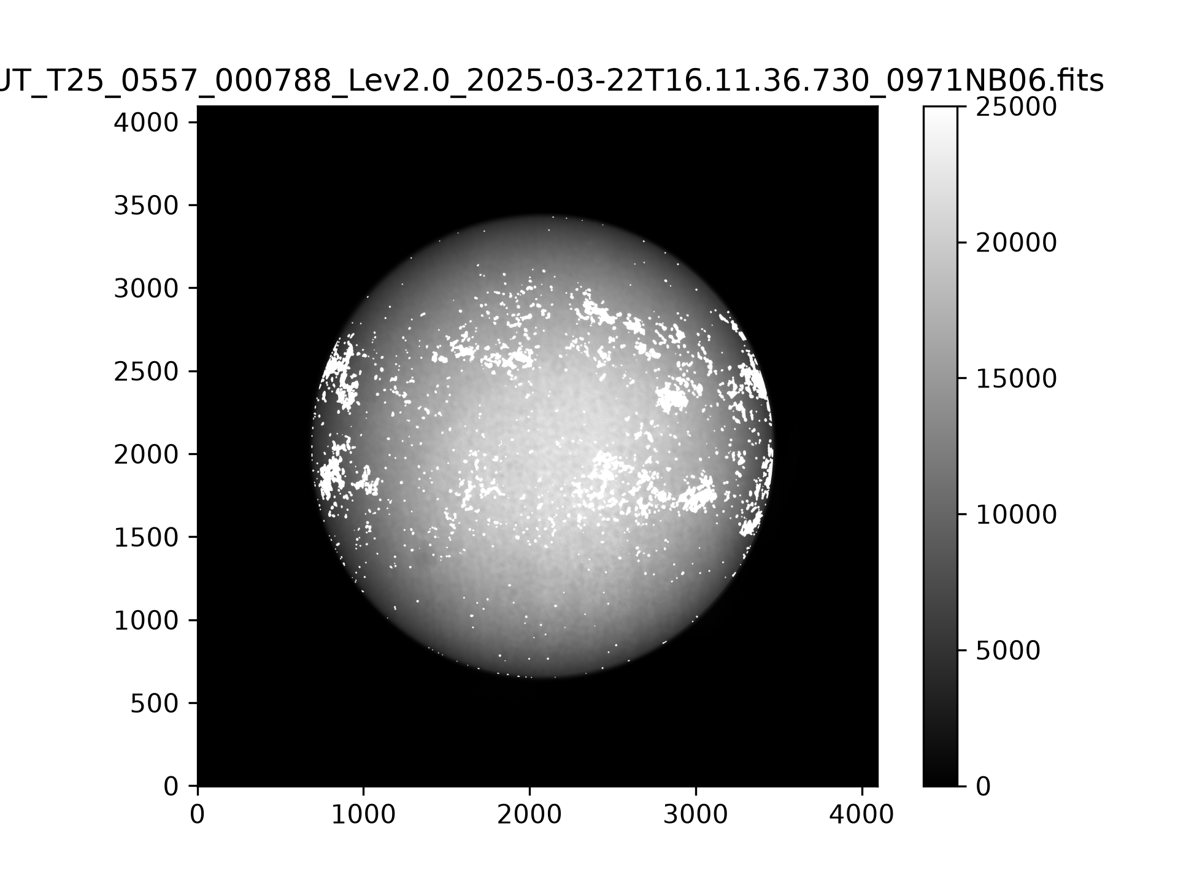
Removing solar features
Noise level for HMI Blos is |B|/mu < 10G
Threshold is set for |B|/mu > 50
HMI BLOS are gaussian blurred to match SUIT resolution.
Masked regions are removed and calib frames are generated.
Calib frame generation for first 2 days is faulty.

Slide 13
Removing solar features
Noise level for HMI Blos is |B| < 10G
Threshold is set for |B| > 50
HMI BLOS are gaussian blurred to match SUIT resolution.
Masked regions are removed and calib frames are generated.
Calib frame generation for first 2 days is faulty.
Go to slideshow mode to play animation

Slide 14
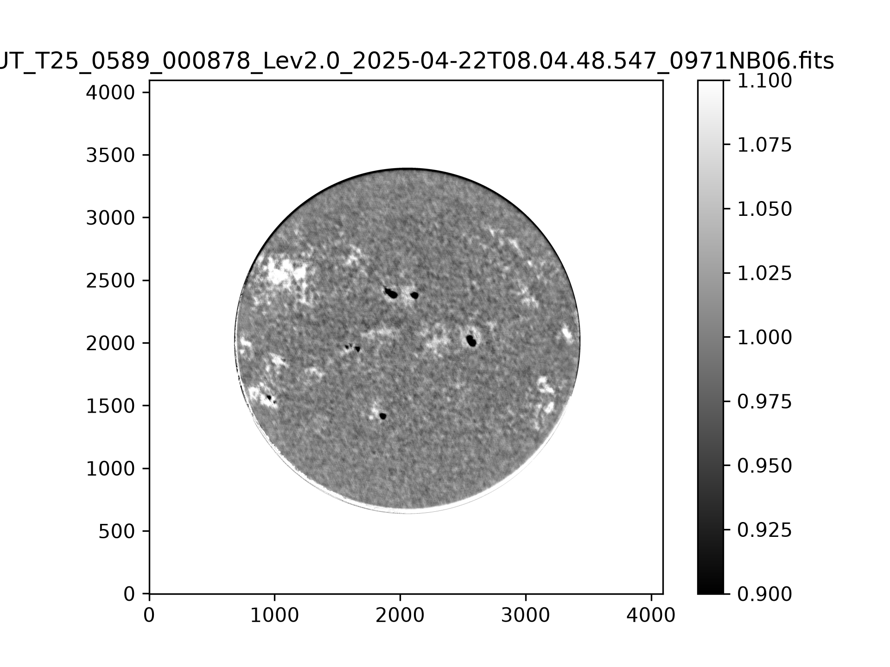
Patches are corrected
Patches are corrected-
Applied Limb darkening correction, and large scale flat correction.

