Slide 1
LED images
Running report compiling results of LED images taken at various settings

Slide 2
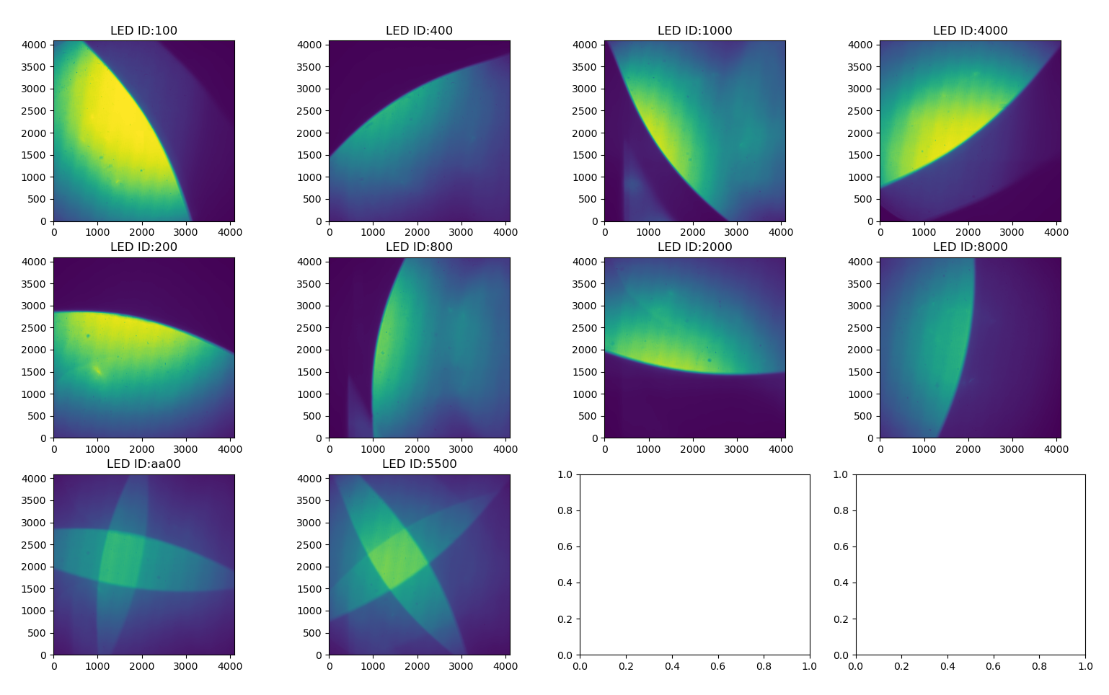
355 nm LED
Shutter Closed
Door Closed
2023-11-23
Level 1 Images

Slide 3
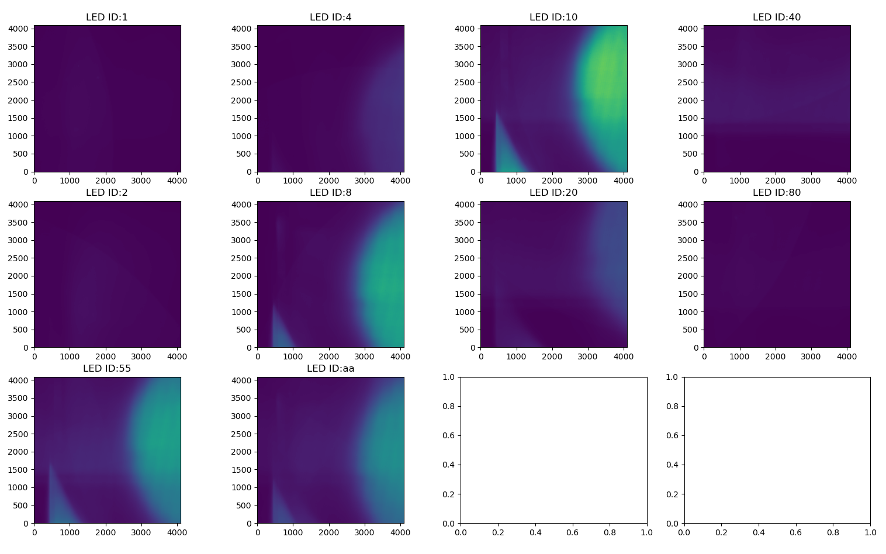
255 nm LED
Shutter Closed
Door Closed
2023-11-23
Level 1 Images

Slide 4

355 nm LED
Shutter Open
Door Closed
2023-11-24
Level 1 Images

Slide 5
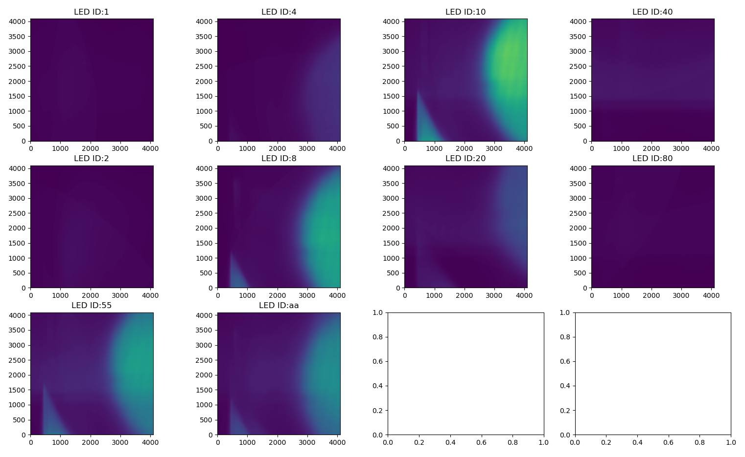
255 nm LED
Shutter Open
Door Closed
2023-11-24
Level 1 Images

Slide 6
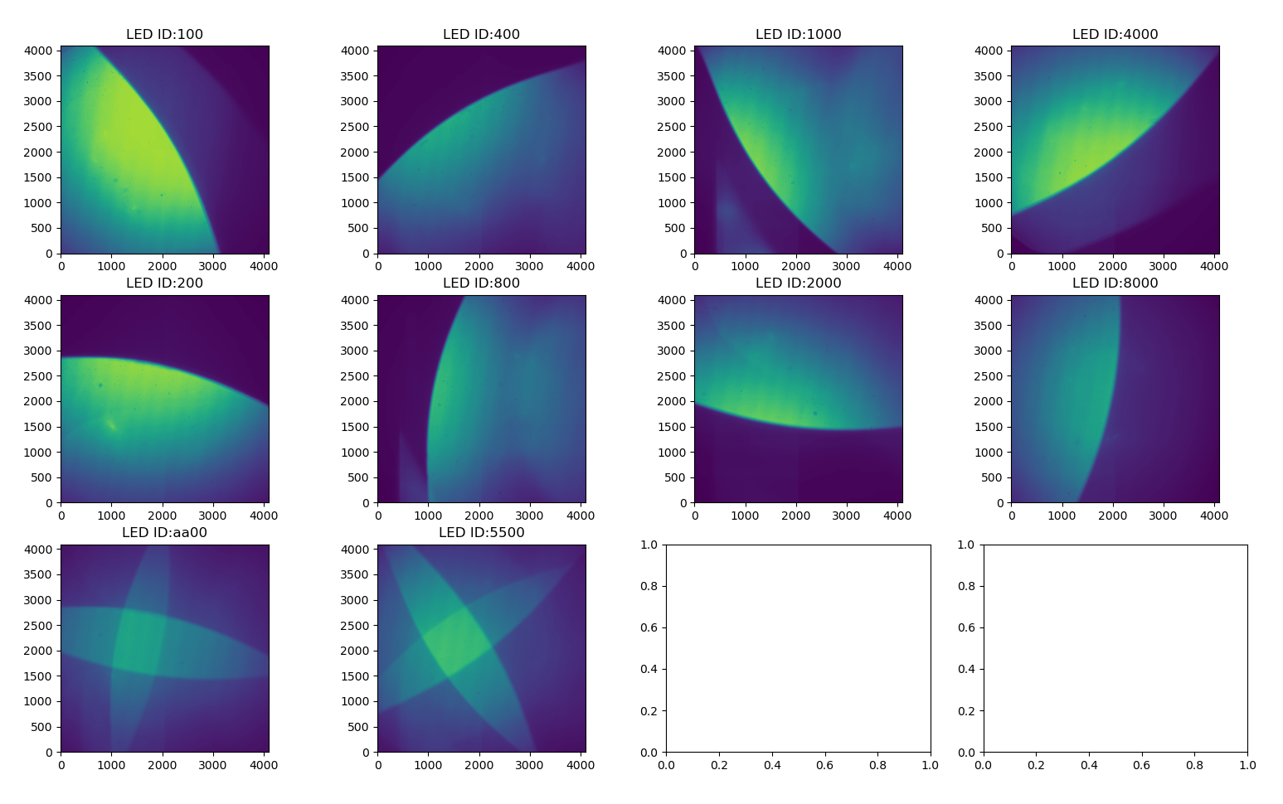
355 nm LED
Shutter Closed
Door Open
2023-12-06
Level 1 Images

Slide 7
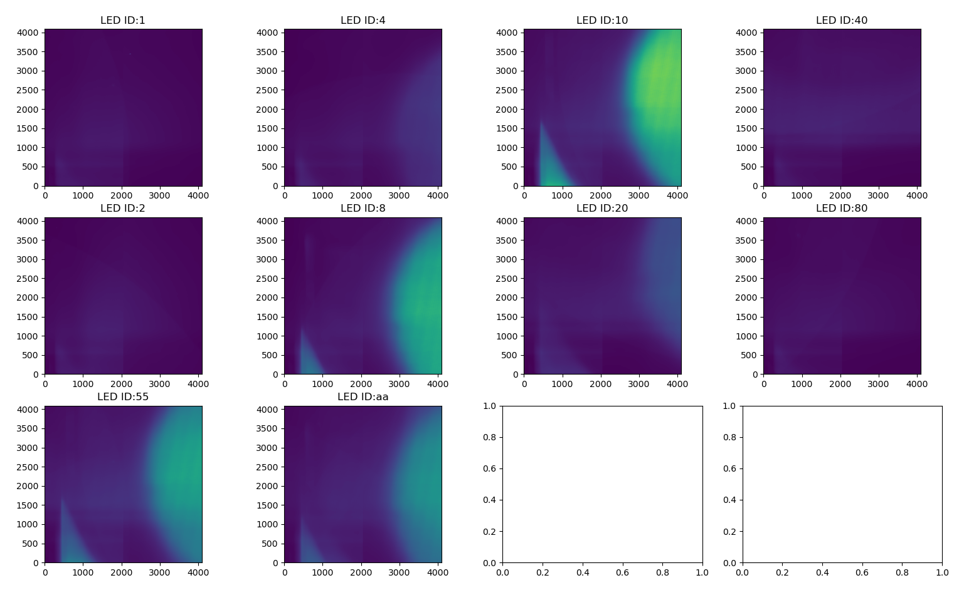
255 nm LED
Shutter Closed
Door Open
2023-12-06
Level 1 Images

Slide 8
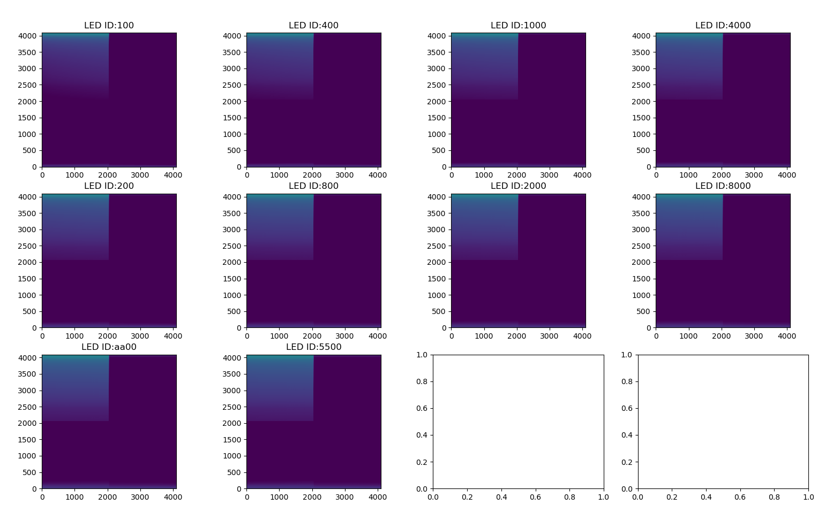
355 nm LED
Shutter Open
Door Open
2023-12-06
Level 1 Images

Slide 9
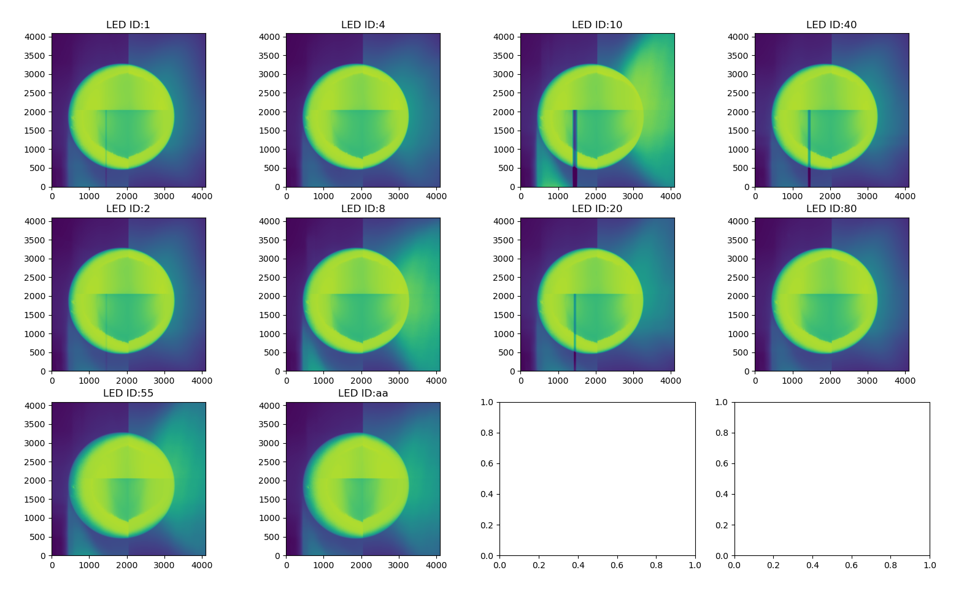
255 nm LED
Shutter Open
Door Open
2023-12-06
Level 1 Images

