Slide 1

The Wellesley Fund: Funding Wellesley’s Critical Needs
Sandy Yeager ‘86, Wellesley Fund Chair
Cameran Mason ‘84, VP for Resources & Public Affairs
Kimberly Hokanson, Director of The Wellesley Fund
Notes:
Sandy
Hello everyone. Thank you all for coming.
My name is Sandy Yeager, Class of 1986, and as the Chair of the Wellesley Fund, I’d like to welcome you to the Alumnae Leadership Council on behalf of the College, the Wellesley Fund Committee, the Office for Resources, and the Wellesley Fund staff.
I’m pleased to be joined by Cameran Mason ’84, the Vice President for Resources and Public Affairs and Kimberly Hokanson, the Director of the Wellesley Fund.

Slide 2
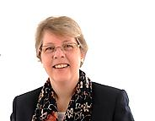
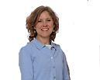
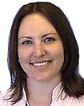
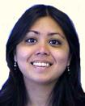
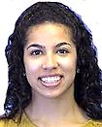
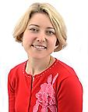

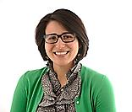


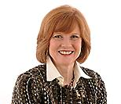
Meet The Wellesley Fund Staff
Kimberly Hokanson
Director
x2328
Kristy Grinder
Assistant Director Friends Marketing
x2872
Kerry Steere
Associate Director
x2329
Rachael Lau ‘08 Assistant Director
x3335
Jessica Telemaque
Assistant Director
x2383
Courtney Greene
Associate Director
x2233
Laura Christian Associate Director
x3366
Emily Randall ’08 Assistant Director
x2234
Barbara Colonna
Administrative Assistant
x2222
Mimi Brinkhaus
Administrative Assistant
x2228
Nancy Brind Administrative Assistant
x2218
Notes:
Sandy
A number of members of the Wellesley Fund staff are here today, as well. Can I ask you all to stand, please?
(TWF Staff in attendance will stand, then be seated again).
Thank you…if you haven’t met your class liaison yet, you will have the opportunity later today or at the Wellesley Fund Office’s “open house” tomorrow morning in Green Hall.

Slide 3
The Role of The Wellesley Fund in Keeping Wellesley Financially Strong
Notes:
SANDY
Our goals this afternoon are threefold: -- to bring you up to speed on the College’s fundraising goals for the year; -- to provide you with some background on why The Wellesley Fund is so important; -- and to talk about your role in making the year a success.
We will have time at the end of this session for Questions and Answers, and will then move into a session on Making the Ask, which we hope will give you some tools to make your own asks successful. But before we get into all that, I want to say Thank You for all that you have done and will do in the coming year for Wellesley.
As volunteers, each of us has agreed to devote a significant amount of time to keeping Wellesley strong by reaching out to classmates and fellow alumnae to seek their financial support. This is important work, and we recognize that you could choose to spend your time in other ways. We are grateful that you are choosing to make Wellesley a priority—the College couldn’t do what needs to be done without you, and I want to thank you all for making this important commitment.
I would be remiss if I didn’t also remind you to be sure to make your own commitment to Wellesley this weekend, if you haven’t done so already. Your ongoing support of the College is much appreciated, and you will find it easier to approach others to give if you can ask them to join you in making a gift this year to Wellesley. But more about Making the Ask later this afternoon.
Now, I’d like to ask Cameran Mason to talk about our results from last year and present our goals for this fiscal year.

Slide 4
2010-11 Wellesley Fund Results
 |  | Donors | % of total donors | Dollars | % of total $
Gift Range | Durant Society Donors
$250,000 |  | 2 |  | $510,000
$100,000 |  | 8 |  | $891,669
$50,000 |  | 14 |  | $778,970
$25,000 |  | 39 |  | $1,100,611
$10,000 |  | 132 |  | $1,552,806
$5,000 |  | 209 |  | $1,142,278
$2,500 |  | 538 |  | $1,445,652
Subtotal |  | 942 | 6% | $7,421,986 | 73%
$1,000 |  | 864 |  | $1,040,069
$500 |  | 980 |  | $527,168
$250 |  | 1,203 |  | $343,032
Subtotal |  | 3,047 | 21% | $1,910,269 | 19%
$100 |  | 4,495 |  | $564,610
Below $100 |  | 6,094 |  | $203,495
Subtotal |  | 10,589 | 73% | $768,105 | 8%
TOTALS |  | 14,562 | 46.6% | $10,100,360
Notes:
Cameran
Thank you, Sandy. The Wellesley Fund is and has always been a proud and robust tradition that Wellesley’s alumnae have supported generously and upon which the College relies. As I’m sure you all know by now, the Wellesley Fund total exceeded $10 million again last year—including more than $7.4 million in gifts from 942 Durant-Level donors—and participation increased to 46.6%—thanks in large part to the work of dedicated volunteers like you.

Slide 5
FY10: Expenditures for Current Operations
Debt Service, 8%
72% of the Operating Budget is allocated to Wellesley’s primary mission: educating our students
Major Maintenance;
Maintenance & Operations,
9%
Instruction & Departmental;
Library; Sponsored
Research, 37%
Auxiliary Enterprises, 11%
General Institutional;
Student Services, 15%
Financial Aid, 20%
FY10 Expenses: $228,319,000
Notes:
Cameran
Over the past few years the economic landscape for colleges and universities nationwide has been extraordinarily difficult, and we are no exception. In FY10, our operating expenses totaled $228,319,000. Note that 72% of expenditures are devoted directly to students and their education.

Slide 6
FY10: Revenue Sources
Endowment Income
Tuition & Fees
35%
39%
Sponsored Research
3%
Spendable Gifts
9%
13%
Other Income
Auxiliary Enterprises
1%
FY10 Total Revenue: $235,248,000
FY10 Spendable (e.g. Current-Use) Gifts: $21.2 million (all gifts=$29.9 million)
Notes:
CAMERAN
Wellesley, like nearly all of her peer schools, depends primarily on 3 revenue sources to cover operating costs SLIDE (“FY10: Revenue Sources”): tuition, endowment income, and gifts. In FY10, spendable gifts totaled $21.2 million and helped cover 9 percent of the College’s operating budget. (Note: the total gifts raised that year equaled $29.9 million, but a portion of that went into the endowment and is not spendable.)
Alumnae often ask me how dollars raised through The Wellesley Fund efforts are spent. Unrestricted gifts support the fundamental aspects of the Wellesley experience: everything from

Slide 7
How Were Wellesley Fund Gifts Spent?
The Wellesley Fund supports: Financial Aid
Last year, The Wellesley Fund provided partial support for 58% of students receiving financial aid.
The average financial aid package was $33,843.
Notes:
CAMERAN
See notes on slide re: Financial Aid

Slide 8
How Were Wellesley Fund Gifts Spent?
The Wellesley Fund supports Academic Excellence: Faculty
Last year, The Wellesley Fund helped compensate Wellesley’s outstanding faculty members (59% of whom are women), allowing the College to maintain an 8:1 student to faculty ratio.
Notes:
CAMERAN
See notes on slide re: Faculty

Slide 9
How Were Wellesley Fund Gifts Spent?
The Wellesley Fund supports Academic Excellence: Students
Last year, The Wellesley Fund supported student research on wide-ranging topics such as
“All-in-one Multifunctional Nanovehicle for Cancer Therapy” and
“Ancient Songs and Current Constructions: The Use of Music in the Ongoing Development of Lithuanian Identity.”
Notes:
CAMERAN
See notes on slide re: Student Academic Excellence

Slide 10
How Were Wellesley Fund Gifts Spent?
The Wellesley Fund supports Student Life
Last year, The Wellesley Fund helped support Wellesley’s
13 Division III athletic teams,
160 student organizations, and
Long-standing traditions such as Flower Sunday, Lake Day, and Hoop Rolling.
Notes:
CAMERAN
See notes on slide re: Student Life
In addition, unrestricted gifts enable President Bottomly to respond to unanticipated needs, programs, projects and opportunities by using these monies where they are needed most or where they will have the greatest impact for the College.

Slide 11
FY12 Wellesley Fund Goals
Dollars: $10,800,000
Durants: $7.9 million from 1,000 Durant-level gifts
Participation: 48% participation
Donors: 15,021 (we need to HOLD ON to EVERY donor from FY11 and ADD 459 more!)
Notes:
CAMERAN
So, enough of looking back—I’m sure you’re all wondering what our goal is for this year. After much thought and analysis, we have set the Wellesley Fund fundraising goal for Fiscal 2011 at $10.8 million and 48% participation.
This is a significant increase in both dollars and donors.
And now, I’d like us to focus more in depth on two areas: The Durant Society and Alumnae participation. First, I’d like to ask Sandy to talk more in-depth about the Durant Society.

Slide 12
The Durant Society
Notes:
SANDY
Thank you, Cameran. Right now, I’d like to share a few of the key elements about The Durant Society that many of us already know but are worth repeating.

Slide 13
Durant Society Levels
$50,000+ President’s Circle Partner
$25,000 President’s Circle Benefactor
$10,000 President’s Circle
$5,000 Dean’s Circle
$2,500 Durant Society Member
$1,000 for ’02-’06 graduates
$500 for ’07-’11 graduates
Notes:
SANDY
The Durant Society is Wellesley’s top donor society for those who make gifts of $2,500 or more in a single year for any purpose (not just The Wellesley Fund). To encourage recent graduates to participate in the Durant Society, we offer discounted membership levels for alumnae 1 to 10 years out.

Slide 14
Durant Society Results from FY11
Overall (gifts for all purposes)
1,358 gifts
$18.6 million
Wellesley Fund (unrestricted, current-use financial aid)
942 gifts (6% of all Wellesley Fund donors)
$7.4 million (73% of the Wellesley Fund total)
Notes:
SANDY
As a group, Durant Society members are a powerful philanthropic force! Last year, there were 1,358 Durant Society members whose gifts to all sources totaled more than $18.6 million. Gifts from more than 940 Durant-level donors to the Wellesley Fund totaled $7.4 million, or 73% of the dollars raised. This year, for the Wellesley Fund, we are hoping to increase that to $7.9 million and (DARE I SAY IT?) 1,000 Durant-level donors!

Slide 15
Durant Society Benefits
Member Benefits
Invitation to attend the Durant Reception with President Bottomly during Reunion;
Invitation to attend semi-annual conference calls to hear the latest campus news from Deans and other members of the Colleges’s senior staff; and
Regional events (*new this year! NYC 11/17/11 is the first one).
Dean’s Circle & President’s Circle Benefits
Include all the above, plus invitations to the Ruhlman & Tanner Conferences; participation in the annual State of the College conference call with President Bottomly for President’s Circle members; and more…
Notes:
SANDY
There are a number of benefits to being a Durant member, which are listed here. We are particularly excited to be offering a series of regional Durant Society events, the first one being an event in New York City on November 17, featuring Professor Pat Berman.
Wellesley is counting on all of the Durant Chairs to help each class reach its Durant goal, as the $10.8 million Wellesley Fund goal is heavily dependent on Durant-level gifts. A few of last year’s Reunion classes held effective Durant challenges, and I know a number of challenges are in the works for this year’s group of Reunions, as well.
Last year’s 10th Reunion class of 2001, which challenged members of the class to give $100/month for 10 months to reach the 10th reunion Durant minimum of $1,000. By the end of June, the class had set a new 10th reunion record for Durant-level gifts! The College has made it particularly easy to make monthly payments with the new giving website. With a monthly gift of $ 277.78, you can make it to the Durant member level by June if you start right now!
And with that pitch, I’d like to ask Kimberly Hokanson to talk about participation.

Slide 16
Alumnae Participation
Notes:
KIMBERLY

Slide 17
Participation History
Notes:
KIMBERLY

Slide 18

What’s the Big Deal about Participation?
Ranking | College (FY11 Participation)
#1 | Williams (62%)
#2 | Amherst (58%)
#3 | Swarthmore (55.8%)
#4 | Pomona (42%)
#5 | Middlebury (57%)
#6 | Bowdoin (56%)
#6 | Carleton (52%)
#6 | Wellesley (46.6%)
#9 | Claremont McKenna (47%)
#10 | Haverford (48%)
Alumnae participation is 5% of ranking criteria,
and a key area where The Wellesley Fund
and our volunteers can have an impact!
Notes:
KIMBERLY

Slide 19
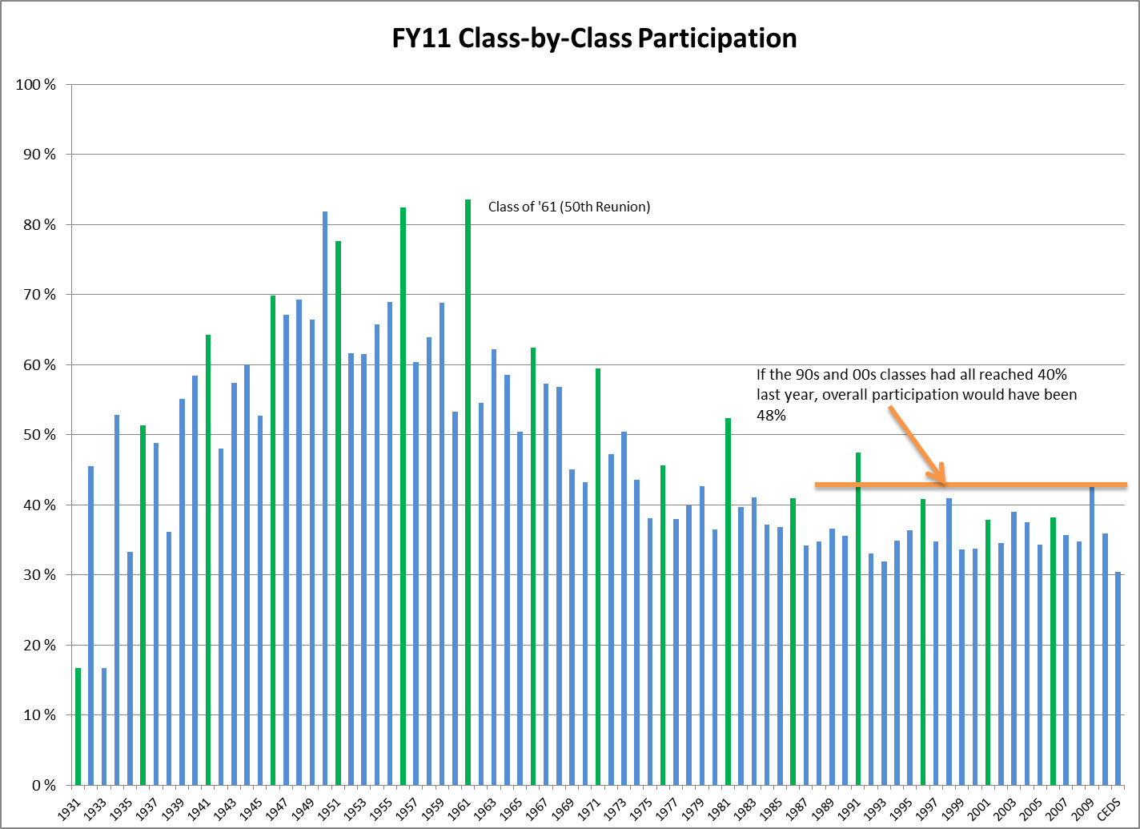
How do the Classes Stack Up?
Notes:
KIMBERLY

Slide 20
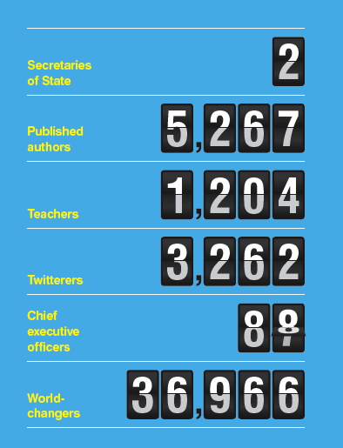
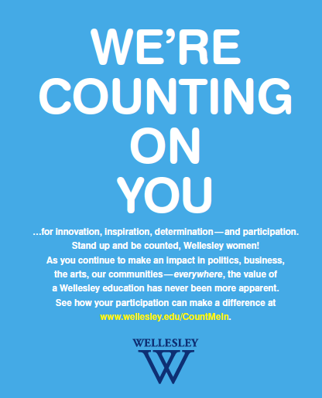
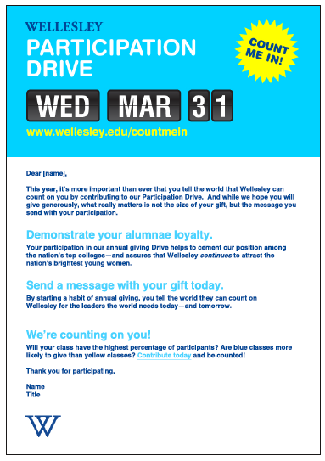
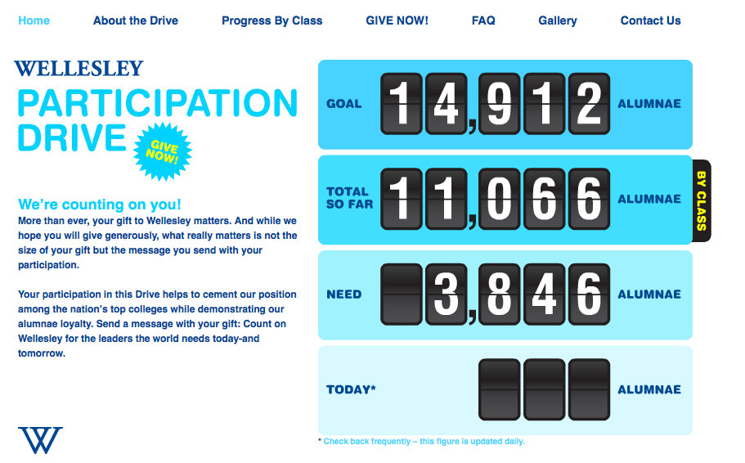
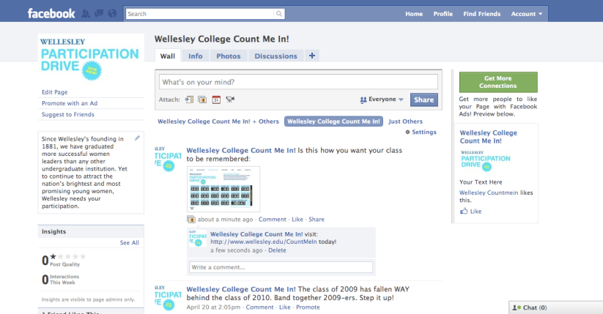
Young Alumnae Participation Needs a Boost: Count Me In!
Magazine ad: released January
Email
Online Site
Facebook
Notes:
KIMBERLY

Slide 21
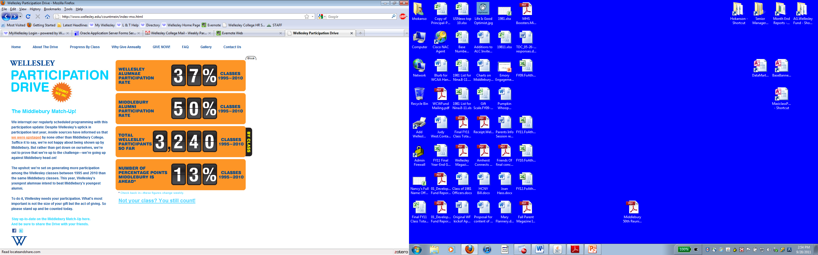
Count Me In: Middlebury Match-up
Notes:
KIMBERLY

Slide 22
Count Me In: Middlebury Match-up
Notes:
KIMBERLY

Slide 23
FY12 Wellesley Fund Goals
Dollars: $10,800,000
Durants: $7.9 million from 1,000 Durant-level gifts
Participation: 48% participation
Donors: 15,021 (we need to HOLD ON to EVERY donor from FY11 and ADD 459 more!)
Notes:
KIMBERLY

Slide 24

FY12 Wellesley Fund Goals
Notes:
KIMBERLY

Slide 25
Take-Aways
Every gift counts
We couldn’t do it without you
THANK YOU!
Notes:
KIMBERLY

Slide 26
Questions & Answers
Notes:
KIMBERLY

