Slide 1


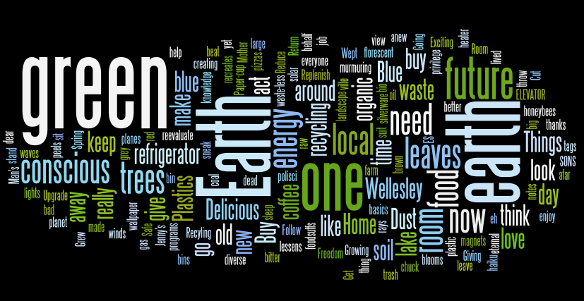
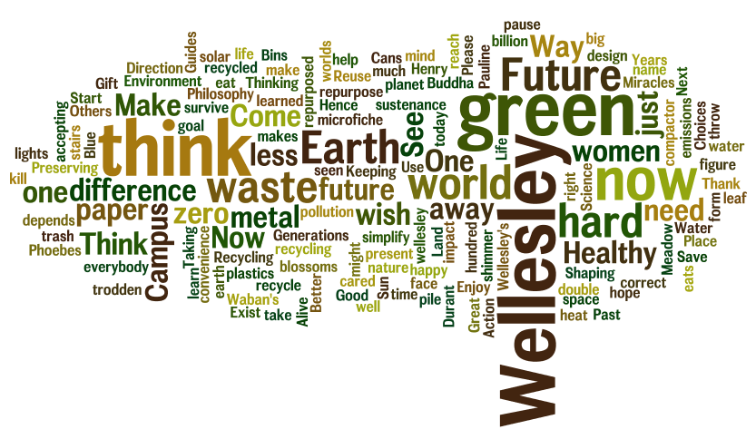
creative vision / sustainability now / spring Ruhlman 2011
Dan J. Brabander, Geosciences
Introduction
ninety-three entries*
ruhlman makes the winner known
joy to share—hopeful
*60 from students
Winners
Results
microfiche metal
all can now be recycled
it makes me happy Betty B. Febo
less might well be more
if Wellesley women learned this
they could teach the world Kim K. McLeod
The one thing better
Than a waste-less move-out is
A buy-less move-in Rebecca A. Ely
Wellesley has a tradition of haiku writing as the academic year comes to a close. These haiku are often a creative escape from the stress of final papers and exams. Recently, Wellesley has been exploring how the grand challenge of sustainability in the 21st century might be uniquely expressed and exemplified by our community. Our residential college of students, staff and faculty is diverse, and sustainability means different things to each constituency. For some it may be expressed around energy use and conversation; for others it may be focused around justice and responsibility. We are sponsoring a haiku-writing contest, soliciting haiku that shares your vision and hope for sustainability at Wellesley. We will use these haiku as a window into our community’s current aspirations upon which we can build a long-term vision for sustainability for our campus. Special prizes for the top three entries and cash prizes for the top five honorable mention. Winning entries announced at the late break poster session.
.
Honorable mentions
If you really love
Wellesley, stick that blue decal
on a bicycle Sophia Liu
At night, as you sleep,
We sneak into the ville and
Reduce the waste stream Rebecca A. Ely
We think, eat, learn, do
Keeping the future in mind--
Wellesley Blue is green. Sandy Kendall
wool socks
warming the feet
heater resting Eriko Houlette
Year-round bananas
Are not as green as they look
Delicious failure Julia C. Rodriguez
Methods
Figure #1 Wordle from text of student haiku entries. Size of word indicates frequency of word use. N= 150
Acknowledgments
Funding: Office of the Provost and President
Sustainability advisory committee: Kristina Jones, Beth DeSombre, Cathy Summa, and Patrick Willoughby
Phoebe Handler, ES ‘12
Figure #2 Wordle from text of staff/faculty haiku entries. Size of word indicates frequency of word use. N= 150
Panel of judges: Dan Chiasson, Dan Brabander, Jay Turner, Kate Salop, and Patrick Willoughby

