Slide 1
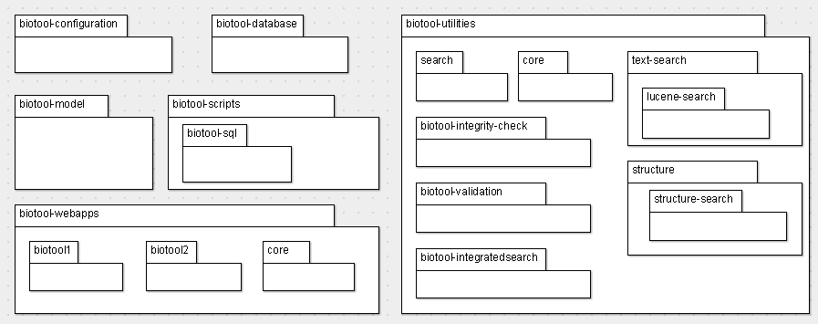

Slide 2
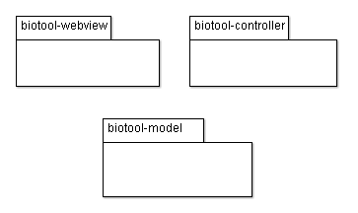
tool-view1
search (structures, text)
tool-view2
validation, integrity
configuration
database
scripts (unix, sql)

