Slide 1
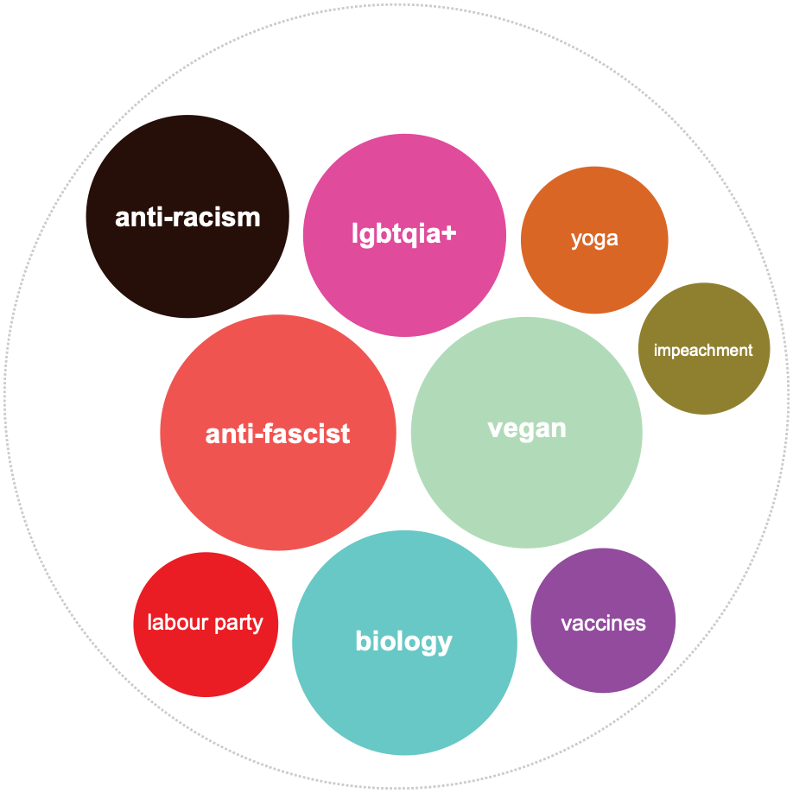
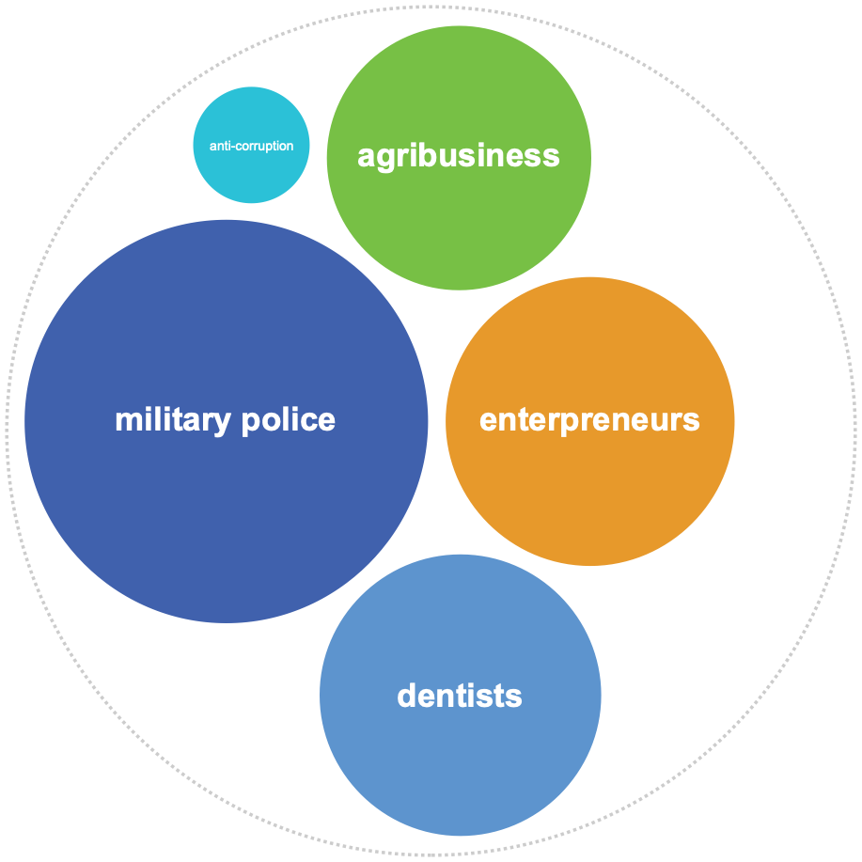




Anti-Bolsonaro accounts
Pro-Bolsonaro accounts
Topics in bio descriptions
Topics in bio descriptions
More Diverse
Less diverse
Progressist
Environment
Self-care
Humanities
Pro-vaccine
Conservative
Militarists
Agro
Neo-liberals
Platforms Links in Bio
Platforms Links in Bio

Slide 2
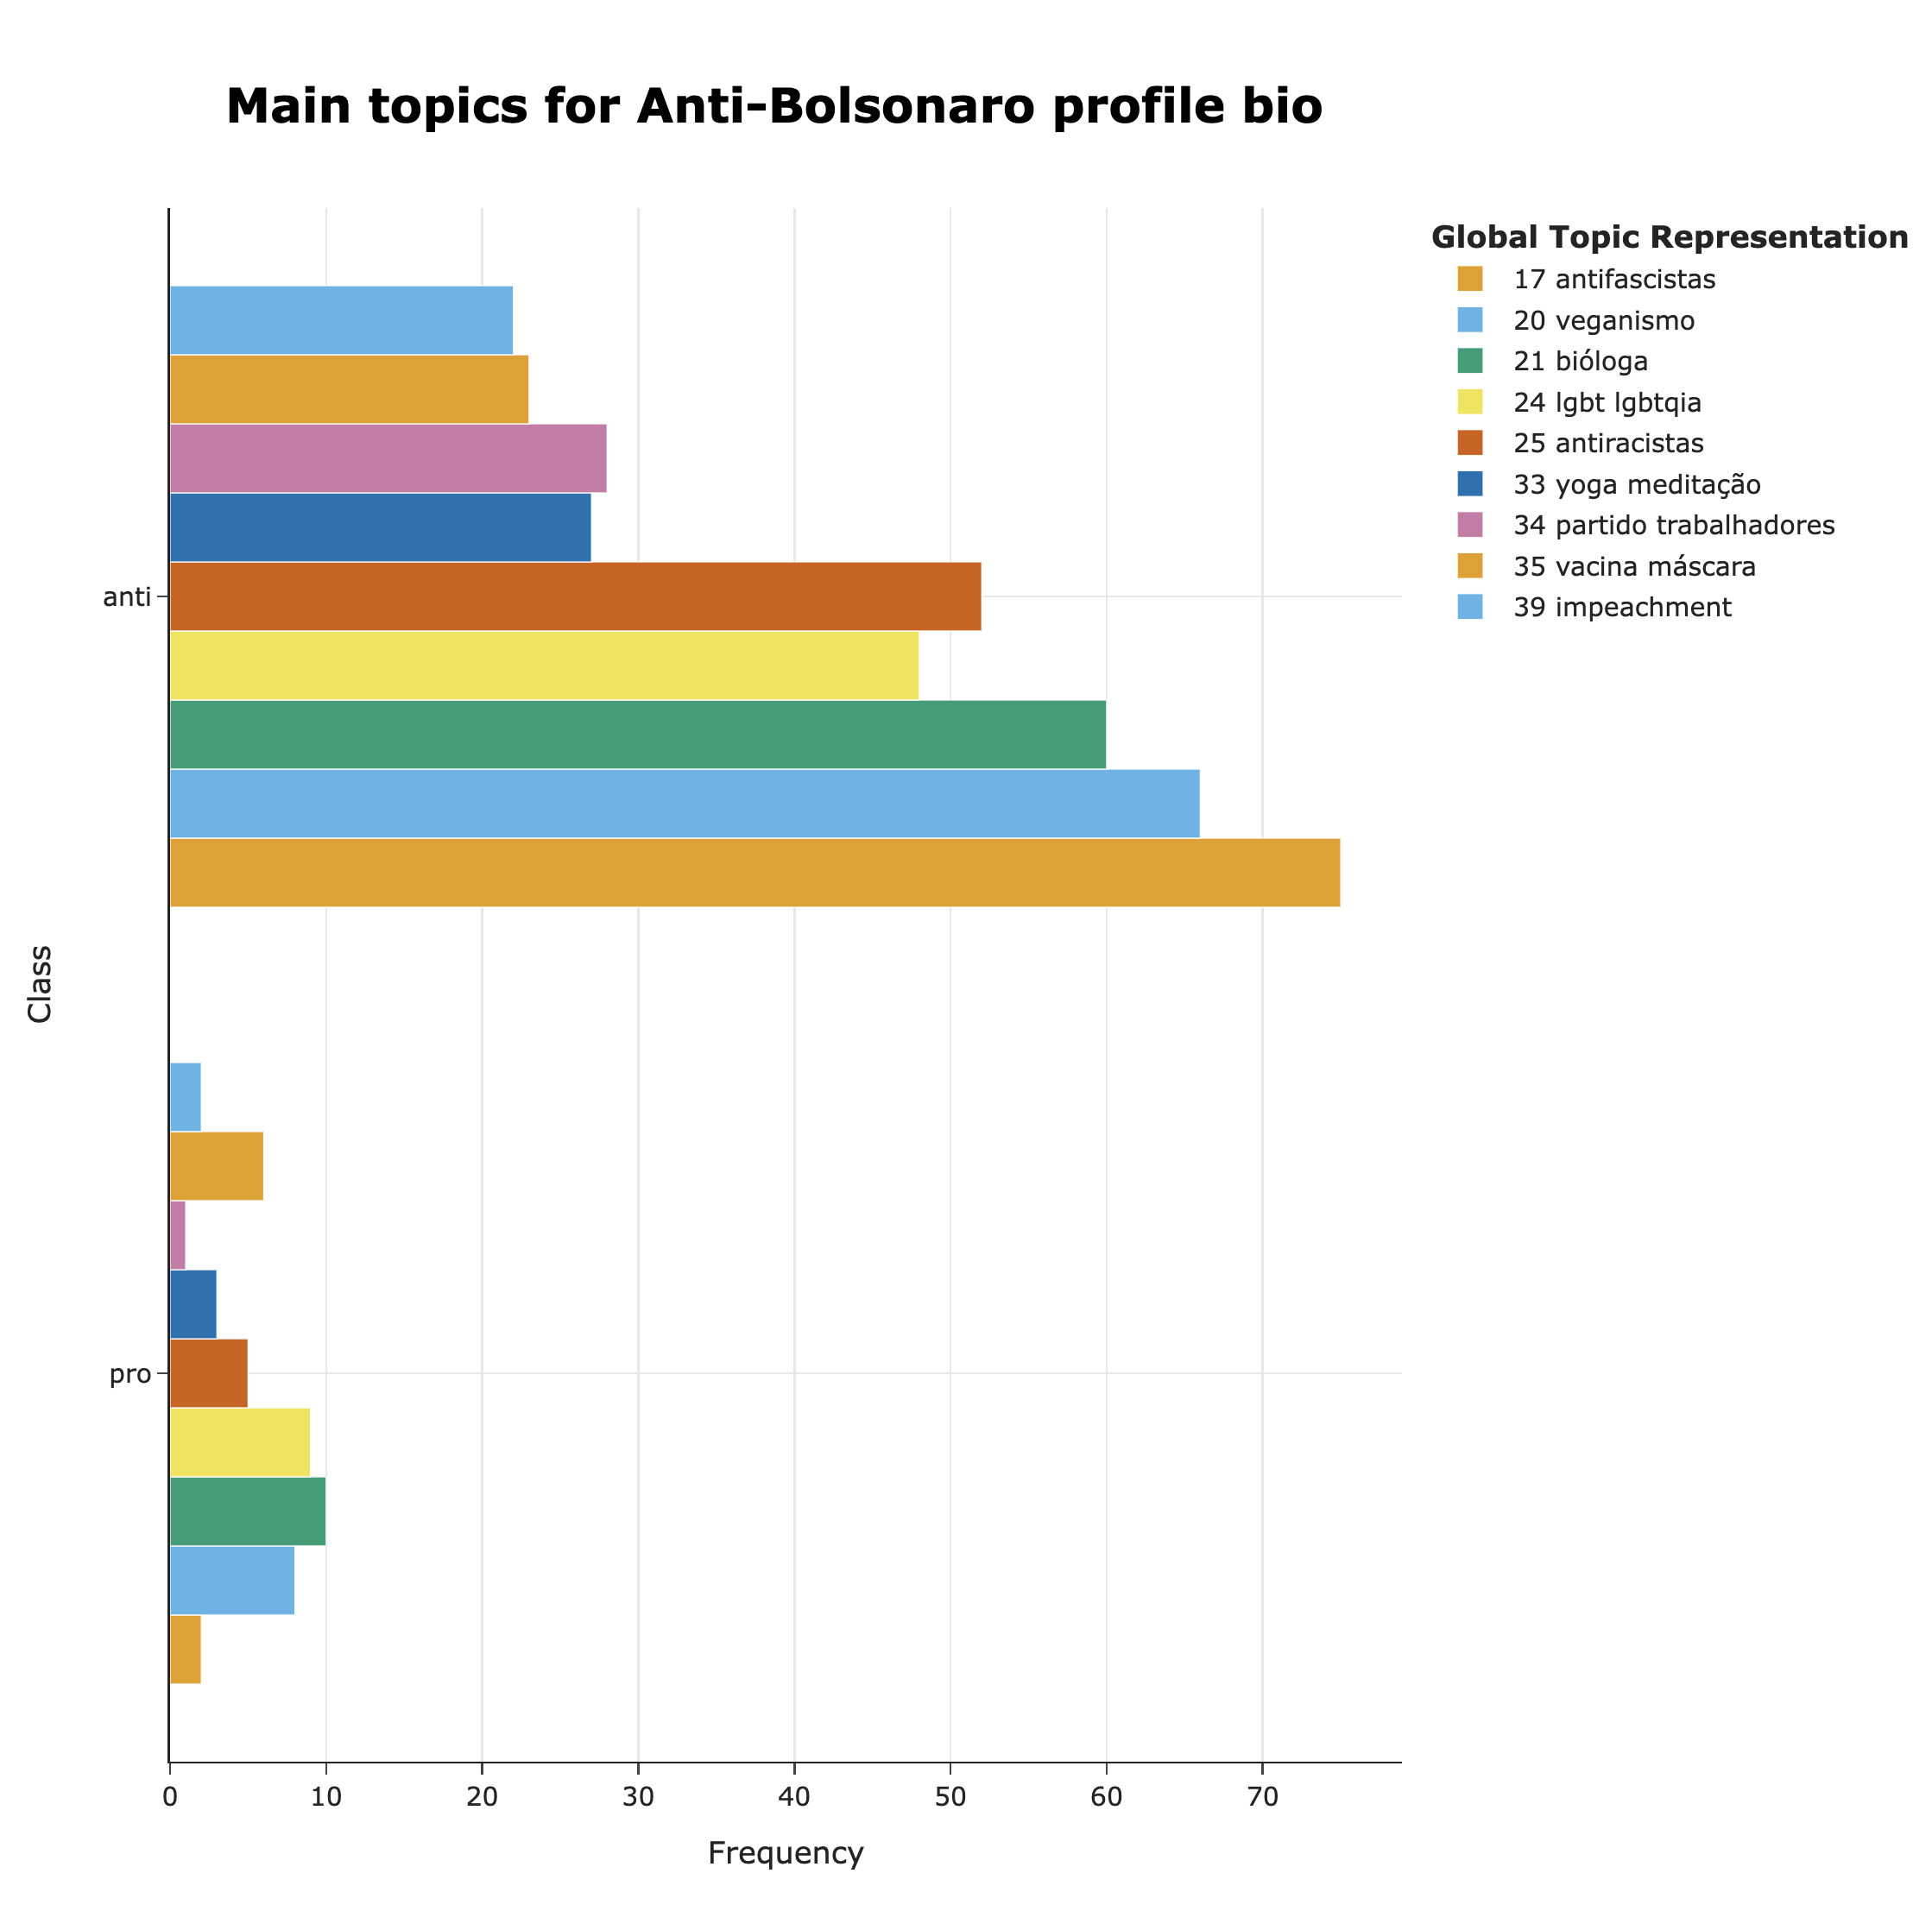
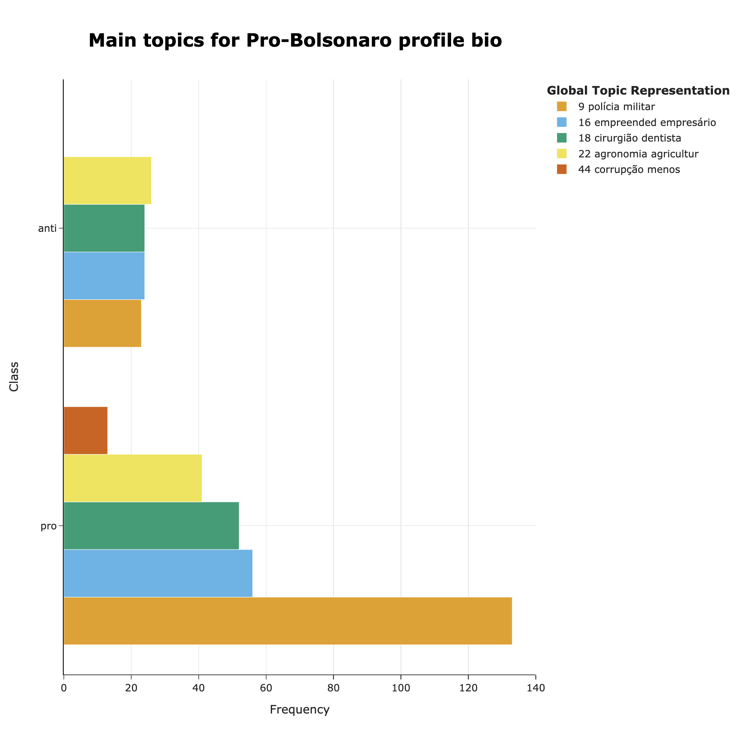
Topics distribution pro and anti bolsonaro accounts

Slide 3
