Slide 1
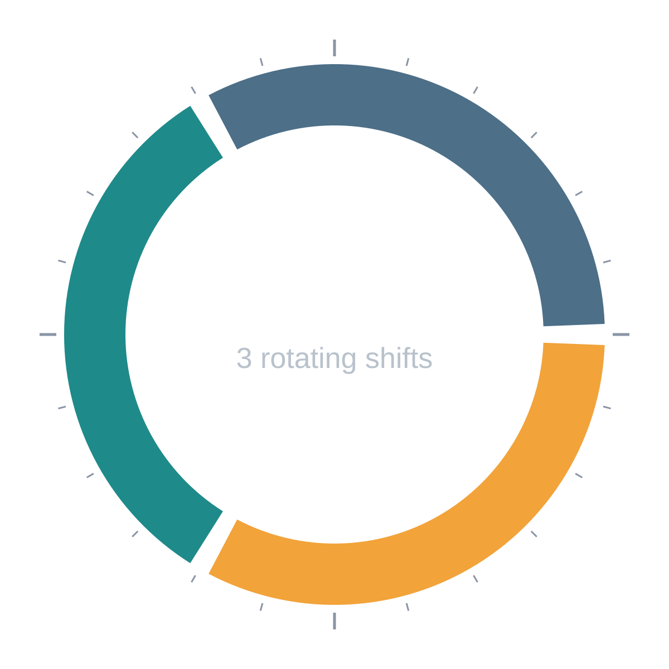
Employee Attendance, Shift & Leave Management System
DBMS PBL | REVIEW 2
Project 38: normalised design, constraint-enforced DDL, SQL reports and a working database prototype
Morning 06-14
Evening 14-22
Night 22-06
Team: [Student names and roll numbers] Guide: [Faculty name] October 2026
Notes:
Introduce the project: a relational database for shift-based organisations covering rosters, attendance, overtime and leave. Review 2 covers normalisation, DDL with constraints, SQL reports and the working prototype.

Slide 2
Review 2 deliverables, all covered
1
3NF design and data dictionary
2
DDL with integrity constraints
12 relations with functional dependencies; every determinant is a key.
Five business rules enforced inside the database, proven by rejection tests.
Slides 3-8
Slides 9-11
3
Sample data and SQL reports
4
Progress and prototype demo
Joins, subqueries, aggregation and views for seven report types.
A runnable PostgreSQL prototype, scripted end to end.
Slides 12-17
Slides 18-19
Notes:
Walk through the four Review 2 deliverables and where each is on the slides. Review 1 (ER model, initial schema) is already complete and is the base for this work.

Slide 3
Final schema: 12 tables in 4 domains
ORGANISATION
SCHEDULING
ATTENDANCE
LEAVE
department
shift
attendance_punch
leave_type
PK dept_id
PK shift_id
FK roster_id (one pair per shift)
PK leave_type_id
employee
roster
daily_summary
leave_balance
PK emp_id | FK dept_id, manager_id
PK roster_id | FK emp_id, shift_id
FK emp_id | one row per day
PK (emp_id, leave_type_id, year)
holiday
Rule: no overlapping shifts
overtime_request
leave_application
PK holiday_id
FK emp_id, approved_by
FK emp_id, leave_type_id
Rules: clock-out after clock-in, one summary per day, authorised overtime
leave_approval
FK app_id, approver_id
Rule: leave within balance
employee.manager_id references employee (reporting line) | every foreign key is enforced | all keys are surrogate integers
Notes:
The ER model from Review 1 became 12 relations. Group them by domain: organisation, scheduling, attendance and leave. Foreign keys are shown under each table name.

Slide 4
From one flat sheet to 3NF
UNF
1NF
2NF
3NF
One flat sheet
Atomic values
No partial dependencies
No transitive dependencies
>
>
>
Employee, department, shift timings, punches, overtime and leave in one wide row, with repeating groups.
Punches, overtime and leave requests become their own rows. Every table gets a primary key.
Shift timings depend on shift_id alone, department data on dept_id; balances keyed by employee, type and year.
dept_name is reached through employee.dept_id; punches keep roster_id only; days is a generated column.
Anomalies removed
Update
Insert
Delete
Change a shift timing once in shift, not in every roster row.
A new department or leave type can exist before any employee uses it.
Removing a day's punch never loses the employee or shift details.
Notes:
Explain the four stages. Start from a single flat attendance sheet; remove repeating groups (1NF), partial dependencies (2NF) and transitive dependencies (3NF). The anomalies row shows the practical benefit.

Slide 5
Functional dependencies (1 of 2)
Relation | Functional dependencies | Why it is in 3NF
department | dept_id → dept_name, location, min_staff dept_name → dept_id | dept_id is the key; dept_name is a candidate key (UNIQUE)
employee | emp_id → all other attributes emp_code → emp_id, email → emp_id | All determinants are candidate keys; department name is not repeated
shift | shift_id → shift_name, start_time, end_time, grace_minutes | Timings stored once; roster refers to shift_id only
holiday | holiday_id → holiday_date, holiday_name holiday_date → holiday_id | Both determinants are keys
roster | roster_id → emp_id, shift_id, work_date (emp_id, shift_id, work_date) → roster_id | Shift times are not copied into roster
attendance_punch | punch_id → roster_id, clock_in, clock_out, source roster_id → punch_id | Employee and date come from roster, not stored again
Notes:
Each row lists the functional dependencies for a relation and why it is in 3NF. Every determinant is a candidate key, so the schema also satisfies BCNF.

Slide 6
Functional dependencies (2 of 2)
Relation | Functional dependencies | Why it is in 3NF
daily_summary | summary_id → all other attributes (emp_id, work_date) → all other attributes | One row per employee-day; figures derived once from punches
overtime_request | ot_id → all other attributes (emp_id, work_date) → ot_id | Approver stored as an employee id only
leave_type | leave_type_id → type_name, annual_quota, is_paid type_name → leave_type_id | Leave policy stored once, not per employee
leave_balance | (emp_id, leave_type_id, bal_year) → entitled_days, used_days | Both attributes depend on the whole composite key
leave_application | app_id → all other attributes (days included) (from_date, to_date) → days | days is a GENERATED column, so it cannot drift
leave_approval | approval_id → all other attributes app_id → approval_id | One decision per application; determinants are keys
Every determinant above is a candidate key, so all 12 relations satisfy 3NF (and BCNF).
Notes:
Continue the dependency table. Point out that days in leave_application is a generated column, so the (from_date, to_date) → days dependency cannot create an update anomaly.

Slide 7
Data dictionary: organisation and scheduling
Table | Purpose | Key columns and constraints
department | Business units and staffing minimum | PK dept_id | dept_name UNIQUE | min_staff CHECK > 0
employee | Staff master record | PK emp_id | emp_code, email UNIQUE | FK dept_id, manager_id | status CHECK
shift | Shift definitions | PK shift_id | shift_name UNIQUE | start_time <> end_time | grace_minutes >= 0 | end <= start means overnight
holiday | Public holidays | PK holiday_id | holiday_date UNIQUE NOT NULL
roster | Who works which shift on which date | PK roster_id | FK emp_id, shift_id | UNIQUE (emp, shift, date) | no-overlap trigger
attendance_punch | Clock-in and clock-out per rostered shift | PK punch_id | roster_id UNIQUE FK | CHECK clock_out > clock_in | source CHECK
Notes:
Concise data dictionary: purpose of each table plus its key columns and constraints.

Slide 8
Data dictionary: attendance and leave
Table | Purpose | Key columns and constraints
daily_summary | One row per employee per day | PK summary_id | UNIQUE (emp_id, work_date) | minutes >= 0 | status CHECK | overtime trigger
overtime_request | Overtime requests and decisions | PK ot_id | UNIQUE (emp, date) | req_minutes 1-240 | decision CHECK | no self-approval
leave_type | Leave policy | PK leave_type_id | type_name UNIQUE | annual_quota >= 0 | is_paid
leave_balance | Entitled vs used days per year | PK (emp_id, leave_type_id, bal_year) | CHECK used <= entitled
leave_application | Leave requests | PK app_id | FK emp_id, leave_type_id | days GENERATED | CHECK to_date >= from_date
leave_approval | Approver decision on a request | PK approval_id | app_id UNIQUE FK | FK approver_id | trigger checks and deducts balance
Notes:
Second half of the data dictionary. Note the leave_approval trigger that checks and deducts balance.

Slide 9
Five business rules, enforced by the database
No overlapping shifts
Trigger on roster compares time ranges; handles night shifts that cross midnight.
1
TRIGGER
Clock-out after clock-in
CHECK (clock_out IS NULL OR clock_out > clock_in) on attendance_punch.
2
CHECK
Leave within balance
CHECK used <= entitled, plus an approval trigger that verifies and deducts days.
3
CHECK + TRIGGER
Authorised overtime
Summary trigger needs an APPROVED request covering the minutes; no self-approval.
4
TRIGGER + CHECK
One summary per day
UNIQUE (emp_id, work_date) on daily_summary.
5
UNIQUE
Notes:
Each business rule from the project statement is enforced by the database itself, so no application can bypass it. Triggers are used where a CHECK cannot look at other rows.

Slide 10
DDL excerpts
Rules 2 and 3: declarative CHECK constraints
Rule 1: roster trigger (excerpt)
-- Rule 2: clock-out after clock-in
CREATE TABLE attendance_punch (
punch_id SERIAL PRIMARY KEY,
roster_id INT NOT NULL UNIQUE
REFERENCES roster(roster_id),
clock_in TIMESTAMP NOT NULL,
clock_out TIMESTAMP,
CONSTRAINT ck_clock_out_after_in
CHECK (clock_out IS NULL
OR clock_out > clock_in)
);
-- Rule 3: leave within balance
CREATE TABLE leave_balance (
emp_id INT NOT NULL,
leave_type_id INT NOT NULL,
bal_year INT NOT NULL,
entitled_days NUMERIC(5,1) NOT NULL,
used_days NUMERIC(5,1) NOT NULL DEFAULT 0,
PRIMARY KEY (emp_id, leave_type_id, bal_year),
CONSTRAINT ck_leave_within_balance
CHECK (used_days >= 0
AND used_days <= entitled_days)
);
CREATE FUNCTION fn_roster_no_overlap()
RETURNS trigger AS $$
BEGIN
-- s = shift row of the NEW roster entry
IF EXISTS (
SELECT 1 FROM roster r
JOIN shift sh USING (shift_id)
WHERE r.emp_id = NEW.emp_id
AND shift_range(r.work_date,
sh.start_time, sh.end_time)
&& shift_range(NEW.work_date,
s.start_time, s.end_time)
) THEN
RAISE EXCEPTION 'Overlapping shift ...';
END IF;
RETURN NEW;
END $$ LANGUAGE plpgsql;
CREATE TRIGGER trg_roster_no_overlap
BEFORE INSERT OR UPDATE ON roster
FOR EACH ROW
EXECUTE FUNCTION fn_roster_no_overlap();
Rule 3 is completed by an approval trigger that checks the balance and deducts the days (slide 17).
shift_range() adds one day when end <= start, so Night (22:00-06:00) overlaps correctly.
Notes:
Show the declarative constraints on the left and the roster overlap trigger on the right. shift_range() adds one day when a shift ends at or before its start, so night shifts compare correctly.

Slide 11
Constraint tests: invalid data is rejected
# | Attempted action | Rule tested | Database response
T1 | Roster E004 on General (09:00-17:00) while already on Evening (14:00-22:00) | No overlapping shifts | Overlapping shift: employee 4 already rostered during General shift on 2026-09-21
T2 | Punch with clock-in 09:00 and clock-out 08:00 | Clock-out after clock-in | violates check constraint "ck_clock_out_after_in"
T3 | Approve 14 days Casual Leave for E005 | Leave within balance | Insufficient leave balance: 14 day(s) requested, 12.0 available
T4 | Set 90 min overtime where no request is approved | Authorised overtime | Unauthorised overtime: no approved request covering 90 min for employee 2 on 2026-09-24
T5 | Second daily summary for E002 on 24-Sep | One summary per day | duplicate key violates unique constraint "uq_one_summary_per_day"
T6 | Employee approves own overtime request | Authorised overtime | violates check constraint "ck_ot_no_self_approval"
Valid path: approving a 3-day Casual Leave for E005 inside a transaction sets the status to APPROVED and moves used days from 0.0 to 3.0 (9.0 remaining). ROLLBACK restores the data.
Notes:
Each row is an invalid operation we actually ran against the prototype, with the real error returned by PostgreSQL. The green line shows the valid path: approving leave inside a transaction.

Slide 12
Sample data: two realistic weeks
15
4
159
150
28
180
Employees
Departments
Rostered shifts
Punches
Overtime requests
Daily summaries
What the data covers
Mon-Sat, 21 Sep to 3 Oct, rotating Morning, Evening and Night shifts
Gandhi Jayanti (2 Oct) as a public holiday
5 leave applications: 3 approved, 1 rejected, 1 pending
28 overtime requests: 21 approved, 7 rejected
Generated by repeatable SQL, so results never change between runs
Notes:
The data covers 21 Sep to 3 Oct 2026 for four departments. It is generated by repeatable SQL so results are reproducible. It includes lateness, absences, overtime decisions and leave.

Slide 13
Reports: roster and lateness
Roster, 21 Sep
JOIN | VIEW
Lateness
GROUP BY | AVG
SELECT work_date, full_name,
shift_name, start_time, end_time
FROM v_roster
WHERE dept_name = 'Production'
AND work_date = '2026-09-21'
ORDER BY start_time;
SELECT full_name,
COUNT(*) AS late_days,
ROUND(AVG(late_minutes),1)
AS avg_late_min
FROM v_lateness
GROUP BY full_name
ORDER BY late_days DESC, avg_late_min DESC
LIMIT 4;
Date | Employee | Shift | Start | End
09-21 | Suresh Patel | Morning | 06:00 | 14:00
09-21 | Ravi Kumar | Evening | 14:00 | 22:00
09-21 | Meena Iyer | Evening | 14:00 | 22:00
09-21 | Anita Sharma | Night | 22:00 | 06:00
09-21 | Arjun Reddy | Night | 22:00 | 06:00
Employee | Late days | Avg late (min)
Ravi Kumar | 4 | 18.3
Farhan Ali | 3 | 25.7
Gopal Yadav | 3 | 21.0
Sneha Das | 3 | 20.7
Only one Production employee is on Morning that day, below the minimum of two.
Ravi Kumar was late 4 times; a punch counts as late only after the 10-minute grace.
Notes:
Roster uses a view that joins four tables. Lateness aggregates the lateness view: count and average minutes per employee. A punch counts as late only after the shift grace period.

Slide 14
Reports: absence and overtime
Absence
SUBQUERY | HAVING
Overtime
JOIN | SUM
SELECT full_name, COUNT(*) AS absent_days
FROM v_absence
GROUP BY full_name
HAVING COUNT(*) > (
SELECT AVG(c) FROM (
SELECT COUNT(*) AS c FROM v_absence
GROUP BY emp_code) t);
SELECT e.full_name,
SUM(ds.overtime_minutes) AS ot_min,
ROUND(SUM(ds.overtime_minutes)/60.0,1)
AS ot_hours
FROM daily_summary ds
JOIN employee e USING (emp_id)
WHERE ds.overtime_minutes > 0
GROUP BY e.full_name
ORDER BY ot_min DESC LIMIT 4;
Employee | Absent days
Neha Singh | 2
Employee | OT minutes | OT hours
Ravi Kumar | 240 | 4.0
Suresh Patel | 225 | 3.8
Rahul Mehta | 165 | 2.8
Lakshmi Menon | 165 | 2.8
The nested query finds employees absent more often than average; Neha Singh (2 days) is the only one.
Only approved overtime is counted: 21 of 28 requests were approved.
Notes:
Absence uses a nested query to compare each employee with the average absence count. Overtime sums only approved minutes, because the trigger blocks anything else from reaching daily_summary.

Slide 15
Reports: leave balances and shift coverage
Leave balances
JOIN | VIEW
Shift coverage
GROUP BY | CASE
SELECT full_name, type_name,
entitled_days, used_days,
remaining_days
FROM v_leave_balance
WHERE used_days > 0
ORDER BY full_name;
SELECT work_date, dept_name,
shift_name, scheduled, min_staff
FROM v_shift_coverage
WHERE coverage = 'UNDERSTAFFED'
ORDER BY work_date, dept_name
LIMIT 4;
Employee | Type | Ent. | Used | Left
Pooja Nair | Casual Leave | 12.0 | 1.0 | 11.0
Rahul Mehta | Earned Leave | 15.0 | 3.0 | 12.0
Suresh Patel | Sick Leave | 10.0 | 2.0 | 8.0
Date | Dept | Shift | Sched. | Min
09-21 | Production | Morning | 1 | 2
09-24 | Production | Morning | 1 | 2
09-25 | Production | Morning | 1 | 2
09-26 | Production | Morning | 1 | 2
Balances change only through the approval trigger, never by hand.
9 of 126 department-shift slots are understaffed, all in Production.
Notes:
Leave balances come from a view that computes remaining days. Shift coverage groups the roster by date, department and shift and compares the head-count with the department minimum.

Slide 16
Reports: department summary view
CREATE VIEW v_dept_summary AS
SELECT d.dept_name,
COUNT(DISTINCT e.emp_id) AS headcount,
COUNT(*) FILTER (WHERE ds.status
IN ('PRESENT','LATE')) AS days_present,
COUNT(*) FILTER (WHERE ds.status='LATE')
AS late_days,
COUNT(*) FILTER (WHERE ds.status='ABSENT')
AS absent_days,
ROUND(SUM(ds.worked_minutes)/60.0,1)
AS total_hours,
ROUND(SUM(ds.overtime_minutes)/60.0,1)
AS overtime_hours
FROM department d
JOIN employee e ON e.dept_id = d.dept_id
LEFT JOIN daily_summary ds
ON ds.emp_id = e.emp_id
GROUP BY d.dept_name;
Department | Staff | Present | Late | Absent | Hours | OT h
Customer Support | 3 | 28 | 5 | 2 | 229.1 | 5.3
Logistics | 4 | 40 | 9 | 3 | 319.6 | 1.3
Production | 5 | 52 | 12 | 1 | 426.6 | 10.8
Security | 3 | 30 | 8 | 3 | 244.0 | 5.5
Production logs the most late arrivals (12 days) and overtime (10.8 h); Logistics and Security lead on absences (3 days each).
Notes:
The department summary view combines joins, FILTER aggregates and rounding. The chart compares late days, absent days and overtime hours per department.

Slide 17
Views, indexing and transactions
6 secondary indexes
v_roster
v_lateness
Roster by department, date and shift
Late arrivals beyond the grace period
employee(dept_id)
roster(work_date, shift_id)
attendance_punch(clock_in)
daily_summary(work_date, status)
leave_application(emp_id, status)
overtime_request(status, work_date)
v_absence
v_leave_balance
Rostered days with no punch
Entitled, used and remaining days
Query plan for a lateness lookup
EXPLAIN SELECT * FROM daily_summary
WHERE work_date = '2026-09-24'
AND status = 'LATE';
Index Scan using idx_summary_date_stat
on daily_summary
v_shift_coverage
v_dept_summary
Scheduled vs minimum staff per shift
Hours, lateness, absence and overtime
Transaction awareness: approving leave is one INSERT. Its trigger checks the balance, deducts the days and updates the status together, and any failure rolls everything back.
Notes:
Six views give ready-made reports. Indexes target the columns used by the reports. The EXPLAIN output proves the planner uses an index. Leave approval is a single INSERT whose trigger runs atomically.

Slide 18
Implementation progress
Requirements and ER model (Review 1)
12 entities, relationships, initial schema
Done
3NF design, dependencies, data dictionary
12 relations; every determinant is a key
Done
DDL and integrity constraints
5 business rules, 3 triggers, 6 indexes
Done
Sample data
15 employees, two weeks of roster, punches, overtime, leave
Done
SQL queries and views
7 report types, 6 views
Done
Constraint testing
6 of 6 invalid operations rejected; valid path commits
Done
Front-end application (Review 3)
Roster, clock-in/out, overtime, leave and reports in Python or Java
Next
Notes:
Everything required for Review 2 is complete and tested. The front-end application is the Review 3 deliverable and has not been started.

Slide 19
Prototype demonstration
1
2
3
4
5
Create schema
Load data
Run reports
Break the rules
Approve leave
psql -f
01_schema.sql
psql -f
02_data.sql
psql -f
03_views_queries.sql
psql -f
04_tests.sql
INSERT INTO
leave_approval ...
12 tables, 3 triggers, 6 indexes
159 roster rows, 150 punches, 180 summaries
6 views: roster, lateness, absence, leave, coverage, department
All 6 invalid operations are rejected with clear messages
Status becomes APPROVED and the balance drops 12.0 to 9.0
Environment: PostgreSQL 16 with the psql console. All four scripts are shared with this deck.
Notes:
Run these five steps live in the psql console. Step 4 shows each rule rejecting bad data; step 5 shows a valid transaction updating the balance.

Slide 20
Next: the application layer for Review 3
A simple Python or Java front-end connected to this database
Roster preparation and clock-in/out entry
Work-hour calculation and overtime approval
Leave processing and balance update
Reports, validation and error handling
Thank you. Questions?
Notes:
Close by previewing Review 3: the application will use the same schema, so every rule shown today also protects the app.

