Slide 1
Locating the Income Disparity by Sex Census Income Dataset (1994 US Census)
Janna Hoyne
August 16, 2026
https://github.com/jannarhoyne-sys/ANA500-Hoyne

Slide 2
Problem Statement
Adjusting for Occupation & Hours Removes the Mechanism
Earnings comparisons by sex are usually adjusted for occupation and hours
The residual is then reported as the disparity
But access to occupations and capacity for long hours are themselves unequal
This project measures where the disparity is located, rather than adjusting it away

Slide 3
Hypothesis Formulation
The Disparity Is Not Uniform & Does Not Resolve Under Matching
Gap persists at equal education and equal hours
Occupational composition differs by sex

Slide 4
Acquire
1994 US Census | Adult Income Extract
32,561
Records × 15 variables
Binary outcome: ≤ $50K vs > $50K
isna() returned 0 | 4,262 cells held [?]

Slide 5
Prepare
Missing Is Not Random | Dropping It Widens the Gap
Every missing [workclass] is also missing [occupation] | 1,836 of 1,836
The missing block shows a 7.7 point gap against 20.1 in complete records
[capital-gain] topcoded at 99999 | documented and not used
46.7% report exactly 40 hours, so hours are banded rather than continuous

Slide 6
Analyze
The gap is located, not adjusted away
Stratified comparison: rates computed inside matched cells
No model, no significance testing
Strata: education, hours, occupation, marital status
Absolute Disadvantage
Point Difference
Relative Disadvantage
Ratio

Slide 7
Report
30.6% of Men Make Over $50K | 10.9% of Women Do
19.6
Point difference
2.79×
Ratio
Unweighted · Weighting moves it by 0.3

Slide 8
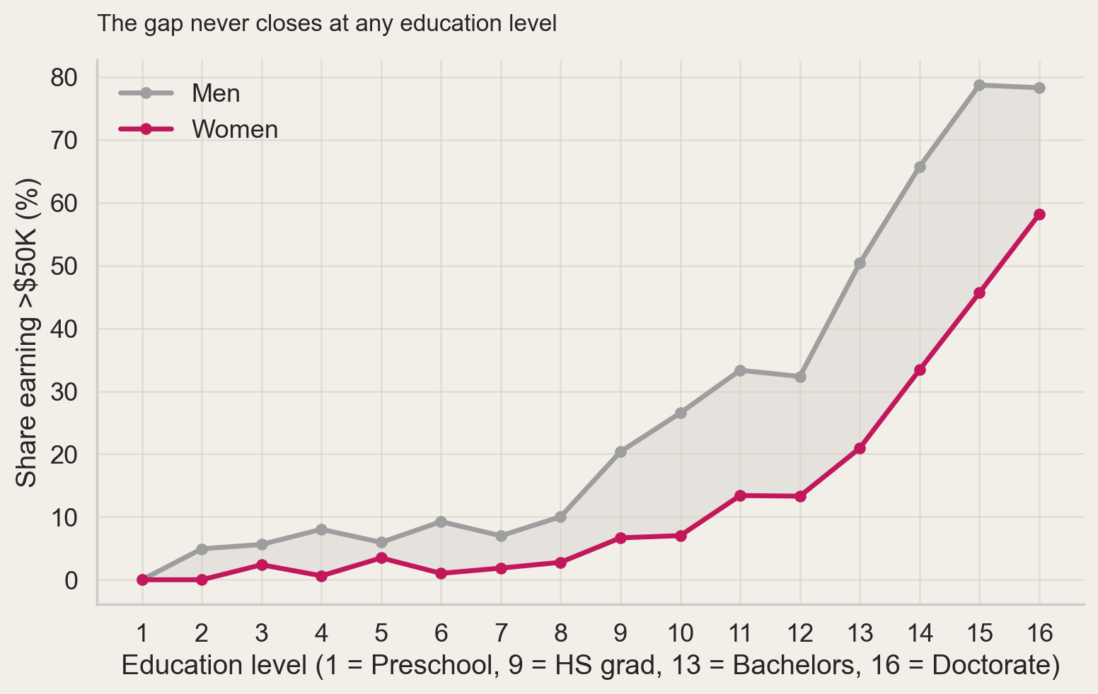
Education
The Gap Never Closes at Any Education Level
16
Education levels, no reversals
Men lead at every one

Slide 9
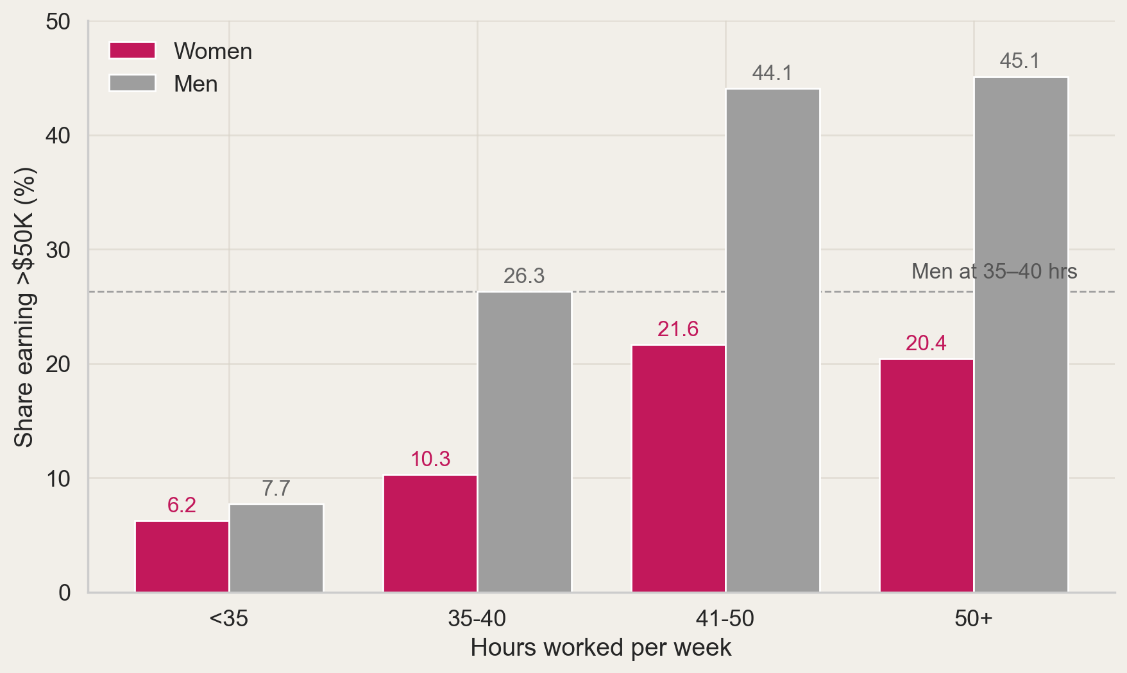
Hours
Women Working 50+ Hours Remain Below Men Working 35 - 40
18.8
Point gain for men at 50+ hours
Women gain 10.1

Slide 10
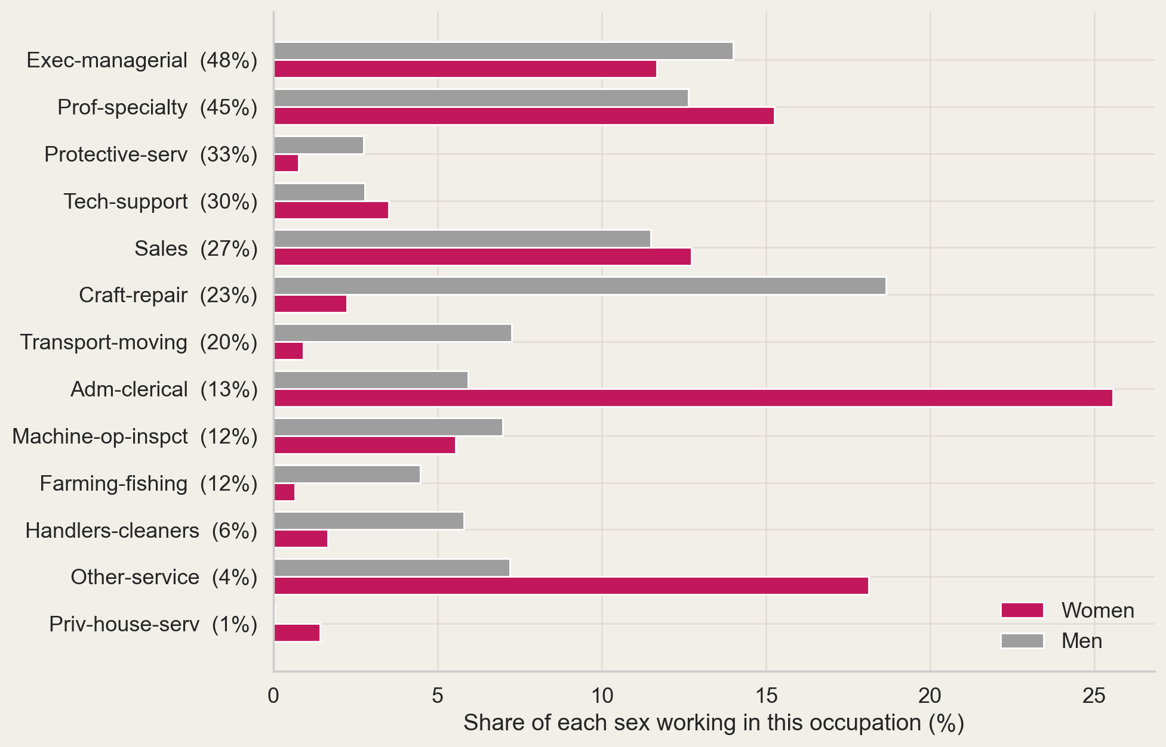
Occupational Composition
Women Concentrate in the Lowest-Paying Occupations
45%
Of women in the three lowest- paying occupations
Men, 13%

Slide 11
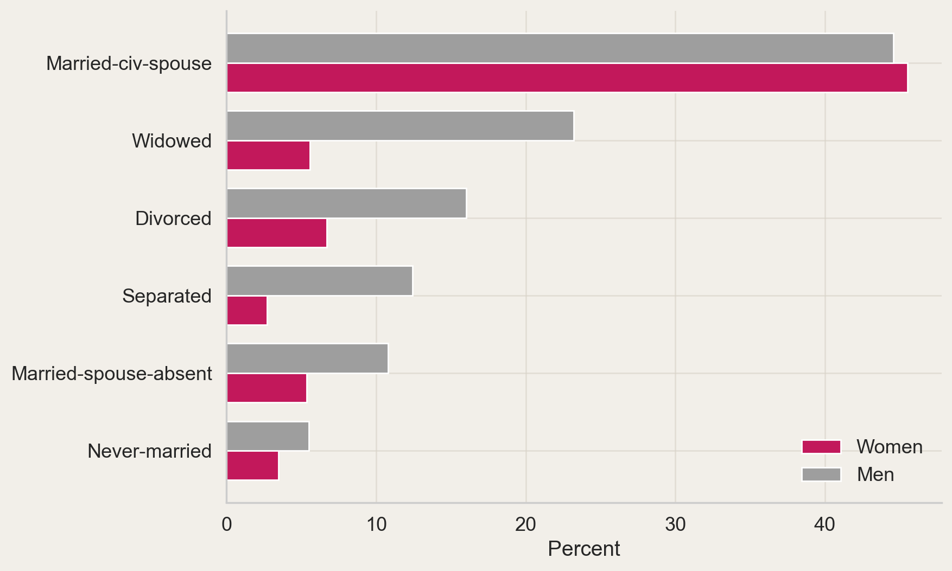
Marital Status
Where the Gap Disappears | And Why That Is Misleading
61%
Of men sit in the one cell with no gap
Women, 15%

Slide 12
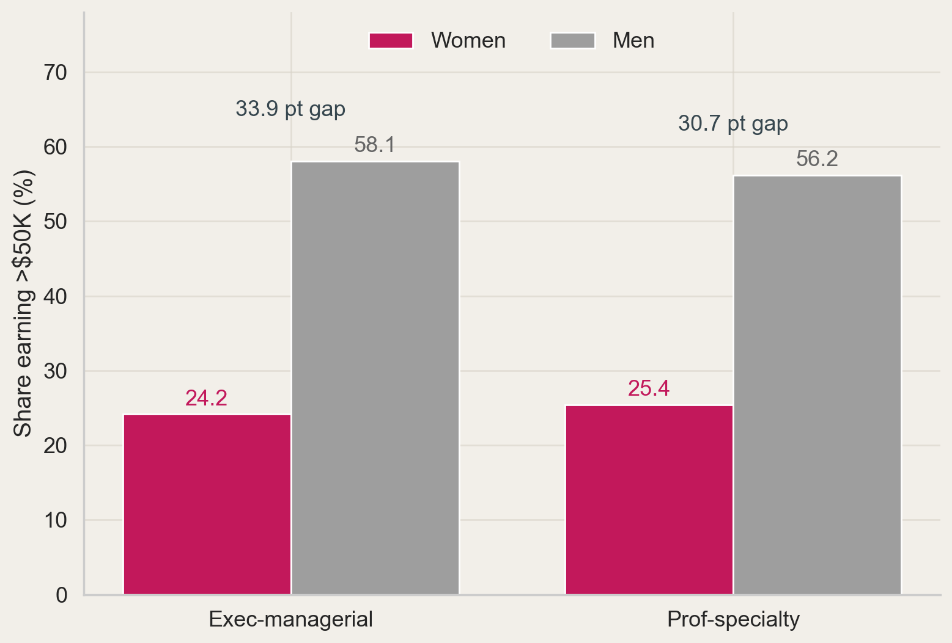
Top Two Occupations
The Gap Is Widest in the Highest-Paying Occupations
15.3%
Of women work in Prof-specialty
Men, 12.6%

Slide 13
Analyze
Income Class Modeled Directly
24.9%
Of records earn above $50K
Target is the census income label, above or below $50K
30,709 records with occupation recorded
Logistic regression, decision tree, random forest, KNN, SVC
Occupation retained as a predictor, not excluded

Slide 14
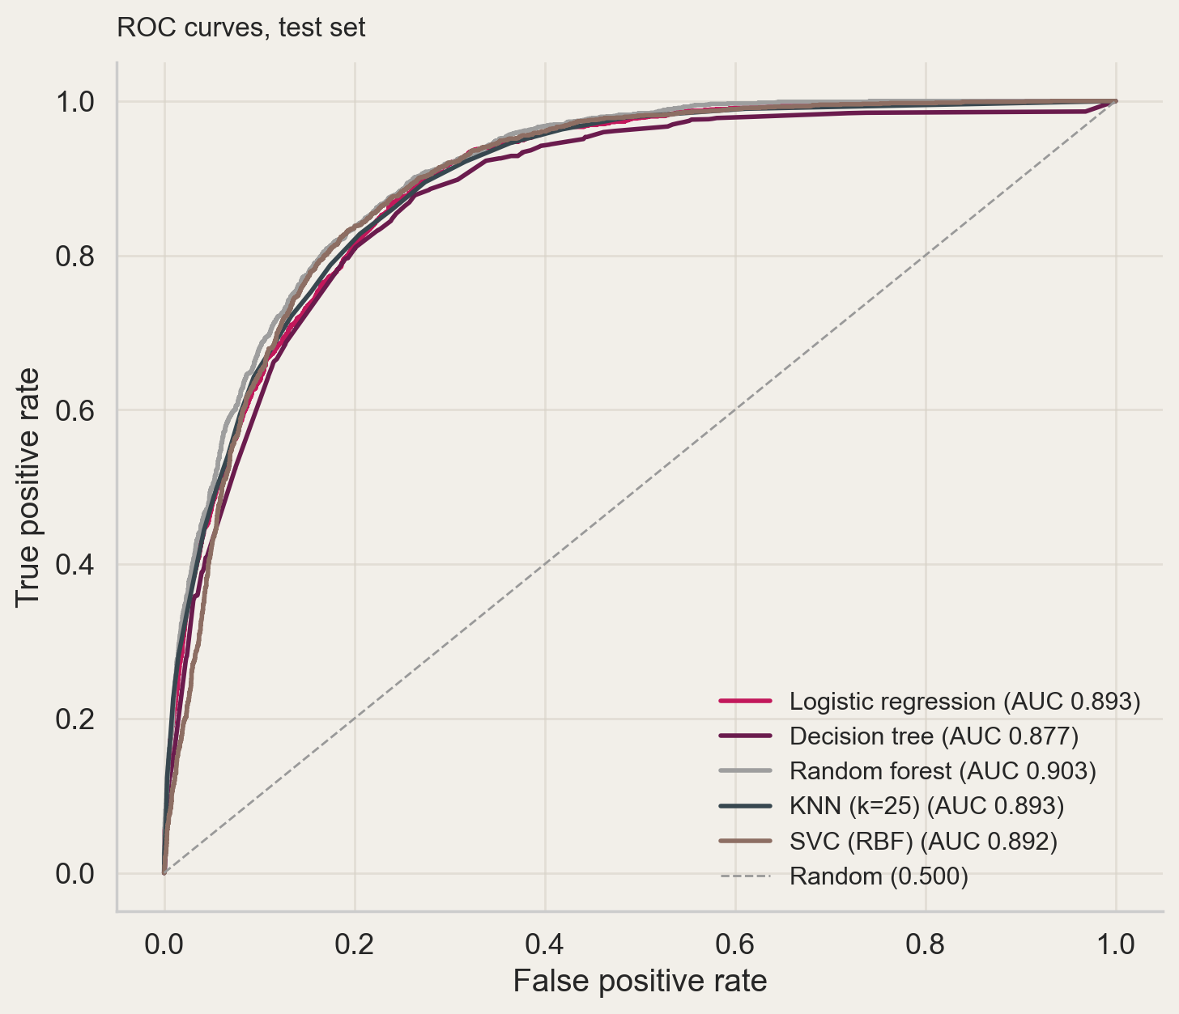
Ranking Quality
All Five Models Rank Well Above Chance
0.903
ROC-AUC, random forest
Random guessing, 0.500

Slide 15
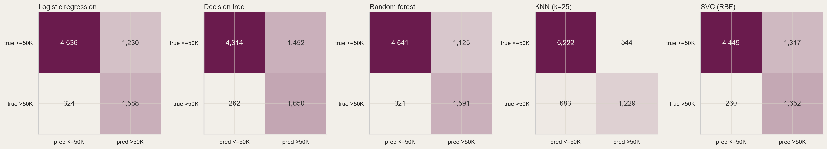
Errors
High Recall Bought With Low Precision
83.1%
Of high earners identified
Precision, 56.4%

Slide 16
Model Comparison
Highest Accuracy Finds the Fewest High Earners
Model | Accuracy | Precision | Recall
Baseline (majority class) | 0.751 | 0.000 | 0.000
Logistic regression | 0.798 | 0.564 | 0.831
Decision tree | 0.777 | 0.532 | 0.863
Random forest | 0.812 | 0.586 | 0.832
KNN (k=25) | 0.839 | 0.692 | 0.640
SVC (RBF) | 0.795 | 0.556 | 0.864
0.000
Baseline F1 at 75.1% accuracy
Best model, 0.688

Slide 17
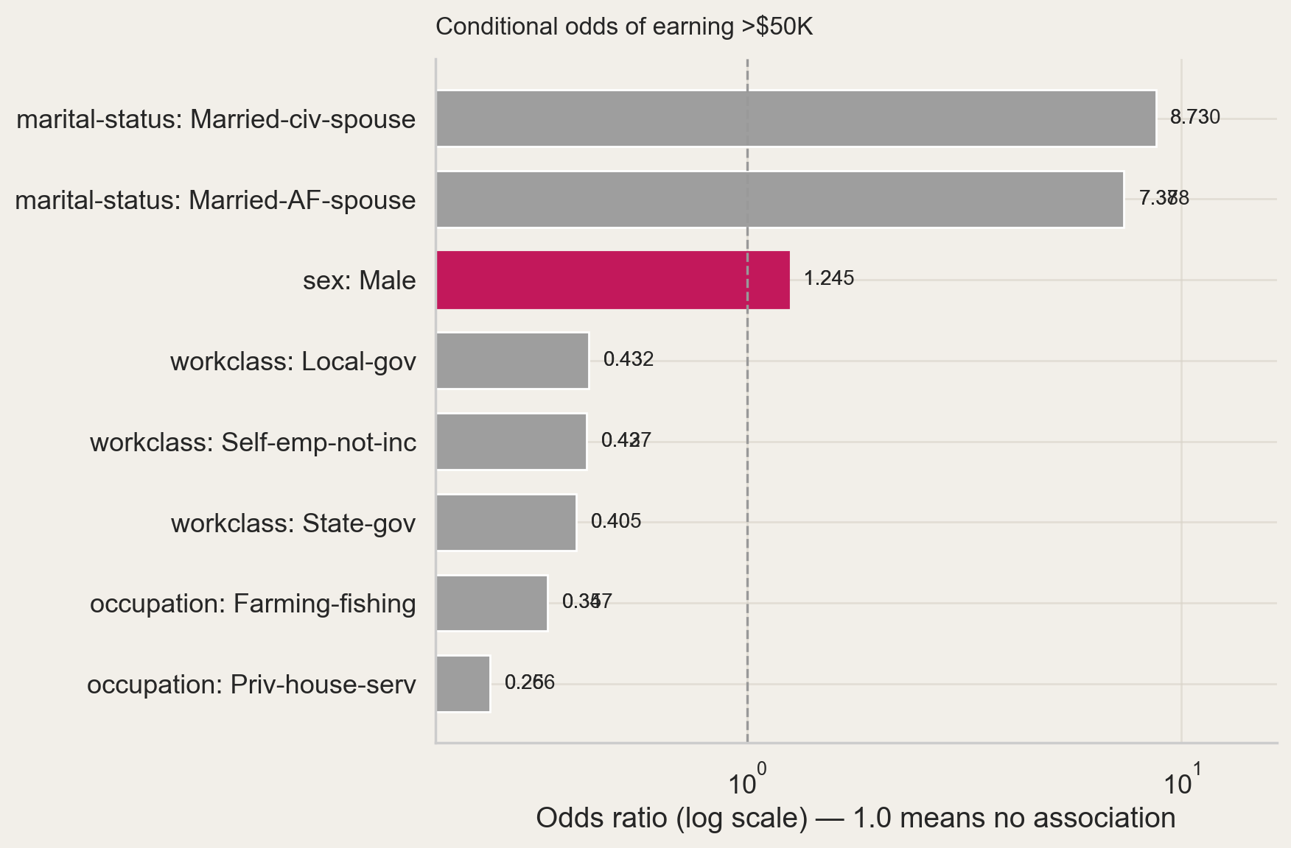
Conditioning
Sex Still Predicts With Occupation Held Constant
1.25×
Conditional odds ratio for men
Unconditional ratio, 2.79×

Slide 18
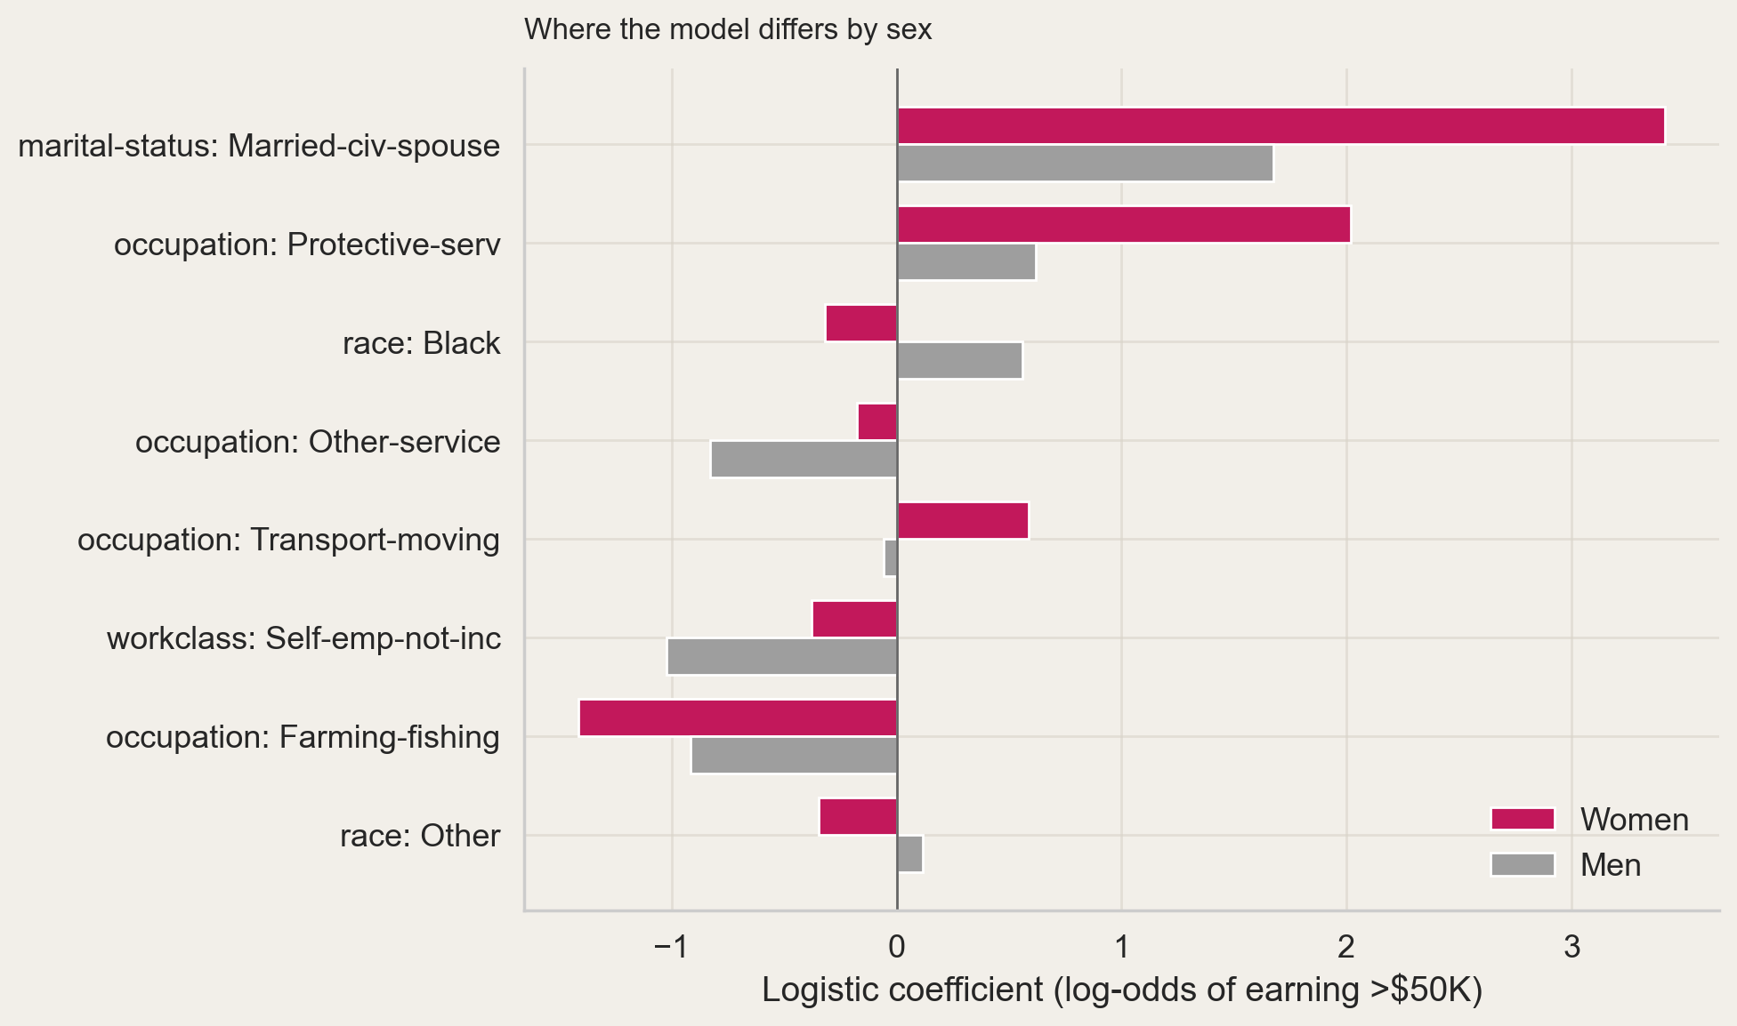
Stratified Models
Marriage Carries Twice the Weight for Women
0.926
ROC-AUC, women’s model
Men, 0.870

Slide 19
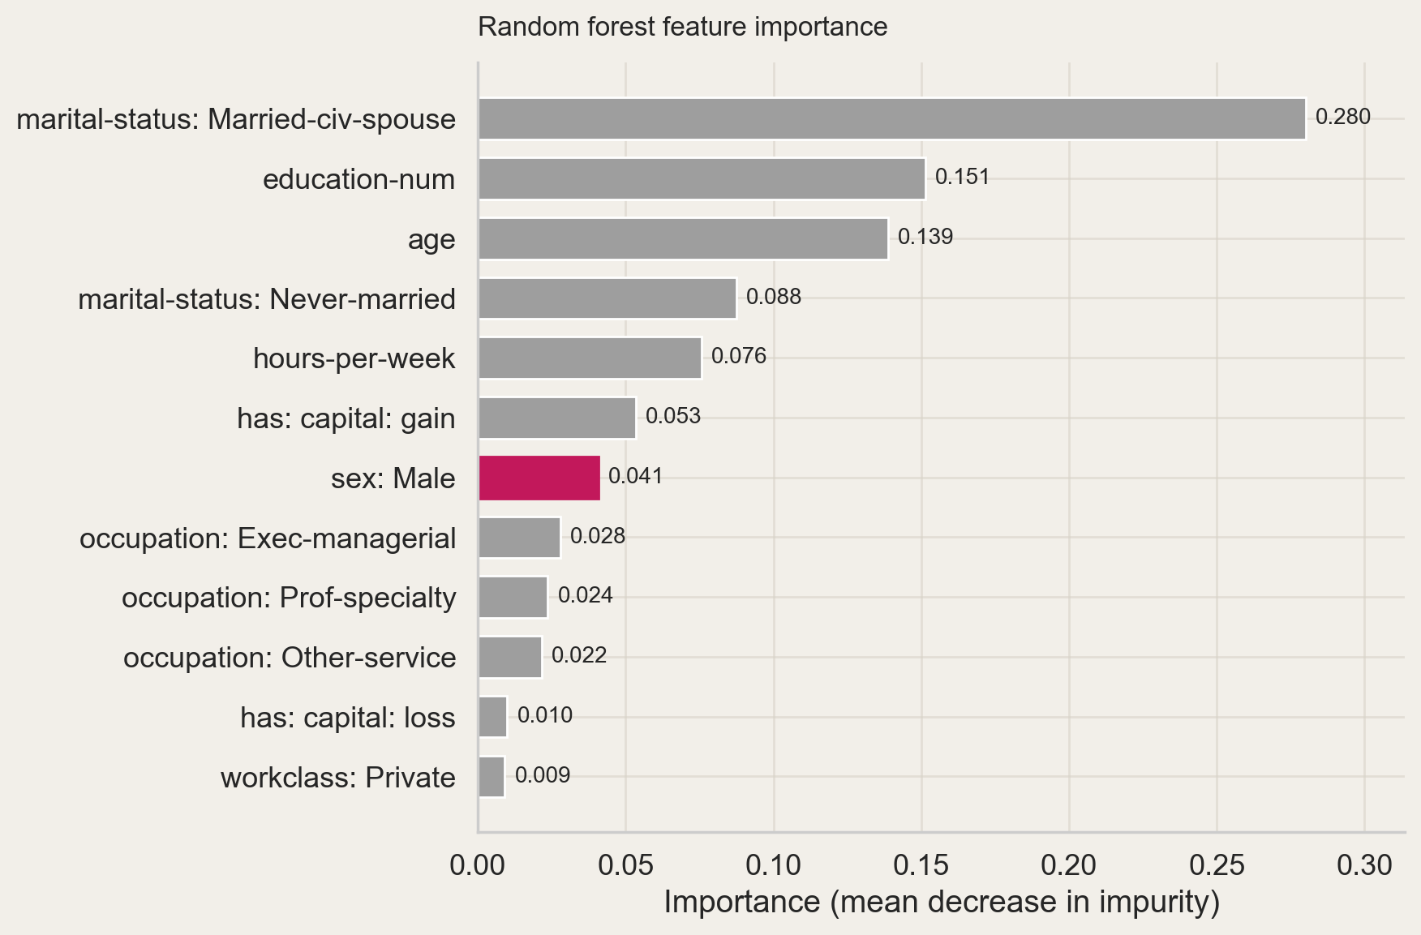
Feature Importance
Marital Status Dominates | Sex Ranks Seventh of 35

Slide 20
Analyze
A Sequence Built From Age
20
Parallel age series
Adult has no time index Age gives an ordering at regular one-year intervals
Target: share above $50K at each age, within group
Groups: sex × education band × marital status, ages 20–70

Slide 21
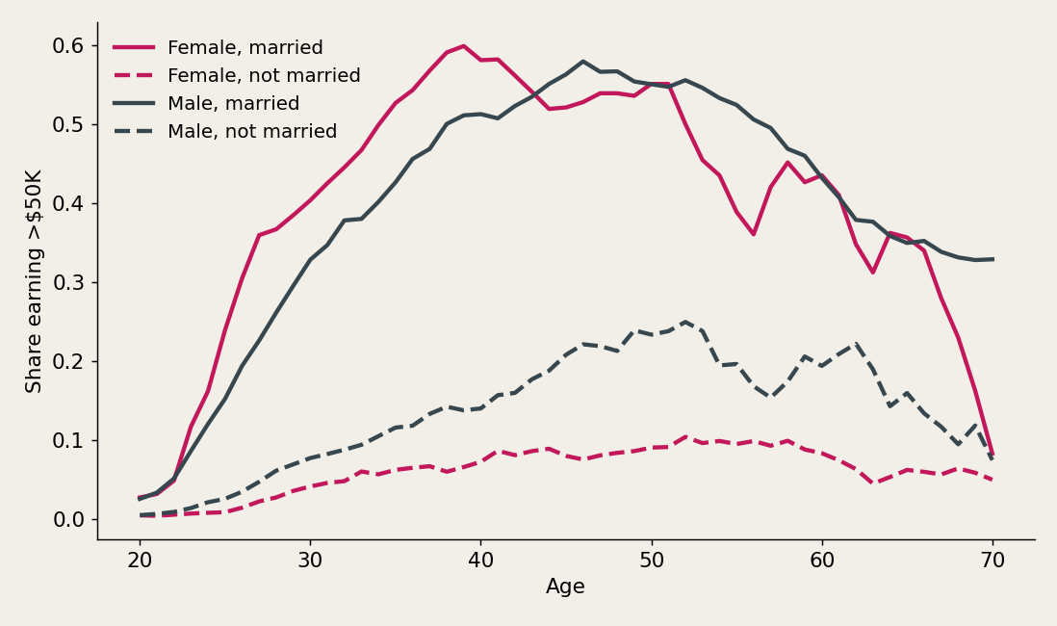
Age Profiles
Marriage Separates Women’s Outcomes Most
51
Ages per series
Median cell, 17 people

Slide 22
Windowing
Eight Ages In, the Ninth Out
Each example: 8 consecutive ages predicting the 9th
Five features per step: rate, age, sex, marriage, education
Split by target age, not at random
Train on ages to 59, hold out 60–70 (620 train, 191 test)
811
Sliding windows

Slide 23
Architectures
Three Recurrent, One Flattened Control
4
Architectures compared
SimpleRNN, LSTM and GRU are all recurrent
Dense on the flattened window & order discarded
MSE loss, Adam, early stopping on validation loss
Seed fixed per model so the comparison is fair

Slide 24
Model Comparison
A Parameter-Free Rule Beats Three of Four Networks
Model | Recurrent | MAE | RMSE
Train mean | — | 0.2096 | 0.2385
Persistence | — | 0.0595 | 0.1007
SimpleRNN | yes | 0.1229 | 0.1489
LSTM | yes | 0.0960 | 0.1218
GRU | yes | 0.0686 | 0.0969
Dense (flattened) | no | 0.0810 | 0.1033
0.824
GRU, best model
Persistence, 0.809

Slide 25
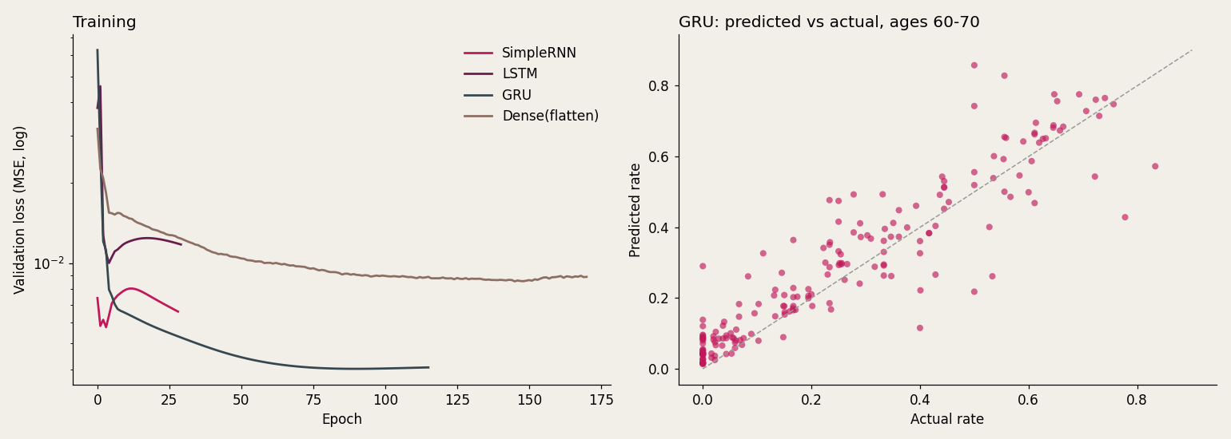
Training
Gated Models Train Longer | SimpleRNN Stops Early
116
Epochs, GRU
SimpleRNN, 29

Slide 26
Where It Fails
Married Women Are the Hardest Group to Fit
0.112
MAE, married women
Married women: MAE 0.112, worst case 0.358
Unmarried women: 0.049
Married men: 0.052 | Unmarried men: 0.081

Slide 27
Act
Where the Disparity Lives, and What Models Can and Can't See
It is widest among the most credentialed and longest-working
Sex still predicts income at 1.25× odds with occupation held constant
Marital status absorbs most of the raw gap and works differently by sex
Age profiles carry real structure, but a persistence rule matches the networks
Only GRU beat the flattened model, and the ranking shifted across seeds
1994 cross-section · age-ordered not time-ordered · correlation not causation

