Slide 1
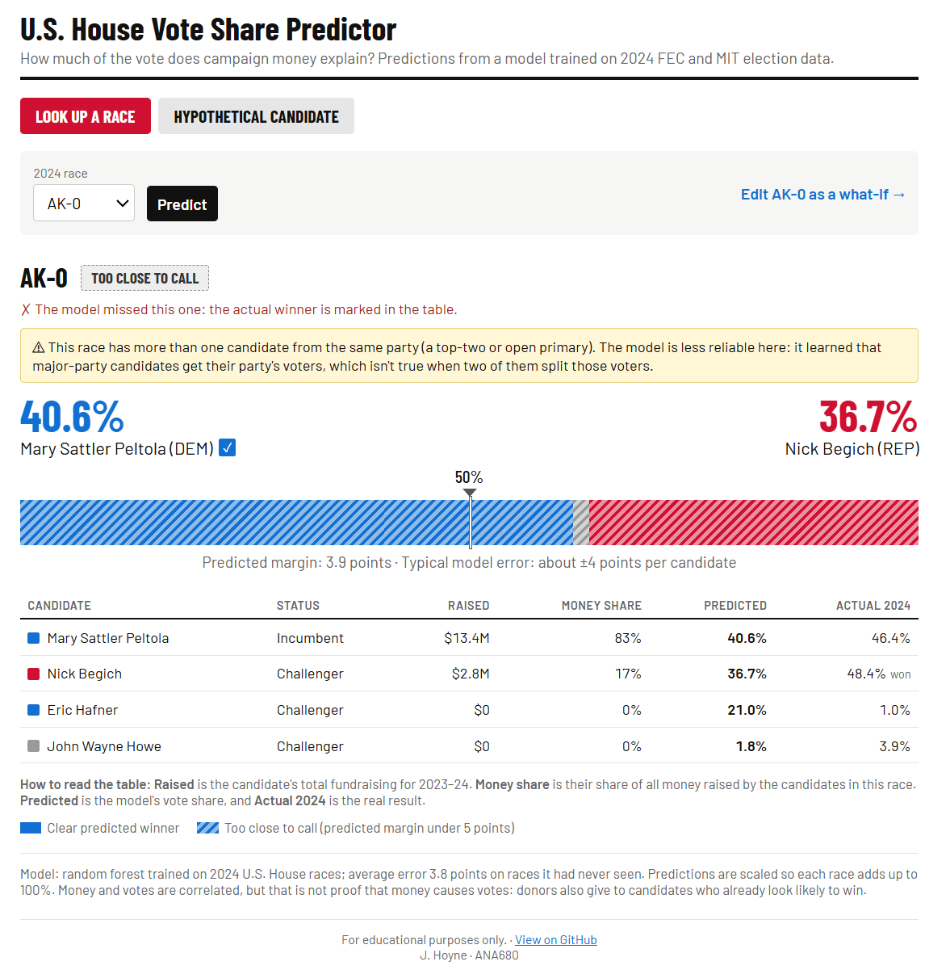
How much of the vote does money explain?
ANA680 · FINAL PROJECT
Predicting 2024 U.S. House vote share from campaign finance and race characteristics
J. Hoyne
Notes:
Open with the question: how much of a House candidate’s vote share can campaign money explain? Money and votes are clearly linked, but not in a straight line. Party, incumbency and what opponents raise all matter too, and they interact. That’s why this is a machine learning problem: the model can learn those combinations from the data instead of me guessing a formula. The bar along the bottom is the same style as the app’s results bar, with the 50% line in the middle.

Slide 2

Data and approach
FEC campaign finance
MIT election results
I
Matched dataset
+
5,302 candidates → 3,078 House filers
1,353 rows → 1,047 general-election candidates
1,023 candidates in 405 races (dropped uncontested)
Money features
Race features
Share of all money raised in the race
Money gap vs. the top opponent
Total raised and opponents’ money
Funding mix: small donors, PACs, self-funding
Party (Democrat, Republican or other)
Incumbent, challenger or open seat
Number of candidates in the race
State
Split by district (70 / 15 / 15), so no race is in both training and testing · Linear regression, random forest and gradient boosting compared · Random forest chosen
Sources: FEC Candidate Summary 2023–24 (fec.gov/data/browse-data/?tab=bulk-data) | MIT Election Data and Science Lab, U.S. House 1976–2024 (doi.org/10.7910/DVN/IG0UN2)
Notes:
Two public datasets: FEC campaign finance for the money, and MIT’s Election Lab for the official vote counts. They share no ID, so I matched them by district and last name, which meant handling accents, two-word last names, married names and names entered backwards. After cleaning and matching, the dataset is 1,023 candidates in 405 races. The features fall into two groups: money relative to the opponents, and characteristics of the race. I split the data by district so candidates from the same race are never in both training and testing, which would leak the answer. I compared three models with cross-validation and chose the random forest.

Slide 3
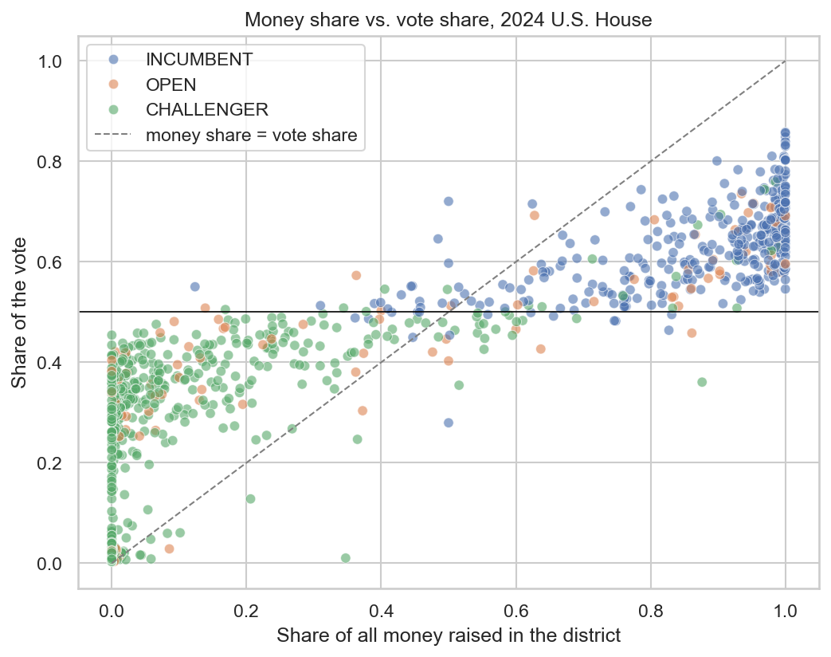
What I found
Money and votes move together, but not one-for-one
Money is far more lopsided than votes
Party sets a floor and a ceiling
Major-party candidates with almost no money still often got 30–45%
Incumbents raise the most and win the most
PAC money and starting cash follow incumbents
The model: about 4 points off on new races
Random forest, tested on races it had never seen
Limits:
Close races: 6 of 9 called
Same-party races (e.g., Alaska)
Correlation ≠ causation
Notes:
The chart is money share against vote share. Money and votes clearly move together, but most points sit above the diagonal on the left and below it on the right: money is much more lopsided than votes. Party sets a floor and a ceiling: a major-party candidate with almost no money still often gets 30 to 45 percent from party voters alone. Incumbents raise the most and win the most, and PAC money and starting cash mostly follow incumbents. The random forest was off by about 4 points on average on races it had never seen. Limits: close races are hard, the model called 6 of 9 close test races. Same-party races, like Alaska’s top-four primary, confuse it, so the app warns users there. And this is correlation, not causation: donors give to candidates who already look likely to win.

Slide 4

From notebook to production
One container, five places
Notebook
Model (.pkl)
Flask app
GitHub Actions
Heroku
Docker image
Local Docker
Heroku container
AWS EC2
AWS SageMaker
Kubernetes
Docker Hub · Amazon ECR
Lessons learned
Next
EC2 timeout: tested on the server, then from my PC, which pointed to the firewall
SageMaker rejected the image format until I pushed it as Docker v2
Found the same-party flaw by using my own app, tested a fix, kept version 1
Test it against the 2026 midterms as new ground truth, and add more election years
Notes:
This slide stays up during the demo; it’s the roadmap. The top row is the path for Part 4: the notebook produces the model file, the Flask app serves it, and GitHub Actions tests it and deploys it to Heroku on every push. The second row is the container: I packaged the app once as a Docker image, and that same image runs locally, on Heroku as a container, on AWS EC2, on AWS SageMaker through Amazon ECR, and on Kubernetes with minikube. Then go through the demo links in this order. Close with what I learned from the hardest problems and what’s next: the 2026 midterms give new ground truth to test how a 2024 model holds up.

Slide 5
Demo links
Stage
Summary
URL
Writeup
GitHub repo and README
https://github.com/jannarhoyne-sys/FEC-Candidate-Summary
Notebook and model
project.ipynb and the .pkl
https://github.com/jannarhoyne-sys/FEC-Candidate-Summary/tree/main/Notebooks
Flask on localhost
Race lookup and a what-if
http://localhost:8080 (run python app.py)
CI/CD pipeline
GitHub Actions runs
https://github.com/jannarhoyne-sys/FEC-Candidate-Summary/actions
Heroku
The live app
https://election-2024-hoyne-5718a83521da.herokuapp.com
Docker Hub
The container image
https://hub.docker.com/r/jannahoyne1/house-vote-share
Heroku container
The container app
https://election-2024-hoyne-docker-791a82f4180f.herokuapp.com
AWS EC2
The app at the server’s IP
http://3.145.216.176 (type http://)
AWS SageMaker
Endpoint page and deploy.py
https://us-east-2.console.aws.amazon.com/sagemaker/home?region=us-east-2#/endpoints
Kubernetes
Config files and minikube
https://github.com/jannarhoyne-sys/FEC-Candidate-Summary/tree/main/k8s

