Slide 1


Slide 2
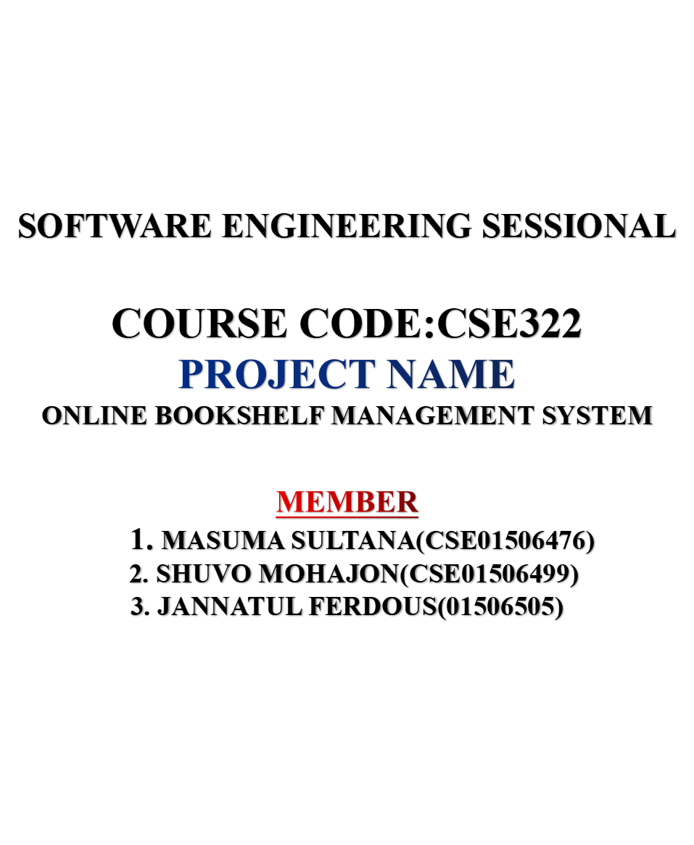

Slide 3
PROJECT OVERVIEW
As the member of books grows in one’s book collection, it would be convenient to have a software utility to manage them. In this project, we propose a software system called online bookshelf management system. It stores book information in a local database. Book information can be easily added, update, delete, search in the database.

Slide 4
Project outcome
* User friendly
* Scalability
* Nice design

Slide 5
Agile Proces Model

Slide 6
What is Agile Proces Model ?
* It is considered both a philoshopy and a method for buidlding and releasing products.
* "Agile process model" refers to a software development approach based on iterative development.
* Agile methods break tasks into smaller iterations, or parts do not directly involve long term planning. The project scope and requirements are laid down at the beginning of the development process.

Slide 7
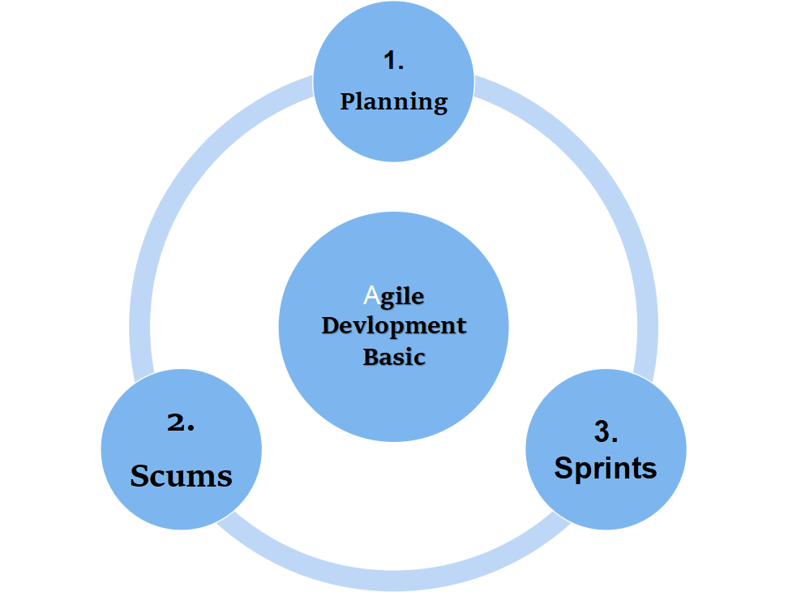

Slide 8
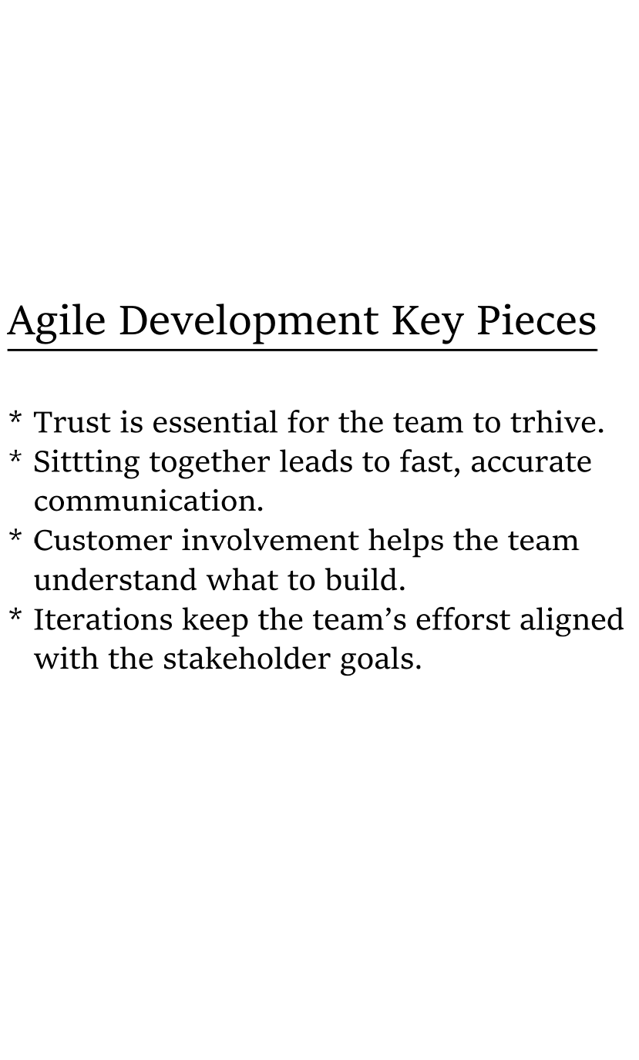

Slide 9
^{Principles of Agile}
* Cusotmer satisfaction by rapid, continous delivery of useful software.
* Working software is delivered frequently
(weeks rather than months)
* Working software is the principal measure of progress.
* Even late changes in requirements are welcome.

Slide 10
^{When to use Agelie Model :}
* When new changes are need to be implement.
* The freedom ageile gives to change is very important.

Slide 11
Advantage
* Time to customer satisfication when continues delivery of useful software.
* Working software is deliver frequently.
* Face to Face conversation is the best form of communcation.

Slide 12
Disadvantage
* Poor resource planning.
* Limited documatation.
* Costly.
* Not suitable for large system.

Slide 13
Goal
* One of the greatest goal of an Agile proce model is improved product quality.

Slide 14
THANK
YOU

