Slide 1
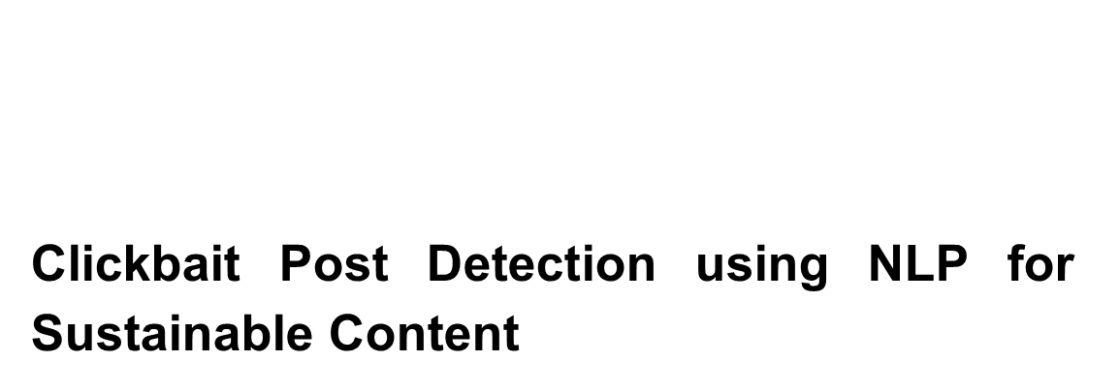
Prepared By: Syeda Jannatul Ferdous
ID: 20301067
Section :01

Slide 2
Motivation
The motivation of this research is to mitigate the clickbait and create reliable content identification.

Slide 3
Contribution
This research enhances clickbait identification, compares methodologies, offers practical insights

Slide 4
Methodology
Gathering dataset
Preprocessing techniques used
Data organization using Word2Vec and TF-IDF feature representation
Concatenation and shuffling of data, storage in an Excel sheet
Application of machine learning methods
Usage of Voting Classifier and Logistic Regression

Slide 5
Conclusion
This Study advances clickbait identification, enhances discernment in deceptive headlines

Slide 6
First Limitation
Limited Understanding of Model Behaviour:
Unclear false positives/negatives hinder model performance evaluation

Slide 7
Second Limitation
Adaptability Issues:
Uncertain effectiveness across platforms, languages, data types

Slide 8
Synthesis
Thorough clickbait analysis, Voting Classifier excels in performance metrics

