Slide 1
GARMENTS INVENTORY MANAGEMENT SYSTEM

Slide 2
SUBSYSTEMS
Raw material storage
Raw material forwarding
Production stage tracking
Delivery subsystem

Slide 3
RAW MATERIAL STORAGE
SUBSYSTEM 1

Slide 4
SEQUENCE DIAGRAM

Slide 5
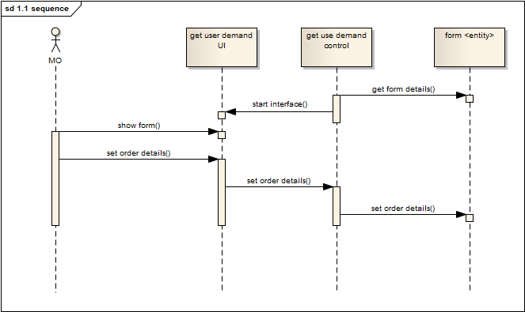
1.1(get user demand)

Slide 6
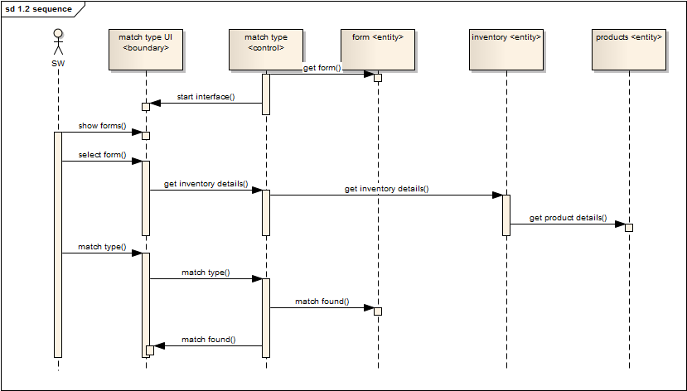
1.2 (match type)

Slide 7
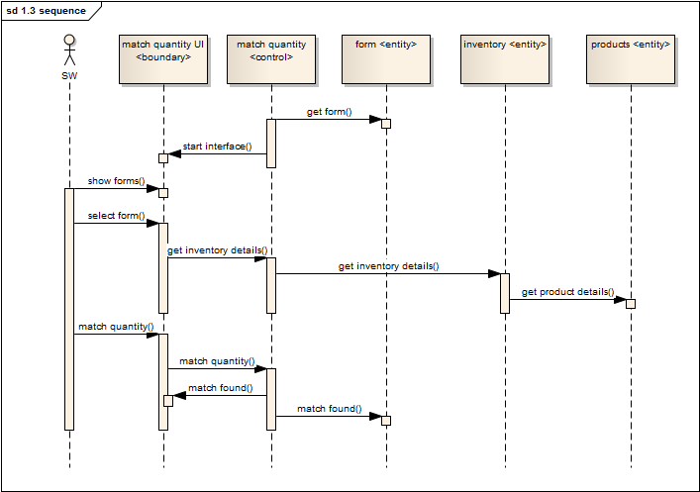
1.3(match quantity)

Slide 8
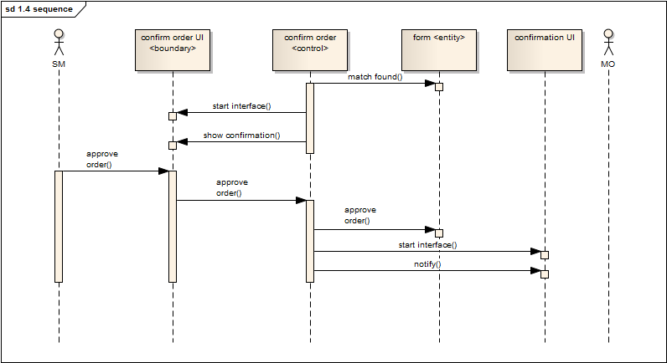
1.4(confirm order)

Slide 9
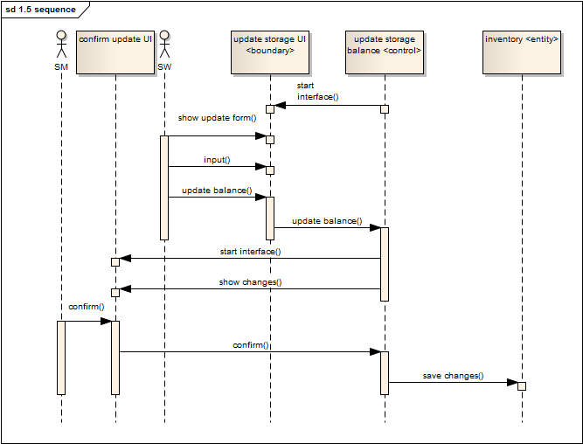
1.5 (update storage balance)

Slide 10
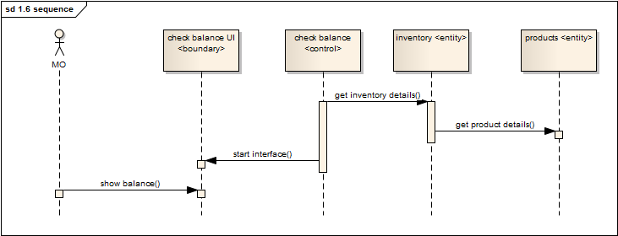
1.6 (check storage balance)

Slide 11
STATE-CHART DIAGRAM

Slide 12
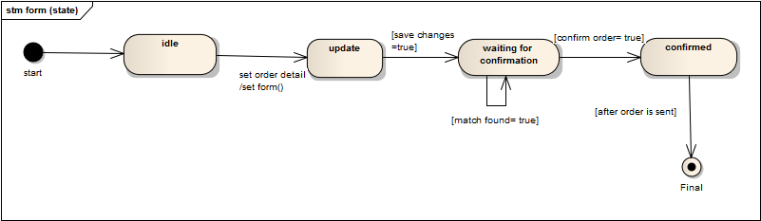
Entity ‘FORM’

Slide 13
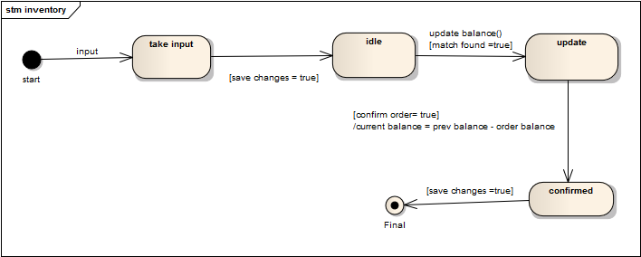
Entity ‘INVENTORY’

Slide 14
Entity ‘PRODUCT’

Slide 15
ACTIVITY DIAGRAM

Slide 16
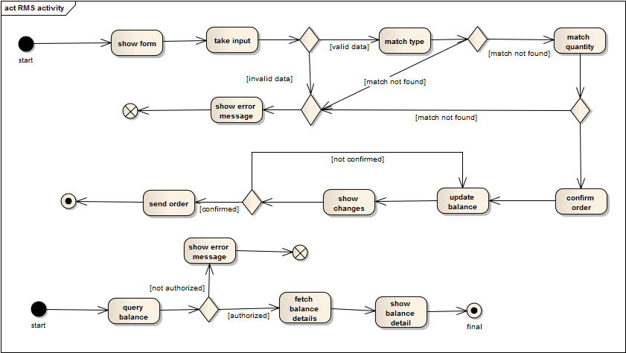

Slide 17
PRODUCTION STAGE TRACKING
SUBSYSTEM 3

Slide 18
SEQUENCE DIAGRAM

Slide 19
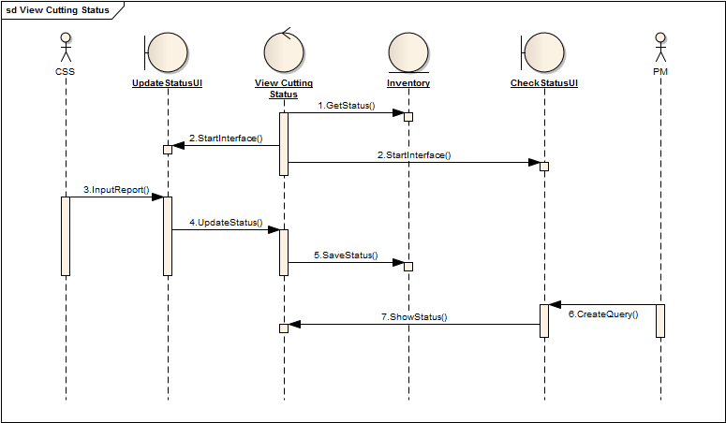
3.1(View Cutting Status)

Slide 20
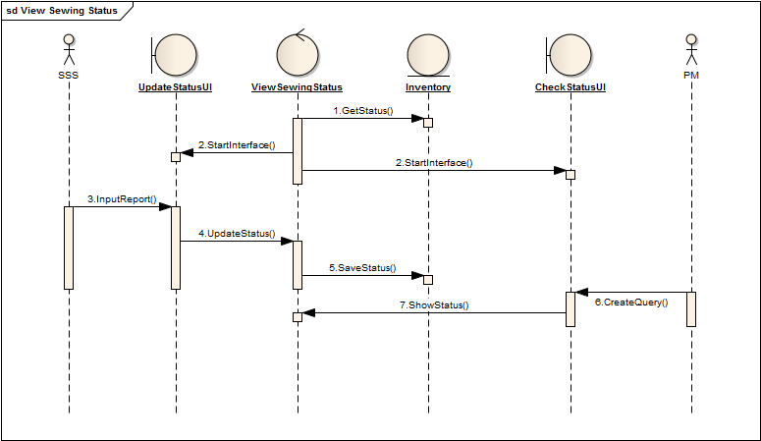
3.2(View Sewing Status)

Slide 21

3.3(view packing status)

Slide 22
3.3(view packing status)

Slide 23
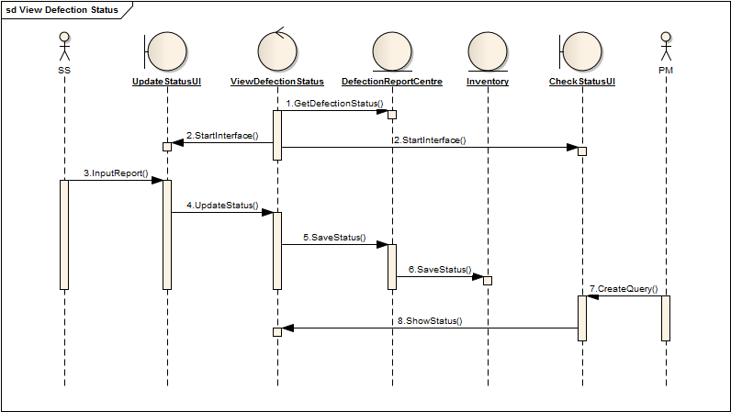
3.4(view defection status)

Slide 24
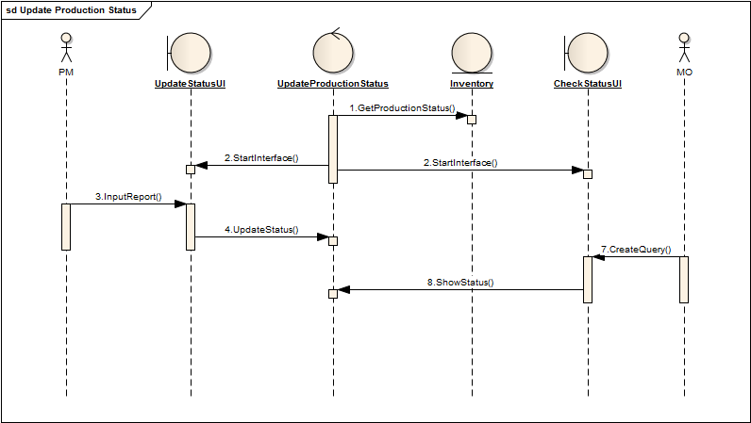
3.5(update production status)

Slide 25
STATE-CHART DIAGRAM

Slide 26
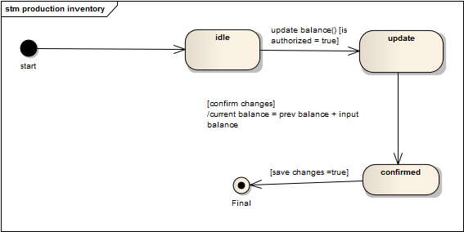
Entity “production inventory”

Slide 27
Entity “defection report center”

Slide 28
ACTIVITY DIAGRAM

Slide 29
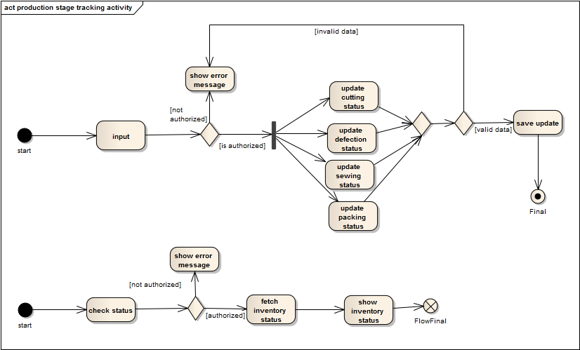

Slide 30
THANK YOU

Slide 31
RAW MATERIAL FORWARDING
SUBSYSTEM 2

Slide 32
SEQUENCE DIAGRAM

Slide 33
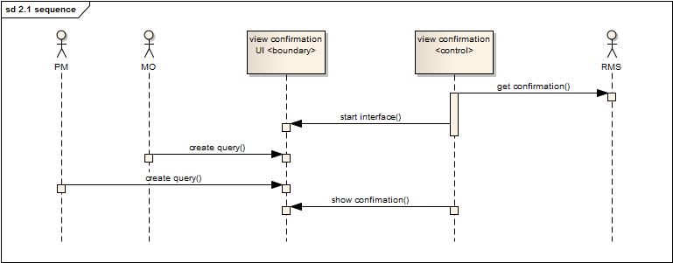
2.1 (view confirmation)

Slide 34
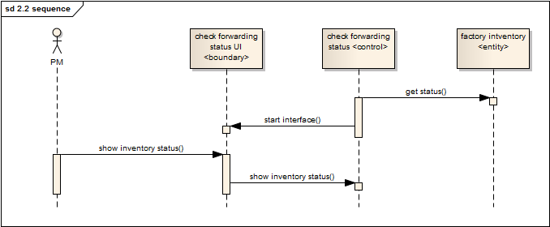
2.2 (check forwarding status)

Slide 35
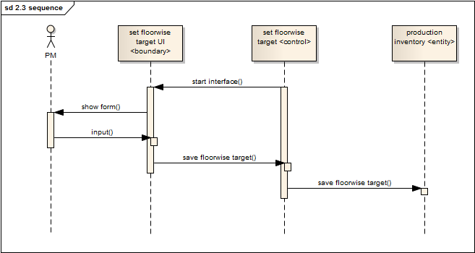
2.3 (set floor wise target)

Slide 36
ACTIVITY DIAGRAM

Slide 37
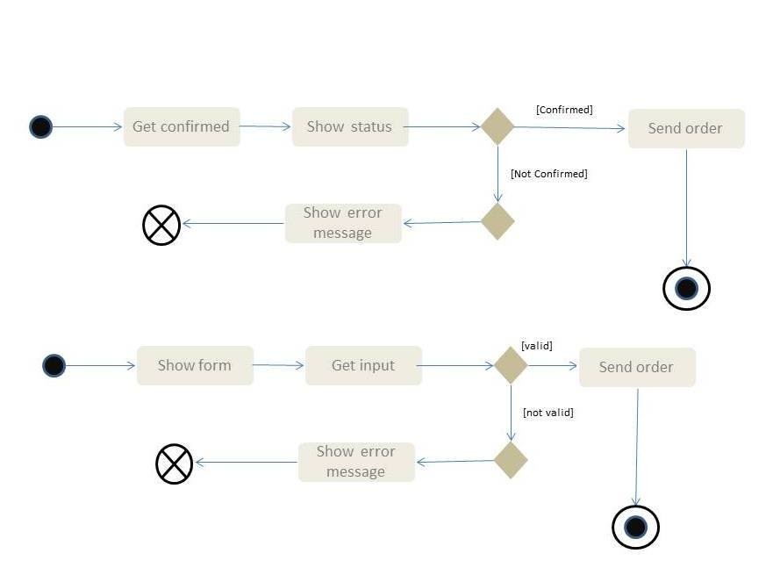

Slide 38
DELIVERY OF PRODUCTS
SUBSYSTEM 4

Slide 39
SEQUENCE DIAGRAM

Slide 40
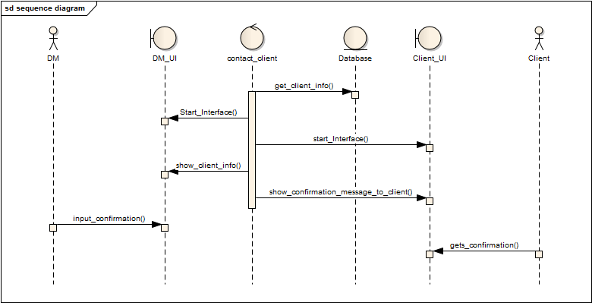
4.1 (Contact client)

Slide 41
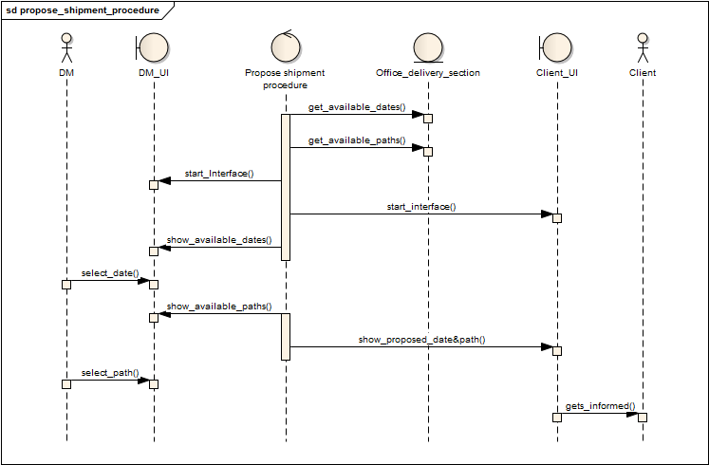
4.2 (Propose shipment procedure)

Slide 42
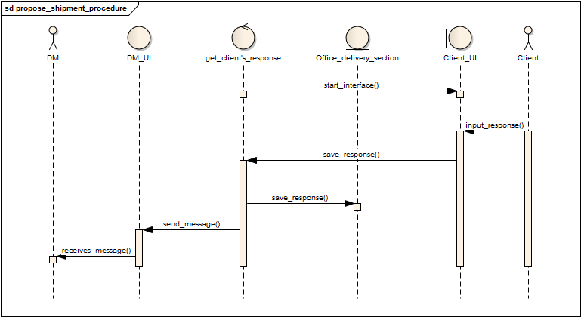
4.3 (Get response from client)

Slide 43
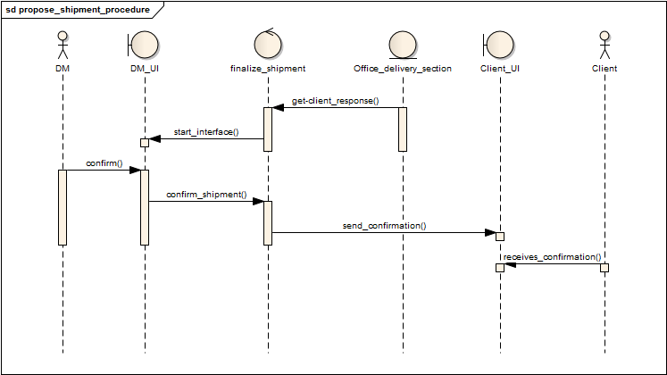
4.4 (Finalize Shipment)

Slide 44
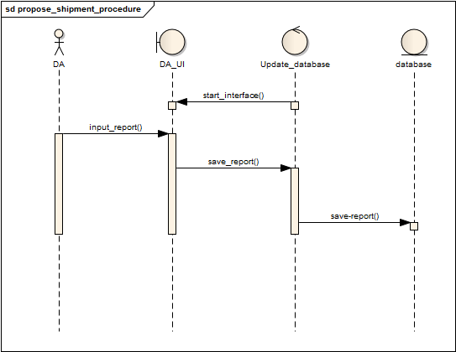
4.5 (Update database)

Slide 45
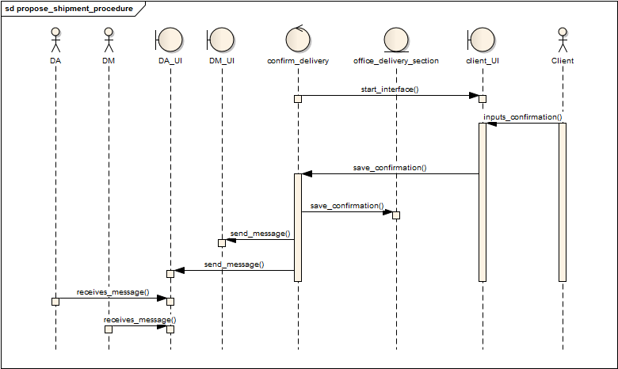
4.6 (Confirm delivery)

Slide 46
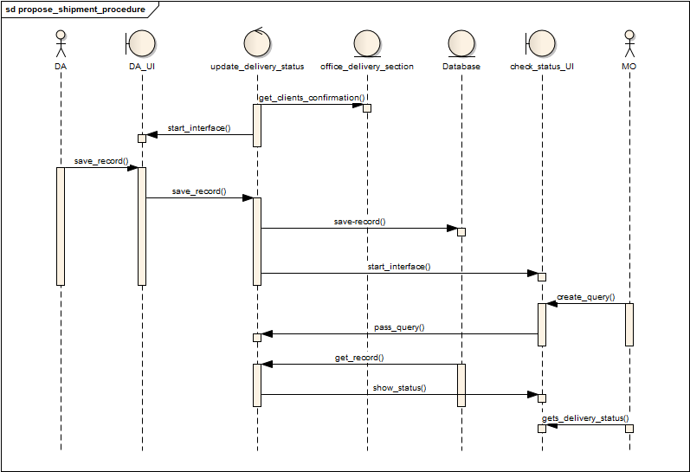
4.7 (Update delivery status)

Slide 47
STATE-CHART DIAGRAM

Slide 48
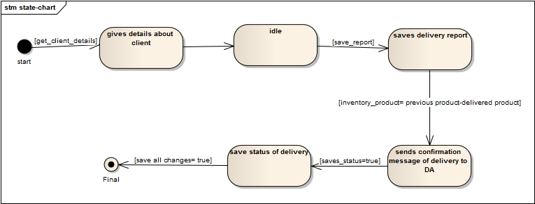
Entity ‘Database’

Slide 49
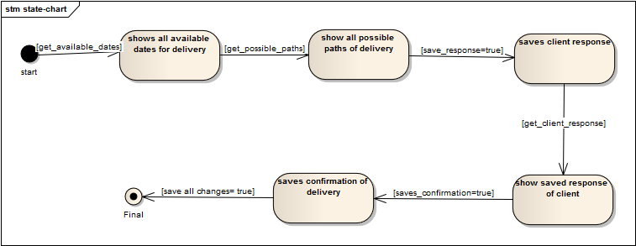
Entity ‘OFFICE DELIVERY SECTION’

Slide 50
ACTIVITY DIAGRAM

Slide 51
