Slide 1



CAPSTONE PROJECT | MASTER OF ANALYTICS
Optimizing Home Loan Decisions with Machine Learning
Default prediction, risk-based borrower segmentation and regulatory stress testing for the Australian mortgage market
Jannathul Firdouz
Auckland University of Technology, in partnership with SAS
With thanks to Dr. Shu Su, Lucy Biasi, Janhav Khanna, Lachlan Catto, Jennifer Chuor
Notes:
Good morning, everyone. My name is Jannathul Firdouz, and today I'll present our capstone project on optimizing home loan decisions using machine learning. First, I'd like to thank my supervisor, Shu, and our industry partners SAS for their guidance and support throughout this project.

Slide 2






Today's agenda
OVERVIEW
01
02
03
Introduction & project motivation
Model development and key results
Borrower segmentation insights
04
05
06
Regulatory and economic impact
Housing market health & policy actions
Conclusion and future directions
Notes:
Here's what I'll talk about today. I'll start with the project background and goals, then explain the methods and model development. After that, I'll share the key results and borrower segmentation insights. We'll also look at the regulatory and economic impacts, and finally, I'll end with the main conclusions and future work.

Slide 3







Project background & motivation
INTRODUCTION
SAS leadership
Market challenges
Global leader in advanced analytics and AI solutions
Rising interest rates and tighter lending regulations
Trusted by major Australian banks for credit risk and compliance
Increasing borrower defaults and affordability pressures
Growing demand for faster, data-driven loan decisions
Banks need lending decisions that are both fast and safe.
Notes:
SAS is a global leader in analytics, trusted by major Australian banks for credit risk modeling. This project was motivated by challenges in today's mortgage market. Banks are facing rising interest rates, tighter regulations, and growing competition among lenders. At the same time, more people struggle to repay home loans. Banks need a better way to make lending decisions that are both fast and safe.

Slide 4

Project objectives
INTRODUCTION
OBJECTIVE 1
OBJECTIVE 2
OBJECTIVE 3
Develop & evaluate loan origination models
Segment borrowers by risk profile
Analyse regulatory & economic impacts
Build and compare default prediction models using SAS Viya and Workbench.
Turn predicted risk into four actionable borrower segments for fairer lending.
Stress-test lending rules and economic shocks to guide housing policy.
Notes:
This project has three main objectives. First, we develop and evaluate advanced home loan origination models using SAS tools. Second, we segment borrowers based on financial and credit characteristics to help banks design fairer lending strategies. Third, we analyze how regulatory policies and economic conditions impact loan affordability and the housing market.

Slide 5
Dataset overview: SAS HMEQ home equity loans
DATA
5,960
13
20%
loan applications
variables
default rate (realistic imbalance)
Target variable
BAD = 1 defaulted | BAD = 0 paid back
Predictor variables
Financial: LOAN, MORTDUE, VALUE, DEBTINC
Employment: JOB, YOJ
Credit: DEROG, DELINQ, CLAGE, NINQ, CLNO
Loan purpose: REASON
Figure 1: Distribution of target variable (BAD)
Notes:
For this project, we used the SAS HMEQ Home Equity Loan dataset, which contains 5,960 loan applications with 13 variables. Our target variable is BAD, where 1 indicates a defaulted loan and 0 indicates a paid-back loan. As shown in the bar chart, about 20 percent of loans defaulted, reflecting a realistic class imbalance. The predictor variables cover financial factors, employment details, credit history, and loan purpose.

Slide 6
Building smarter home loan origination models
01
Using SAS Viya and Workbench to enhance accuracy and efficiency in loan approvals
Notes:
Now we are moving to Objective 1, which is to build smarter home loan models using SAS Viya to make loan approvals faster and more accurate.

Slide 7





Pipeline for loan origination models
OBJECTIVE 1 | METHOD
STEP 1
STEP 2
STEP 3
STEP 4
STEP 5
STEP 6
Raw data collection
Data cleaning & preparation
Feature engineering & selection
Model training & optimization
Validation & performance testing
Business integration & deployment
Missing value imputation, outlier treatment
WOE binning, IV ranking
4 candidate models
AUC, Gini, KS, F1
SAS Viya decisioning
Notes:
This data pipeline shows how we achieved Objective 1. We collected and cleaned data, selected key features, built and tested predictive models, and prepared them for deployment in loan decisions.

Slide 8
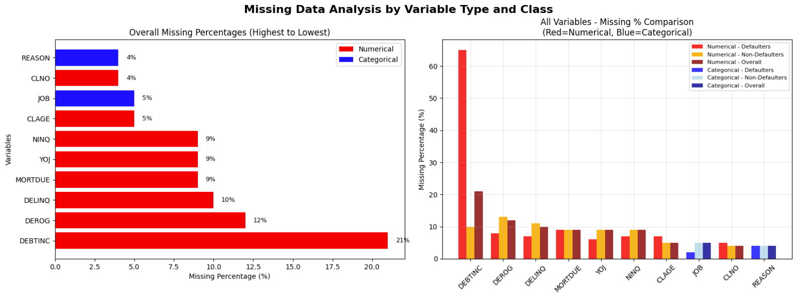


Data cleaning: missing value imputation
OBJECTIVE 1 | DATA PREPARATION
65% vs 10%
DEBTINC missing for defaulters vs non-defaulters. Missingness itself is a strong risk signal.
Figure 2: (L) Group-wise missing values (%) by variable | (R) DEBTINC before and after imputation
Advanced regression-based group-wise imputation
Missing-value indicators created as predictors
Imputation validated: distributions preserved
Notes:
Missing data was a key challenge here. Debt-to-Income ratio (DEBTINC) had 65% missing for defaulters but only 10% missing for non-defaulters. This tells us missingness itself is a strong risk signal. We used group-wise imputation and also created missing indicators to capture this predictive power. After imputation, we ensured the data distribution remained the same.

Slide 9
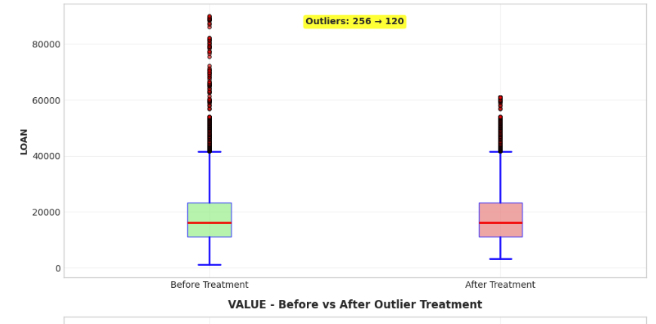


Outlier detection & treatment
OBJECTIVE 1 | DATA PREPARATION
Detection
Outliers found in LOAN, VALUE, DEBTINC, CLAGE
47 to 60 extreme cases per variable (1st / 99th percentile)
Treatment
Winsorized at the 1st / 99th percentile
All samples kept, only extremes capped
Risk outliers (e.g. delinquencies) retained as genuine behaviour
Figure 3: Outlier treatment for VALUE, capping at the 1st and 99th percentiles
Notes:
We handled financial outliers (e.g. high loans, property values) using Winsorization. Risk-related outliers (e.g. delinquencies) were kept, as they reflect borrower behavior. Extreme values were capped to maintain stability without losing key insights. This visual is an example of before and after outlier treatment.

Slide 10



Feature engineering & transformation
OBJECTIVE 1 | FEATURE ENGINEERING
Binning & discretization
Derived variables
Benefits
Weight of Evidence (WOE) binning for continuous variables
Risk-based categories via quantile binning
Manual binning for sparse counts (DEROG, DELINQ, NINQ)
Loan-to-value (LTV) ratio
Missing-value indicator flags
Improved model interpretability
Enhanced predictive power
Better handling of non-linear relationships
Scorecard-ready features
Notes:
In this step, we converted continuous variables to categorical bins and applied Weight of Evidence (WoE) to key predictors to improve interpretability and model performance. We also created a new variable, the Loan-to-Value ratio. These steps made the data more suitable for credit risk modeling.

Slide 11
Weight of Evidence (WOE) & Information Value (IV)
OBJECTIVE 1 | FEATURE ENGINEERING
Rules for interpreting IV
WEIGHT OF EVIDENCE
WOE = ln ( % of goods / % of bads )
Information value | Predictiveness
< 0.02 | Not useful for prediction
0.02 to 0.1 | Weak predictive power
0.1 to 0.3 | Medium predictive power
0.3 to 0.5 | Strong predictive power
> 0.5 | Suspiciously strong (check for leakage)
Measures how well each bin separates good from bad borrowers. % of goods (bads) = share of all good (bad) customers that fall in the bin.
INFORMATION VALUE
IV = Σ ( % of goods − % of bads ) × WOE
Summarises a variable's overall power to predict default, used to rank and select features.
Notes:
We used Weight of Evidence to measure how variables separate defaulters from non-defaulters, then calculated Information Value to find the most useful variables for predicting risk.

Slide 12
Debt burden and credit history are the strongest predictors
OBJECTIVE 1 | FEATURE SELECTION
Feature | IV | Strength
DEBTINC | 0.7751 | Very strong
DELINQ | 0.5411 | Very strong
CLAGE | 0.2434 | Medium
DEROG | 0.2317 | Medium
NINQ | 0.1575 | Medium
LOAN | 0.0972 | Weak
MORTDUE | 0.0469 | Weak
VALUE | 0.0443 | Weak
YOJ | 0.0281 | Weak
CLNO | 0.0211 | Weak
Table 1: IV values and feature strength in predicting loan default
Notes:
Based on the table results, we selected the top predictors. Variables like LOAN, MORTDUE, and VALUE had lower scores but were still helpful, so we kept them in the model.

Slide 13



Model development overview
OBJECTIVE 1 | MODELLING
Data split
Logistic regression
Baseline scorecard model
4,172
1,788
Decision tree
training samples (70%)
test samples (30%)
Interpretable splits
Stratified sampling keeps a 20% default rate in both sets
Class weighting handles the imbalance
Random forest
Ensemble method for accuracy
Neural network / gradient boosting
Strong predictive power
Notes:
After selecting the features, we split the data into 70% for training and 30% for testing, maintaining the same 20% default rate in both sets. Due to the imbalanced dataset, we used class weighting. We then built and compared models such as Logistic Regression, Decision Tree, Random Forest, Neural Network and Gradient Boosting.

Slide 14

Random forest is the champion model
OBJECTIVE 1 | RESULTS
Model | Accuracy | F1-score | ROC-AUC
Logistic regression | 85.1% | 69.3% | 91.0%
Decision tree | 91.1% | 78.0% | 87.8%
Neural network | 94.9% | 86.1% | 95.7%
Random forest | 95.0% | 86.6% | 96.6%
CHAMPION MODEL
Random forest
0.966
0.866
Table 2: Test-set performance across candidate models
ROC-AUC
F1-score
Highest ROC-AUC and F1 of all models, balancing accuracy, stability and business performance.
Notes:
We compared several models, including Logistic Regression, Decision Tree, Neural Network, and Random Forest. Both Neural Network and Random Forest did well, but the Random Forest performed better overall. It had the highest scores for ROC-AUC and F1-score, showing it is accurate and reliable at predicting borrower risk. These results suggest that the Random Forest is the best choice because it balances accuracy, understanding, and business performance.

Slide 15
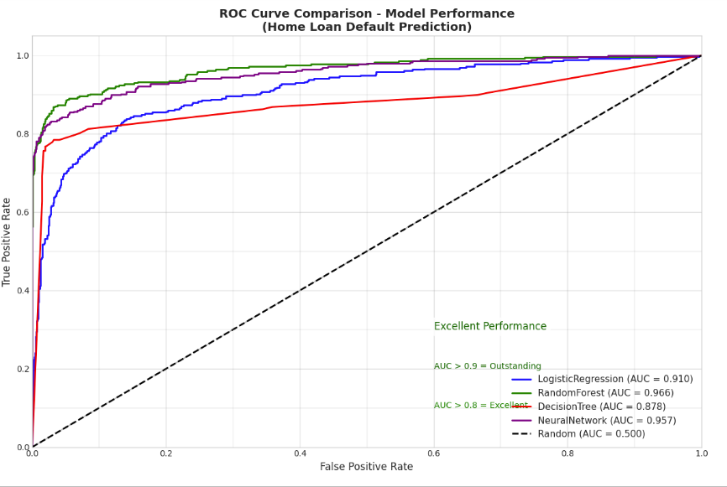
Champion model evaluation: random forest
OBJECTIVE 1 | RESULTS
0.966
0.931
ROC-AUC
Gini
Excellent classification
Outstanding discrimination
0.837
95%
KS statistic
Accuracy
Strong separation
Overall
80%
0.994 / 0.966
Recall
Train / test AUC
Bad loans caught
Low overfitting
Stable, accurate and ready for deployment in SAS Viya
Figure 4: ROC curve comparison across models
Notes:
As shown in the figure, the random forest ROC curve stays very close to the top-left corner, indicating excellent model performance. The Random Forest achieved a ROC-AUC of 0.966, a Gini score of 0.931, and a KS value of 0.837, demonstrating a strong ability to distinguish between risky and safe borrowers. It reached 95% overall accuracy and successfully identified about 80% of defaulters. There was minimal overfitting, with a training AUC of 0.994 and a test AUC of 0.966. Overall, the model is stable, highly accurate, and ready for deployment in SAS Viya.

Slide 16

What Objective 1 delivered
OBJECTIVE 1 | KEY FINDINGS
Higher predictive accuracy
Excellent risk discrimination
Advanced models such as neural network and random forest outperformed the logistic baseline.
Random forest delivered the best separation of good and bad borrowers with strong stability.
Fairer, more accurate approvals
Data-driven origination
Better-calibrated risk reduces both wrongful rejections and risky approvals.
Supports an efficient home loan origination process in the Australian market.
Notes:
Here are the key findings from Objective 1. Advanced models, such as Neural Network and Random Forest, significantly improved predictive accuracy. Among them, Random Forest provided the best risk discrimination and showed strong model stability. These results demonstrate that the model not only improves accuracy but also enhances fairness in loan approvals. Overall, it supports a more efficient, data-driven home loan origination process in the Australian market.

Slide 17
A smarter lending strategy: risk-based borrower segmentation
02
Using machine learning to drive profitability and manage risk
Notes:
Next, we move to Objective 2. We used machine learning to segment borrowers by risk, helping improve lending decisions, reduce risk, and meet business and regulatory goals.

Slide 18


From prediction to action
OBJECTIVE 2 | METHOD
Leverage
Segment
Enable
our high-performance default prediction model
borrowers into distinct risk profiles
targeted product offers, pricing and automated decisions
Turning predictive scores into actionable lending strategies.
Notes:
Our high-performing default prediction model lets us segment borrowers into clear risk profiles. This enables targeted product offers, more accurate pricing, and faster, automated decisions. Essentially, we're turning predictive scores into actionable lending strategies.

Slide 19
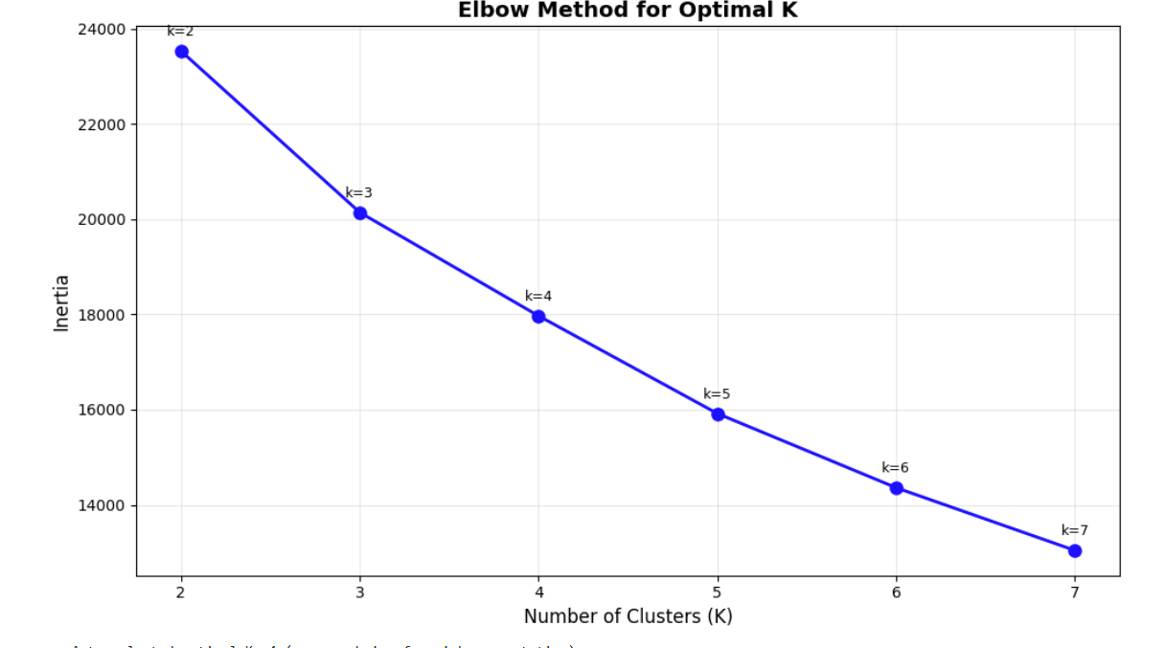


Borrower segmentation using K-means clustering
OBJECTIVE 2 | METHOD
Elbow method
Clear bend at K = 4
Silhouette score
0.19 at K = 4 (acceptable)
Davies-Bouldin / Calinski-Harabasz
1.617 / 868.6, well-separated segments
Business fit
Industry standard of 4 actionable risk tiers
Figure 5: Elbow method for the optimal number of clusters (K)
Notes:
We used K-Means clustering to group borrowers based on their risk profiles. To choose the best number of clusters, we applied the elbow method, silhouette scores, and other evaluation metrics, and found that four clusters gave the best balance of simplicity and separation. This makes the segmentation reliable and useful for real-world lending strategies.

Slide 20
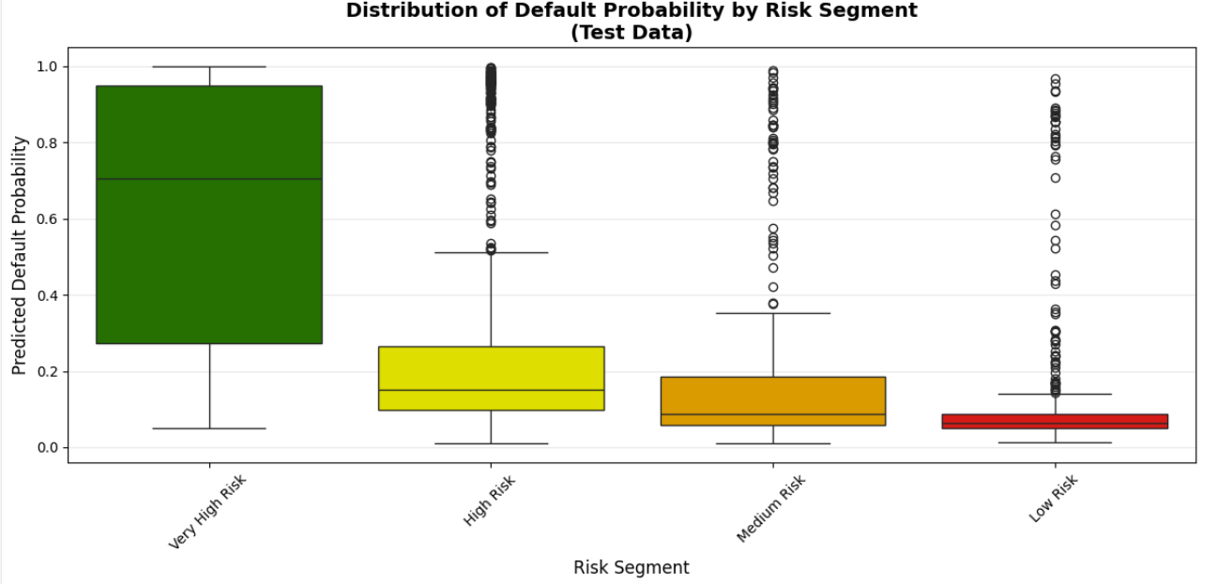
Introducing the four borrower personas
OBJECTIVE 2 | SEGMENTS
LOW RISK
The Secure Borrower
Stable finances, clean history
MEDIUM RISK
The Managing Borrower
Moderate debt, some credit hiccups
HIGH RISK
The Strained Borrower
High debt burden, notable credit issues
Figure 6: Predicted default probability distribution by risk segment
VERY HIGH RISK
Default probability rises steadily from Secure to Vulnerable borrowers, giving each persona a clear lending treatment.
The Vulnerable Borrower
Severe financial distress
Notes:
We identified four borrower types: Secure Borrower, low risk with stable finances. Managing Borrower, medium risk with some debt. Strained Borrower, high risk with credit issues. Vulnerable Borrower, very high risk with financial stress. These personas help us create targeted lending strategies. The boxplot shows default probabilities are highest for Vulnerable Borrowers, medium for Strained and Managing Borrowers, and lowest for Secure Borrowers.

Slide 21
Segments match real-world default outcomes
OBJECTIVE 2 | VALIDATION
Low Risk
452 applicants
+3 pts
Medium Risk
299 applicants
+4 pts
High Risk
844 applicants
+8 pts
Very High Risk
193 applicants
+1 pt
MAE 0.040
Average error of about 4 points; highest-risk segment predicted almost exactly.
Figure 7: Predicted vs actual default rates (test set)
Notes:
The key question is: do these segments reflect real-world outcomes? The answer is yes. Comparing predicted risk to actual defaults in our test data, the average error was only 4%. This shows our segments are accurate and reliable enough to guide real business decisions.

Slide 22
Strategic decision framework
OBJECTIVE 2 | STRATEGY
1. Segment by risk profile
2. Define action
3. Assign terms
4. Monitor & adjust
Risk segment | Portfolio | Lending action | Pricing | Monitoring
Low Risk | 29.3% | Auto-approve: instant decision | 6.5 to 7.5% | Light touch, quarterly review
Medium Risk | 42.4% | Approve with conditions: extra verification | 7.5 to 9.0% | Standard monitoring, payment tracking
High Risk | 18.1% | Manual review: senior assessment | 9.0 to 11.5% | Active monitoring, early-warning alerts
Very High Risk | 10.2% | Decline: protect portfolio | 12.5%+ if approved | Intensive monitoring, default prevention
Notes:
Let me walk you through our risk-based lending strategy. For LOW RISK borrowers, about 29% of applicants, we auto-approve them quickly, offer competitive rates between 6.5 and 7.5%, and only do light monitoring after approval. MEDIUM RISK applicants, the largest group at 42%, get conditional approval with some extra checks, pay slightly higher rates of 7.5 to 9.0%, and receive standard monitoring. HIGH RISK borrowers, 18% of applicants, require manual review by senior staff, pay premium rates of 9.0 to 11.5% to compensate for their risk, and get active monitoring with early warning alerts. VERY HIGH RISK applicants, 10% of cases, we typically decline to protect our portfolio. If approved under strict conditions, they'd pay 12.5% or higher with intensive monitoring. The key insight: borrowers pay rates that match their risk level, while we manage our portfolio responsibly.

Slide 23
Business impact summary
OBJECTIVE 2 | IMPACT
67.3%
20-25%
29.1%
55.1%
of customers get instant decisions
reduction in portfolio default risk
margin improvement on approved loans
better capital utilization
Metric | Before | After | Improvement
Default rate | 20.0% | 13.7% | 20-25% reduction
Profit margin | 7.0% avg | 9.04% avg | 29.1% increase
Auto-approval | Manual process | 67.3% automated | Efficient process
Capital efficiency | $50.3M RWA | $22.6M RWA | 55.1% better capital use
Table 3: Business benefits. RWA = risk-weighted assets; APRA = Australian Prudential Regulation Authority. Calculations in the appendix.
Notes:
Implementing this Strategic Decision Framework delivers significant benefits: 67% of customers get instant loan decisions. Portfolio default risk drops by roughly 20 to 25%. Profit margins on approved loans improve by about 29%. Capital utilization becomes 55% more efficient. This framework helps us serve customers faster, reduce risk, increase profits, and make better use of our resources.

Slide 24


What Objective 2 delivered
OBJECTIVE 2 | KEY FINDINGS
Four risk segments
Validated against reality
Tailored actions
Portfolio benefits
Fair & compliant
Low, Medium, High and Very High risk, each with a clear persona.
Segments match actual defaults with an average error of about 4%.
Fast-track, conditional, senior review or minimise exposure.
Faster decisions, fewer defaults, higher margins, efficient capital.
Supports fair, data-driven and compliant lending decisions.
Notes:
Based on our predictive model, we segmented borrowers into four risk profiles: Low, Medium, High, and Very High Risk. These segments closely match real-world outcomes, with an average prediction error of only about 4%. Each segment has tailored actions, from fast-track approvals for low-risk borrowers to cautious handling of very high-risk applicants. Implementing this framework improves portfolio performance: faster decisions, 20 to 25% reduction in default risk, 29% margin improvement, and 55% more efficient capital utilization. Overall, this approach ensures fair, data-driven, and compliant lending decisions.

Slide 25
Regulatory & economic impact on home loans
03
1
Assess how lending regulations affect loan origination and affordability
2
Analyse the effect of economic shocks on loan volumes and default risk
3
Provide insights for policy that supports a stable housing market
Notes:
The main goal of Objective 3 is to understand how regulatory and economic factors influence home loan origination and affordability. We specifically look at how changes in lending regulations or economic shocks affect loan volumes and default risks. These insights will help us propose policy recommendations aimed at supporting a healthier and more stable housing market.

Slide 26

Four key areas of study
OBJECTIVE 3 | METHOD
Regulatory impact
Economic scenarios
Market health assessment
Policy actions
How LVR, buffers, DTI limits and stress rates change loan origination
Rate shocks, housing corrections, recovery and stagflation
Scorecard across five dimensions of housing market health
Prioritised recommendations and their cumulative impact
Notes:
Our methodology for Objective 3 has four parts: analyzing regulatory impacts, modeling economic shocks, assessing market health, and providing policy recommendations.

Slide 27
Regulatory impact analysis: three scenarios
OBJECTIVE 3 | REGULATION
Scenario | LVR limit | Serviceability buffer | DTI limit | Stress test rate
Current APRA | 0.80 | 0.03 | None | 0.07
Tightened regulation | 0.70 | 0.04 | 6.0 | 0.08
First home buyer support | 0.90 | 0.025 | 7.0 | 0.065
Table 4: Regulatory scenarios on lending standards and stress testing
Current APRA
Tightened regulation
First home buyer support
Baseline regulatory settings: up to 80% LVR with a 3% serviceability buffer.
Stricter risk limits: 70% LVR, higher buffer and stress rate, DTI cap of 6.
Relaxed entry conditions: 90% LVR and lower stress test rate.
Notes:
This table presents the regulatory scenarios we modeled using APRA parameters. Under the Current APRA rules, borrowers can borrow up to 80% of the property value with a 3% serviceability buffer. Tightened Regulation reduces the LVR to 70% and raises stress test rates to limit risk. First Home Buyer Support is more flexible, allowing a 90% LVR and lower test rates to assist new buyers.

Slide 28
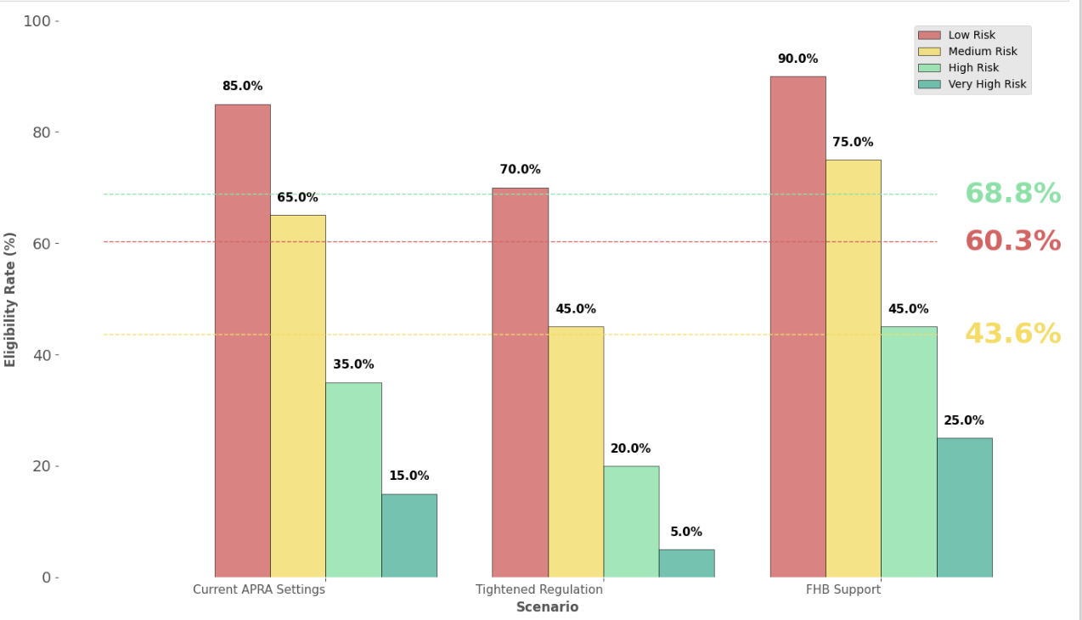
Tighter rules improve stability but reduce access
OBJECTIVE 3 | REGULATION
Average borrower eligibility
69%
First home buyer support
60%
Current APRA
44%
Tightened regulation
Low-risk borrowers are barely affected; high-risk borrowers are highly sensitive, so targeted support works better than blanket changes.
Figure 8: Regulatory impact on borrower eligibility by risk segment
Notes:
In this chart, we show the average borrower eligibility under different regulatory scenarios. Current APRA allows about 60% of borrowers to qualify. Tightened regulations reduce eligibility to 44%, while First Home Buyer Support increases it to around 69%. Low-risk borrowers are mostly unaffected, whereas high-risk borrowers are very sensitive to these changes, highlighting the need for targeted policy interventions.

Slide 29

Macroeconomic stress scenarios
OBJECTIVE 3 | ECONOMY
Scenario | Interest rate | Property prices | Unemployment | Consumer confidence
Interest rate shock | +2.0% | -5.0% | +1.0% | -10%
Housing market correction | +1.0% | -15.0% | +2.0% | -20%
Economic recovery | -1.0% | +8.0% | -1.5% | +15%
Stagflation | +3.0% | -10.0% | +2.5% | -25%
Table 5: Economic scenarios with changes in interest rates, property prices, unemployment and consumer confidence. Green = favourable, red = adverse.
Scenarios are severe but plausible stress tests to assess portfolio resilience, not forecasts of future events.
Notes:
This slide summarizes the economic scenarios we modeled. For example, an interest rate shock assumes rates rise by 2%, property prices fall by 5%, unemployment increases by 1%, and consumer confidence drops by 10%. Each scenario helps us understand how different economic changes could impact the housing market and loan affordability, allowing banks and policymakers to plan for potential risks.

Slide 30
Economic shocks cut lending and raise default risk
OBJECTIVE 3 | ECONOMY
+2% interest rate
Origination -7.9%, defaults +6.4%
-15% property values
Origination -14.1%, defaults +13.7%
Economic recovery
Origination +9.9%, defaults +1.1%
Stagflation
Origination -16.9%, defaults +12.1%
Figure 9: Impact of economic changes on lending and loan risk
Notes:
This chart shows how different economic scenarios affect the housing and lending market. When interest rates rise by about 2%, loan origination drops by nearly 8%, and default risk increases by around 6%, showing tighter lending conditions. A 15% fall in property values has an even stronger impact: origination falls by 14% and defaults rise by nearly 14%. During economic recovery, loan activity increases by about 10% with only a small rise in defaults, which is positive for lenders. Stagflation (high inflation plus slow growth) causes a big drop in lending (17%) and higher risk (12.1%). Overall, these results highlight how economic changes directly influence lending volumes and borrower risk, helping banks plan for different conditions.

Slide 31
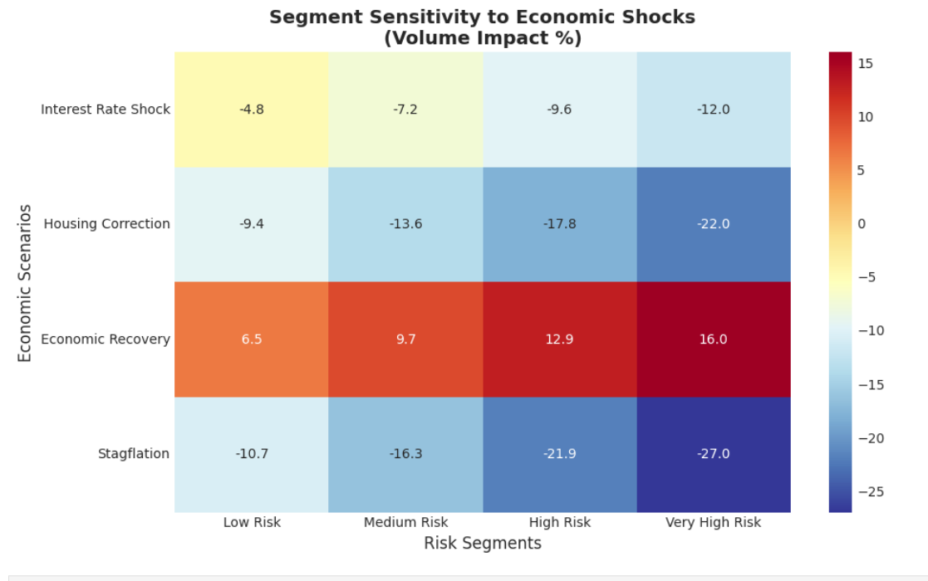
Riskier segments are most sensitive to shocks
OBJECTIVE 3 | ECONOMY
Interest rate shock
Negative across all segments, worsening with risk
Housing correction
Significant; most severe for Medium to Very High risk
Economic recovery
Positive; gains increase with risk
Stagflation
Strong negative, especially High and Very High risk
High-risk borrowers fall up to 27% in downturns but recover fastest (up to +16%).
Figure 10: Volume impact across risk segments by economic scenario
Notes:
The heatmap shows how different groups of borrowers react to changes in the economy. During tough times, high-risk borrowers drop a lot, up to 27%, which shows they are very vulnerable. But when the economy recovers, they also bounce back the fastest, up to 16%. These groups are risky, but they also have the chance to grow quickly when conditions get better. This means lenders need to carefully balance taking advantage of opportunities and managing risks.

Slide 32
Housing market health assessment
OBJECTIVE 3 | MARKET HEALTH
OVERALL HEALTH SCORE
69.2 / 100
Moderately healthy: stable, with room to improve
Strongest
Weakest
Affordability
Access
75
60
Figure 11: Market health score breakdown by category
Notes:
Next, we used a scorecard approach to measure housing market health across five categories: Affordability, Access, Stability, Sustainability, and Resilience. The bar chart shows that Affordability (75) is the strongest area, while Access (60) is the weakest, meaning many people still struggle to qualify for loans. The Overall Health Score stands at 69.2, which classifies the market as moderately healthy: stable, but with room for improvement in access and resilience. Based on these findings, we now move to practical policy recommendations that can help address the gaps.

Slide 33

Policy recommendations
OBJECTIVE 3 | POLICY
HIGH PRIORITY
MEDIUM PRIORITY
MEDIUM PRIORITY
Credit access optimization
Risk-based capital framework
Affordability support schemes
Review serviceability buffers
Implement tiered LVR limits
Streamline the application process
Introduce risk-weighted capital rules
Mandatory stress testing for lenders
Expand shared equity schemes
Enhance first home buyer grants and guarantees
Notes:
Our policy priorities focus on improving access, managing risk, and supporting affordability. High priority: optimize credit access by reviewing buffers, tiered LVR limits, and streamlining applications. Medium priority: strengthen the system with risk-based capital rules and mandatory stress testing. Medium priority: support buyers through expanded shared equity schemes and enhanced first home buyer grants. Together, these actions make the housing market more accessible and resilient.

Slide 34
Policies compound to lift market health to 97
OBJECTIVE 3 | POLICY
69.2
Current state
84.2
After credit access optimization (+15.0)
89.2
After risk-based capital framework (+5.0)
97.2
After affordability support (+8.0)
Policies have cumulative, reinforcing effects.
Figure 12: Cumulative policy impact on market health
Notes:
The cumulative policy chart shows how these initiatives progressively improve the overall market health score, from 69.2 in the current state to 97.2 after full implementation, illustrating strong compounding effects.

Slide 35






It is getting harder to get a home loan
OBJECTIVE 3 | KEY FINDINGS
Tighter lending rules
Policy recommendation
Loans are safer
Make loans easier for creditworthy borrowers
People who already struggle are hit the hardest.
Fewer people qualify
Keep banks strong
Weak economy
Fewer people qualify
Support those struggling with deposits
More people can't repay
Safely increase access and improve market health
Notes:
Getting a home loan is getting harder. Tighter lending rules make loans safer, but fewer people qualify. A weak economy with high rates and unemployment further reduces eligibility and increases repayment risks. Those already struggling are hit the hardest. Our policy recommendation is simple: make loans easier for creditworthy borrowers, keep banks strong, and support those struggling with deposits. This approach safely increases access to home loans and improves overall housing market health.

Slide 36



Conclusion & strategic impact
CONCLUSION
Key deliverables
Business value
Strategic benefits
Random forest default model: 95% accuracy, ROC-AUC 0.966
Four borrower risk tiers with tailored strategies
Regulatory and stress-test impact analysis
67% of borrowers get instant automated decisions
29% margin improvement via risk-based pricing
20-25% reduction in portfolio default risk
55% more efficient capital utilization
Balanced growth: tiered strategy per segment
Regulatory ready: APRA-aligned, transparent decisions
Fair lending: risk-appropriate pricing
Economic resilience: built-in stress testing
Final recommendation: implement the SAS-powered framework for smarter, fairer and more profitable home loan origination.
Notes:
Our model delivers 95% accuracy in default prediction, with a ROC-AUC of 0.966, and segments borrowers into 4 risk tiers. It also provides insights on regulatory and stress-test impacts. This gives faster decisions for 67% of borrowers, better margins, lower default risk, and more efficient capital use. Strategically, it ensures balanced growth, fair lending, and regulatory compliance. Recommendation: implement the SAS-powered framework for smarter, fairer, and more profitable home loan origination.

Slide 37
Limitations & future work
CONCLUSION
Limitations
Future work
No date fields, so no link to economic or regulatory time series
Historical / synthetic data may not reflect current market trends
Random forest is highly accurate but less interpretable
Fixed recovery and loss rates, not dynamic across scenarios
Integrate economic indicators (interest rates, inflation, unemployment)
Apply explainable AI (SHAP, LIME) for transparent decisions
Validate and refine with real bank data
Extend segmentation with behavioural and regional insights
Notes:
While our model performs strongly, there are a few limitations to note. First, since our dataset lacked date fields, we couldn't assess the impact of changing economic conditions over time. Also, we used historical or synthetic data and fixed recovery rates, which may not fully represent real market behaviour. In the future, integrating economic variables, using explainable AI tools, and validating with real banking data will make the model more transparent, robust, and industry-ready.

Slide 38
References
CONCLUSION
Australian Prudential Regulation Authority. (2021). Prudential practice guide APG 220: Credit risk management. https://www.apra.gov.au
Basel Committee on Banking Supervision. (2005). An explanatory note on the Basel II IRB risk weight functions. Bank for International Settlements. https://www.bis.org/bcbs/irbriskweight.pdf
Reserve Bank of Australia. (2023). Statement on monetary policy: Economic outlook. https://www.rba.gov.au/publications/smp/2023/nov/economic-outlook.html
Reserve Bank of Australia. (2024). Financial stability review, September 2024: Financial stability assessment. https://www.rba.gov.au/publications/fsr/2024/sep/financial-stability-assessment.html
Reserve Bank of Australia. (n.d.). Lenders' interest rates. https://www.rba.gov.au/statistics/interest-rates/

Slide 39
Thank you
Questions and discussion
Jannathul Firdouz | Master of Analytics, AUT
Notes:
Thank you for listening. I'm happy to take any questions.

Slide 40
Appendix
A
Calculation details, scoring methodology and supporting analysis
Notes:
In the appendix, we've detailed the calculations behind instant decision rates, portfolio risk reduction, profitability improvements, and capital utilization efficiency. These figures are based on conservative assumptions, ensuring credibility and transparency.

Slide 41
Instant decisions: 67.3%
APPENDIX | CALCULATION
RESULT
Inputs
Total applications = 1,789
Auto-approved = 1,204
Calculation
Auto-approval rate = (1,204 / 1,789) x 100
= 67.3%
Result
67.3% instant automated decisions
67.3%
of applications auto-approved
METHODOLOGY
Direct count from the model's loan decision distribution.

Slide 42
Portfolio risk reduction: 20-25%
APPENDIX | CALCULATION
RESULT
Current state
Defaults 357 / customers 1,789 = 20.0% default rate
After strategy (decline Very High Risk)
VHR customers = 182, assumed default rate 60%
Expected VHR defaults = 182 x 0.60 = 109
New defaults = 357 - 109 = 248
New portfolio = 1,789 - 182 = 1,607
New default rate = 248 / 1,607 = 15.4%
Risk reduction
(20.0% - 15.4%) / 20.0% = 23.0%
23.0%
relative reduction in default rate (claimed conservatively as 20-25%)
METHODOLOGY
Expected value calculation with conservative assumptions.

Slide 43
Profitability improvement: 29.1%
APPENDIX | CALCULATION
RESULT
Scenario 1: flat pricing (traditional)
Flat interest rate = 7.0%, all 1,789 customers approved
Scenario 2: risk-based pricing
Average risk-based rate = 9.04%
Approved = 1,204 + 248 + 79 = 1,531
Approval rate = 1,531 / 1,789 = 85.6%
Relative margin improvement
(9.04 - 7.0) / 7.0 x 100 = 29.1%
29.1%
margin improvement per approved loan
METHODOLOGY
Margin comparison on approved loans. This is margin per approved loan, not total revenue.

Slide 44
Capital utilization: 55.1%
APPENDIX | CALCULATION
RESULT
Worst case: all loans at highest risk weight
Total loans = $33,504,614
Worst-case RWA = $33,504,614 x 1.50 = $50,256,921
Actual: risk-weighted by segment
Low (x0.20) $4,193,423 | Medium (x0.50) $11,255,250
High (x1.00) $6,210,150 | Very High (x1.50) $922,575
Total actual RWA = $22,581,897
Efficiency improvement
Savings = $27,675,024
$27,675,024 / $50,256,921 = 55.1%
55.1%
reduction in risk-weighted assets
METHODOLOGY
APRA-standard risk-weighted assets (RWA) calculation.

Slide 45
Housing market health: category scoring
APPENDIX | SCORING
Category (weight) | What it measures | Scoring rule | Target
Affordability (25%) | Average interest rate for the low-risk segment | ≤6.5%: 85 | ≤7.5%: 75 | ≤8.5%: 65 | >8.5%: 55 | ≥75 points
Access (25%) | Origination rate (share of applicants who receive loans) | ≥60%: 80 | ≥50%: 70 | ≥40%: 60 | ≥30%: 50 | <30%: 40 | ≥60% access → ≥75
Stability (20%) | Share of High and Very High risk loans in originated volume | ≤5%: 90 | ≤10%: 80 | ≤15%: 70 | ≤20%: 60 | >20%: 50 | ≤10% → ≥80
Sustainability (15%) | Diversity of active loan segments (volume >10% of total) | Active segments / total segments x 100 | ≥75% active → ≥80
Resilience (15%) | Worst negative volume impact across economic scenarios | 100 - 1.5 x max negative impact (40 if impact ≥ 0) | ≥75 points
Overall health | Weighted average of the five category scores | Weights shown in brackets | ≥75 points
Table 6: Housing market health metrics and scoring methodology

Slide 46
Supporting metrics for the health score
APPENDIX | SCORING
Metric | Description | Calculation | Target
Access rate | Share of applicants who successfully originated loans | Total originated loans / total applicants | ≥60%
High-risk share | Share of originated loans that are High or Very High risk | (High + Very High originated) / total originated x 100 | ≤10%
Average interest rate | Average rate for the low-risk segment | Mean rate, Low Risk segment | ≤7.5%
Active segments | Segments with originated volume above 10% of total | Count of segments with volume >10% | ≥75% active
Total segments | Number of loan segments analysed | Count of segments | -

Slide 47
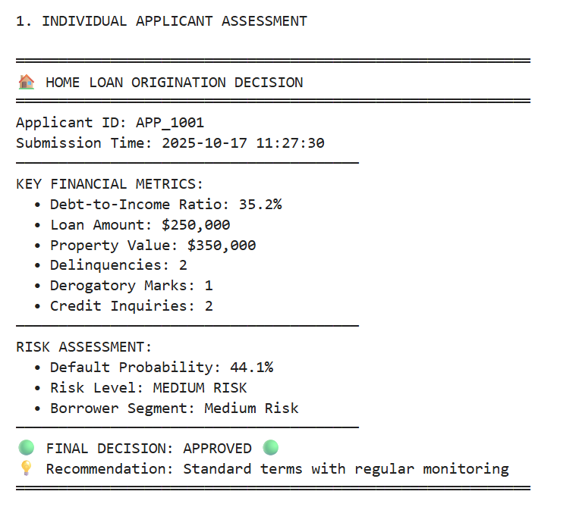
Real-world deployment output
APPENDIX | DEPLOYMENT
In production, this is the clear, actionable output delivered to loan officers within seconds.
Risk probability score
44.1% chance of default
Clear categorisation
Medium Risk segment
Specific recommendation
Standard terms with monitoring
Transparent reasoning
Based on measurable financial metrics
Notes:
This is exactly the kind of output that would be delivered to loan officers in a production environment. Instead of just a simple 'approved' or 'declined', our model provides: a risk probability score (44.1% chance of default), clear categorization (Medium Risk segment), specific recommendations (standard terms with monitoring), and transparent reasoning based on measurable financial metrics. This enables banks to make more nuanced, data-driven lending decisions while maintaining regulatory compliance.

Slide 48
Choosing the number of segments
APPENDIX | SEGMENTATION
1.617
868.6
0.192
Davies-Bouldin index
Calinski-Harabasz index
Silhouette score
Good separation between the 4 segments
Well-defined, distinct segments
Acceptable level of cluster separation
K = 4
Multiple validation indices together justify four segments, which also align with the practical, interpretable risk tiers banks use.

Slide 49
Portfolio action matrix
APPENDIX | STRATEGY
GROW
MANAGE
Low risk, large segment
Best rates (6.5 to 7.5%)
Streamlined approval
Premium marketing
Medium risk, medium segment
Moderate rates
Standard checks
Ongoing support
524 applicants | 9.7% default rate
323 applicants | 17.7% default rate
Action: Fast-track and invest
Action: Maintain and monitor
MONITOR
MITIGATE
High risk, large segment
Higher rates
More due diligence
Collateral required
Very high risk, small segment
Mostly declined
Strict approvals only
Focus on recoveries
759 applicants | 27.9% default rate
182 applicants | 72.6% default rate
Action: Tighten controls
Action: Minimise exposure
Notes:
Here's how we tailor actions by segment: Low Risk, fast-track approvals, offer best rates, and target premium marketing. Medium Risk, approve with monitoring and moderate terms. High Risk, apply tighter controls, higher rates, and require collateral. Very High Risk, minimize exposure, decline most applications, and focus on recoveries. This tiered approach helps optimize portfolio growth while controlling risk effectively.

