Slide 1

Modeling the Impact of Out-of-Schema Questions in Task-oriented Dialog Systems
Jannat Ara Meem

Slide 2

Outline
Introduction
Methodology
Evaluation
Conclusion

Slide 3
Introduction

Slide 4

Task-oriented Dialog Systems
Find a restaurant
Book a hotel room
Find a gift
Reserve a table
Provide predetermined services to users

Slide 5

Task-oriented Dialog Systems
Speaker: USER
Slots:
Required information for task completion
At each turn, slots can either be filled or requested
slots filled:
food = 'Italian’
area = 'south side'
slots requested: NONE
t₁
I am looking for Italian food on the south side of the city.

Slide 6

Task-oriented Dialog Systems
Speaker: USER
Speaker: SYSTEM
Searches for an item in the database that matches the provided attributes (slots) [1].
slots filled:
food = 'Italian’
area = 'south side'
slots requested: NONE
t₁
I am looking for Italian food on the south side of the city.
name | area | food | pricerange | . . .
Pizza Hut Cherry Hinton | south | Italian | moderate
Frankie and Bennys | south | Italian | expensive
Denny’s | south | American | moderate
 |  | …
Do you prefer moderately priced or expensive?
t₂
slots filled:
pricerange = ‘No
preference’
slots requested: NONE
t₃
slots requested:
pricerange
No preference, please.
. . .
I have Pizza Hut Cherry Hinton which is in the moderate price range and Frankie and Bennys which is in the more expensive price range. Which would you prefer?
t₄
restaurant schema
slots requested:
restaurant

Slide 7
Task-oriented Dialog Systems
Speaker: USER
Speaker: SYSTEM
Searches for an item in the database that matches the provided attributes (slots) [1].
slots filled:
food = 'Italian’
area = 'south side'
slots requested: NONE
t₁
I am looking for Italian food on the south side of the city.
name | area | food | pricerange | . . .
Pizza Hut Cherry Hinton | south | Italian | moderate
Frankie and Bennys | south | Italian | expensive
Denny’s | south | American | moderate
 |  | …
Do you prefer moderately priced or expensive?
t₂
slots filled:
pricerange = ‘No
preference’
slots requested: NONE
t₃
slots requested:
pricerange
SUCCESS State : User-intended task is completed by filling all required slots.
No preference, please.
I have Pizza Hut Cherry Hinton which is in the moderate price range and Frankie and Bennys which is in the more expensive price range. Which would you prefer?
t₄
restaurant schema
slots requested:
restaurant
slots filled:
bookpeople = ‘2’
restaurant = ’Pizza
Hut Cherry Hinton’
slots requested: NONE
t₅
Can you book a table for 2 at Pizza Hut Cherry Hinton?
Your table has been booked.
t₆
SUCCESS!

Slide 8
Existing work assumption
name | area | food | pricerange | . . .
Pizza Hut Cherry Hinton | south | Italian | moderate
Frankie and Bennys | south | Italian | expensive
Denny’s | south | American | moderate
 |  | …
User interactions with the system is limited to the information available in the database (Chen et al. [1], Gangal et al. [11], Siddique et al. [12])
What happens when the user seeks an information that does not exist in the database?

Slide 9
What happens when the user seeks an information that does not exist in the database?
Speaker: USER
Speaker: SYSTEM
name | area | food | pricerange | . . . | vegan?
Pizza Hut Cherry Hinton | south | Italian | moderate |  | x
Frankie and Bennys | south | Italian | expensive |  | x
Denny’s | south | American | moderate |  | x
 |  | …
slots filled:
food = 'Italian’
area = 'south side'
slots requested: NONE
t₁
I am looking for Italian food on the south side of the city.
Do you prefer moderately priced or expensive?
t₂
slots filled:
pricerange = ‘No
preference’
slots requested: NONE
t₃
slots requested:
pricerange
No preference, please.
restaurant schema
I have Pizza Hut Cherry Hinton which is in the moderate price range and Frankie and Bennys which is in the more expensive price range. Which would you prefer?
t₄
slots requested:
restaurant
vegan?
slots filled: NONE
slots requested: vegan
(out-of-schema)
t₅
Is it possible to have a vegan dish?
. . .
I don’t know.
t₆
out-of-schema questions

Slide 10


What happens when the user seeks an information that does not exist in the database?
Speaker: USER
Speaker: SYSTEM
slots filled:
food = 'Italian’
area = 'south side'
slots requested: NONE
t₁
I am looking for Italian food on the south side of the city.
45% of users abandon the chatbot after just one “non-progress” event. (Li et al. [2])
Do you prefer moderately priced or expensive?
t₂
slots filled:
pricerange = ‘No
preference’
slots requested: NONE
t₃
slots requested:
pricerange
No preference, please.
Revenue drop!
I have Pizza Hut Cherry Hinton which is in the moderate price range and Frankie and Bennys which is in the more expensive price range. Which would you prefer?
t₄
slots requested:
restaurant
slots filled: NONE
slots requested: vegan
(out-of-schema)
t₅
Is it possible to have a vegan dish?
Non-progress event
I don’t know.
t₆
out-of-schema questions
User drops out

Slide 11
Related Works
Zero-shot slot-filling models
The task is to identify unseen slot tokens in an utterance and attach a label to those tokens.
Coach [14] uses the seen domain data to learn templates for the unseen slots based on whether the words are slot tokens or not.
LEONA [15] is an end-to-end model that effectively captures rich and context-aware linguistic features at different granularities and detect unseen slot tokens.

Slide 12
Related Works
Chatlog analysis in large-scale conversational AI
Periodically analyzing the chat log to improve the effectiveness of a conversational AI system is common practice.
Ponnusamy et al. [14] analyze recent Alexa chat logs on a regular basis to discover unclear/error-prone user queries and retrain the system.

Slide 13
Related Works
User drop-out from chatbot
Ignored in most existing works on task-oriented dialog systems.
Liu et al. [2]’s study of different types of “Non-Progress” events in a banking chatbot is one of the very few works in this domain.
The goal is to learn when the user is dissatisfied with the chatbot, based on the Non-Progress events.
The work is descriptive, that is, no method was proposed to decide what new information to ingest to the chatbot to improve its future performance.

Slide 14
How to overcome user drop-outs?
name | area | food | pricerange | . . . | vegan
Pizza Hut Cherry Hinton | south | Italian | moderate |  | yes
Frankie and Bennys | south | Italian | expensive |  | no
Denny’s | south | American | moderate |  | yes
 |  | …
Extend the database
Challenges
restaurant schema
A large number of out-of-schema questions
Too expensive for a domain expert to answer all of them.
Our approach
Pick k-most critical out-of-schema questions

Slide 15
Contributions
Formulate Out-of-Schema Questions Selection (OQS) problem
Propose two algorithms for solving the OQS problem: Frequency-based and Markov Chain-based
Create and publish two datasets for the OQS problem.
Quantitative and a realistic simulation-based evaluation

Slide 16
Methodology

Slide 17
Out-of-Schema Questions Selection (OQS)
Given a list of dropped-out conversations D and an integer k, find the 𝑘 out-of-schema questions that, if answered will maximally increase the expected number of successful conversations in D.
OQS Algorithm
Top k out-of-schema questions
If
answered
# successful conversations
A conversation is considered successful when SUCCESS state is reached.
…

Slide 18

Out-of-Schema Questions Selection (OQS)
Given a list of dropped-out conversations D and an integer k, find the 𝑘 out-of-schema questions that, if answered will maximally increase the expected number of successful conversations in D.
OQS Algorithm
Detect Out-of-Schema Questions
If
answered
# successful conversations
Top k out-of-schema questions
Model Conversation
…
Benefit Calculation
$$benefit(q,c_{i})$$
Chatlog

Slide 19
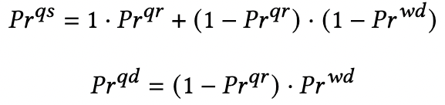
(a)
(b)

Slide 21

Out-of-Schema Questions Selection (OQS)
Given a list of dropped-out conversations D and an integer k, find the 𝑘 out-of-schema questions that, if answered will maximally increase the expected number of successful conversations in D.
OQS Algorithm
Detect Out-of-Schema Questions
Top k out-of-schema questions
If
answered
k
# successful conversations
Model Conversation
…
We use existing zero-shot slot-detection algorithms for this stage (Coach [14], LEONA [15]).
Benefit Calculation
$$benefit(q,c_{i})$$
D

Slide 22

Out-of-Schema Questions Selection (OQS)
Given a list of dropped-out conversations D and an integer k, find the 𝑘 out-of-schema questions that, if answered will maximally increase the expected number of successful conversations in D.
OQS Algorithm
Detect Out-of-Schema Questions
Top k out-of-schema questions
If
answered
k
# successful conversations
Model Conversation
…
We propose two algorithms for these two stages:
Frequency-based
Markov Chain-based
Benefit Calculation
$$benefit(q,c_{i})$$
D

Slide 23
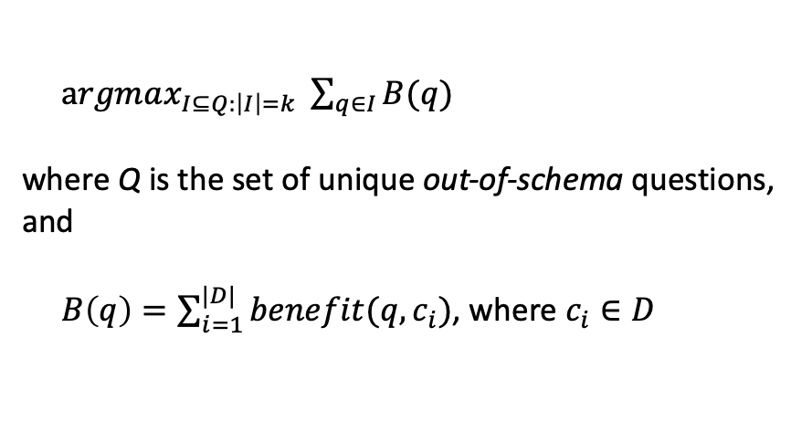

Out-of-Schema Questions Selection (OQS)
Given a list of dropped-out conversations D and an integer k, find the 𝑘 out-of-schema questions that, if answered will maximally increase the expected number of successful conversations in D.
OQS Algorithm
Detect Out-of-Schema Questions
Top k out-of-schema questions
If
answered
k
# successful conversations
Model Conversation
$argmax_{I⊆Q:\left|I\right|=k} \sum_{q∈I}{B(q)}$
where Q is the set of unique out-of-schema questions,
and $B\left(q\right)=\sum_{i=1}^{|D|}{benefit(q,c_{i})}$, where $c_{i}∈D$
…
Benefit Calculation
$$benefit(q,c_{i})$$
D

Slide 24
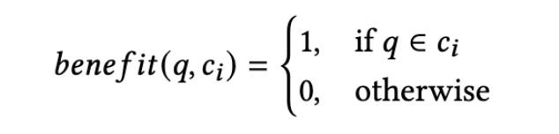
Frequency-based Selection
Picks the user questions that are asked in the highest number of failed conversations.
Model Conversation:
Conversations set of out-of-schema questions
Benefit Calculation:
Given an out-of-schema question q and a conversation c_{i} ,
Limitations:
A question’s impact on the success rate of the system depends not only on its frequency but also at which point they are asked in the conversation.
Ignores the position of the question meaning how far it is asked from the success state
Not enough to identify the questions’ significance in the system’s success rate

Slide 25
Markov Chain-based Selection
Model Conversation
Intuition: Questions closer to the success state are more important.
𝑆𝑈𝐶𝐶𝐸𝑆𝑆 & 𝐷𝑅𝑂𝑃: absorbing states
s₁ through s_{n} : slots
q_{i}, r_{i}, w_{i} : supporting states
Each conversation can be represented as a path in this model.
r_{n}
w_{n}

Slide 26
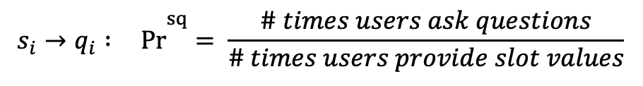
Markov Chain-based Selection
Model Conversation
$$s_{i}→q_{i} :\overset{ sq}{Pr}= \frac{\# times users ask questions}{\# times users provide slot values}$$
r_{n}
w_{n}

Slide 27
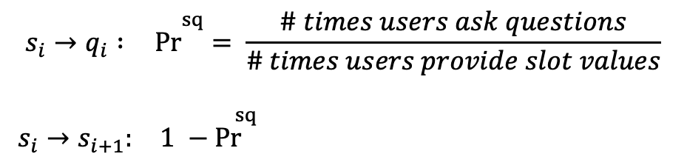
Markov Chain-based Selection
Model Conversation
$$s_{i}→q_{i} :\overset{ sq}{Pr}= \frac{\# times users ask questions}{\# times users provide slot values}$$
$s_{i}→s_{i+1}:\overset{ sq}{ 1 −Pr}$
r_{n}
w_{n}

Slide 28
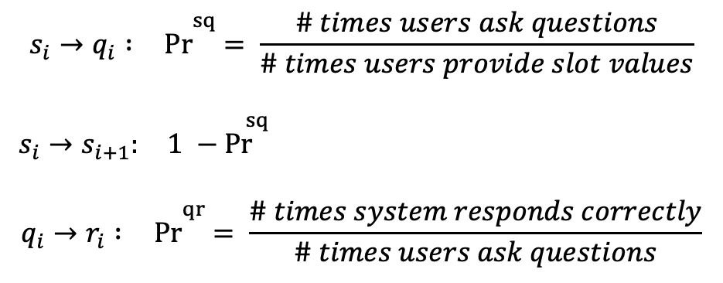
Markov Chain-based Selection
Model Conversation
$$s_{i}→q_{i} :\overset{ sq}{Pr}= \frac{\# times users ask questions}{\# times users provide slot values}$$
$s_{i}→s_{i+1}:\overset{ sq}{ 1 −Pr}$
$$q_{i}→r_{i} :\overset{ qr}{Pr}= \frac{\# times system responds correctly}{\# times users ask questions}$$
r_{n}
w_{n}

Slide 29
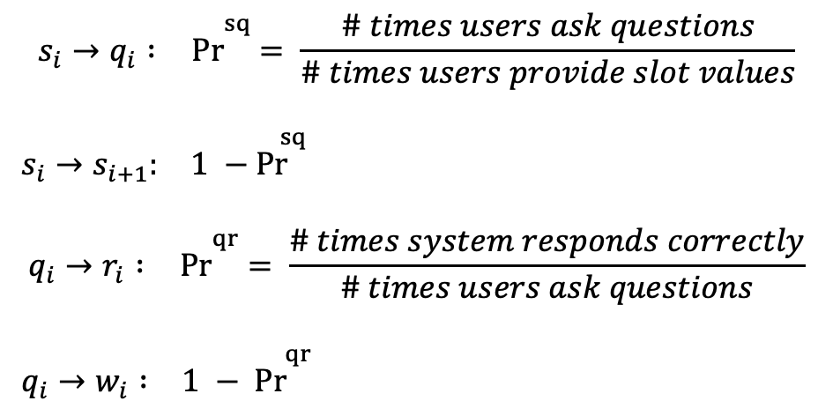
Markov Chain-based Selection
Model Conversation
$$s_{i}→q_{i} :\overset{ sq}{Pr}= \frac{\# times users ask questions}{\# times users provide slot values}$$
$s_{i}→s_{i+1}:\overset{ sq}{ 1 −Pr}$
$$q_{i}→r_{i} :\overset{ qr}{Pr}= \frac{\# times system responds correctly}{\# times users ask questions}$$
$q_{i}→w_{i} :\overset{ qr}{1 − Pr}$
r_{n}
w_{n}

Slide 30
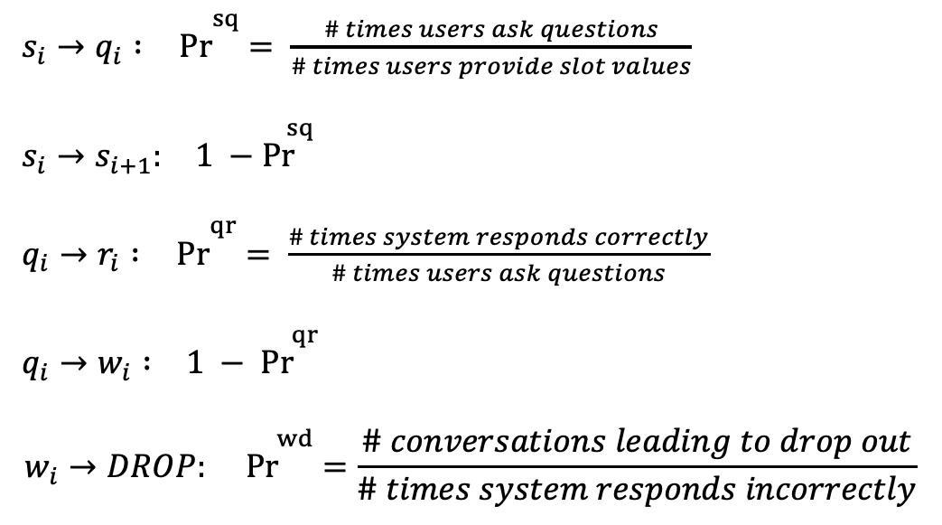
Markov Chain-based Selection
Model Conversation
$s_{i}→q_{i} :\overset{ sq}{Pr}= \frac{\# times users ask questions}{\# times users provide slot values}$
$s_{i}→s_{i+1}:\overset{ sq}{ 1 −Pr}$
$q_{i}→r_{i} :\overset{ qr}{Pr}= \frac{\# times system responds correctly}{\# times users ask questions}$
$q_{i}→w_{i} :\overset{ qr}{1 − Pr}$
$$w_{i}→DROP:\overset{ wd}{Pr}=\frac{\# c\text{onversations} \text{leading} \text{to} \text{drop} \text{out}}{\# times system responds incorrectly}$$
r_{n}
w_{n}

Slide 31
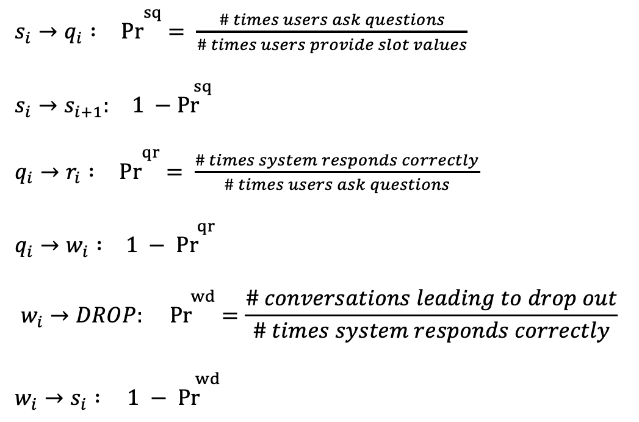
Markov Chain-based Selection
Model Conversation
$s_{i}→q_{i} :\overset{ sq}{Pr}= \frac{\# times users ask questions}{\# times users provide slot values}$
$s_{i}→s_{i+1}:\overset{ sq}{ 1 −Pr}$
$q_{i}→r_{i} :\overset{ qr}{Pr}= \frac{\# times system responds correctly}{\# times users ask questions}$
$q_{i}→w_{i} :\overset{ qr}{1 − Pr}$
$$w_{i}→DROP:\overset{ wd}{Pr}=\frac{\# c\text{onversations} \text{leading} \text{to} \text{drop} \text{out}}{\# times system responds correctly}$$
$w_{i}→s_{i} :\overset{ wd}{1 − Pr}$
r_{n}
w_{n}

Slide 32
Markov Chain-based Selection
Benefit Calculation
Replay of a conversation: a hypothetical future conversation that is identical to 𝑐_{i} up to the point when out-of-schema question 𝑞 is asked.

Slide 33
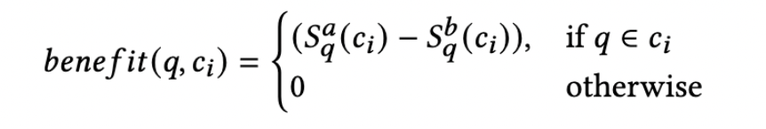
Markov Chain-based Selection
Benefit Calculation
We use the PageRank formula [5] to calculate the probability of reaching the success state, assuming that a random user starts from a state and transitions from one state to the other.

Slide 34
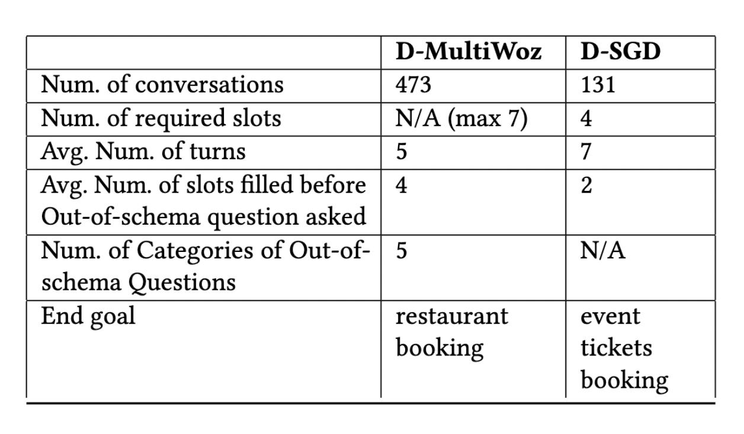
Datasets
Existing datasets such as MultiWoz [6], ATIS [7] , SNIPS [8] and SGD [9] are built based on the assumption that users don’t ask any out-of-schema questions.
For our task, we need a dataset
having multi-turn conversations and
a number of out-of-schema user questions,
and these questions can be asked at any point of the conversation,
finally leading users to drop out.
We built two new datasets: D-MultiWoz and D-SGD by extending two existing datastets.
Dataset summary:

Slide 35
Dataset creation: D-MultiWoz
Speaker: USER
Speaker: SYSTEM
We inserted out-of-schema questions and user drop-outs in the existing successful conversations of the MultiWoz[6] dataset.
slots filled:
food = 'Italian’
area = 'south side'
slots requested: NONE
t₁
I am looking for Italian food on the south side of the city.
Do you prefer moderately priced or expensive?
t₂
slots filled:
pricerange = ‘No
preference’
slots requested: NONE
t₃
slots requested:
pricerange
No preference, please.
I have Pizza Hut Cherry Hinton which is in the moderate price range and Frankie and Bennys which is in the more expensive price range. Which would you prefer?
t₄
slots requested:
restaurant
slots filled:
bookpeople = ‘2’
restaurant = ’Pizza
Hut Cherry Hinton’
slots requested: NONE
t₅
Can you book a table for 2 at Pizza Hut Cherry Hinton?
Your table has been booked.
t₆

Slide 36
Dataset creation: D-MultiWoz
Steps
Speaker: USER
Speaker: SYSTEM
Pick a random user turn, t
slots filled:
food = 'Italian’
area = 'south side'
slots requested: NONE
t₁
I am looking for Italian food on the south side of the city.
Do you prefer moderately priced or expensive?
t₂
slots filled:
pricerange = ‘No
preference’
slots requested: NONE
t₃
slots requested:
pricerange
No preference, please.
I have Pizza Hut Cherry Hinton which is in the moderate price range and Frankie and Bennys which is in the more expensive price range. Which would you prefer?
t₄
slots requested:
restaurant
slots filled:
bookpeople = ‘2’
restaurant = ’Pizza
Hut Cherry Hinton’
slots requested: NONE
t₅
Can you book a table for 2 at Pizza Hut Cherry Hinton?
Your table has been booked.
t₆

Slide 37
Dataset creation: D-MultiWoz
Steps
Speaker: USER
Speaker: SYSTEM
Pick a random user turn, t
slots filled:
food = 'Italian’
area = 'south side'
slots requested: NONE
t₁
I am looking for Italian food on the south side of the city.
Do you prefer moderately priced or expensive?
t₂
slots filled:
pricerange = ‘No
preference’
slots requested: NONE
t₃
slots requested:
pricerange
No preference, please.
I have Pizza Hut Cherry Hinton which is in the moderate price range and Frankie and Bennys which is in the more expensive price range. Which would you prefer?
t₄
slots requested:
restaurant
slots filled:
bookpeople = ‘2’
restaurant = ’Pizza
Hut Cherry Hinton’
slots requested: NONE
t₅
Can you book a table for 2 at Pizza Hut Cherry Hinton?
Your table has been booked.
t₆

Slide 38
Dataset creation: D-MultiWoz
Steps
Speaker: USER
Speaker: SYSTEM
Get filled slots up to turn (t-1): F
slots filled:
food = 'Italian’
area = 'south side'
slots requested: NONE
t₁
I am looking for Italian food on the south side of the city.
F = {food, area, pricerange}
Do you prefer moderately priced or expensive?
t₂
slots filled:
pricerange = ‘No
preference’
slots requested: NONE
t₃
slots requested:
pricerange
No preference, please.
I have Pizza Hut Cherry Hinton which is in the moderate price range and Frankie and Bennys which is in the more expensive price range. Which would you prefer?
t₄
slots requested:
restaurant
slots filled:
bookpeople = ‘2’
restaurant = ’Pizza
Hut Cherry Hinton’
slots requested: NONE
t₅
Can you book a table for 2 at Pizza Hut Cherry Hinton?
Your table has been booked.
t₆

Slide 39
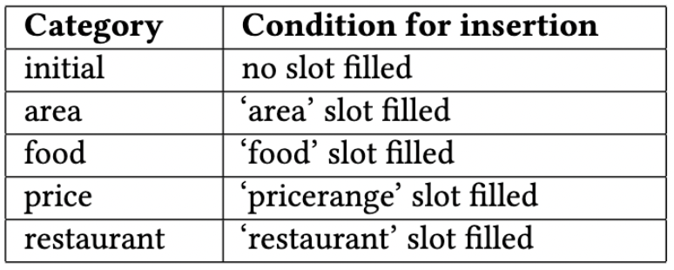
Dataset creation: D-MultiWoz
Steps
Pick the Question Category following these conditions
F = {food, area, pricerange}
Speaker: USER
Speaker: SYSTEM
slots filled:
food = 'Italian’
area = 'south side'
slots requested: NONE
t₁
I am looking for Italian food on the south side of the city.
Do you prefer moderately priced or expensive?
t₂
slots filled:
pricerange = ‘No
preference’
slots requested: NONE
t₃
slots requested:
pricerange
initial | area | food | price | restaurant
Can you recommend a restaurant near a park? | Is there any metro station in the area? | Is it possible to change the level of spice? | Is brunch cheaper than dinner? | What time does the restaurant close?
What is the hottest brunch spot in town? | Is this a safe area? | Is there a vegan dish? | Is the food worth the price? | Can I make reservation online?
Where should I dine near the airport? | Is free parking available? | Is gluten-free option available? | Is the tip included in the bill? | Do they have free wifi?
 |  | …
No preference, please.
I have Pizza Hut Cherry Hinton which is in the moderate price range and Frankie and Bennys which is in the more expensive price range. Which would you prefer?
t₄
slots requested:
restaurant
slots filled:
bookpeople = ‘2’
restaurant = ’Pizza
Hut Cherry Hinton’
slots requested: NONE
t₅
Can you book a table for 2 at Pizza Hut Cherry Hinton?
Your table has been booked.
t₆

Slide 40
Dataset creation: D-MultiWoz
Steps
Pick the Question Category following these conditions
F = {food, area, pricerange}
Speaker: USER
Speaker: SYSTEM
slots filled:
food = 'Italian’
area = 'south side'
slots requested: NONE
t₁
I am looking for Italian food on the south side of the city.
Do you prefer moderately priced or expensive?
t₂
slots filled:
pricerange = ‘No
preference’
slots requested: NONE
t₃
slots requested:
pricerange
initial | area | food | price | restaurant
Can you recommend a restaurant near a park? | Is there any metro station in the area? | Is it possible to change the level of spice? | Is brunch cheaper than dinner? | What time does the restaurant close?
What is the hottest brunch spot in town? | Is this a safe area? | Is there a vegan dish? | Is the food worth the price? | Can I make reservation online?
Where should I dine near the airport? | Is free parking available? | Is gluten-free option available? | Is the tip included in the bill? | Do they have free wifi?
 |  | …
No preference, please.
I have Pizza Hut Cherry Hinton which is in the moderate price range and Frankie and Bennys which is in the more expensive price range. Which would you prefer?
t₄
slots requested:
restaurant
slots filled:
bookpeople = ‘2’
restaurant = ’Pizza
Hut Cherry Hinton’
slots requested: NONE
t₅
Can you book a table for 2 at Pizza Hut Cherry Hinton?
Your table has been booked.
t₆

Slide 41
Dataset creation: D-MultiWoz
Steps
Speaker: USER
Speaker: SYSTEM
Pick a Question randomly from the chosen Category
slots filled:
food = 'Italian’
area = 'south side'
slots requested: NONE
t₁
I am looking for Italian food on the south side of the city.
Do you prefer moderately priced or expensive?
t₂
slots filled:
pricerange = ‘No
preference’
slots requested: NONE
t₃
slots requested:
pricerange
initial | area | food | price | restaurant
Can you recommend a restaurant near a park? | Is there any metro station in the area? | Is it possible to change the level of spice? | Is brunch cheaper than dinner? | What time does the restaurant close?
What is the hottest brunch spot in town? | Is this a safe area? | Is there a vegan dish? | Is the food worth the price? | Can I make reservation online?
Where should I dine near the airport? | Is free parking available? | Is gluten-free option available? | Is the tip included in the bill? | Do they have free wifi?
 |  | …
No preference, please.
I have Pizza Hut Cherry Hinton which is in the moderate price range and Frankie and Bennys which is in the more expensive price range. Which would you prefer?
t₄
slots requested:
restaurant
slots filled:
bookpeople = ‘2’
restaurant = ’Pizza
Hut Cherry Hinton’
slots requested: NONE
t₅
Can you book a table for 2 at Pizza Hut Cherry Hinton?
Your table has been booked.
t₆

Slide 42
Dataset creation: D-MultiWoz
Steps
Speaker: USER
Speaker: SYSTEM
Insert the question
slots filled:
food = 'Italian’
area = 'south side'
slots requested: NONE
t₁
I am looking for Italian food on the south side of the city.
Do you prefer moderately priced or expensive?
t₂
slots filled:
pricerange = ‘No
preference’
slots requested: NONE
t₃
slots requested:
pricerange
initial | area | food | price | restaurant
Can you recommend a restaurant near a park? | Is there any metro station in the area? | Is it possible to change the level of spice? | Is brunch cheaper than dinner? | What time does the restaurant close?
What is the hottest brunch spot in town? | Is this a safe area? | Is there a vegan dish? | Is the food worth the price? | Can I make reservation online?
Where should I dine near the airport? | Is free parking available? | Is gluten-free option available? | Is the tip included in the bill? | Do they have free wifi?
 |  | …
No preference, please.
I have Pizza Hut Cherry Hinton which is in the moderate price range and Frankie and Bennys which is in the more expensive price range. Which would you prefer?
t₄
slots requested:
restaurant
slots filled:NONE’
slots requested: vegan
t₅
Is there a vegan dish?
Your table has been booked.
t₆

Slide 43
Dataset creation: D-MultiWoz
Steps
Speaker: USER
Speaker: SYSTEM
Remove rest of the conversation and insert user drop-out
slots filled:
food = 'Italian’
area = 'south side'
slots requested: NONE
t₁
I am looking for Italian food on the south side of the city.
Do you prefer moderately priced or expensive?
t₂
slots filled:
pricerange = ‘No
preference’
slots requested: NONE
t₃
slots requested:
pricerange
No preference, please.
I have Pizza Hut Cherry Hinton which is in the moderate price range and Frankie and Bennys which is in the more expensive price range. Which would you prefer?
t₄
slots requested:
restaurant
slots filled:NONE’
slots requested: vegan
t₅
Is there a vegan dish?
I don’t know.
t₆
User drops out

Slide 44
Dataset creation: D-SGD
We extended the dataset published by Maqbool et al. [10].
Maqbool et al. published dataset of off-script queries (similar to our out-of-schema questions)
The dataset focuses on coreference resolution i.e. turning the queries into self-contained queries.
They did not focus on where (how far from the SUCCESS state) the question is asked.
All questions asked to seek extra information after the intended task has been completed, so no impact on the success rate of the system.

Slide 45
Dataset creation: D-SGD
Speaker: USER
Speaker: SYSTEM
slots filled: NONE
slots requested:
NONE
t₁
I wish to book for an event.
Off-script question asked to seek extra information after the intended task has been completed.
Is there any specific city should I search?
t₂
slots filled: NONE slots requested: city_of_event
. . .
I wish to book one ticket for the event Crystal Lake on the 6th.
So no impact on the success rate of the system.
slots filled: NONE slots requested: date, number_of_seats,
event_name
t₅
All slots filled
Kindly ensure that, 1 ticket has been reserved for the event Crystal Lake on next Wednesday at London.
t₆
SUCCESS!
t₇
slots requested:
event_start_time
(out-of-schema)
At what time will Crystal Lake start?
Self-contained off-script query

Slide 46
Dataset creation: D-SGD
Steps
Speaker: USER
Speaker: SYSTEM
Pick a random user turn, t
slots filled: NONE
slots requested:
NONE
t₁
I wish to book for an event.
Is there any specific city should I search?
t₂
slots filled: NONE slots requested: city_of_event
. . .
slots filled: NONE slots requested: date, number_of_seats,
event_name
I wish to book one ticket for the event Crystal Lake on the 6th.
t₅
Kindly ensure that, 1 ticket has been reserved for the event Crystal Lake on next Wednesday at London.
t₆
SUCCESS!
t₇
slots requested:
event_start_time
(out-of-schema)
At what time will Crystal Lake start?
Self-contained off-script query

Slide 47
Dataset creation: D-SGD
Steps
Speaker: USER
Speaker: SYSTEM
Replace this turn with the off-script query
slots filled: NONE
slots requested:
NONE
t₁
I wish to book for an event.
Is there any specific city should I search?
t₂
slots filled: NONE slots requested: city_of_event
. . .
slots filled: NONE slots requested: date, number_of_seats,
event_name
I wish to book one ticket for the event Crystal Lake on the 6th.
t₅
Kindly ensure that, 1 ticket has been reserved for the event Crystal Lake on next Wednesday at London.
t₆
SUCCESS!
t₇
slots requested:
event_start_time
(out-of-schema)
At what time will Crystal Lake start?
Self-contained off-script query

Slide 48
Dataset creation: D-SGD
Steps
Speaker: USER
Speaker: SYSTEM
Remove rest of the conversation and insert user drop-out
slots filled: NONE
slots requested:
NONE
t₁
I wish to book for an event.
Is there any specific city should I search?
t₂
slots filled: NONE slots requested: city_of_event
. . .
At what time will Crystal Lake start?
slots requested:
event_start_time
(out-of-schema)
t₅
Kindly ensure that, 1 ticket has been reserved for the event Crystal Lake on next Wednesday at London.
t₆
SUCCESS!
t₇
slots requested:
event_start_time
(out-of-schema)
At what time will Crystal Lake start?
Self-contained off-script query

Slide 49
Dataset creation: D-SGD
Steps
Speaker: USER
Speaker: SYSTEM
slots filled: NONE
slots requested:
NONE
t₁
I wish to book for an event.
Is there any specific city should I search?
t₂
slots filled: NONE slots requested: city_of_event
. . .
At what time will Crystal Lake start?
slots requested:
event_start_time
(out-of-schema)
t₅
User drops out

Slide 50
Evaluation

Slide 51
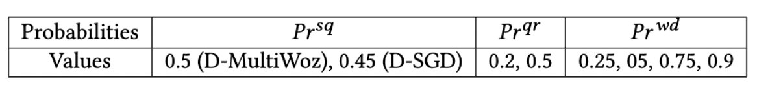
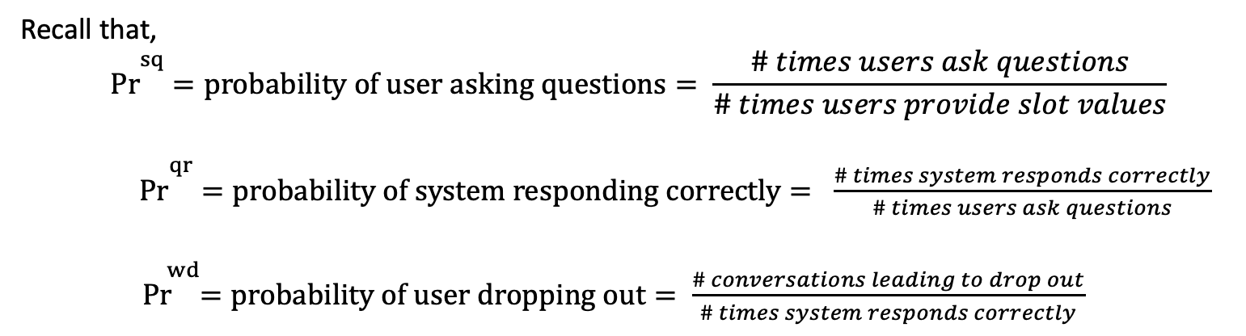
Quantitative Evaluation
Experimental Setup
We compare the performances of our two OQS algorithms along with a Random approach, which selects k random out-of-schema questions.
Assumption: Top k questions selected by OQS algorithm are answered and user does not drop out.
Performance metric: The number of conversations that have one of the top k questions and 1, 2 or 3 unfilled slots (hops) to reach the SUCCESS state.
Parameters:
Recall that,
$$\overset{ sq}{Pr}=probability of user asking questions= \frac{\# times users ask questions}{\# times users provide slot values}$$
$\overset{ qr}{Pr}=probability of system responding correctly= \frac{\# times system responds correctly}{\# times users ask questions}$
$\overset{ wd}{ Pr}=probability of user dropping out= \frac{\# conversations leading to drop out}{\# times system responds correctly}$

Slide 52


Quantitative Evaluation
Results
(a) for$\overset{ sq}{Pr}$= 0.2
(b) for$\overset{ sq}{Pr}$= 0.5
Observations:
Markov-based top k question selection brings a significantly higher number of conversations closer to the success state for both the datasets for four different values of Pr^{wd.}
Markov-based algorithm outperforms the Frequency-based and the Random approach by a larger degree for larger values of k,
as there are more ties in the frequencies for larger k values, and Frequency-based method selects randomly from questions having the same frequency.

Slide 53
Simulation-based Evaluation
Experimental Setup
We generate simulated replays of the conversations in the datasets.
An original conversation from the datasets modeled as a Markov chain.
Out-of-schema question q asked at state q_{k}

Slide 54
Simulation-based Evaluation
Experimental Setup
A random user repeats each conversation in the chatlog, up to the point when an out-of-schema question q has been asked (q_{k}).

Slide 55
Simulation-based Evaluation
Experimental Setup
Then chooses a path following our Markov Chain-based conversation modeling.

Slide 56
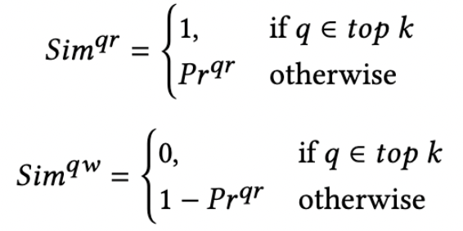
Simulation-based Evaluation
Experimental Setup
Then chooses a path following our Markov Chain-based conversation modeling.
r_{k}

Slide 57
Simulation-based Evaluation
Experimental Setup
User continues with the conversation until SUCCESS or DROP state has been reached.
r_{k}

Slide 58
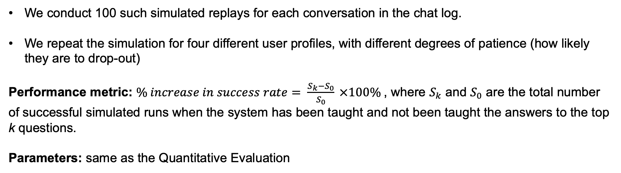
Simulation-based Evaluation
Experimental Setup
We conduct 100 such simulated replays for each conversation in the chat log.
We repeat the simulation for four different user profiles, with different degrees of patience (how likely they are to drop-out)
Performance metric: $\% increase in success rate= \frac{S_{k}−S_{0}}{S_{0}} ×100\%$, where $S_{k}$ and $S_{0}$ are the total number of successful simulated runs when the system has been taught and not been taught the answers to the top k questions.
Parameters: same as the Quantitative Evaluation

Slide 59
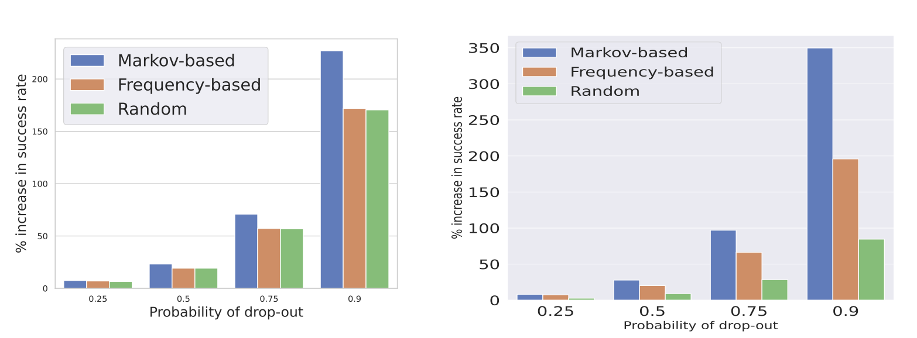
Simulation-based Evaluation
Results
(for top 20 questions)
(a) Simulation results for D-MultiWoz
(b) Simulation results for D-SGD
Observations:
Markov Chain-based selection provides better results (up to 78% w.r.t Frequency-based and up to 313% w.r.t Random approach) in almost all the cases
The higher the probability of drop-out is, the more effective Markov Chain-based selection is compared to Frequency-based and Random approach,
because the importance of the position of a question is increased for larger probability of drop-out, as user dropouts become more common.

Slide 60
Conclusion
Defined the OQS problem.
Presented two approaches for identifying the most significant out-of-schema user questions.
Published two new datasets for the problem.
Our experimental analyses show that our methods, especially the Markov Chain-based method, increase the success rate of the chatbot .
Future direction
We will study how to estimate the cost of answering a question and incorporate this cost into the OQS algorithms.
We will use the semantics of an out-of-schema question to estimate how likely the user is to dropout, instead of assuming uniform dropout probability for all unanswered questions.

Slide 61
Current research
Problem
Large language models (LLMs) often generate incorrect or old information
LLMs are expensive to update as they have billions of parameters
Goal
Improve the accuracy of Large Language Models'(LLMs) answer-generation capabilities without expensive training or parameters tuning
Existing Work
Perform poorly for multi-hop question-answering
Cannot handle questions that need up-to-date information to answer the question
Our Approach
Integrate external knowledge base into the LLMs
Discover a path-based reasoning for the generated answers

Slide 62
References
Lu Chen, Boer Lv, Chi Wang, Su Zhu, Bowen Tan, and Kai Yu. 2020. Schema-guided multi-domain dialogue state tracking with graph attention neural networks. In Proceedings of the AAAI Conference on Artificial Intelligence, Vol. 34. 7521–7528.
Chi-Hsun Li, Su-Fang Yeh, Tang-Jie Chang, Meng-Hsuan Tsai, Ken Chen, and Yung-Ju Chang. 2020. A conversation analysis of non-progress and coping strategies with a banking task-oriented chatbot. In Proceedings of the 2020 CHI Conference on Human Factors in Computing Systems. 1–12.
Rashmi Gangadharaiah and Balakrishnan Narayanaswamy. 2019. Joint multiple intent detection and slot labeling for goal-oriented dialog. In Proceedings of the 2019 Conference of the North American Chapter of the Association for Computational Linguistics: Human Language Technologies, Volume 1 (Long and Short Papers). 564–569.
Yutai Hou, Wanxiang Che, Yongkui Lai, Zhihan Zhou, Yijia Liu, Han Liu, and Ting Liu. 2020. Few-shot slot tagging with collapsed dependency transfer and label-enhanced task-adaptive projection network. arXiv preprint arXiv:2006.05702 (2020).
Sergey Brin and Lawrence Page. 1998. The anatomy of a large-scale hypertextual web search engine. Computer networks and ISDN systems 30, 1-7 (1998), 107–117.
Paweł Budzianowski, Tsung-Hsien Wen, Bo-Hsiang Tseng, Inigo Casanueva, Stefan Ultes, Osman Ramadan, and Milica Gašić. 2018. MultiWOZ–a large-scale multi-domain wizard-of-oz dataset for task-oriented dialogue modelling. arXiv preprint arXiv:1810.00278 (2018).
Xingkun Liu, Arash Eshghi, Pawel Swietojanski, and Verena Rieser. 2019. Benchmarking natural language understanding
services for building conversational agents. arXiv preprint arXiv:1903.05566 (2019).

Slide 63
References
8. Alice Coucke, Alaa Saade, Adrien Ball, Théodore Bluche, Alexandre Caulier, David Leroy, Clément Doumouro, Thibault
Gisselbrecht, Francesco Caltagirone, Thibaut Lavril, et al . 2018. Snips voice platform: an embedded spoken language
understanding system for private-by-design voice interfaces. arXiv preprint arXiv:1805.10190 (2018).
Abhinav Rastogi, Xiaoxue Zang, Srinivas Sunkara, Raghav Gupta, and Pranav Khaitan. 2020. Towards scalable multi- domain conversational agents: The schema-guided dialogue dataset. In Proceedings of the AAAI Conference on Artificial Intelligence, Vol. 34. 8689–8696.
Muhammad Hasan Maqbool, Luxun Xu, AB Siddique, Niloofar Montazeri, Vagelis Hristidis, and Hassan Foroosh. 2022. Zero-label Anaphora Resolution for Off-Script User Queries in Goal-Oriented Dialog Systems. In 2022 IEEE 16th International Conference on Semantic Computing (ICSC). IEEE, 217–224.
Varun Gangal, Abhinav Arora, Arash Einolghozati, and Sonal Gupta. 2020. Likelihood ratios and generative classifiers for unsupervised out-of-domain detection in task-oriented dialog. In Proceedings of the AAAI Conference on Artificial Intelli- gence, Vol. 34. 7764–7771.
AB Siddique, Fuad Jamour, and Vagelis Hristidis. 2021. Linguistically-enriched and context-awarezero-shot slot filling. In Proceedings of the Web Conference 2021.3279–3290.
Bing Liu and Ian Lane. 2016. Attention-based recurrent neural network models for joint intent detection and slot filling. arXiv preprint arXiv:1609.01454 (2016).
Pragaash Ponnusamy, Alireza Roshan Ghias, Chenlei Guo, and Ruhi Sarikaya. 2020. Feedback-based self-learning in large-scale conversational ai agents. In Proceedings of the AAAI conference on artificial intelligence, Vol. 34. 13180–13187.

Slide 64
References
Zihan Liu, Genta Indra Winata, Peng Xu, and Pascale Fung. 2020. Coach: A Coarse to-Fine Approach for Cross-domain Slot Filling. arXiv preprint arXiv:2004.11727 (2020).
15. AB Siddique, Fuad Jamour, and Vagelis Hristidis. 2021. Linguistically-enriched and context-aware zero-shot slot filling. In
Proceedings of the Web Conference 2021. 3279–3290.

Slide 65
Thank You

