Slide 1

Data 603
MULTIPLE REGRESSION ANALYSIS OF ENERGY CONSUMPTION IN THE CITY OF CALGARY
Group 13: CODE 404
Khushi Himanshu Dave
Jannatul Naeema
Zheyu Song
Shashank Kumar Srivastava

Slide 2

Analysis Objectives
Analyzing the energy consumption situations at different structure and facilities at City of Calgary.
Goal: Predict future energy use for the buildings and investigate the effects of different variables.
We have performed several steps in alignment with the course material to help us analyze our data.
This study is important to assess if the energy use of buildings and structures are in aligned with the sustainable building policy.
Through this investigation, we aim to understand better energy efficiency and we aim to provide new insights as to whether the energy efficiency need to be improved.

Slide 3
Introduction of the Dataset and Variables
Dataset name: Building Energy Benchmarking Data (from the City of Calgary webpage)
Open dataset : tabular format
297 rows , 23 columns,
17 different types of property built from 1896 to 2018
Independent Variables: 20 variables (Property type, Number of Buildings, Property GFA, CO2 Emission etc.)
Numerical Variables: 17 variables
Categorical Variable: 3 variables (Property type, Year Built, Energy Star Score)
2019-2021, Annually
Dependent Variable: Site Energy

Slide 4
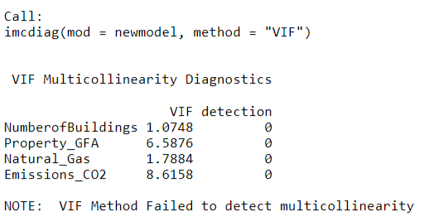
First Order Model
Multicollinearity Assumption

Slide 5
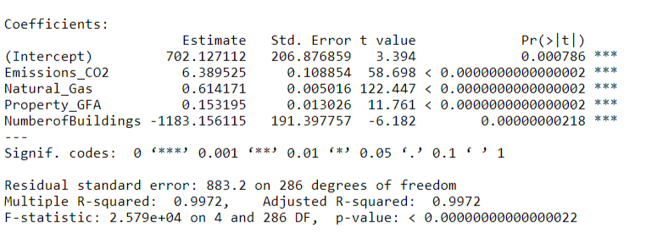
Stepwise Regression Procedure

Slide 6
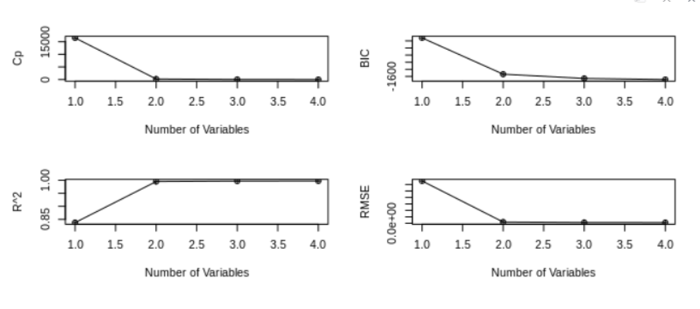
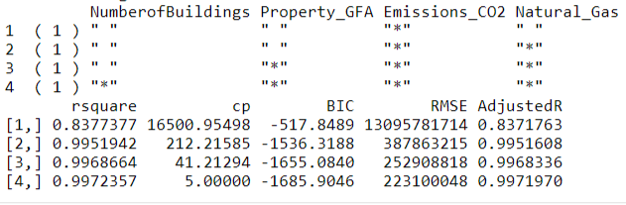
All Possible Regressions Selection Procedure

Slide 7
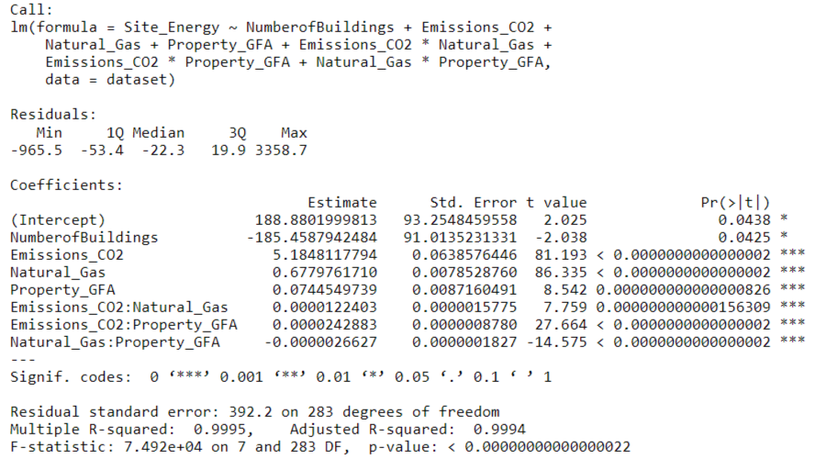
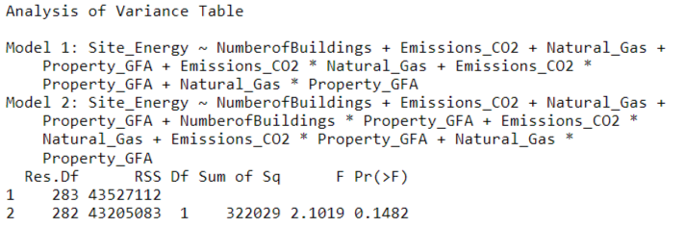
Interaction Term

Slide 8
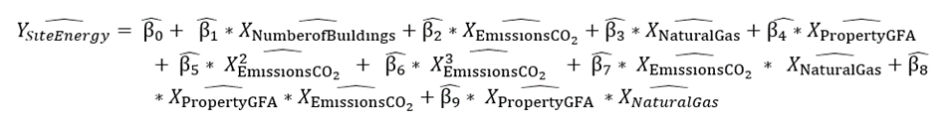
Higher Order

Slide 9
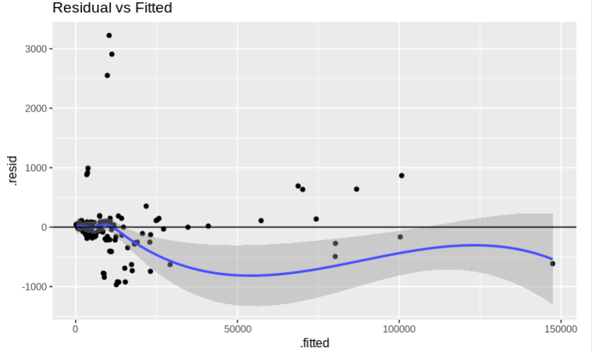
Linearity Assumption

Slide 10
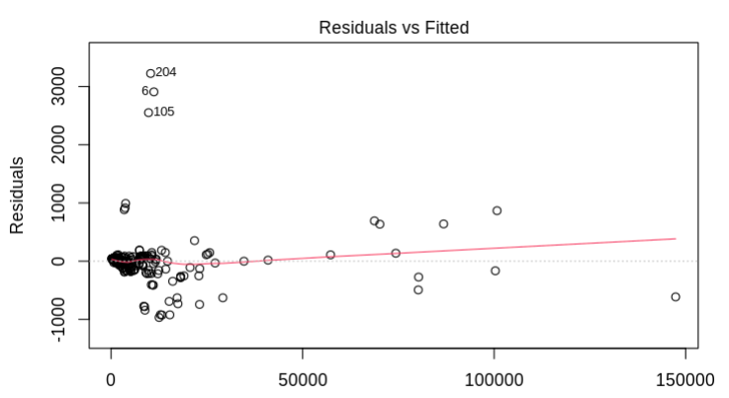
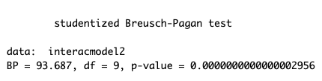
Equal Variance Assumption

Slide 11
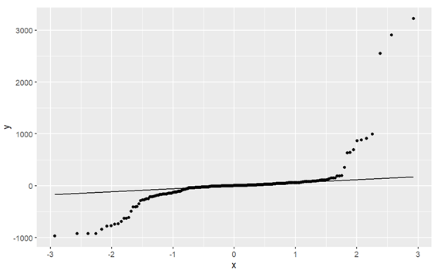
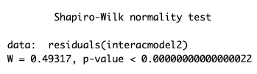
Normality Assumption

Slide 12
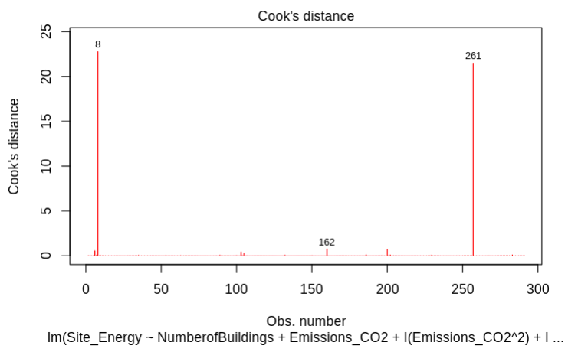
Outliers Testing

Slide 13
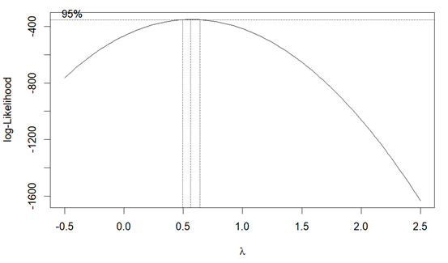
Box – Cox Transformations
After box-cox transformation the Residual standard error improved from 381.8 to 16.78
But
Shapiro-Wilk normality test, p-value=0.000000003178 \>0.05; confirms that not normally distributed
Breusch-Pagan test that result from the Box-Cox model, the p-value < 0.000000000000000220 which is <0.05; homoscedasticity does not exist

Slide 14
Results
With four variables: Adjusted R^2 = 0.9972 and RMSE = 883.2
Interaction terms: Adj R^2 = 0.9994 and RMSE = 392.2
With Higher order terms: Adj R^2 = 0.9995 and RMSE = 381.8
Final Model: Adj R^2 = 0.9995 and RMSE = 16.78

Slide 15
Results and Conclusions
Significant Variables
Improved Model
Adjusted R-squared
Assumptions
Best model for Prediction

