Slide 1

STUDENT MANAGEMENT SYSTEM (GUB PORTAL)
Jannatul Ferdeous
ID : 201002468
CSE_201DK

Slide 2
TABLE OF CONTENTS
INTRODUCTION
OBJECTIVES
DESIGN GOAL
IMPLEMENTATION
RESULT
SCOPE OF THE FUTURE WORK

Slide 3
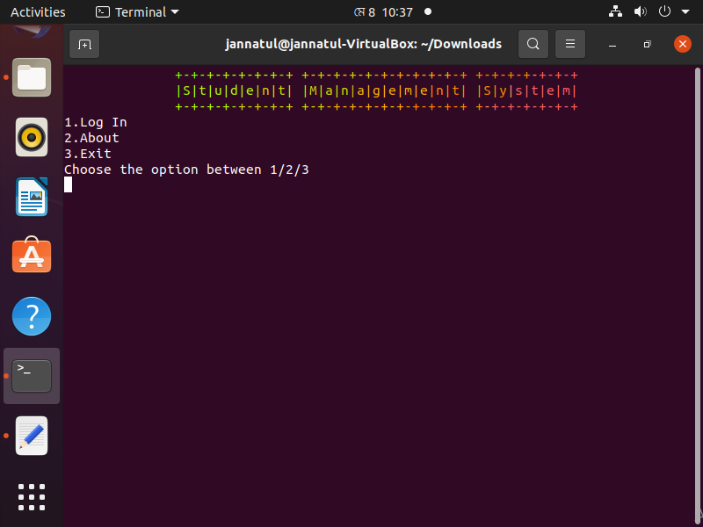
INTRODUCTION
A Student Management System is also known as a Student Information System (SIS). These systems work to coordinate scheduling and communications between faculty regarding students. The Name of Project is Student Management System (GUB Portal) . Where there will be a log in system. After a successful login the user will get access to do their task. And all the task will be academic related.

Slide 4

OBJECTIVES
To know about the Student management System design goal.
Explaining the management system that how we implement with the help of Ubuntu using shell script language.
Describing the management system result that we successfully implemented .
To learn about scope of the work

Slide 5
DESIGN GOAL
Teacher
Evaluation
Student
result
Design
Goal
Add result
Academic
work
All work in one system
Student Management System (SMS) is a solution tool that is designed to track, maintain and manage all the data.
Try to make simple teachers kroner.
Help teacher to do their academic work easily.
Try to do all the academic work in one place.

Slide 6
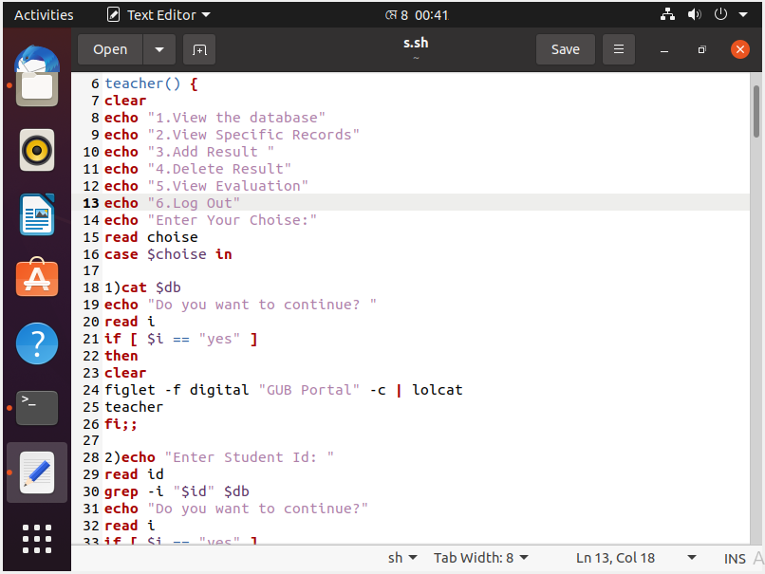
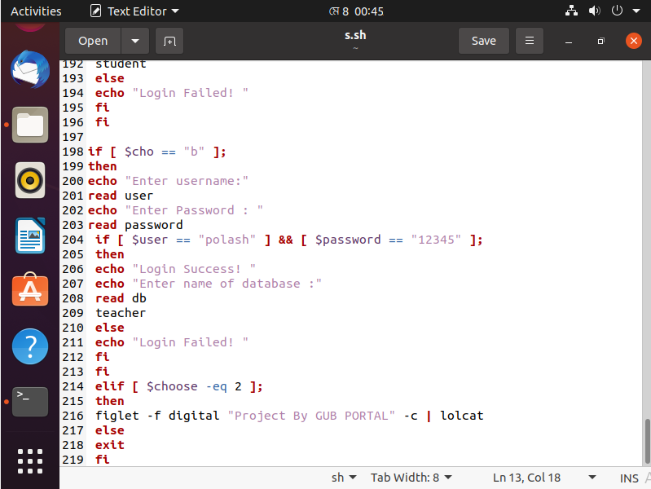
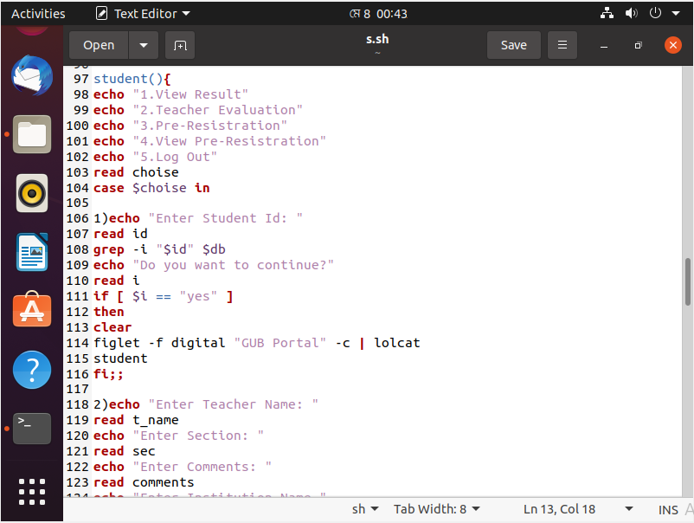
IMPLEMENTATION
We successfully implemented our project using ubuntu.

Slide 7
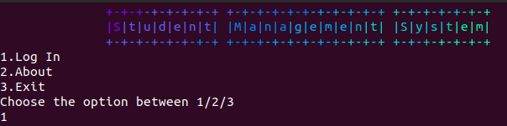
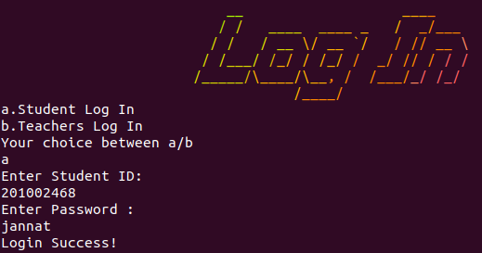
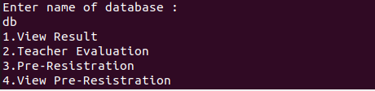
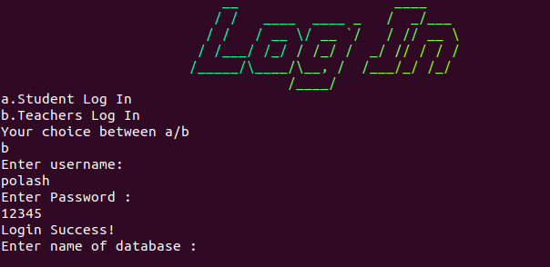
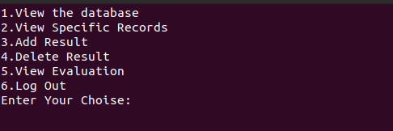
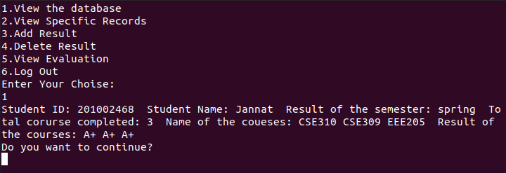
RESULT

Slide 8

SCOPE OF THE FUTURE WORK
Can be use in any Educational Institute.
Both Student and Teacher can use.
All options are in one place.
Updatable according to our need.
Simple & easy to use.

Slide 9
Thank You

