Slide 1
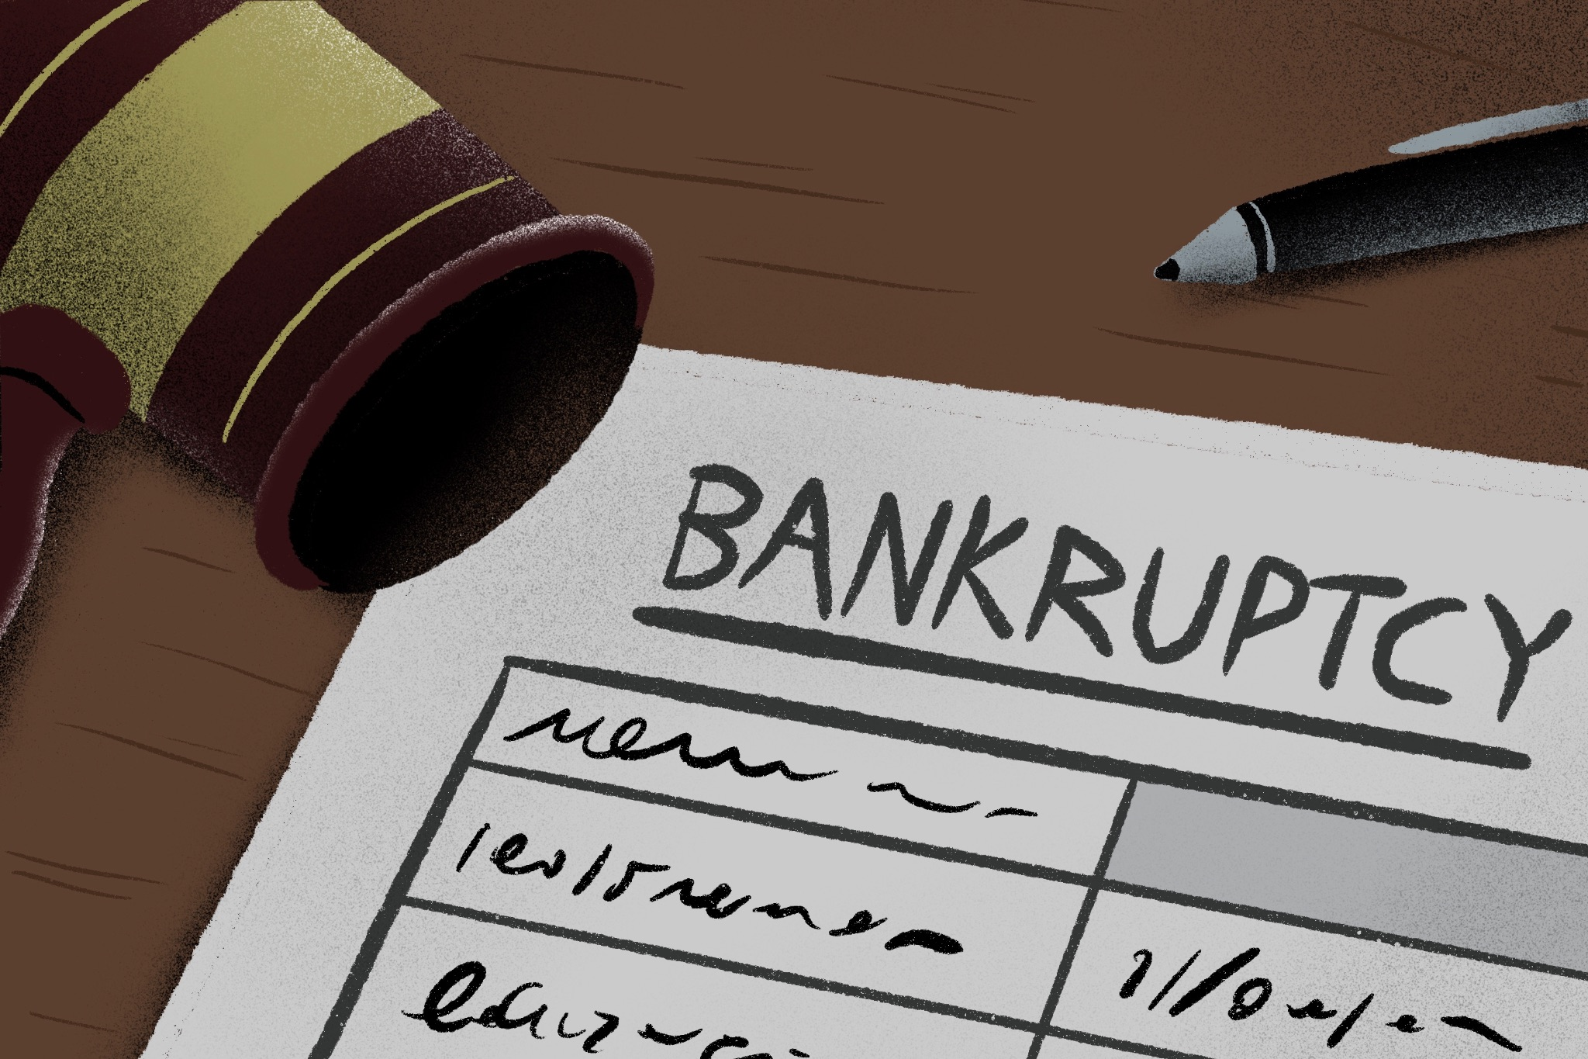
US Company Bankruptcy Dataset from 1999 to 2018
Group Members: Jannatul Ferdos Hashi, Arun Balaram, Sree Rama Pavan Vannemsetti, Kangna Parekh

Slide 2
Introduction
As a group, we all agreed to work on the Bankruptcy dataset.
We found a dataset for bankruptcy prediction related to American Public companies listed on the New York Stock Exchange and NASDAQ is provided. Dataset comprises accounting data from 8262 distinct companies recorded during the period spanning from 1999 to 2018.

Slide 3
Purpose
Our main objective for exploring this data was to train our models to predict the companies which remain without any bankruptcy and also features impacting the companies to remain alive.
Goal - Predicting Companies remain without Bankrupt
We have applied few Machine Learning models, Deep Neural Networks to find the accuracy and precision. Also, used Tableau for the visualization.
Models & Visualizations:
Logistic Regression
Random Forest
Gradient Boosting
Neural Networks & Deep Learning
Tableau

Slide 4
Neural Networks - Hashi
Project Goal:
• Develop a robust model to identify companies not at risk of bankruptcy.
• Apply deep learning techniques to achieve this.
• Enable stakeholders to assess financial stability and make informed decisions.
• Utilize various financial metrics as features and preprocess the data included scaling and one-hot
encoding for categorical variables
Model Performance:
• Loss: 0.2438
• Accuracy: 93.6%

Slide 5
Logistic Regression - Arun
CONFUSION MATRIX
TRUE NEGATIVE (34) FALSE POSITIVE (3910)
FALSE NEGATIVE (29) TRUE POSITIVE (55038)
The Confusion Matrix has 3910 false positive outcomes, meaning that there were 3910 companies that were thought to be alive, but actually went bankrupt. Due to the variables being all financial variables, and no external variables, this is the reason why the model may not have had small inaccuracies with the dataset.
CLASSIFICATION REPORT OUTCOME FOR COMPANIES THAT ARE ALIVE
ACCURACY = 93% PRECISION = 94% RECALL = 100% (1) F-1 SCORE = 97%

Slide 6
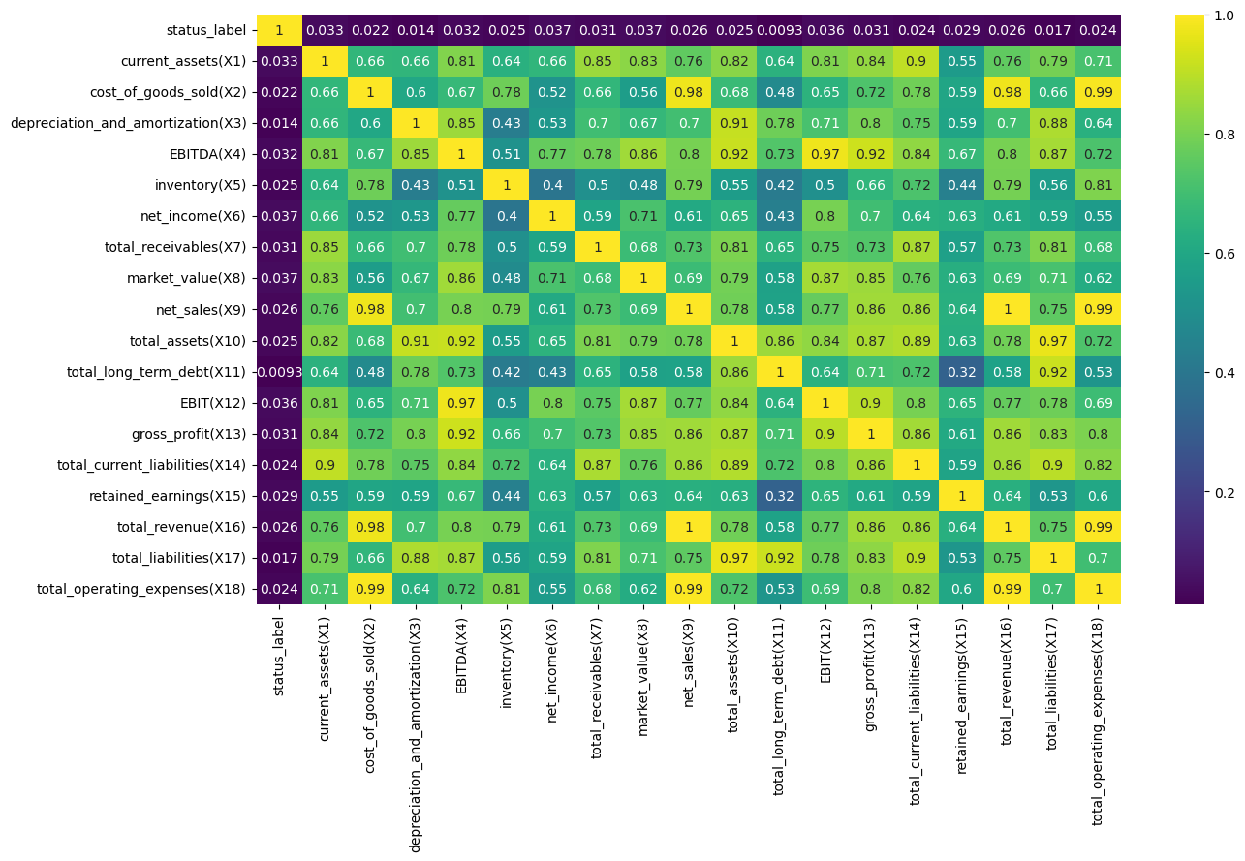
Random Forest & Feature Engineering - Sree

Slide 7
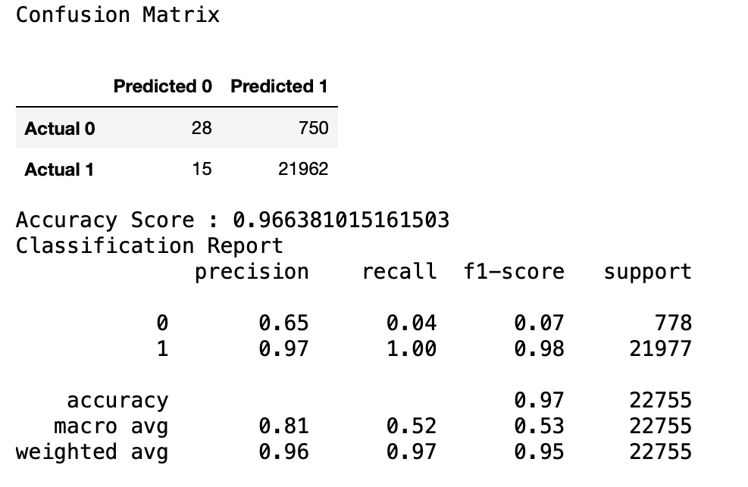
Random Forest & Feature Engineering - Sree

Slide 8
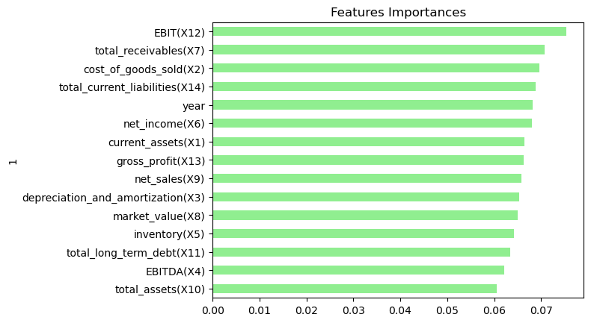
Random Forest & Features Importance - Sree

Slide 9
Random Forest & Feature Engineering - Sree
Using the Random Forest classification technique, a machine learning algorithm was built that would identify if the company remain without bankruptcy must be targeted to enhance the market value and retained earning. Also, a multi-class classification was done to spot which feature dominated the company's performance.
A company may need to enter bankruptcy due to poor market value, increase in liabilities or long term debt. This data analytic based algorithm helps companies to predict their performance and keep them alive in the market.
Need some more features to provide more accurate information on the companies not to enter the bankruptcy. Even though the accuracy is high, the model seems to be biased.

Slide 10
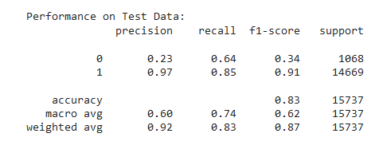
XGBoost - Hashi
Model’s Performance on testing data:

Slide 11
Limitations
Imbalanced Dataset
Insufficient Features
Sensitivity to Data Changes
Variables are all Financial-related (no external variables)

Slide 12
Tableau Visualizations - Kangna
https://public.tableau.com/views/project4_16969880816240/SUCESSFAILUREstory?:language=en-US&publish=yes&:display_count=n&:origin=viz_share_link

