Slide 1

Course Name: FPGA Laboratories
Course No: ECE 128 Term: Fall 2024
Course Instructor: Jannatun Naher, PhD

Slide 2

Numbering Systems and Adder Designs

Slide 3
Number Representation
Recap: data formats in Verilog
– syntax: <size>'<radix><value>;
– Radix: O for octal, b or B for binary, d or D for decimal, h
or H for hexadecimal
– Other than 0 and 1, value can also be x (unknown) and z
(high impedance), but can not be negative
More examples
– 5’O37 // 5-bit octal
– 7’Hz // 7-bit z extended to zzzzzzz

Slide 4
Binary Codes
Processors typically compute in binary form, but
input and output can be encoded in other form
Binary coded decimal
– Use four binary bits for one decimal digits with the weight
of 8-4-2-1
Gray code
– Minimize bit flips in adjacent values
Hamming code
– Increase hamming distance between any pair of valid codewords to detect errors

Slide 5
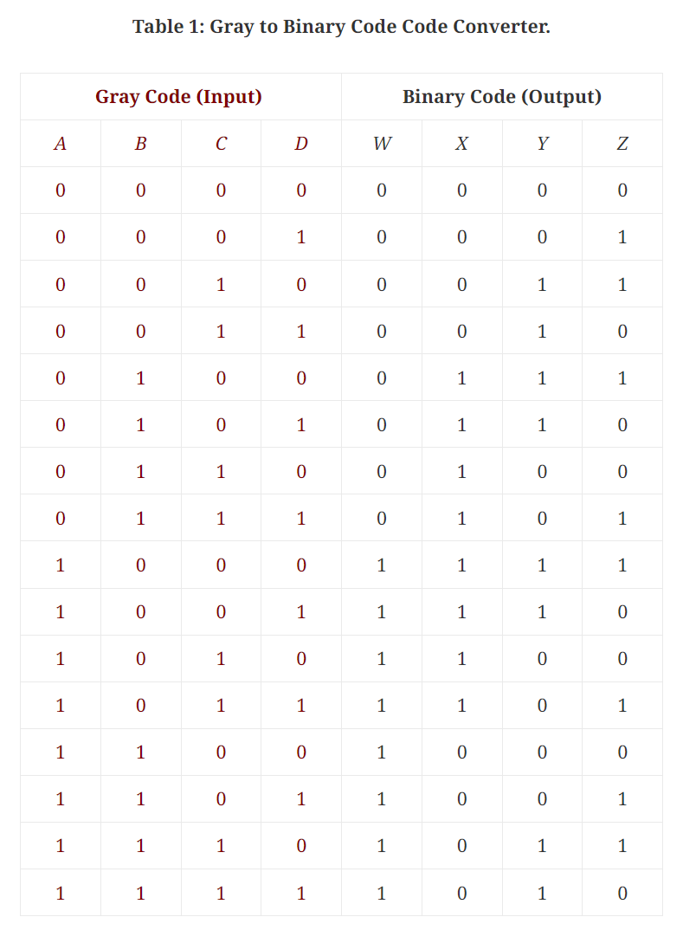
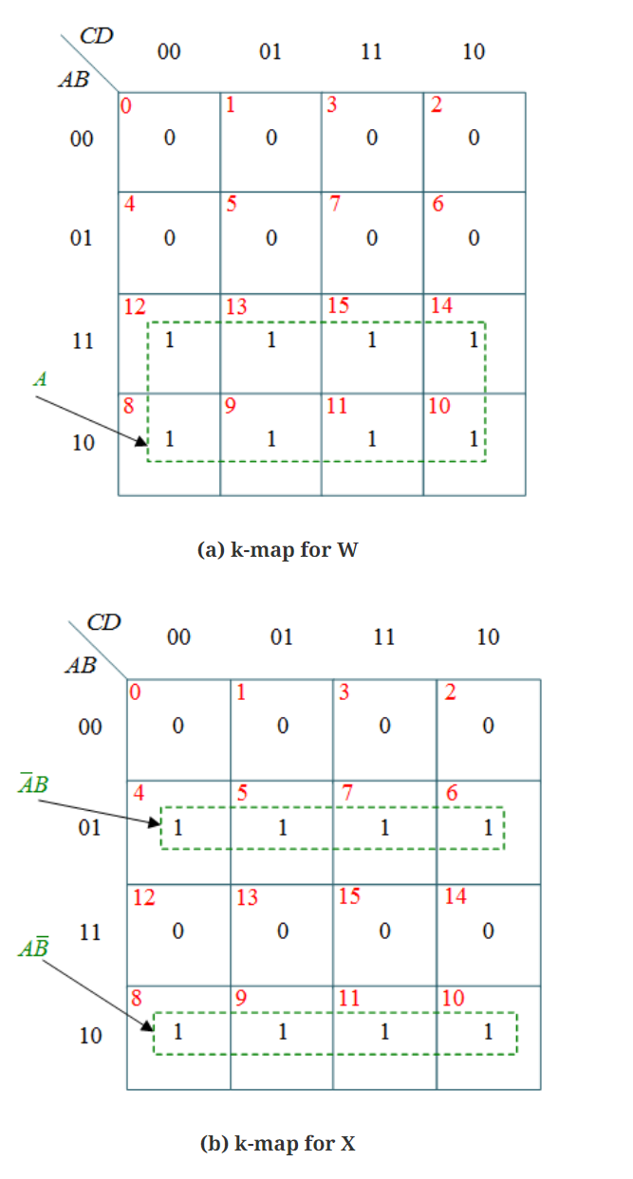
Decimal, BCD, and Gray Code

Slide 6
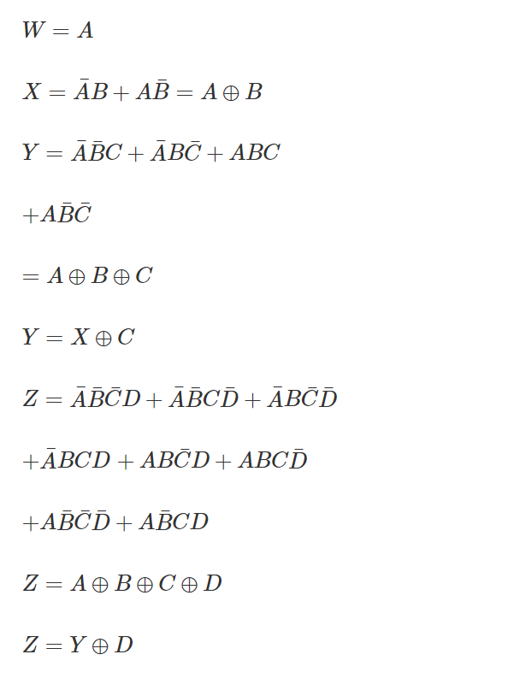
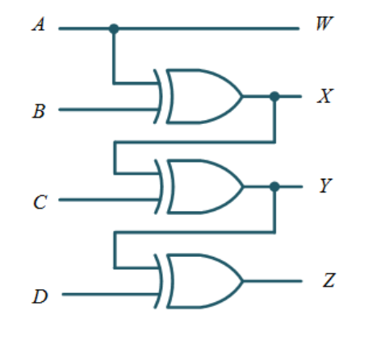
Decimal, BCD, and Gray Code

Slide 7
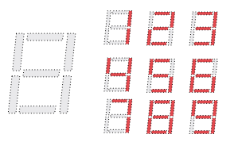
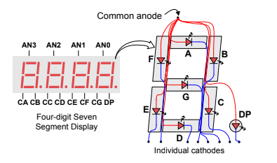
Seven Segment Displays
Fig. An un-illuminated seven-segment display and nine illumination patterns corresponding to decimal digits.

Slide 8
Seven Segment Displays
Anode is controlled by PMOS (0=ON)
– An anode is shared among all segments of one display
• Each segment is a light-emitting diode (LED)
– Anode connect to Vhigh and Cathode = 0, light ON
– A cathode is shared among multiple displays

Slide 9
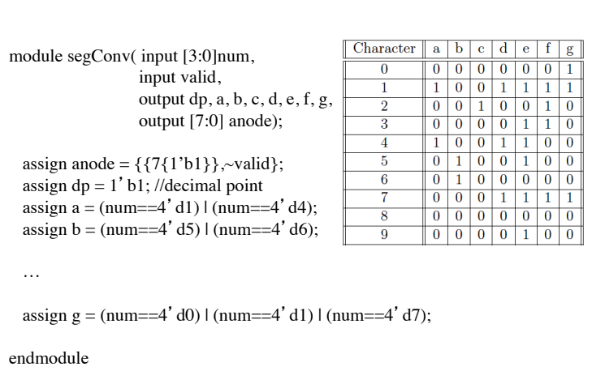
Segment Converter

Slide 10
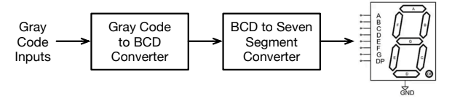
Hierarchical (Modular) Design
Divide a system into smaller parts
– Test smaller part one by one
– Reuse and replicate parts
An example of converting Gray code to BCD, and then to seven segment display

Slide 11
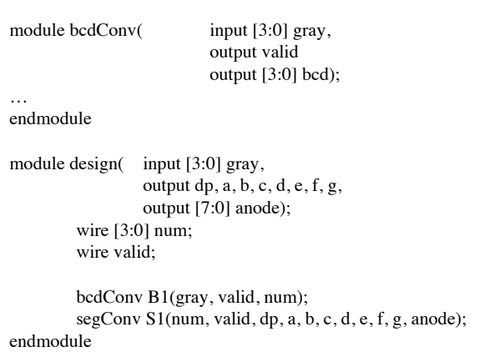
Skeleton of the Verilog Code

Slide 12
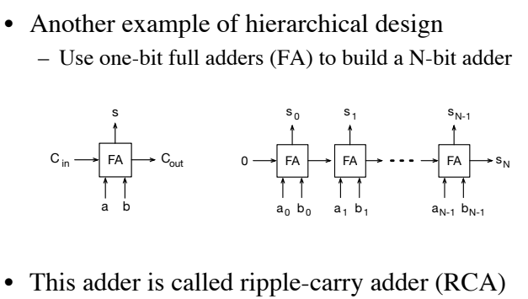
Adder Design

Slide 13
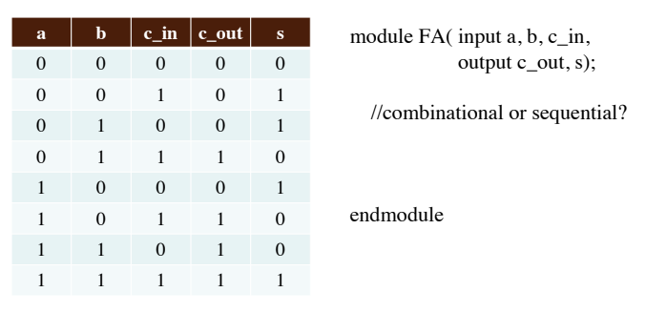
Implementation of a Full Adder

Slide 14
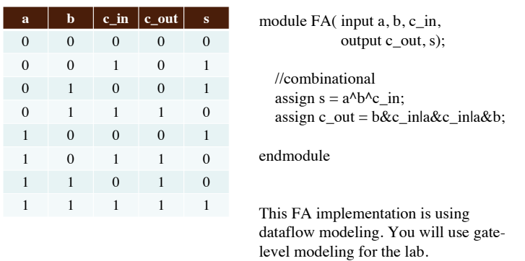
Implementation of a Full Adder

Slide 15
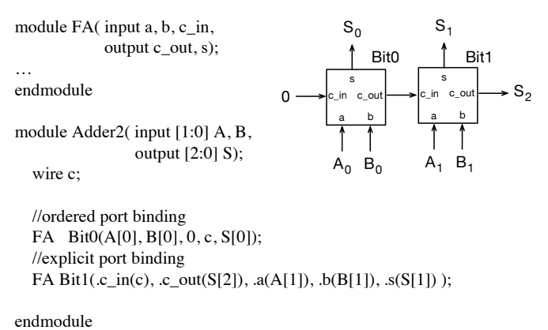
2-Bit Adder

Slide 16
Latency of Addition
Latency of combinational logic is the time between input occurs and output becomes stable
Critical path: the path between and input and output with the maximum delay determine the latency of combinational logic
The RCA has a long critical path
– Carry at each bit position depends on the calculation of the carry at previous bit position
– Example
c_out_1 = b_1&c_in_1|a_1&c_in_1|... = b_1&c_out_0|a_1&c_out_0|...;
– The critical path increases linearly with the width of the adder
Latency of combinational logic can be input and last input dependent

Slide 17
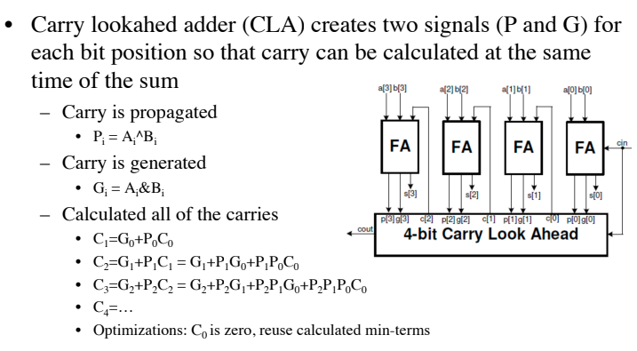
Alternative: Carry Lookahead Adder

Slide 18
How to Convert Codes?
Combinational or sequential logic?
– Output depends on input only
– Each output depends on multiple input bits
Step 1: write truth table for each output bit
Step 2 (optional): use Kaurnaugh map to derive simplified combinational logic for each output
Step 3: implement in Verilog

Slide 19
SOP & POS
Sum-of-Products circuit: focus on inputs states where truth table is a 1.
Product-of-Sums: focus on input states where truth table is a 0.
Minterm: a product term that includes each input of a circuit or its complement.
Maxterm: A maxterm is a Boolean expression resulting in a 0 for the output of a single cell expression, and 1s for all other cells in the K-maps

Slide 20
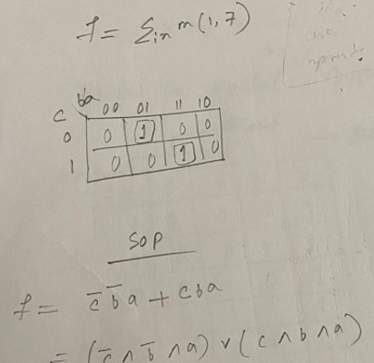
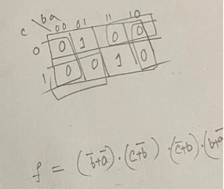
Max & Min Terms
Max Terms
Min Terms

Slide 21
More Examples for K-Maps (4 bit Prime Numbers)
F(d,c,b,a) is true if input d,c,b,a is prime

Slide 22
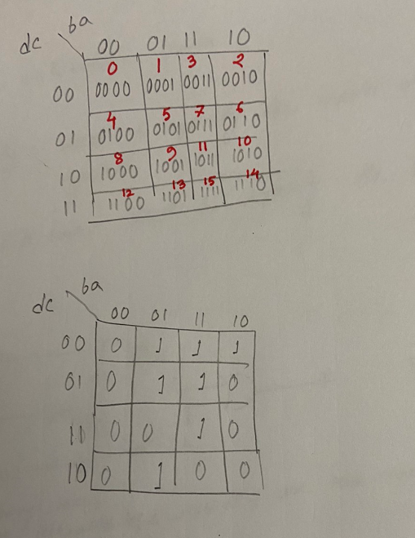
Design 4 bit prime numbers (using K maps)

Slide 23
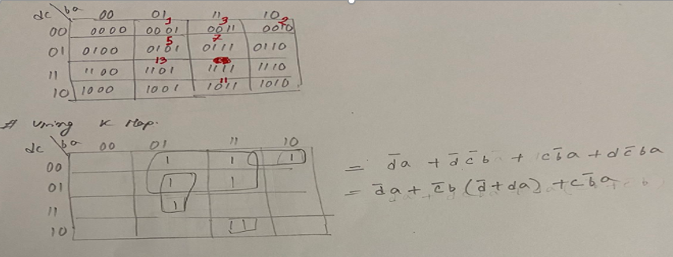
Design 4 bit prime numbers (using K maps)

Slide 24
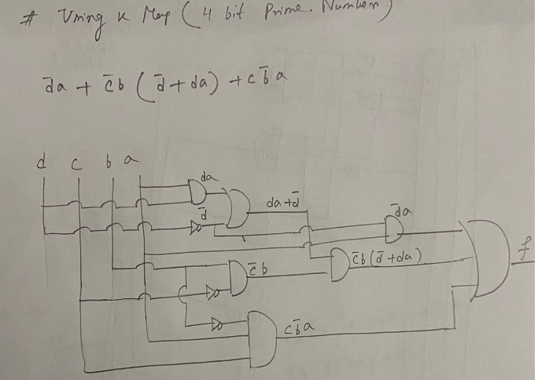
Design 4 bit prime numbers (using K maps)

Slide 25
Short-cut way:

