Slide 1
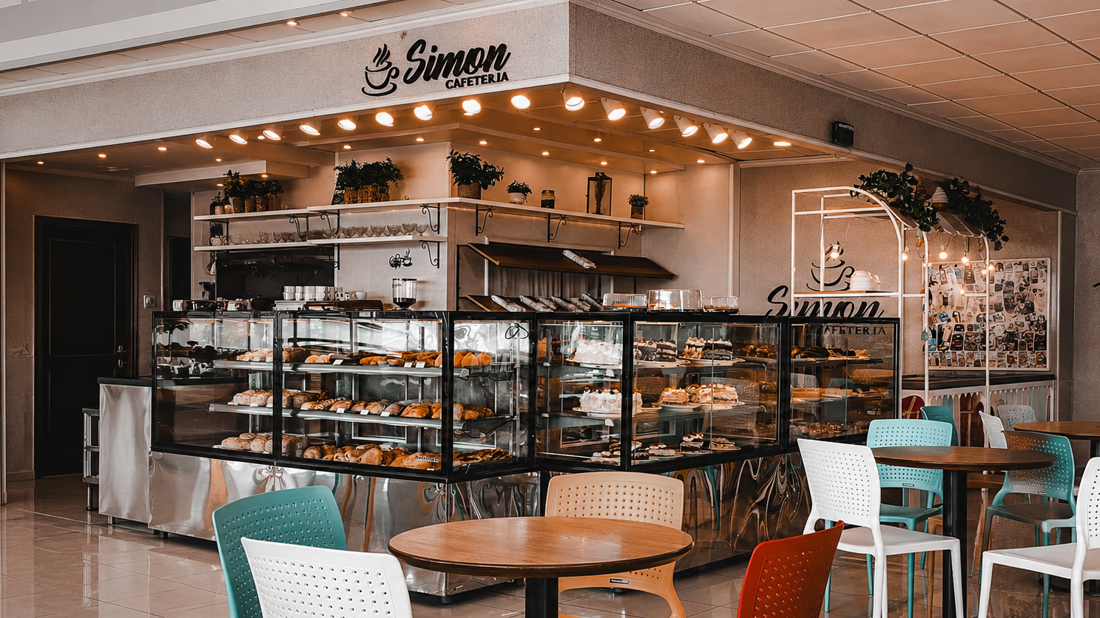
Smart Food Ordering & Token Generation System
A full-stack cafeteria web application that lets students order food, complete payment selection, receive a token, and track status without standing in long queues.
Customer
Gateway
Admin
Menu, cart, checkout
Mock OTP + PIN flow
Orders, status, reports
Smart Food Ordering & Token Generation System
01

Slide 2
SYSTEM SCOPE
The project connects student convenience with cafeteria operations.
I built separate customer and admin workflows that meet at the order and token database.
Customer side
Admin side
Browse categories and food items
Search and filter menu
Add items to localStorage cart
Checkout with cash or online payment option
Receive token and track order status
View live dashboard statistics
Manage orders by status
Add, edit, delete food items
Manage categories
View sales reports and revenue summary
Order
Token
Smart Food Ordering & Token Generation System
02

Slide 3
ARCHITECTURE
The architecture keeps the system modular and easy to explain.
Frontend pages call REST APIs; Express routes apply business logic; the database layer stores users, menu, orders, and tokens.
Frontend
HTML, CSS, Vanilla JS
Menu, cart, checkout, tracking, dashboard
API Layer
Express.js REST routes
/auth, /menu, /orders, /admin
Business Logic
Session checks, price validation, token generation, status updates
Database
MySQL primary database
JSON fallback when MySQL is unavailable
Smart Food Ordering & Token Generation System
03

Slide 4
CUSTOMER JOURNEY
A student can complete the full ordering journey from one browser flow.
The customer experience is designed to be simple: choose food, confirm cart, select payment, and receive the token.
1
Browse menu
2
Add to cart
3
Checkout
4
Place order
5
Get token
Category tabs + search filters
Quantity and subtotal stored locally
Billing details and payment method
API validates cart and saves order
Student tracks status with token
Presentation line: I focused on reducing manual waiting time by making the order information available before the student reaches the counter.
Smart Food Ordering & Token Generation System
04

Slide 5
PAYMENT GATEWAY
The payment gateway is implemented as a safe mock checkout flow.
For a university demo, I simulated the main stages of online payment without connecting to real bank or mobile-money APIs.
1
Choose method
2
Enter account
3
Verify OTP
4
Confirm PIN
5
Process payment
Cash, bKash, Nagad, or Card
Mobile number or card number
Simulated 6-digit OTP step
Secure PIN/password step
Fake transaction ID then order API
Easy explanation for teacher
A real payment gateway talks to a provider like bKash, Nagad, Stripe, or a bank. My project uses the same user journey for learning: select provider, verify identity, confirm payment, receive transaction ID, then generate token. Because this is a demo system, the transaction ID is generated locally instead of charging real money.
Smart Food Ordering & Token Generation System
05

Slide 6
TOKEN LOGIC
Token generation converts a confirmed order into a queue number.
The backend checks the latest token, increases the number, pads it to three digits, and saves it with the order.
1. Read last order
2. Calculate next
3. Save and return
Database query checks the newest token number, for example T005.
Remove the T prefix, convert 005 to a number, add 1, then format back to 006.
The order is inserted as Pending and the response returns tokenNumber to the customer.
Example: last token T005 -> next token T006
Smart Food Ordering & Token Generation System
06

Slide 7
TRACKING
Order tracking keeps the student informed after checkout.
The token is useful because it links the customer view and the admin preparation workflow.
1
Pending
2
Preparing
3
Ready
4
Completed
Order received
Kitchen is working
Student can collect
Order closed
How tracking works
The track page calls /api/orders/track/:token. It fetches the matching order and items, then refreshes the visual status stepper so the student does not need to ask the counter repeatedly.
Smart Food Ordering & Token Generation System
07

Slide 8
ADMIN PANEL
The admin panel turns incoming tokens into an organized service board.
Staff can control the menu and update order progress from protected admin pages.
Dashboard
Order board
Food CRUD
Total orders, pending queue, ready orders, revenue
View token, customer, items, total, and update status
Add, edit, delete food items and availability
Categories
Reports
Access control
Create, rename, delete menu categories
Sales total, count, and status distribution
Admin routes protected by server-side middleware
Smart Food Ordering & Token Generation System
08

Slide 9
DATA & SECURITY
Database and security choices make the project reliable for demo and deployment.
The schema stores the core entities, while sessions and password hashing protect user/admin actions.
users
categories
food_items
id, name, email, hashed password, role
food grouping
name, price, image, availability
orders
order_items
user, token, total, status, time
order, food, quantity, subtotal
Reliability
Security
MySQL is primary; JSON fallback keeps all features working when MySQL is unavailable.
bcrypt password hashing, session cookies, and admin middleware protect restricted routes.
Smart Food Ordering & Token Generation System
09

Slide 10
CONCLUSION
This project demonstrates a complete full-stack software development cycle.
It includes UI, API design, database design, authentication, payment simulation, token generation, and admin operations.
What I built
Future improvement
Customer ordering flow
Mock payment gateway
Token generation and tracking
Admin order/menu/report management
Connect a real payment provider API
Add email/SMS token notification
Add cancellation/refund flow
Deploy with production database
Final line: The main goal was to reduce waiting time and make cafeteria order handling more organized.
Smart Food Ordering & Token Generation System
10

