Slide 1

SMILE DENTAL HEALTHCARE

Slide 2
SMILE DENTAL HEALTHCARE
At Smile Dental Healthcare, it is our topmost priority to provide the highest quality of dental services to all our patients with compassion and dignity at the most affordable cost to our customers.

Slide 3
SMILE DENTAL HEALTHCARE
An Ideal Dental Clinic Management Software has to manage multiple clinics and perform multiple functions. Along with this, with Dental Clinic Management Software as an admin you can monitor the access given to the users and enable/disable features based on your specific clinic requirements.

Slide 4
PROJECT MEMBERS:
Together we provided each of our skills to come up with the database in the field of dentistry.
PANGAN, JAN NEIL B.
MOJENO, ALDEN IVERSON M.
LIMSINGIAN, LAURELLE T.
DIZON, LANCE T.

Slide 5
DIAGRAMS

Slide 6
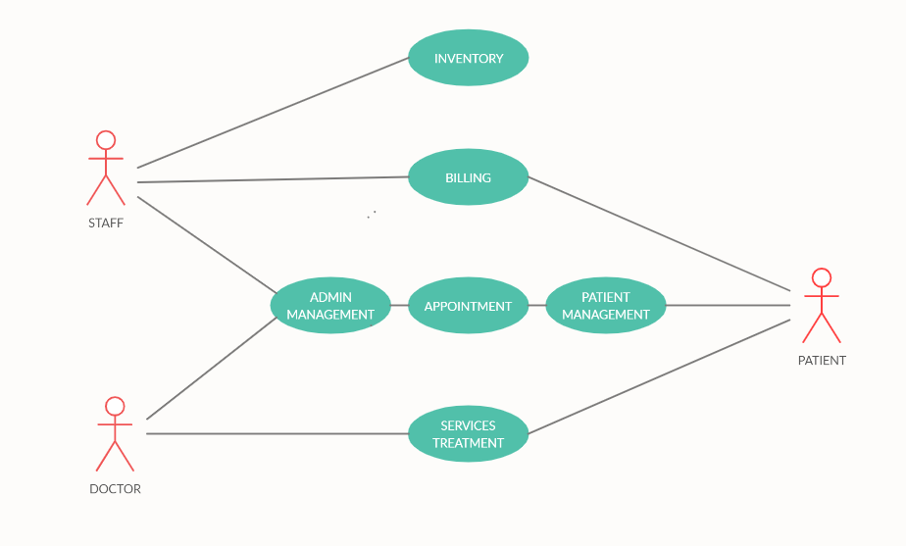
CASE DIAGRAM
Visual representation of a user's interaction with the system

Slide 7
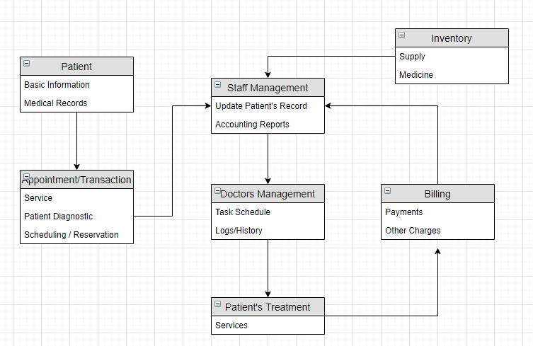
DATA FLOW DIAGRAM
Visual representation of a data flow of a process in our system

Slide 8
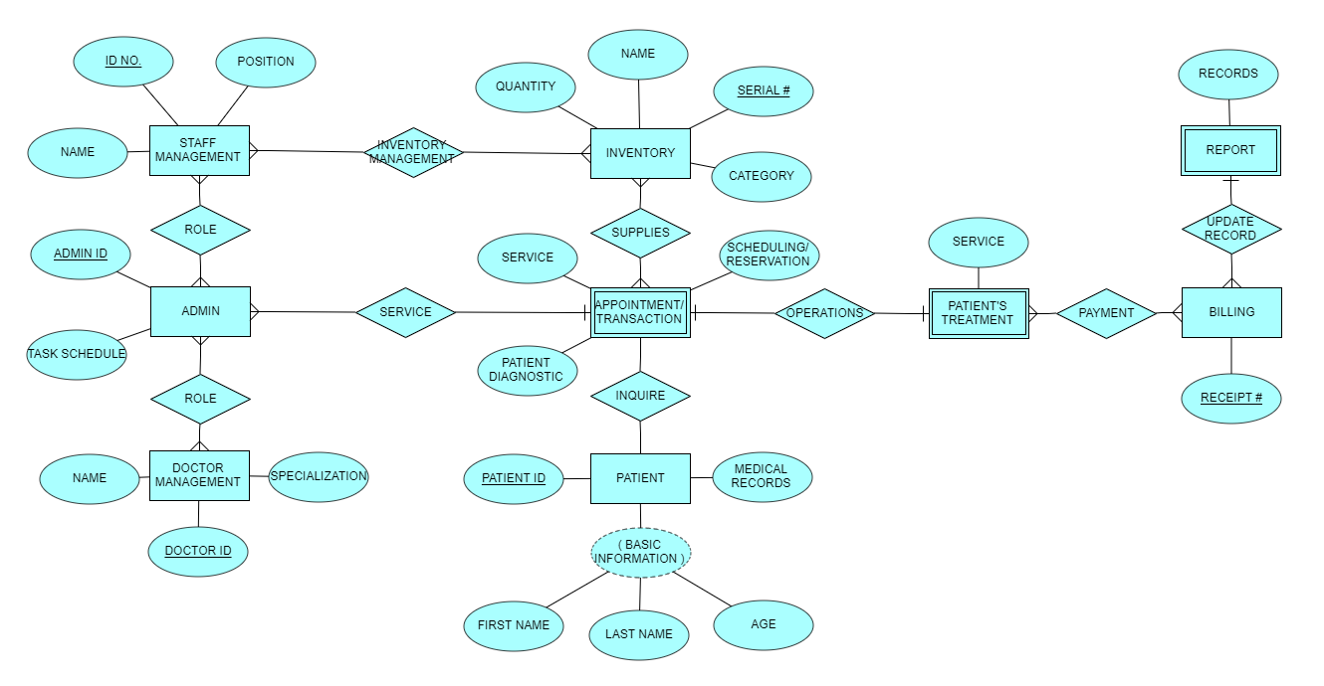
ENTITY RELATIONSHIP DIAGRAM
Visual representation of relationships between tables within that database

Slide 9
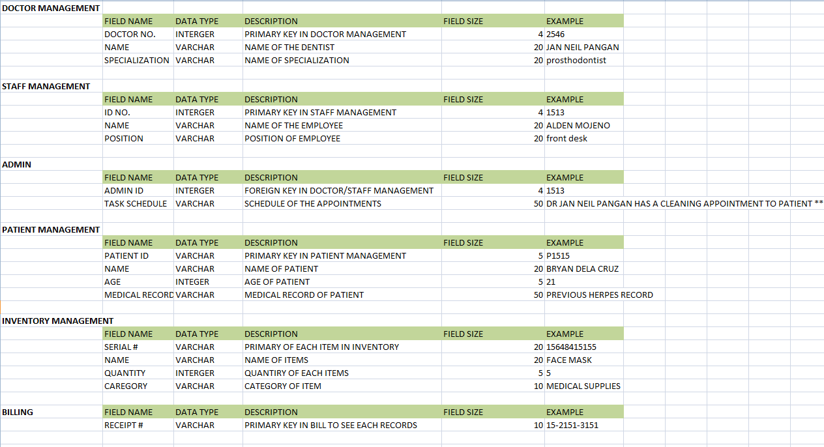
DATA DICTIONARY
Data Dictionary a set of information describing the contents, format, and structure of a database

Slide 10
OUTPUT

Slide 11
SMILE WEB APPLICATION
Our web application has two formats.
> ADMIN AND MEMBER FORMAT
Admin has more access in our application they have different additional Dropdownlist within the Patient, Inventory, Appointment, and Account Tab since patients should not have an access in clinic’s inventory and account management
ADMIN
MEMBER

Slide 12
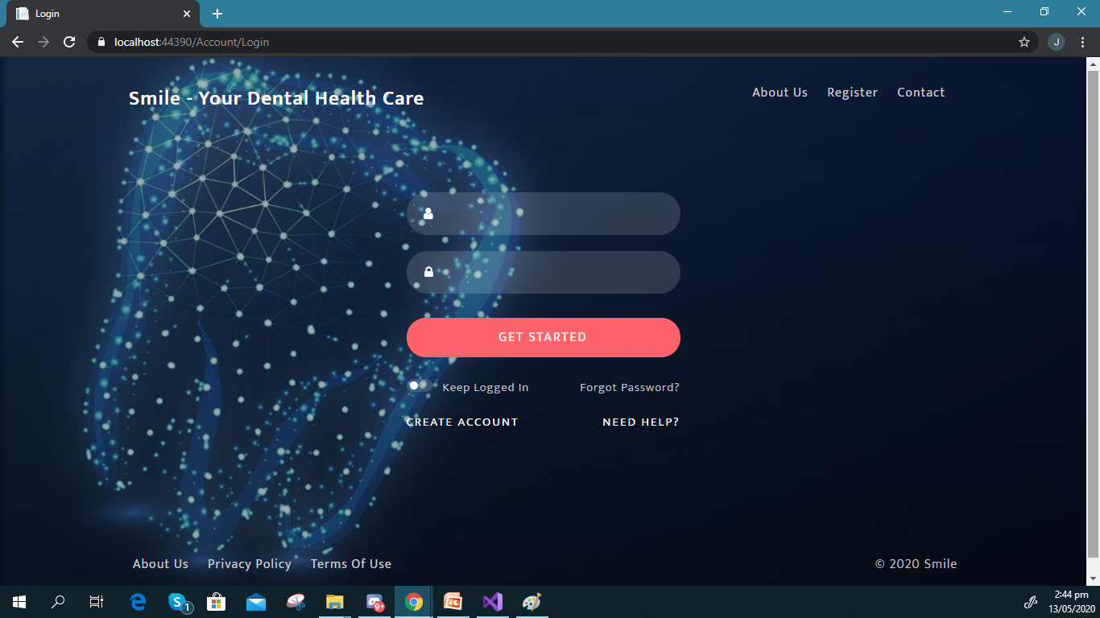
LOGIN PAGE
Username: admin
Password: mco

Slide 13
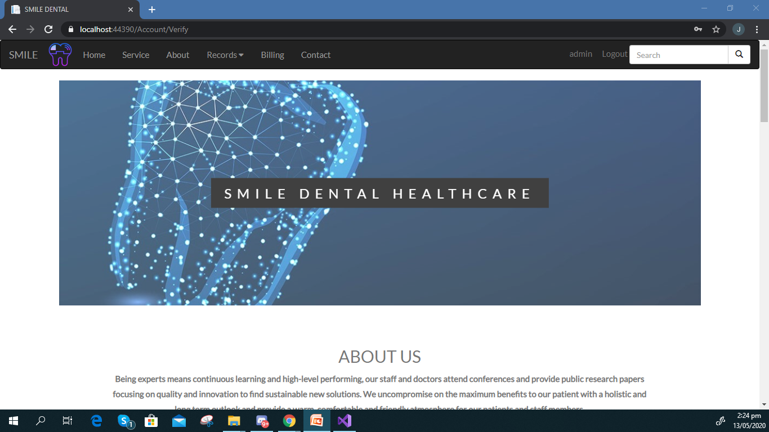
HOME TAB
This is where you can find the mission and vision of the company and major information regarding our dental clinic.

Slide 14
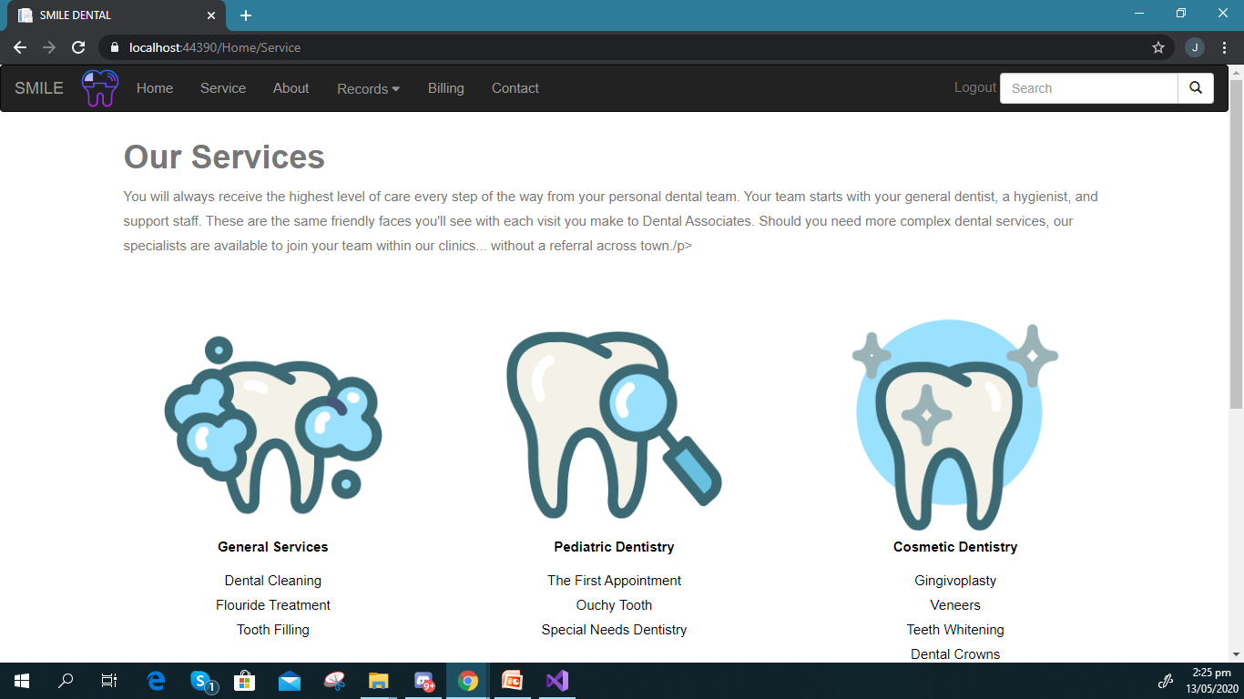
SERVICE TAB
This is where you can find the service our dental clinic offers.

Slide 15
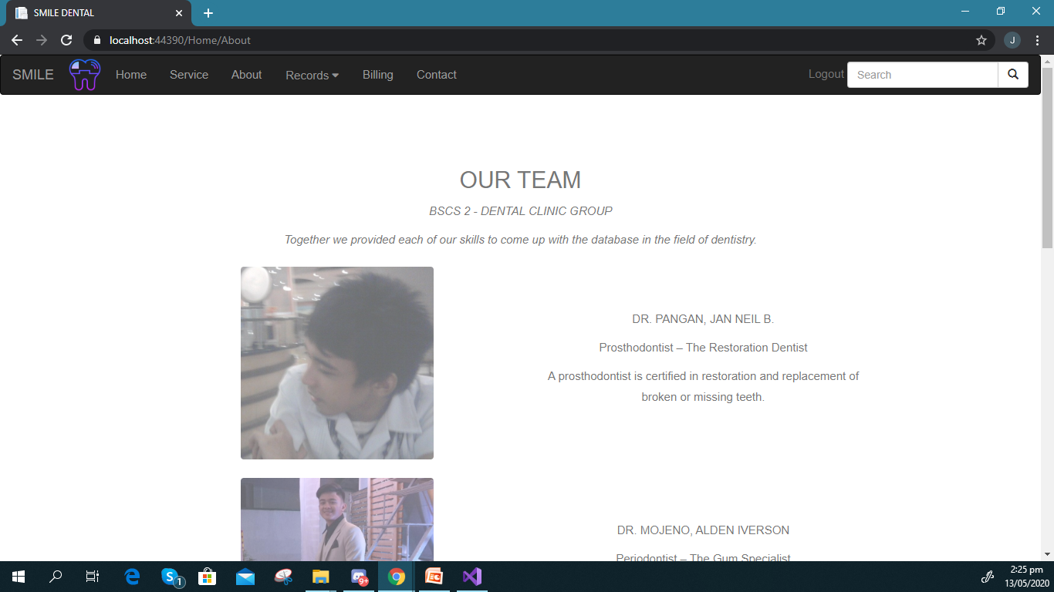
ABOUT TAB
This is where you can find the our team and doctors information.

Slide 16
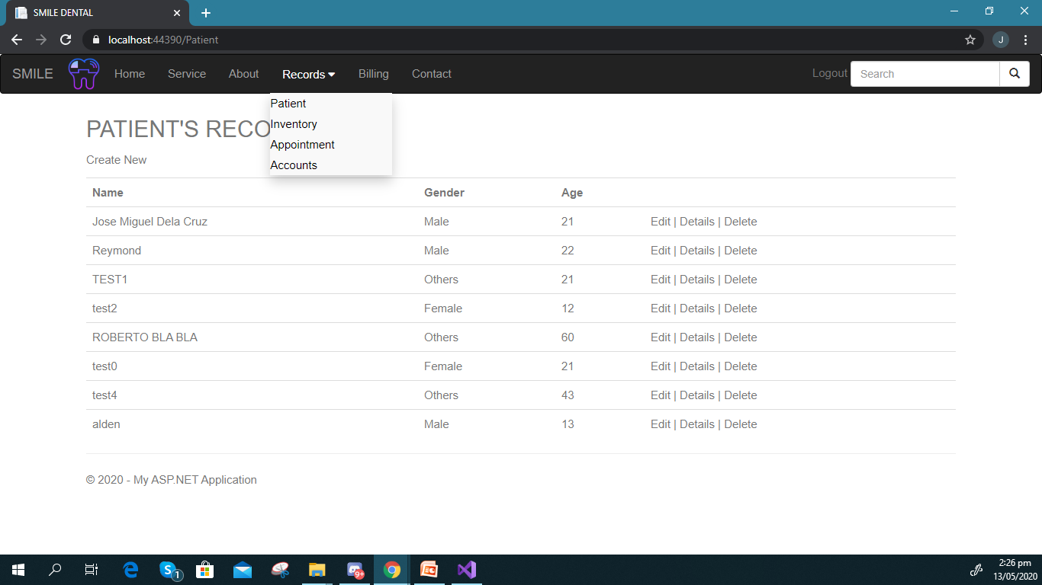
PATIENT TAB
This is where you can find the patient's information. You can add, update and remove their records.

Slide 17
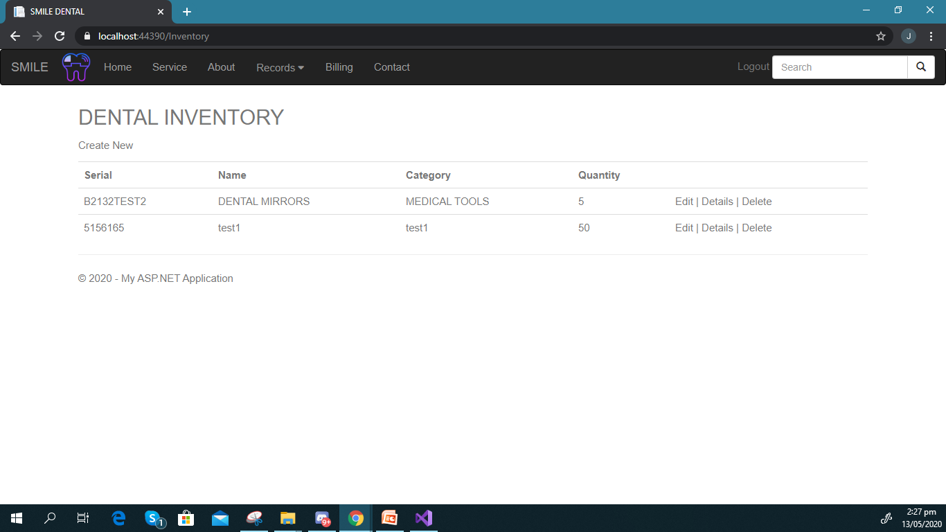
INVENTORY TAB
This is where you can find the inventory system of our clinic. You can also add update and remove items.

Slide 18
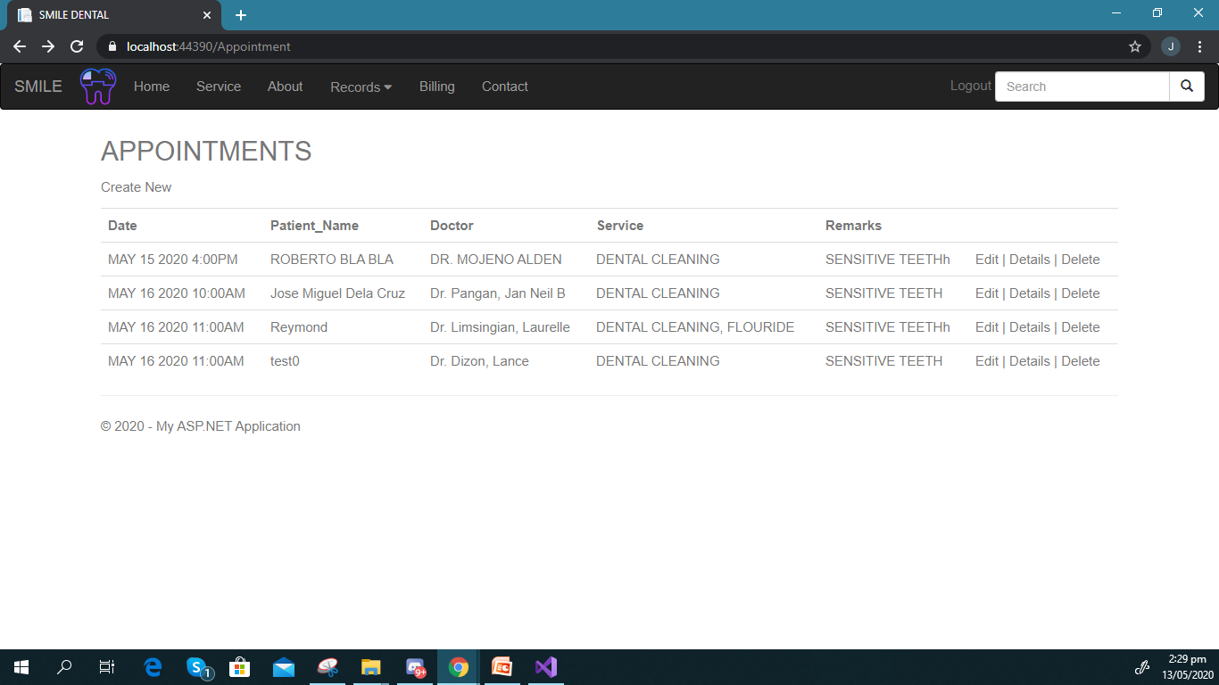
APPOINTMENT TAB
This is where the inventory system of our clinic is located. You can also add, update and remove items.

Slide 19
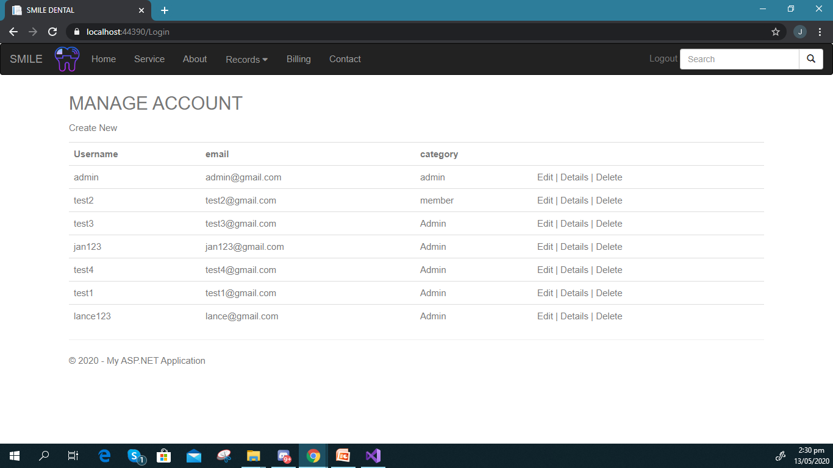
ACCOUNT TAB
This is where we make a new account for admin and for members.

Slide 20
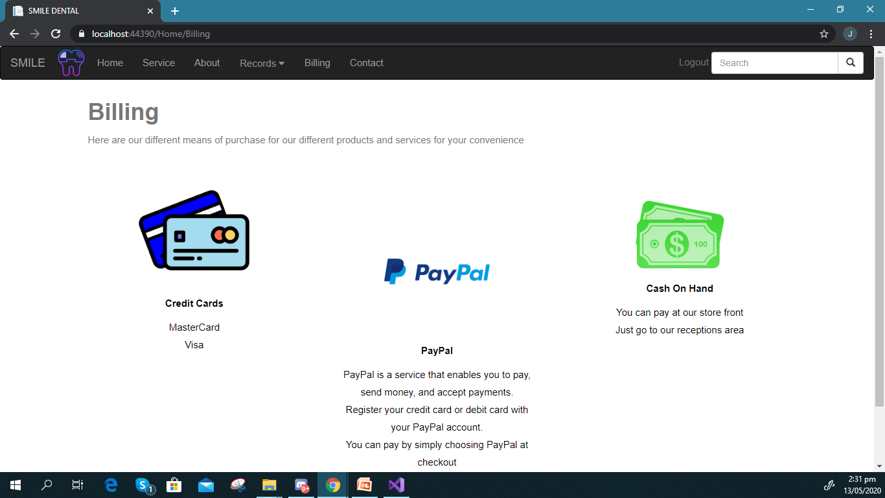
BILLING TAB
This is where we can register the transaction and make a receipt in our admin’s side. But for our customer’s side, they can also make online payments.

Slide 21
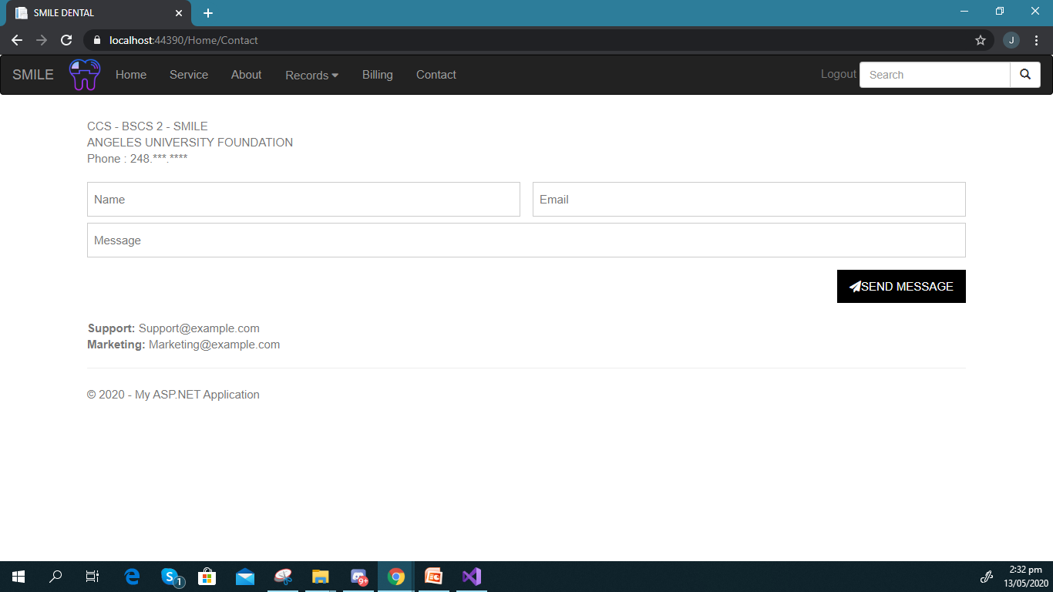
CONTACT TAB
This is where our customer can contact us for any concern, to inquire and make an appointment.

Slide 22
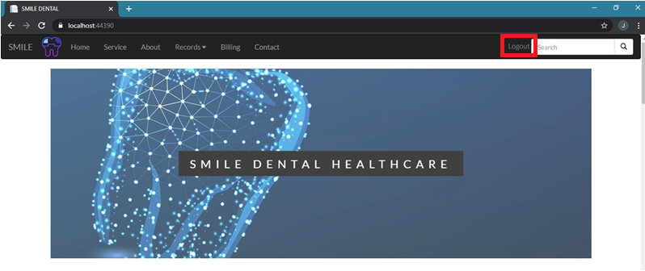
LOGOUT BUTTON
You can press logout button to go back to the login page.

Slide 23
CODE IN RAZOR

Slide 24
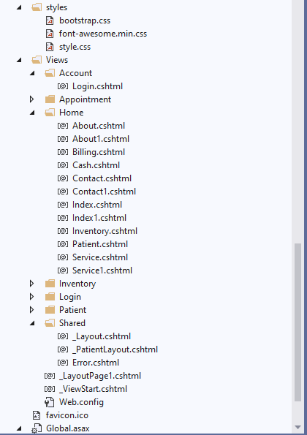
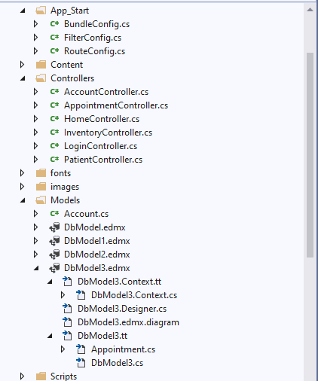
LIST OF ALL CSHTML, STYLE, CONTROLLER AND MODEL

Slide 25
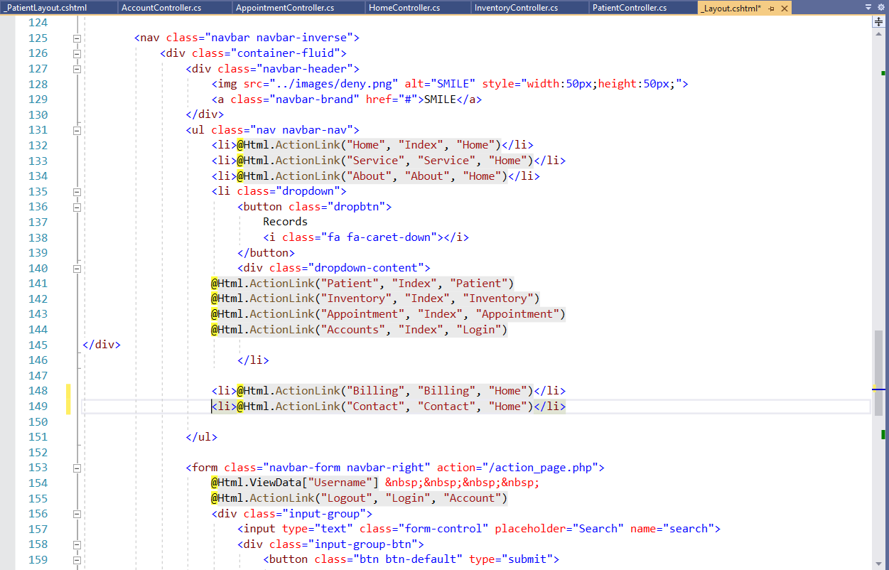
LAYOUT CODE

Slide 26
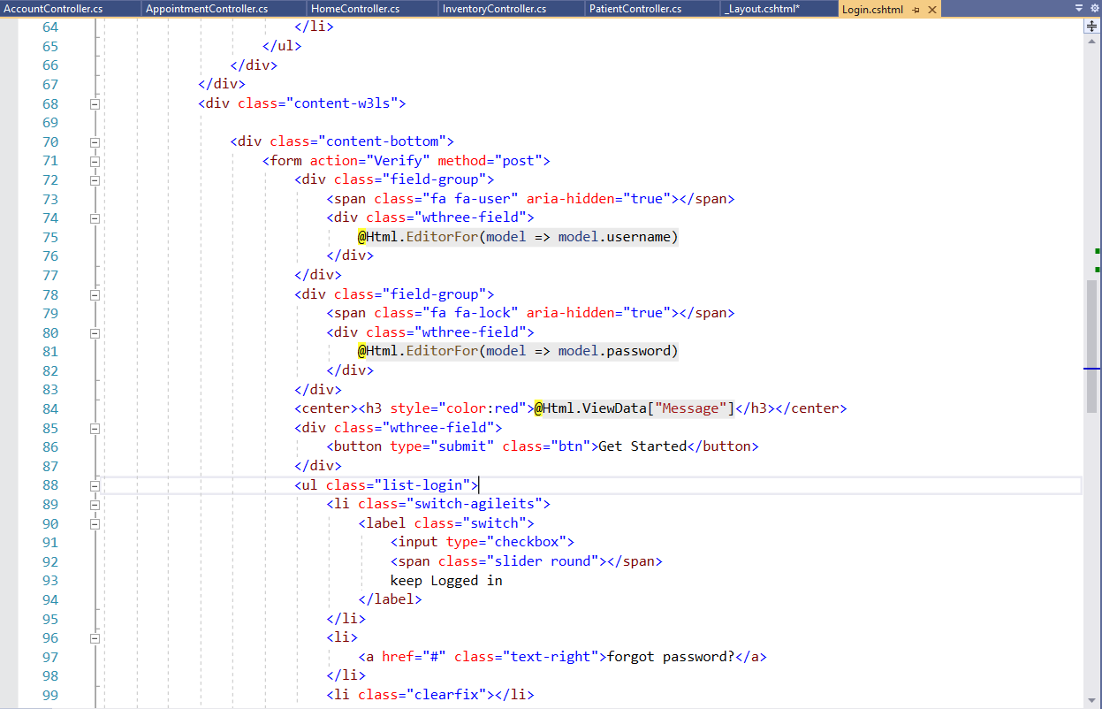
EXAMPLE OF CSHTML CODE

Slide 27
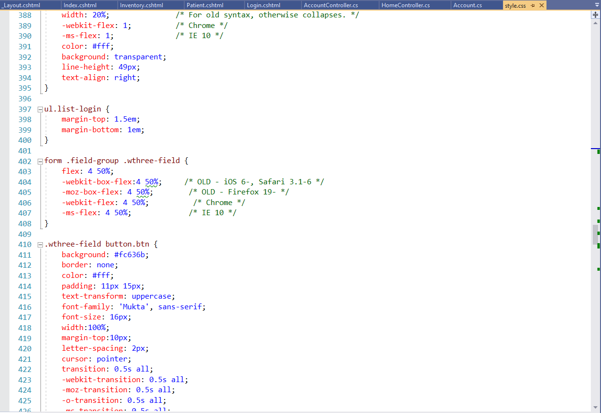
CCS CODE

Slide 28
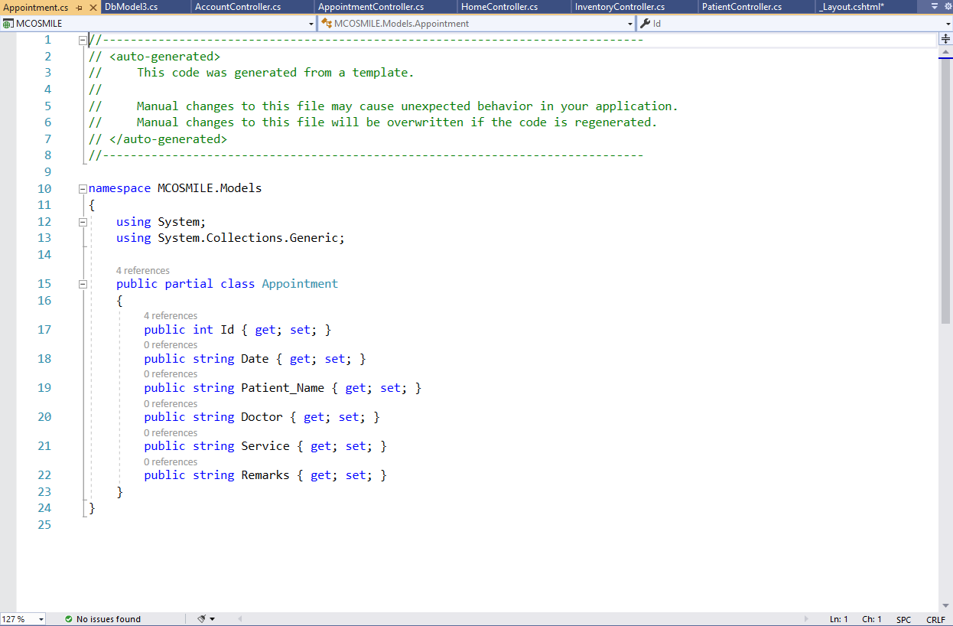
MODEL CODE

Slide 29
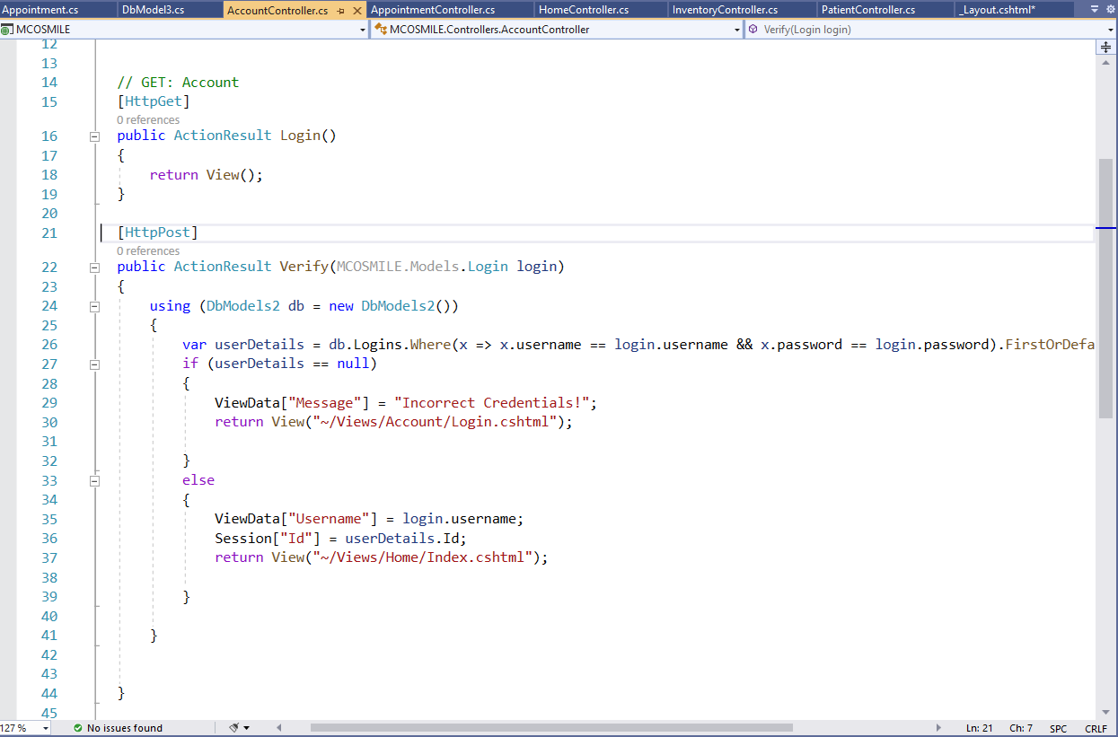
CONTROLLER CODE - ACCOUNTCONTROL

Slide 30
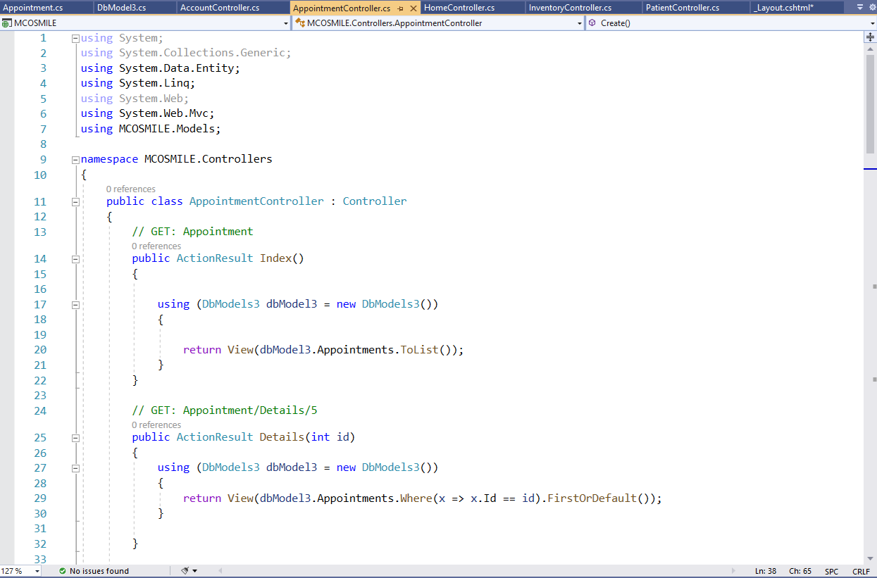
CONTROLLER CODE - APPOINTMENTCONTROL

Slide 31
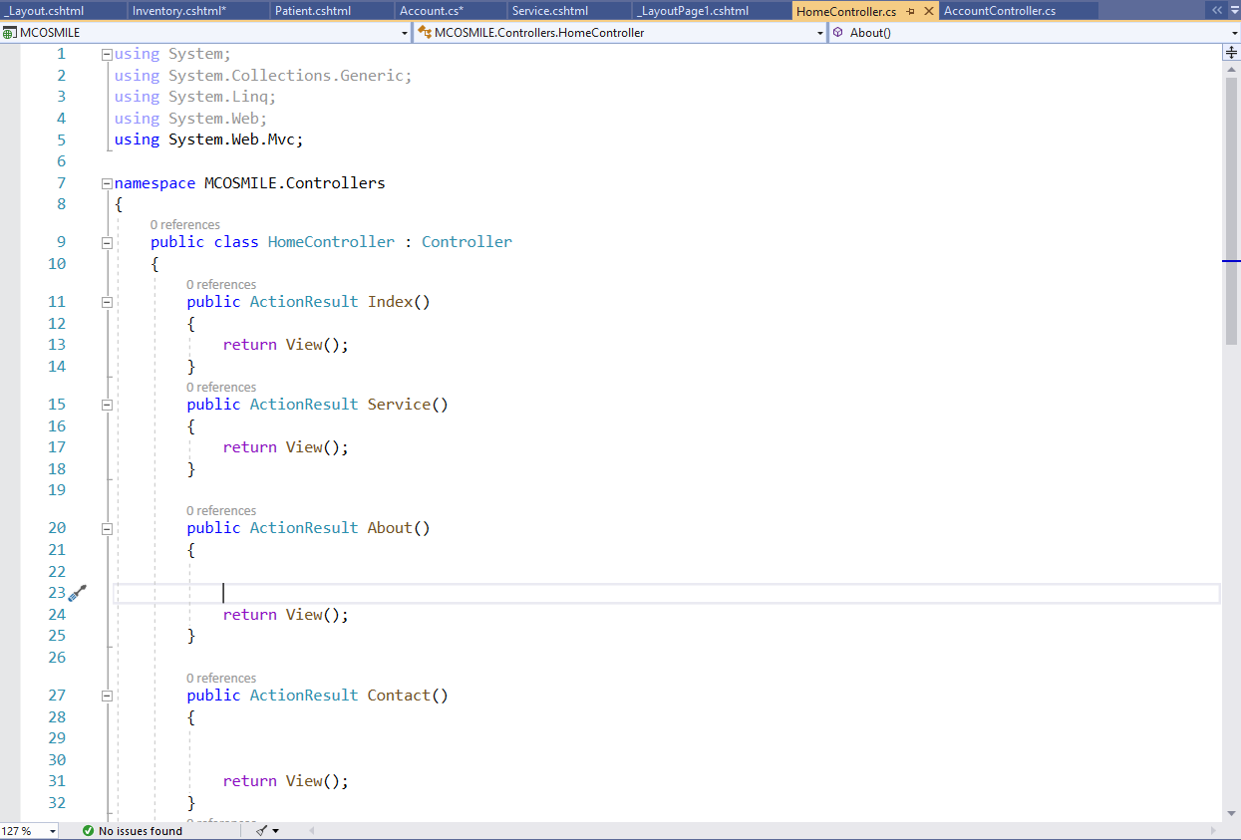
CONTROLLER CODE - HOMECONTROLLER

Slide 32
OPEN FOR SUGGESTIONS END

