Slide 1

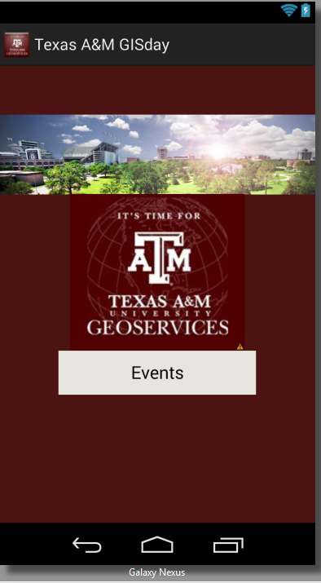

TAMU GIS Day
(logo)
View Events

Slide 2
Login
Event Calendar
Share
Logout
Logs user out
Event Calendar
Shows full calendar
Share
Takes them to facebook
Event Checkin
Enters their partcipantGuid into the database for that event
My Events
Shows events they went to. Shows upcoming events which are RSVP’s for
Settings
Registers which classes they are in. Other phone settings
Non-Logged In Menu
Logged In Menu

Slide 3
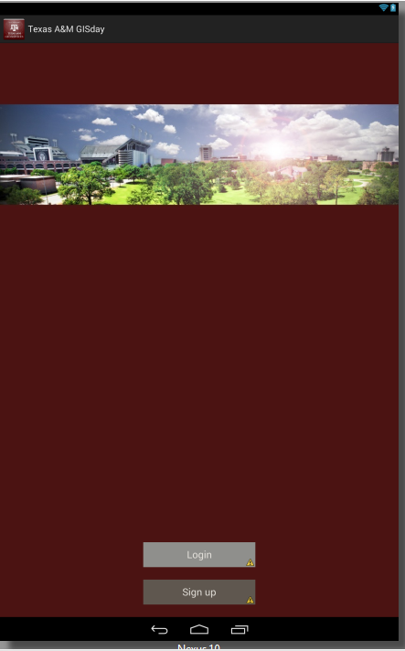
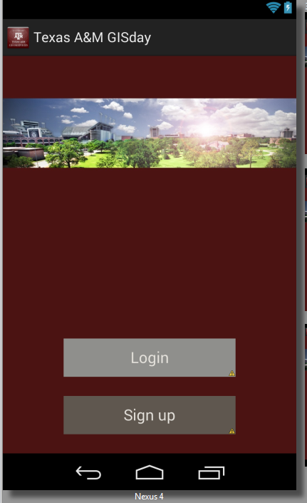
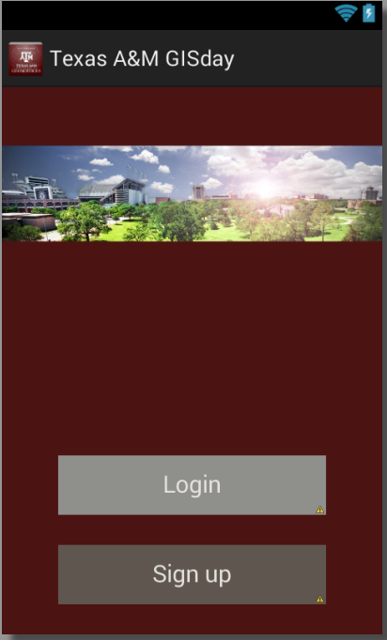
Login
Signup

Slide 4
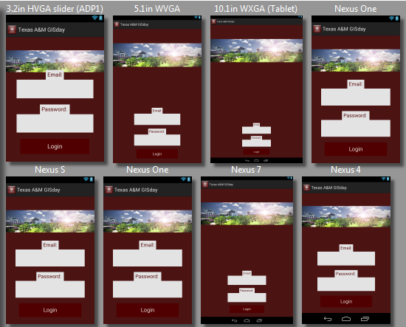
Email
password

Slide 5
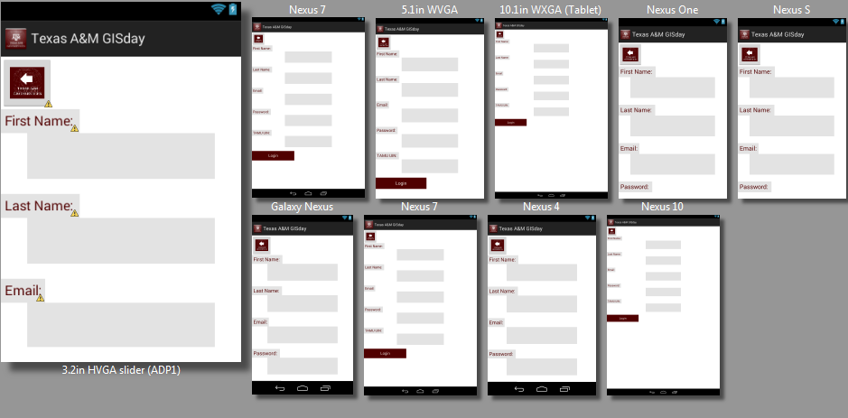
Email
password
First name
Last name
UIN

Slide 6
My Courses
Courses they are enrolled in and want extra credit for
Notification Options
My Courses
Event Reminders. Push Notifications. Etc.
Class 1
Class 2
Class 3
Send Event Reminders
Yes/No remind them of events 30 mins prior
Allow Push Notifications
Yes/No send their phones push notifications
Allow GPS Tracking
Yes/No track phone GPS location
Settings Menu
Notifications Menu

Slide 7
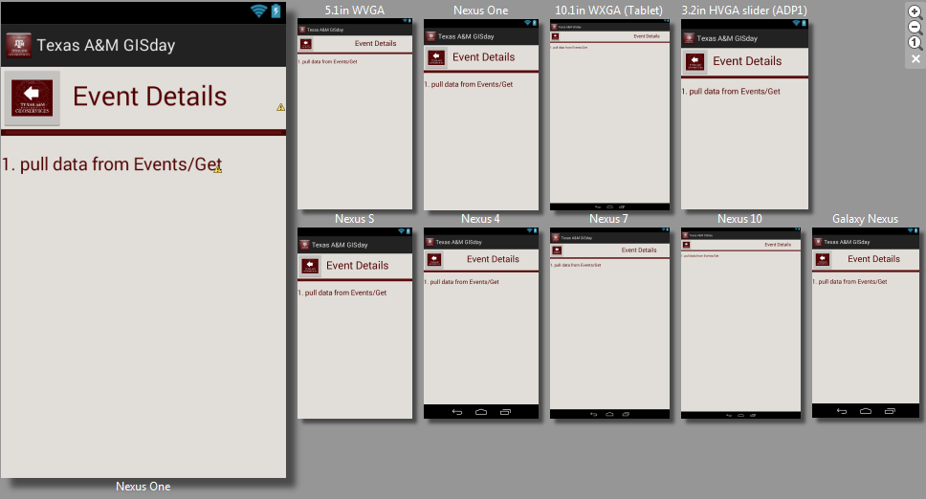
Event 1
Event 2
Event 3

