Slide 1
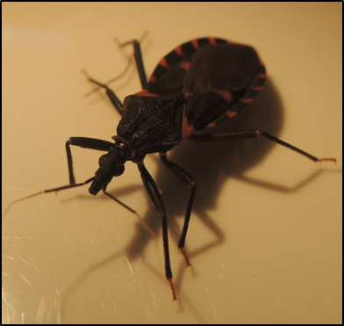
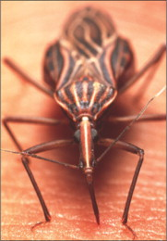
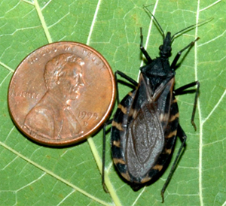
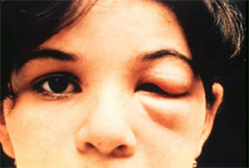
Kissingbug.tamu.edu
Presented to: Geography 489/689 Texas A&M University, College Station, Texas
2-25-2014
Yolanda J. McDonald
Jannel Gonzales
Department of Geography
Texas A&M University

Slide 2
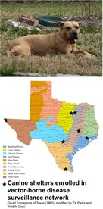
Client Problem – Lack of a Public Access Interactive Map
Need: Due to the large number of kissing bugs
submitted to the lab by the general public, the lab
would like to establish a site where submitters can
see the role that their submissions play in Chagas research throughout Texas.
Solution: The interactive map will be at the county-level, and it will have the number of kissing bugs found by type of bug, location (county), and the tested and infected status. It will be updated monthly, as well as contain user-defined time intervals to search kissing bugs status.

Slide 3
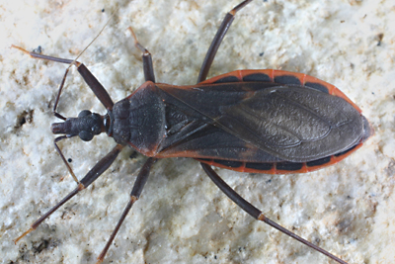
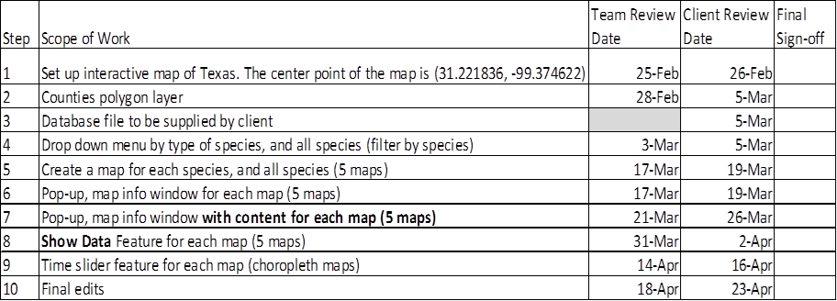
Steps/Deliverables
Working with a database file – aggregating point data to polygon

Slide 4
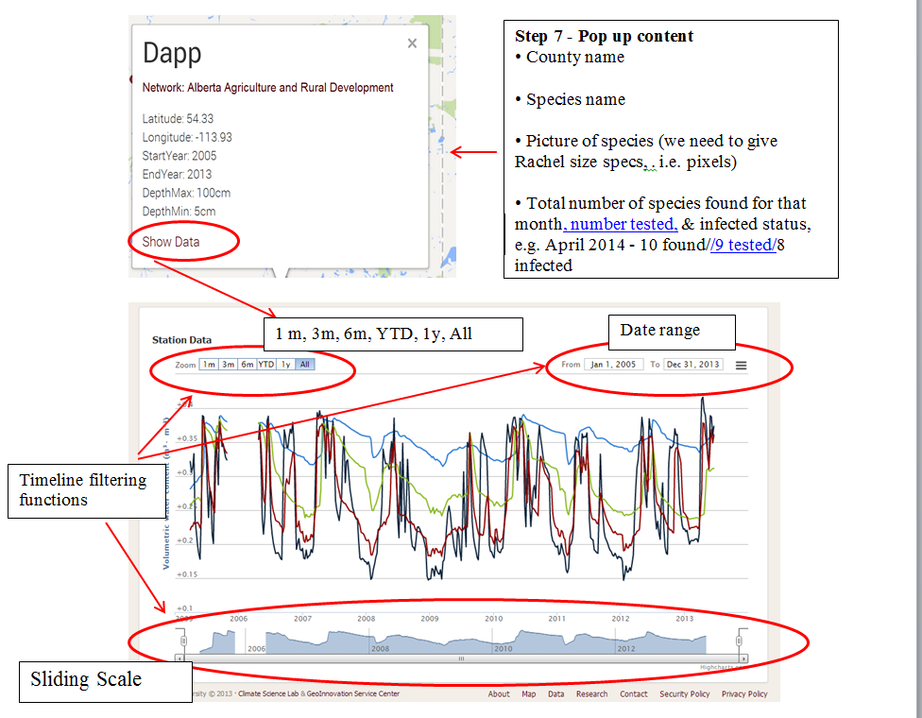
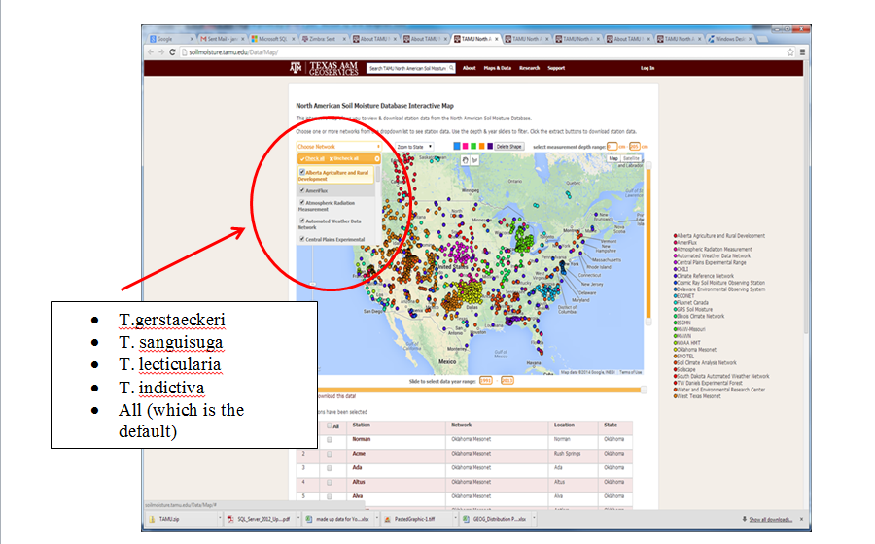
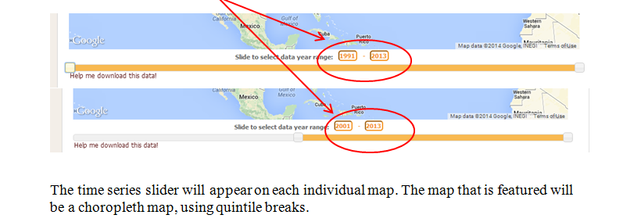
HIghlighted Project Steps

Slide 5
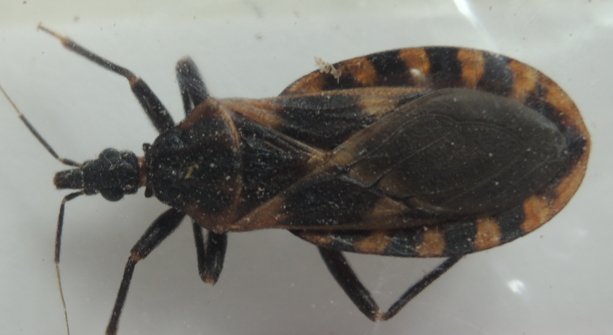
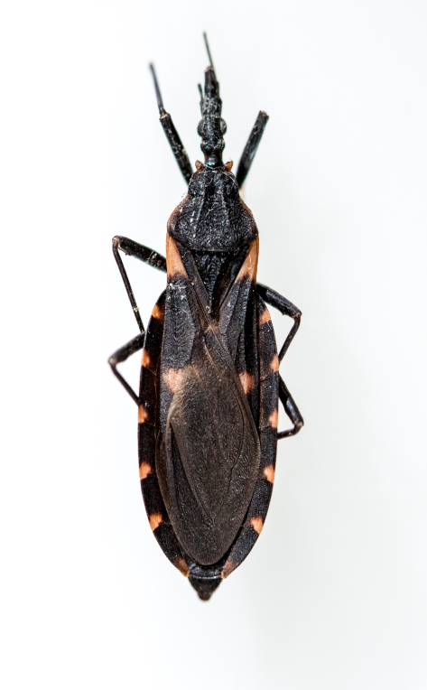
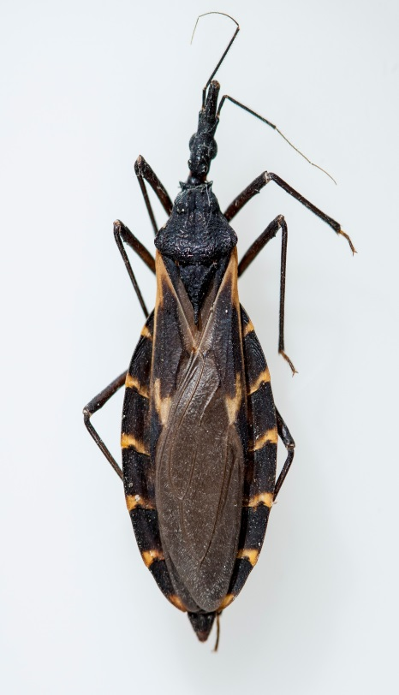
Thank you for Listening
Questions?

