Slide 1

COLLEGE E-COMMERECE WEBSITE
TS- WEB/CC/AI TRACK CAPSTONE PROJECT
Presented By:
S.K. Jani Begum
B. Shravya Vani
N. Vidyavathi
Jayalakshmi
S.K Jani B.
Guided By: Uma Maheshwari Mam

Slide 2
OUTLINE
Abstract
Problem Statement (Should not include solution)
Aims , Objective & Proposed System/Solution
System Design
System Development Approach(Technology Used)
Conclusion
References
Future Scope

Slide 3
Abstract
System which maintains the information about the book Present in the syllabus, their authors, This is very difficult to Organize manually. Maintenance of all this information manually is a very complex task. It reduced the workload of management as most of the manual work done is reduced
To help support notes collections, the digital initiatives, and external partner institution digital projects, It provide services that include the digitization of analog objects, metadata management, digital preservation, and discovery and access of digital collections. “Notes Management System” is a web application written for all operating systems, designed to help users maintain and organize shop virtually.
This software is easy to use for both beginners and advanced users. It features a familiar and well thought- out, an attractive user interface, combined with strong searching Insertion and reporting capabilities. The report generation facility of notes system helps to get a good idea of which helps the students in during examination.

Slide 4
Problem Statement
The problem statement of this website is to create an easy reference of notes and helping the students to enhance the last year question papers

Slide 5
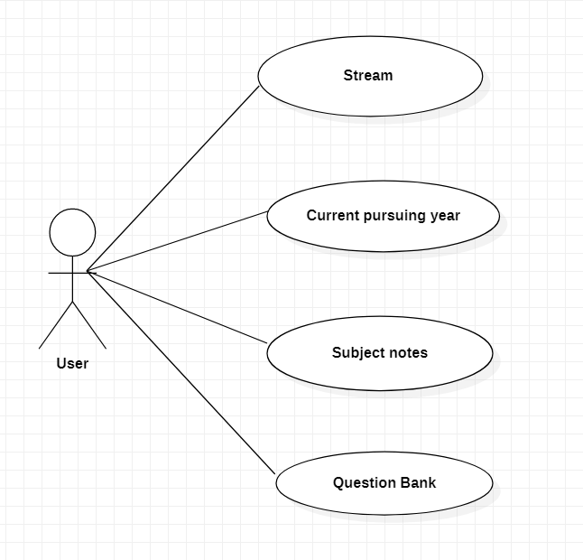
System Architecture

Slide 6

System Deployment Approach
The front end is designed using of HTML , PHP ,CSS, Java script
HTML:
HTML or Hypertext Markup Language Is the main markup language for creating web pages and other information that can be displayed in a web browser.HTML is written in the form of HTML elements consisting of tags enclosed in angle brackets (like ), within the web page content.HTML tags most commonly come in pairs like <h1> and </h1>, although some tags represent empty elements and so are unpaired.

Slide 7
System Deployment Approach
CSS:
Cascading Style Sheets (CSS) is a style sheet language used for describing the look and formatting of a document written in a markup language. While most often used to style web pages and interfaces written in HTML and XHTML, the language can be applied to any kind of XML document, including plain XML, SVG and XUL.
Java script:
JavaScript (JS) is a dynamic computer programming language. It is most commonly used as part of web browsers, whose implementations allow client-side scripts to interact with the user, control the browser, communicate asynchronously, and alter the document content that is displayed. It is also being used in server-side programming, game development and the creation of desktop and mobile applications.

Slide 8

THANK YOU

