Slide 1
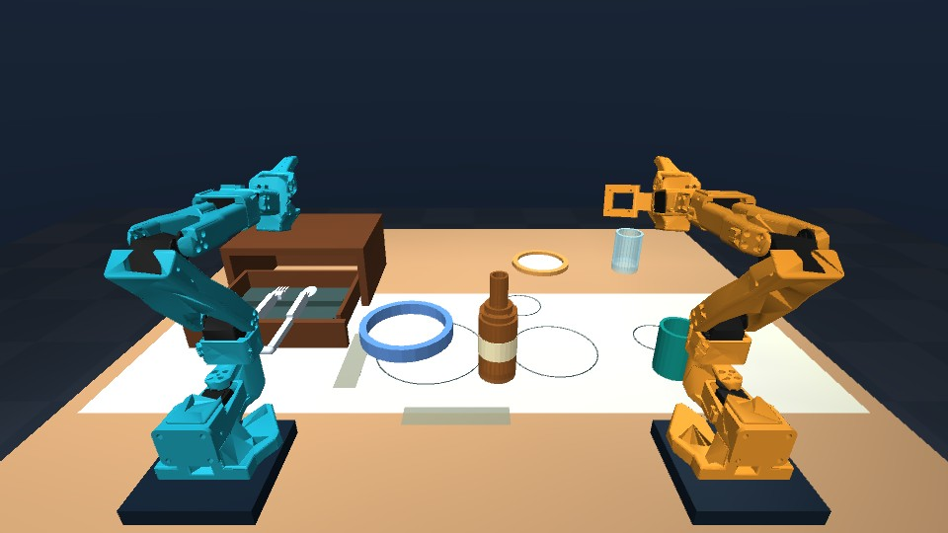
Talos
Spoken instructions for a
physical dinner-table simulation
Two SO-101 arms
MuJoCo physics
Experimental learned bottle control
Intel online challenge + Speechmatics bonus
Notes:
AI Infra Summit online Intel challenge and Speechmatics bonus. Official challenge: https://lablab.ai/ai-hackathons/ai-infra-summit-hackathon . Original simulator image from this project. Project code and dinner geometry MIT; SO-101 Menagerie assets Apache-2.0.

Slide 2
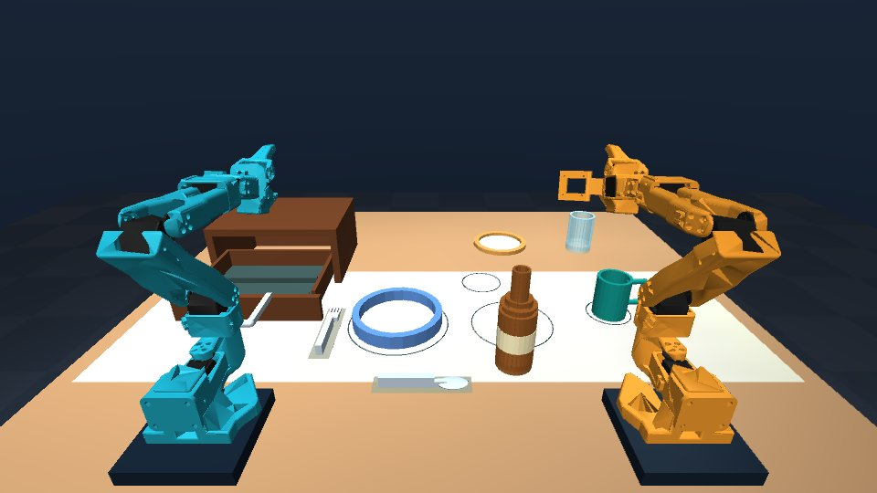
Dinner-table manipulation
“Set the table”
Place bottle, plate and mug.
Open the passive drawer.
Retrieve the fork and spoon.
Every grasp, lift and placement
passes physical contact checks.
Notes:
Local evidence: .run/submission-work/voice-set-table/result.json. Six skills completed in 249.68 simulation seconds. These are programmed exact-state IK skills, not learned policies. Dinner geometry includes graspable plate rim and cutlery handles.

Slide 3
Speech and control
Speechmatics streaming transcription
A short-lived browser token keeps the API key on the server.
Final transcripts become typed movement instructions.
A bounded language grammar selects a physical skill or relay.
The user chooses programmed or learned bottle control.
Visible task stages, cancellation and explicit failure feedback.
Notes:
Speechmatics temporary token endpoint and browser integration in simulation_lab/speech.py and web/speech.js. End-to-end API tests used explicitly synthetic English speech. Microphone path is implemented but has not been validated with a person speaking. Typed commands use the same constrained parser.

Slide 4
Two arms share the bottle
“Pass the bottle to the right arm”
1 Left arm lifts and releases in a shared table area.
2 Left arm parks before the right arm approaches.
3 Right arm regrips, lifts and places at the right side.
76.3 s simulated time 1.45 mm final placement error
Notes:
Physical evidence: .run/submission-work/command-relay-right/result.json and states.npz. Seed 42, two successful contact-only legs, 76.325 simulation seconds, 1.451 mm final xy error. Additional seed 2026091101 passed. This is a programmed, table-supported relay. Direct airborne handoff and reverse direction are not claimed.

Slide 5
Learned bottle controller
Overhead bottle localization and motor feedback
A classical RGB detector locates the bottle at startup.
A trained neural primitive predicts the joint trajectory.
OpenVINO generates joint targets.
MuJoCo actuators and finger contacts move the bottle.
An independent physical monitor checks support and placement.
The policy has no continuous visual correction yet.
Notes:
Model card: models/bottle_visual/README.md. Classical color localization in the initial overhead RGB image -> centroid padded to 32 features; internal progress Fourier features -> three-layer 256-unit SiLU MLP -> 12 joint targets. Joint feedback guards progress. The detector is not learned. Wrist images are not used by this encoder. No continuous visual correction. Simulator object poses are isolated in an independent evaluator, never used to select neural actions.

Slide 6
Physical evaluation
Reliable task-preset starts, limited wider coverage
10 / 10
1 / 3
New task-preset scene seeds
Wider development starts
The ten-seed test uses small upright bottle-position changes.
Larger workspace moves and other learned skills remain unresolved.
Notes:
Selected upright model: 22 stage-aligned training demonstrations. Frozen new-seed OpenVINO evaluation: submission/evidence/ten-seed-upright-visual.json, seeds 2026091301-1310, 10/10, 0.36-1.66 mm placement errors, 28.4-29.3 simulated seconds. Seeds are now exposed. Wider-position development cases train-017/019/025 achieved 1/3, and were training cases, not held out. These two columns are different reset distributions, not a controlled comparison. Original three-view model 0/10 broader results are retained separately.

Slide 7
Intel OpenVINO execution
0.157 ms
0.688 ms
Intel CPU median inference
Intel UHD iGPU median inference
FP32 model export with numerical parity checks.
Physical OpenVINO rollout passes familiar bottle starts.
Network timing only. NVIDIA renders the current camera images.
Core Ultra hardware execution has not been tested.
Notes:
Measured artifact submission/evidence/upright-visual-network-benchmark.json. OpenVINO 2026.3, FP32, Intel Core i7-10850H CPU and Intel UHD Graphics GPU.0. CPU median 0.15695 ms p95 0.221505; iGPU median 0.68825 p95 1.82926. Network-only microbenchmark excludes image rendering/localization, feedback guard and physics. Numerical parity tested on 32 synthetic feature/time batches. MuJoCo camera rendering currently uses NVIDIA. Core Ultra hardware not tested.

Slide 8
Reproducible prototype
Runnable simulation, weights and evidence
Six selectable views and four-view 720p recordings.
200 Hz physics control independent of browser frame rate.
Reproducible training and evaluation scripts.
Current scope: physical dinner skills, spoken commands,
a table-supported relay and a learned bottle baseline.
github.com/jannissio/talos-ai-infra
Notes:
Repository: https://github.com/jannissio/talos-ai-infra . Development and pre-event infrastructure reuse disclosed in docs/PROVENANCE.md. Official challenge written Core Ultra language differs from livestream interpretation permitting other Intel devices; no eligibility guarantee. User submits final entry. No direct handoff, pouring, learned general dinner policy or physical robot deployment claim.

