Slide 1
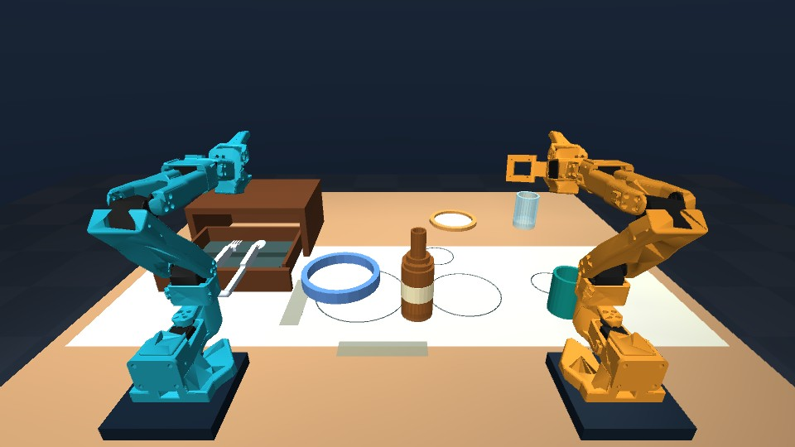
Talos
Spoken instructions for
learned dinner-table tasks
Two SO-101 arms
Six neural dinner skills
Bottle relays in both directions
Intel online challenge + Speechmatics integration
Notes:
Versioned September 14 update of the preserved v6 baseline. Seven-item camera-driven table setting is unfinished. Source: docs/PC_HANDOFF.md and docs/hackathon/FINAL_SUBMISSION_CHECKLIST.md.

Slide 2
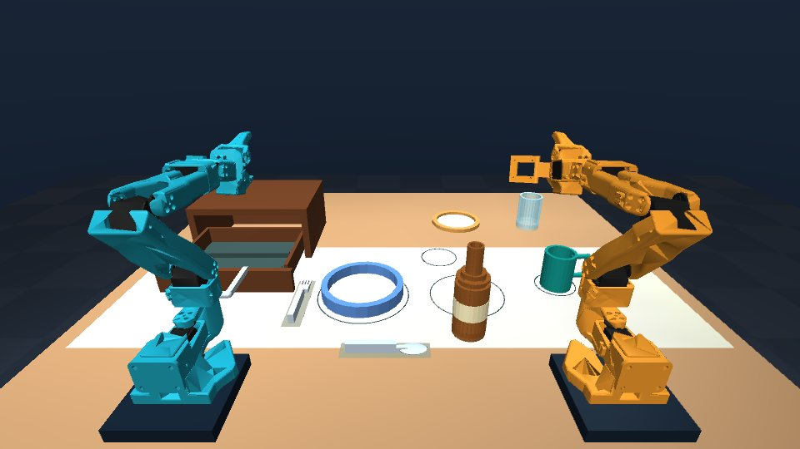
Six learned skills, one sequence
“Set the table”
Place the bottle, plate and mug.
Open the drawer.
Retrieve and place fork and spoon.
8/10 frozen full-sequence trials.
Task-preset variation; fixed destinations.
Notes:
Original frozen six-skill evidence: docs/robotics/evidence/learned-dinner-v6/summary.json. Eight successes, two failures. Task-preset variation and fixed goals, not joint tabletop coverage.

Slide 3
Speech and control
Supported voice commands use Speechmatics
A human "Set the table" command completed all six skills.
The local voice run included 15 live mug corrections.
Bounded grammar and RGB scene checks choose the next skill.
Unsupported commands are refused. Progress and cancellation stay visible.
The hosted demo accepts typed commands. The local browser lab supports voice.
Notes:
Human full-sequence voice run and hosted CPU result: docs/robotics/evidence/human-voice-dinner-v1/README.md. Transcript Set the table; all six tasks and 15 live mug corrections, parked arms. Grammar remains bounded. No private audio or credential is embedded.

Slide 4
Learned bottle relay in both directions
Each arm releases onto the shared table
1 First arm lifts and releases the bottle on the table.
2 Both arms park before the second grasp.
3 Second arm places the bottle at its trained destination.
Frozen trials: 5/5 left to right and 5/5 right to left.
Two upright start regions and fixed goals. No airborne transfer.
Notes:
Frozen relay evidence: docs/robotics/evidence/learned-relays-v3/summary.json. Five trials per direction. Intermediate table release and parked arms; not airborne handoff.

Slide 5
How learned control works
Neural skills with bounded visual correction
The five newer dinner skills use 201 verified inputs.
Four bottle-relay models use 52 inputs; originals are preserved.
Joint feedback regulates neural motion.
A separate physical monitor checks contact, placement and parked arms.
Late mug vision: 20/20 live and 20/20 baseline workflows.
With corrective images frozen: 0/20. Narrow tested starts.
Notes:
Baseline training counts: models/dinner_suite/README.md and training/dinner_suite. Late-mug camera gates: models/dinner_visual_mug_v1/README.md and docs/robotics/evidence/mug-visual-correction-v2/README.md. Live and baseline each 20/20, frozen images 0/20 on narrow workflows. This is not general visual recovery.

Slide 6
Physical evaluation
Frozen physical trials with every outcome retained
8 / 10
10 / 10
Six learned dinner tasks
Randomized task-preset starts
Bottle relay trials
Five in each direction
Dinner failures: mug 14.59 mm and spoon 13.61 mm XY error.
Fixed goals and small task-preset variations define this result.
Notes:
Original dinner/relay frozen outcomes remain unchanged. Eight of ten dinner workflows pass with the original models; both failures remain. No pooling with later visual-profile results.

Slide 7
Intel execution and remaining eligibility
0.157 ms
0.688 ms
Core i7-10850H CPU
FP32 neural inference
Intel UHD integrated GPU
FP32 neural inference
Six-skill baseline runs with Intel CPU/iGPU and UHD rendering.
Core Ultra Series 2/3 and the latest live-mug Intel run remain open.
0.157/0.688 ms describe the original bottle network only.
Legacy hardware execution does not establish Core Ultra eligibility.
Notes:
Historical original-bottle neural timing is retained. Actual six-skill legacy Intel CPU/GPU.0 inference and UHD rendering: docs/robotics/evidence/intel-final-legacy-v3/README.md. Available i7-10850H is not Core Ultra Series 2/3. New visual-profile Intel execution and eligibility remain unresolved.

Slide 8
Reproducible baseline, active development
Code, models, compact inputs and complete outcomes
Private CPU demo: all six skills passed in 287.79 wall seconds.
All frozen outcomes and compact training inputs remain packaged.
Original work is MIT; third-party components retain their licenses.
Seven jointly randomized items: no complete workflow has passed.
The adapted CLIPort runtime works; its Talos action policy is untrained.
github.com/jannissio/talos-ai-infra
Notes:
Private live-mug CPU trial passed in 287.79 wall seconds: docs/robotics/evidence/human-voice-dinner-v1/README.md. Shared pipeline: docs/robotics/WHOLE_TABLE_PIPELINE.md. CLIPort runtime adaptation is not a trained Talos spatial policy. Original source MIT; upstream licenses and notices retained. Public judge access awaits agreed final release; Submit remains the user action.

