Slide 1
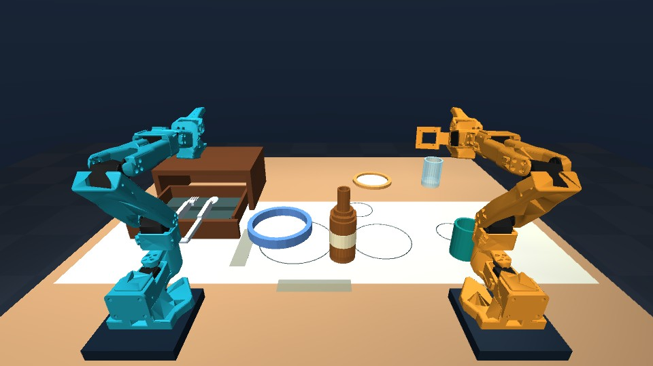
Talos
Spoken instructions for
learned dinner-table tasks
Two SO-101 arms
Six neural dinner skills
Bottle relays in both directions
Intel online challenge + Speechmatics integration
Notes:
Talos submission baseline, September 13, 2026. Original cover image illustrates the same MuJoCo dinner scene. Source architecture and constraints: docs/hackathon/FINAL_SUBMISSION_CHECKLIST.md. Original deck is preserved.

Slide 2
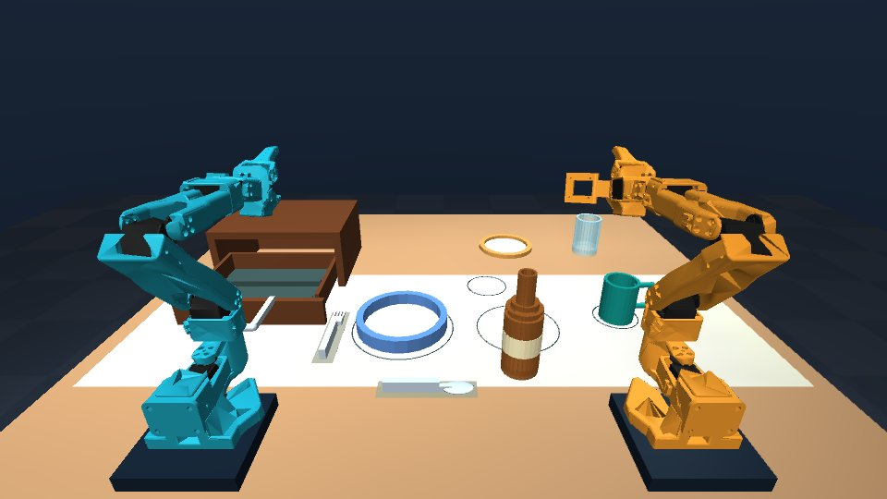
Six learned skills, one sequence
“Set the table”
Place the bottle, plate and mug.
Open the drawer.
Retrieve and place fork and spoon.
8/10 frozen full-sequence trials.
Each run starts a randomized scene.
Notes:
Frozen six-skill evidence: docs/robotics/evidence/learned-dinner-v6/summary.json and all ten reports. Eight successes, two placement failures. Weights and exact compact inputs: models/dinner_suite and training/dinner_suite.

Slide 3
Speech and control
Supported voice commands use Speechmatics
A human microphone trial passed on this PC.
The API key stays in the local server’s .env file.
Bounded grammar and RGB scene checks choose the next skill.
Unsupported commands are refused. Progress and cancellation stay visible.
The hosted demo accepts typed commands. The local browser lab supports voice.
Notes:
Human microphone trial confirmed by the user on September 13. Speechmatics uses a short-lived browser token; the API key remains in local .env. The grammar is bounded. No general language-understanding claim.

Slide 4
Learned bottle relay in both directions
Each arm releases onto the shared table
1 First arm lifts and releases the bottle on the table.
2 Both arms park before the second grasp.
3 Second arm places the bottle at its trained destination.
Frozen trials: 5/5 left to right and 5/5 right to left.
Two upright start regions and fixed goals. No airborne transfer.
Notes:
Frozen relay evidence: docs/robotics/evidence/learned-relays-v3/summary.json. Five left-to-right plus five right-to-left trials. Table release and parked arms precede the second grasp. This is not an airborne handoff.

Slide 5
How learned control works
Initial RGB features condition a small neural network
201 verified inputs train five new dinner skills.
The original bottle model stays intact. Four relay models use 52 inputs.
Joint feedback regulates neural motion.
A separate physical monitor checks contact, placement and parked arms.
Continuous visual correction remains unfinished.
The next experiment compares live and frozen camera input.
Notes:
Training: five new dinner models use 41+41+41+39+39=201 eligible inputs, plus 13 inputs for each of four relay legs. All repaired aligned-input replays passed before fitting. Original bottle training input is separate and preserved. Control and monitoring roles: models/dinner_suite/README.md.

Slide 6
Physical evaluation
Frozen physical trials with every outcome retained
8 / 10
10 / 10
Six learned dinner tasks
Randomized task-preset starts
Bottle relay trials
Five in each direction
Dinner failures: mug 14.59 mm and spoon 13.61 mm XY error.
Fixed goals and small task-preset variations define this result.
Notes:
Dinner seeds 2026091901 through 2026091910, frozen before evaluation. Mug failure 2026091902: 14.590542 mm XY. Spoon failure 2026091905: 13.6133 mm XY. Acceptance remains 8 mm. All reports and video traces retained. Relay seeds 2026092501-2505 and 2026092601-2605.

Slide 7
Historical Intel bottle benchmarks
0.157 ms
0.688 ms
Core i7-10850H CPU
FP32 neural inference
Intel UHD integrated GPU
FP32 neural inference
These laptop results describe the original bottle model.
Final-suite Intel execution and Core Ultra eligibility remain open.
Network timing only. New models pass OpenVINO parity on this AMD/NVIDIA PC.
Core Ultra hardware execution has not been tested.
Notes:
Historical laptop measurements from the original submission/Talos.pptx and models/bottle_visual benchmark provenance. Latencies are neural inference only, not full application latency. Final Intel work: docs/robotics/INTEL_FINAL_VERIFICATION.md. Written challenge: https://drive.google.com/file/d/1xSisqTQUAFQiLOpjLZrCVTCsQi4bMCpO/view . Core Ultra verification is pending.

Slide 8
Reproducible baseline, active development
Code, models, compact inputs and complete outcomes
Six learned dinner skills complete without resets.
All frozen outcomes and exact training inputs are packaged.
The live demo is under private verification before release.
Still open: broad placement coverage and continuous visual correction.
Pouring, airborne handoffs and general object handling remain unfinished.
github.com/jannissio/talos-ai-infra
Notes:
Private development repository: https://github.com/jannissio/talos-ai-infra . Private Space: https://huggingface.co/spaces/jannis-sms/talos-dinner-robotics . Public release waits until final submission. Broader robotics work: docs/robotics/experiments/rgb-servo-bottle-v1.json . This deck is the versioned submission baseline, not a claim that the broader goal is complete.

