Slide 1

From Poor Ratings to Exceptional Stays
A Data-Driven Analysis of Factors Influencing Airbnb Guest Satisfaction
By Jan Noel Vero & Nadiya Al-Shahaibi
Business Analysts

Slide 2

INTRODUCTION
Background
The short-term rental market has grown rapidly, with Airbnb becoming a dominant platform for travelers worldwide. As competition intensifies, understanding what drives guest satisfaction — and what leads to poor ratings — has become critical for hosts seeking to improve their listings and maximize bookings.

Slide 3
RESEARCH FRAMEWORK
Goal & Objective
Goal
Objective
Analyze Airbnb listing characteristics that influence guest ratings and identify practical strategies for improving underperforming listings.
Identify the characteristics of low-rated Airbnb listings and determine which property features are associated with higher guest satisfaction.

Slide 4
RESEARCH QUESTIONS
Research Questions
1
What is the distribution of Airbnb listings based on high, average, and low ratings?
Is there a significant difference in price between poorly rated and highly rated Airbnb listings?
2
3
Which property types are more likely to receive poor guest ratings?
4
Do amenities significantly influence the price of Airbnb listings?
5
Do amenities significantly influence Airbnb ratings?

Slide 5
RESEARCH QUESTIONS
Research Questions (Continued)
6
Does the location of an Airbnb listing significantly influence guest ratings?
7
Does the location of an Airbnb listing significantly influence Airbnb prices?
8
Does the number of reviews significantly influence Airbnb ratings?
9
Which month the highest number of reviews and the highest average Airbnb rating?
10
What improvements should Airbnb hosts prioritize to transform poorly rated listings into highly rated accommodations?

Slide 6
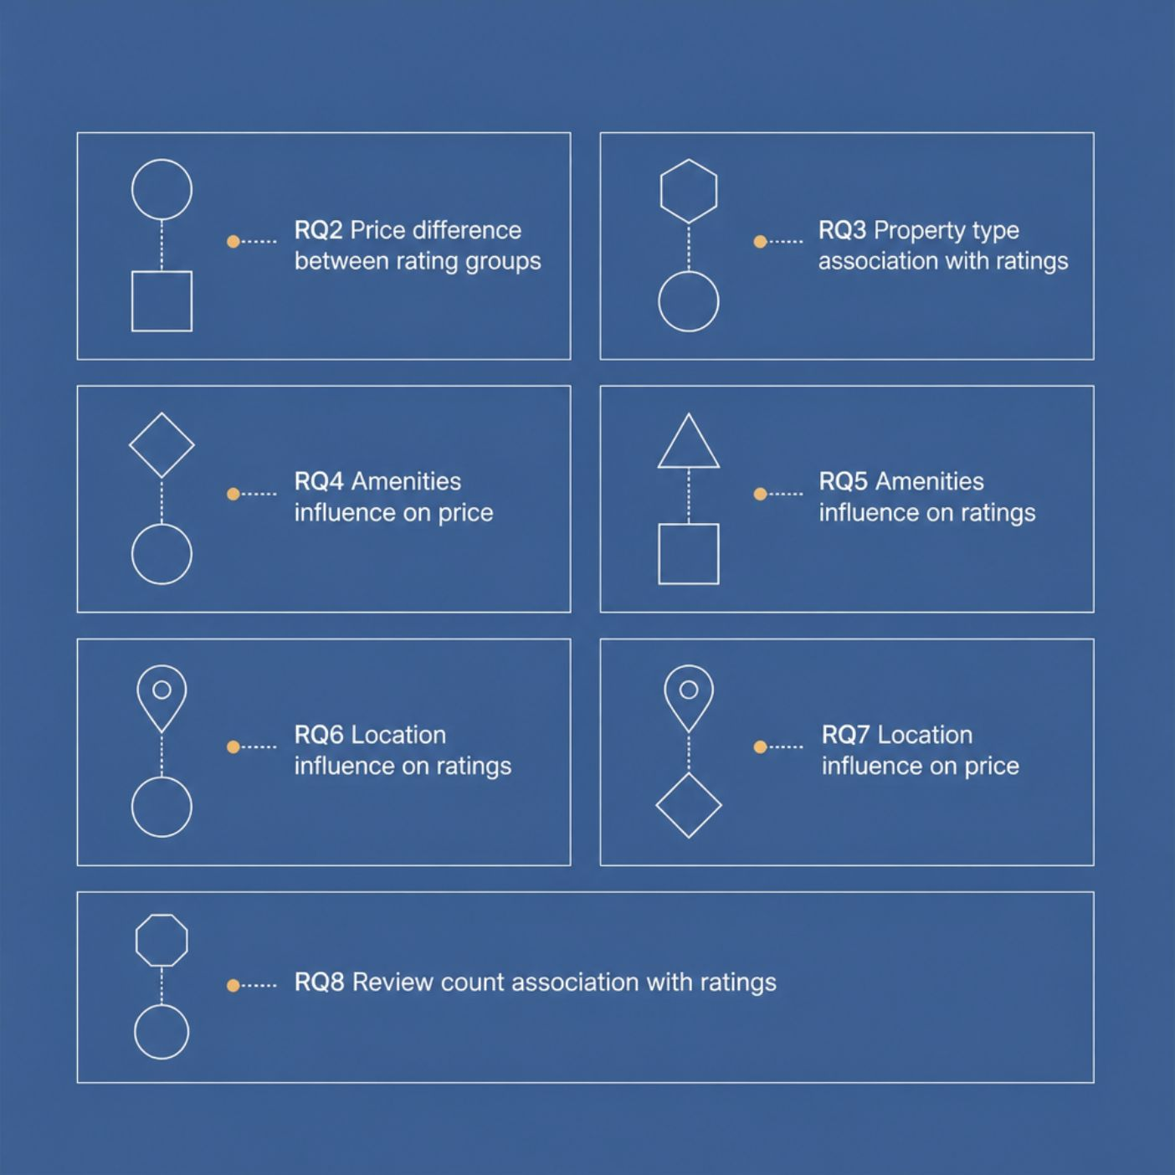

HYPOTHESES
Statistical Hypotheses
Each research question was tested using null (H₀) and alternative (H₁) hypotheses to determine statistical significance across price, property type, amenities, location, and review volume.
All hypotheses were tested at a standard significance level to ensure rigorous, reproducible findings.

Slide 7
METHODOLOGY
Data Cleaning & Insights
Roadblock
How It Was Addressed
Missing ratings
Identified and handled during cleaning
Duplicate listings
Counted, inspected, and removed
Price format
Converted to numeric values
Inconsistent property info
Cleaned and standardized fields
Location formatting
Restructured into City and Country
Special characters
Removed invalid listings
Amenities in text
Extracted keywords; created Amenity Count
Python & MySQL
Cleaned in Python, loaded into MySQL
SQL column names
Used backticks for spaced names
Uneven rating groups
Only 20 low-rated — comparisons made cautiously
Uneven monthly data
Treated monthly findings with caution

Slide 8
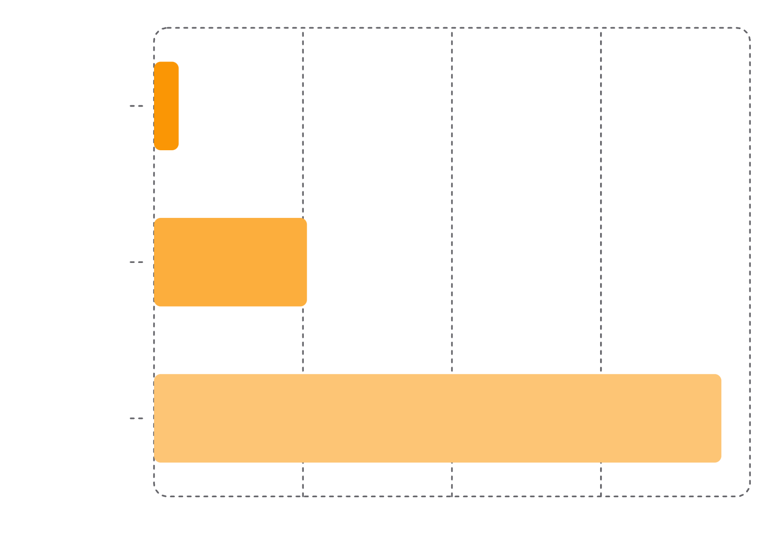

RQ1 — RATING DISTRIBUTION
How Are Listings Distributed by Rating?
Key Finding
The vast majority of Airbnb listings — 76.16% — fall into the high-rated category. Only 3.31% are classified as low-rated, representing just 20 listings out of the total dataset.
This skewed distribution highlights that poor ratings are relatively rare, but understanding their root causes remains essential for helping underperforming hosts improve.
Low-rated listings (n=20) require careful statistical handling when compared to the 460 high-rated listings.
Notes:
The majority of Airbnb listings are highly rated, representing 76.16 percent or 460 listings. Average rated listings account for 20.53 percent or 124 listings, while only 3.31 percent or 20 listings are classified as poorly rated. This indicates that guest ratings are strongly concentrated in the high rating category, with poorly rated properties representing only a small proportion of the dataset.

Slide 9
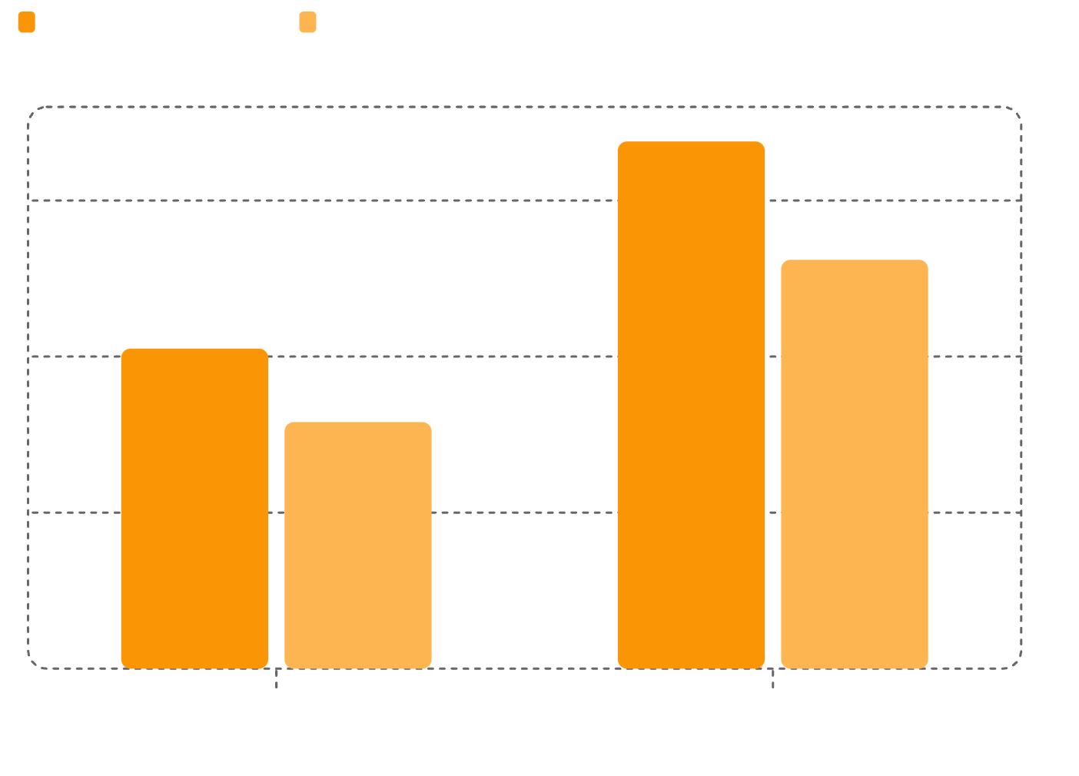
RQ2 — PRICE VS. RATINGS
Do Poorly Rated Listings Cost Less?
Price Gap Analysis
Highly rated listings command significantly higher prices — an average of $168.93 versus $102.55 for low-rated listings, a difference of nearly $66.
Median prices reinforce this trend: $131 (high) vs. $79 (low), suggesting the gap is not driven by outliers.
20
460
Low-rated listings
High-rated listings
Notes:
Highly rated Airbnb listings have a higher median price of $131.00, compared with $79.00 for poorly rated listings.
The Mann Whitney U test produced a p value of 0.0063. Since this is below 0.05, the difference in prices between poorly rated and highly rated listings is statistically significant.
Conclusion: Listing price is significantly associated with rating category in this dataset.

Slide 10
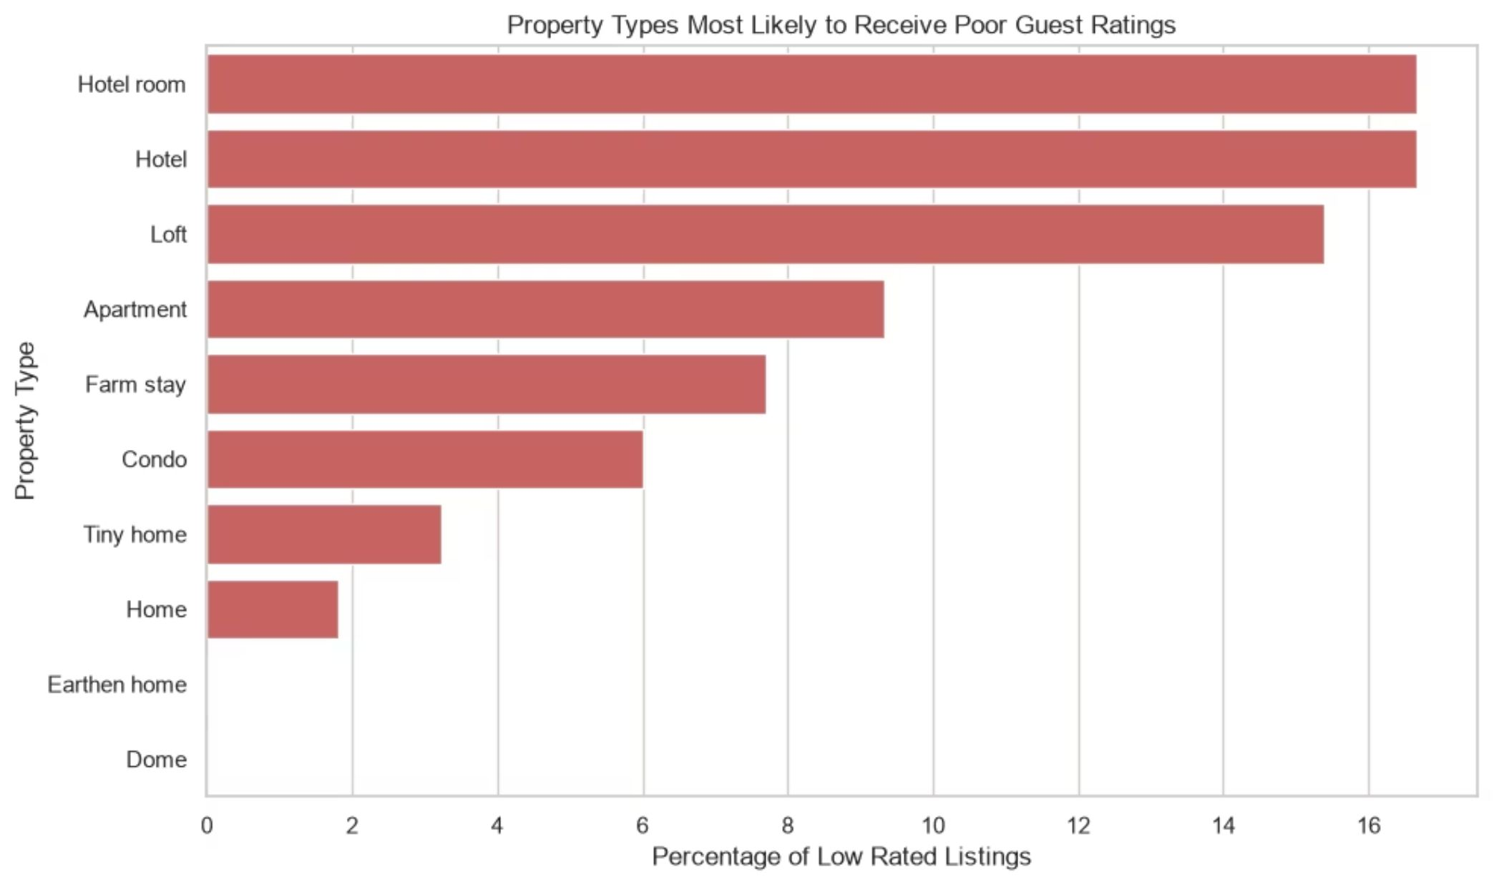
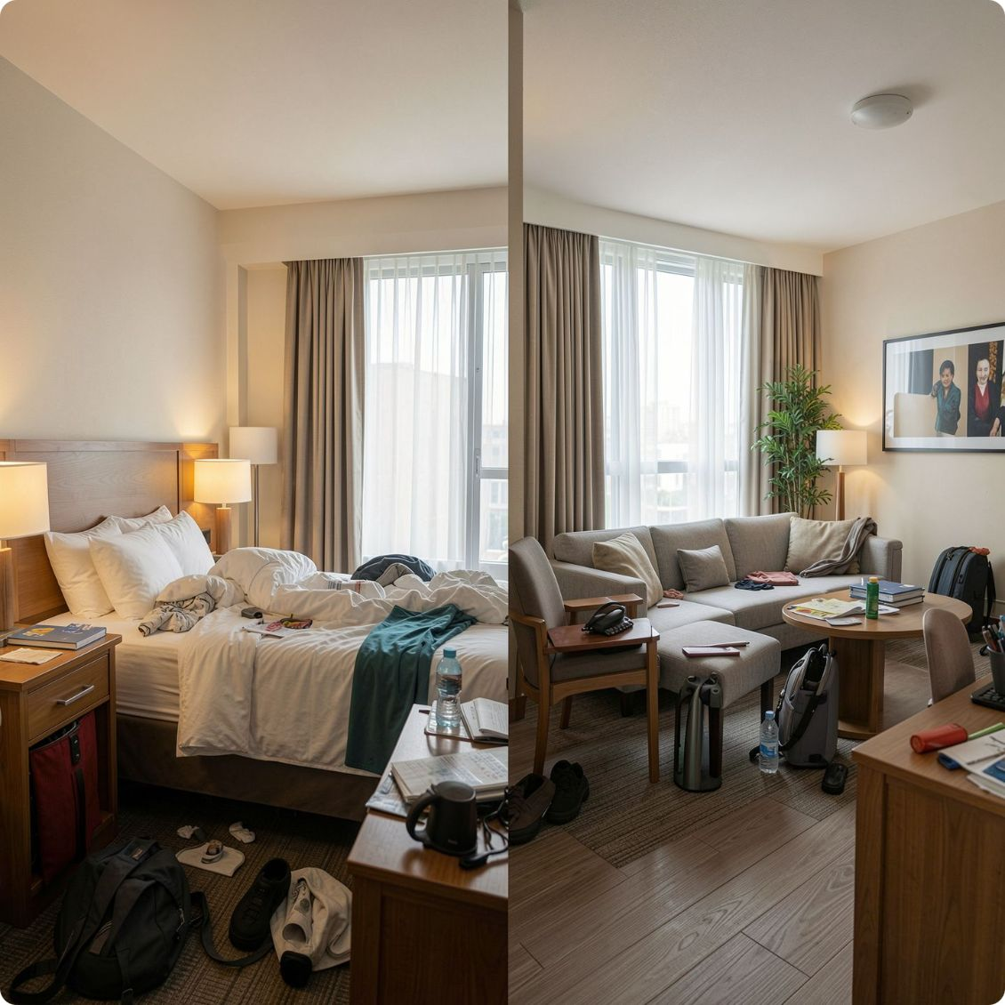
RESEARCH QUESTION 3
Poor Ratings by Property Type
Hotel rooms and hotels recorded the highest share of poor ratings at 16.67%, followed by lofts at 15.38%. Apartments had the lowest poor rating rate at just 9.33% — suggesting guests hold hotel-style listings to a higher standard than residential properties.
Notes:
#RQ3 Result: Hotel rooms and hotels are the property types most likely to receive poor guest ratings, with 16.67 percent of listings in each category classified as low rated. Lofts follow closely at 15.38 percent, while apartments have a lower rate of 9.33 percent but account for the largest number of poorly rated listings at 7 properties. Several property types, including cabins, villas, treehouses, cottages, and rooms, recorded no poorly rated listings in this dataset.
#Important interpretation
#There is one caution worth mentioning in your project. Hotels and hotel rooms each have only 6 listings, so their 16.67 percent rate represents just 1 poorly rated property each. In contrast, apartments have 75 listings, with 7 receiving poor ratings.
#Therefore, I would phrase your overall finding as:
#Conclusion: Hotel rooms, hotels, and lofts showed the highest proportions of poor ratings. However, apartments contributed the greatest number of poorly rated listings overall. Results for property types with small sample sizes should be interpreted cautiously.

Slide 11
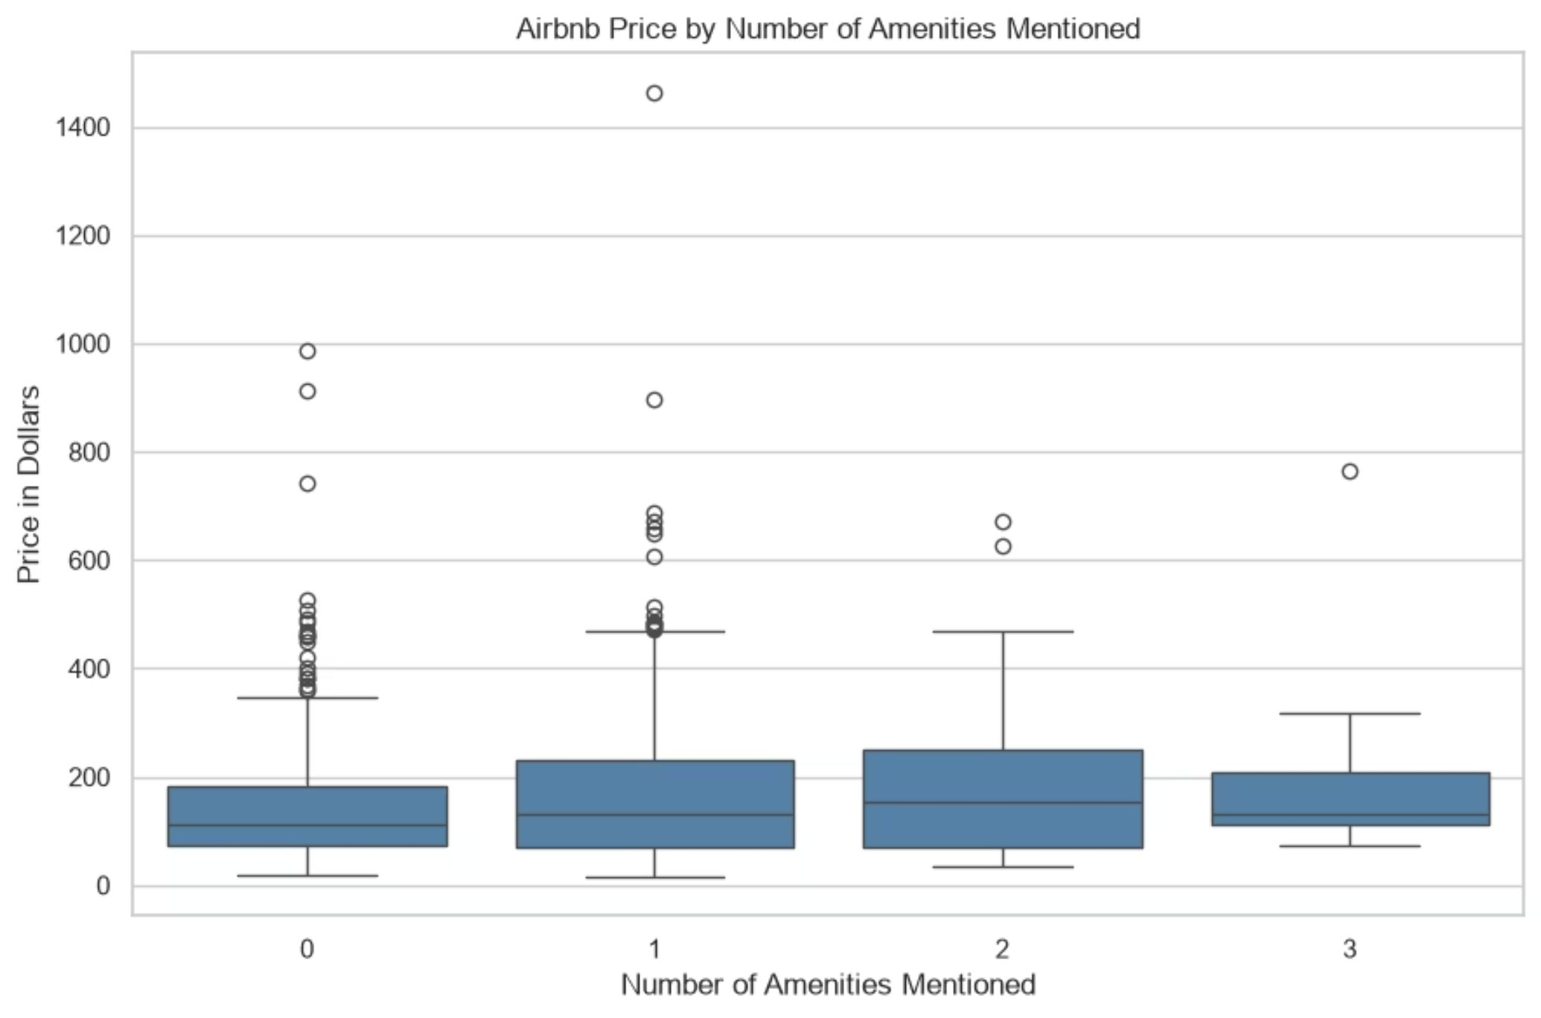

RESEARCH QUESTION 4
Amenities & Airbnb Pricing
What the Data Shows
Listings mentioning more amenities tend to have higher prices, and this relationship is statistically significant. However, the correlation is weak — amenities alone do not strongly determine Airbnb prices.
Location and property type are likely stronger price drivers than amenity count.
Notes:
#RQ4 Result: The analysis found a statistically significant positive relationship between the number of amenities mentioned and Airbnb listing prices. The Spearman correlation was 0.101, with a p value of 0.013, which is below the 0.05 significance level. However, the correlation is weak, indicating that amenities mentioned are associated with higher prices, but the relationship is small.
#Descriptive results support the general direction:
#Amenities mentioned Listings Average price Median price
0 409 $144.04 $112.00
1 159 $188.80 $131.00
2 28 $195.25 $154.50
3 8 $224.75 $130.00
#The average price rises from $144.04 for listings with no amenities mentioned to $224.75 for listings mentioning three amenities. However, the median does not increase consistently, which reinforces that the relationship is not strong.
#Conclusion: Listings mentioning more amenities generally tend to have higher prices. Although this relationship is statistically significant, its weak correlation suggests that amenities alone do not strongly determine Airbnb prices. Other factors, such as location and property type, are likely to play a larger role.

Slide 12
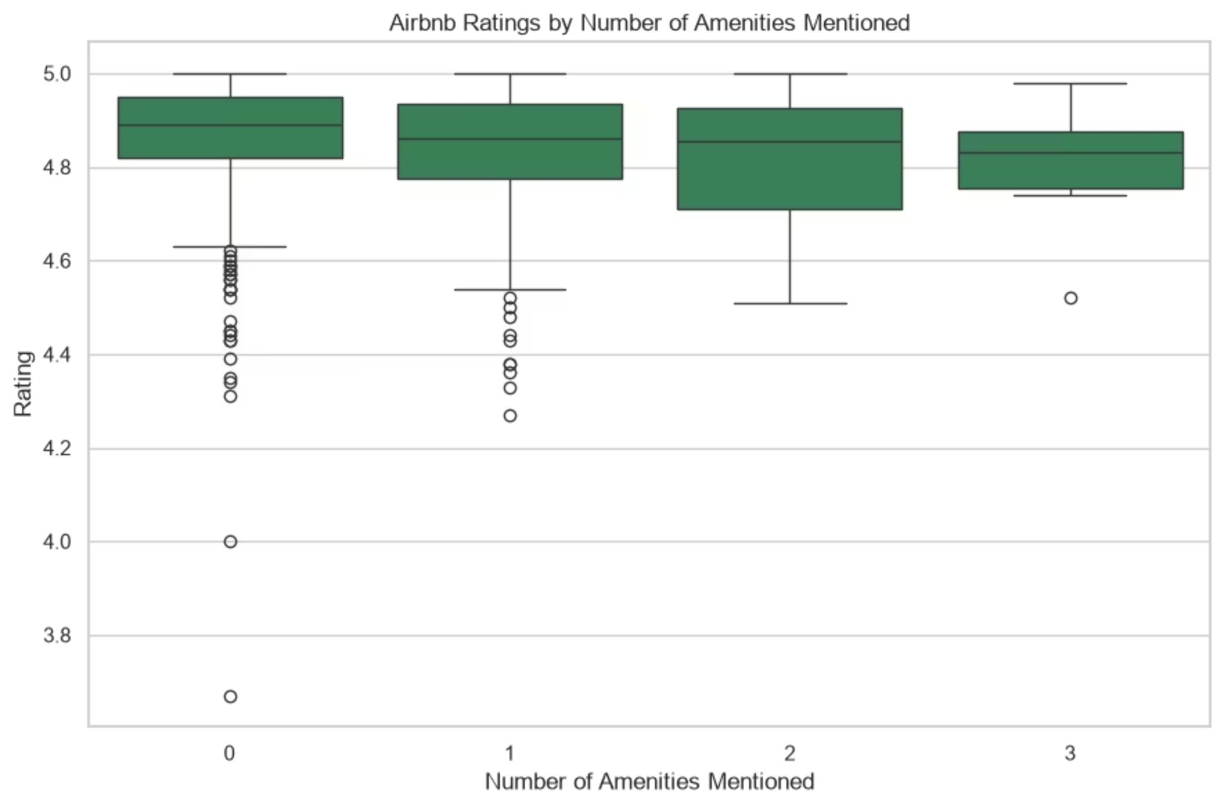
RESEARCH QUESTION 5
Amenities & Guest Ratings
Key Statistics
Spearman Correlation: −0.115
P-Value: 0.0045
There is a statistically significant relationship between the number of amenities mentioned and Airbnb ratings — but it is negative and weak. More amenities listed does not translate to better guest satisfaction.
Notes:
#RQ5 Result: The analysis found a statistically significant negative relationship between the number of amenities mentioned and Airbnb ratings. The Spearman correlation was negative 0.115, with a p value of 0.0045, which is below the 0.05 significance level. However, the correlation is very weak, indicating that the number of amenities mentioned has only a small relationship with guest ratings.
#Your descriptive results also show that average ratings decline slightly as more amenities are mentioned:
#Amenities mentioned Listings Average rating Median rating
0 409 4.858 4.890
1 159 4.827 4.860
2 28 4.830 4.855
3 8 4.802 4.830
#Conclusion: Listings mentioning more amenities do not necessarily receive better guest ratings. Although the relationship is statistically significant, its very weak negative correlation suggests that amenities mentioned in the listing description are not a strong driver of guest satisfaction. Other factors, such as service quality, property condition, location, and whether guest expectations are met, may be more important.

Slide 13
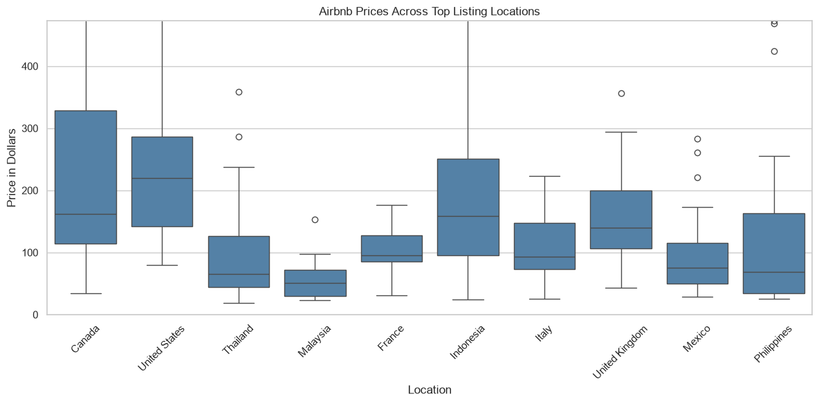
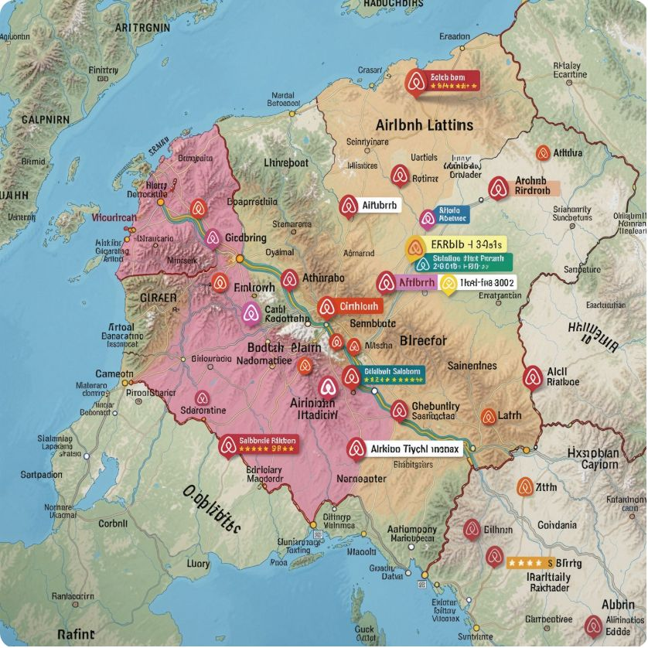
RESEARCH QUESTION 6
Ratings Vary Significantly by Location
The Kruskal-Wallis test confirms a statistically significant difference in Airbnb ratings across locations (H = 65.785, p = 0.0). Where a listing is located meaningfully influences the guest experience and resulting ratings.
Notes:
#RQ6 Result: Airbnb guest ratings differ significantly across locations. The Kruskal Wallis test produced an H statistic of 65.785 with a p value below 0.001, indicating that the differences in ratings across countries are statistically significant.
#Conclusion: Location has a statistically significant association with Airbnb guest ratings in this dataset. However, the test only establishes that at least one location differs from another. It does not establish that location causes the differences in ratings. Other factors associated with each market, such as property characteristics, service quality, pricing, and guest expectations, may also contribute to these differences.

Slide 14
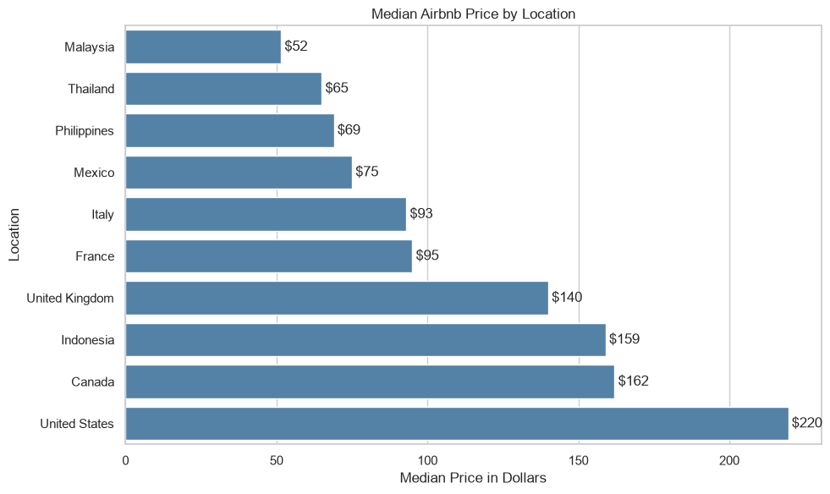
RESEARCH QUESTION 7
Prices Vary Significantly by Location
Statistical Evidence
Kruskal-Wallis H: 196.358
P-Value: 5.903294656518362e-31
The extremely low p-value confirms that Airbnb prices differ significantly across locations. Geography is one of the strongest determinants of listing price in this dataset.
Notes:
#RQ7 Result: Airbnb prices differ significantly across locations. The Kruskal Wallis test produced an H statistic of 196.358 with p < 5.903294656518362e-31, confirming a statistically significant difference in listing prices across locations. United States recorded the highest average price at $220. Malaysia had the lowest average price at $52, followed by Thailand at $65 and Philippines 69.
#Conclusion: Location is significantly associated with Airbnb listing prices. Properties in locations such as USA, Canada, and Indonesia tend to command substantially higher prices, while listings in Malaysia and Thailand are considerably less expensive. This suggests that geographic market conditions are an important factor in Airbnb pricing.

Slide 15
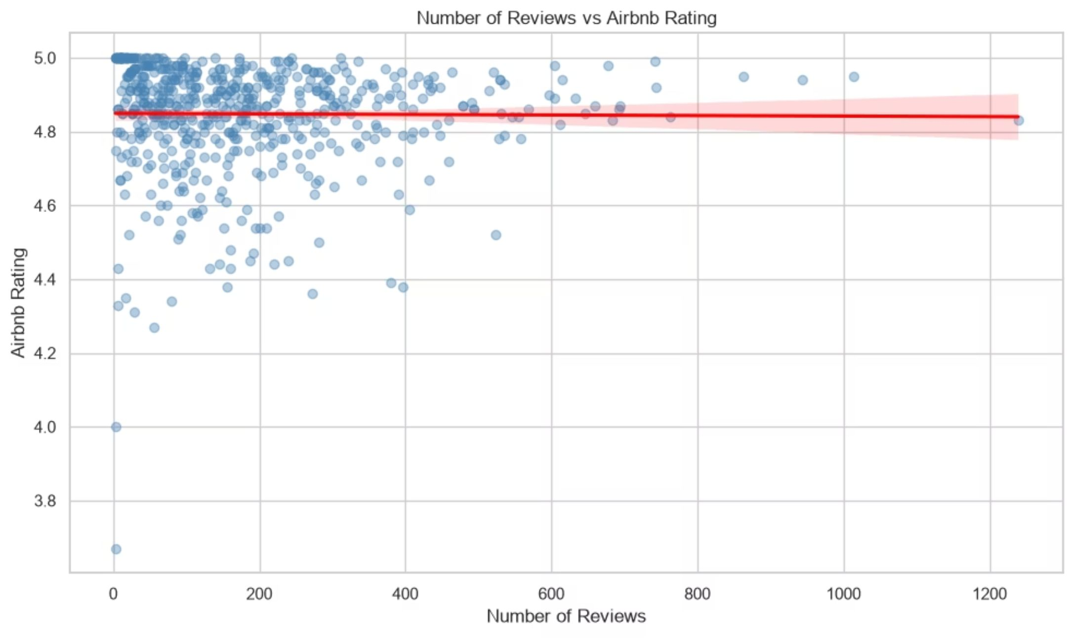
RESEARCH QUESTION 8
Review Volume & Guest Ratings
Key Statistics
Spearman Correlation: −0.184
P-Value: 5.38 × 10⁻⁶
There is a statistically significant but weak negative relationship between the number of reviews and Airbnb ratings. Listings with more reviews tend to have slightly lower ratings — though the effect is modest.
Notes:
#RQ8 Result: The analysis found a statistically significant negative relationship between the number of reviews and Airbnb ratings. The Spearman correlation was negative 0.184, with p < 0.001. This indicates that listings with more reviews tend to have slightly lower ratings, although the relationship is weak.
#dataset contains 604 listings. The average listing has about 178 reviews and an average rating of 4.85. Review counts vary substantially, from 3 to 1,239 reviews, while ratings are much more concentrated, ranging from 3.67 to 5.00.
#Conclusion: The number of reviews is significantly associated with Airbnb ratings, but the relationship is weak. Listings with larger numbers of reviews tend to have slightly lower ratings. This may reflect greater exposure to a wider range of guest experiences, but the analysis does not establish that having more reviews causes ratings to decline.#

Slide 16
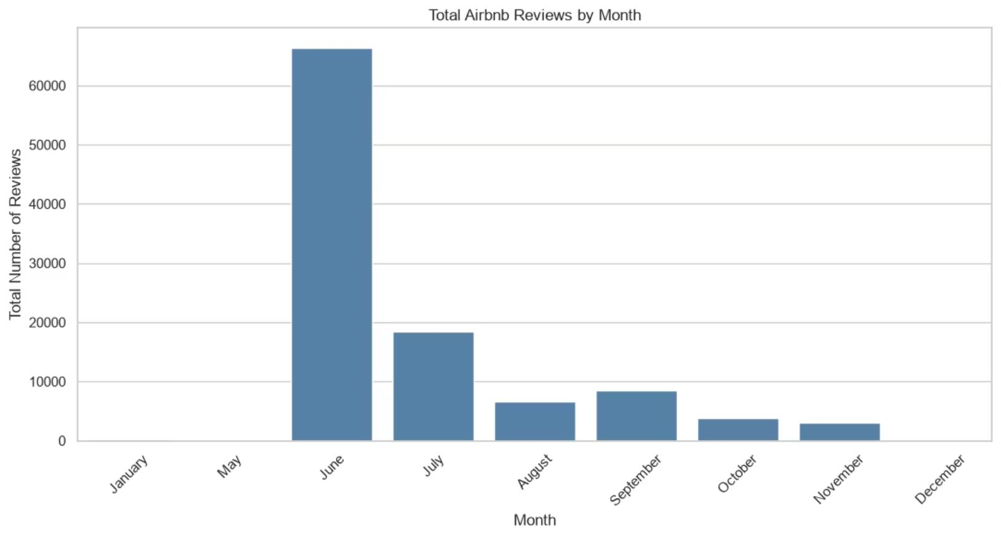
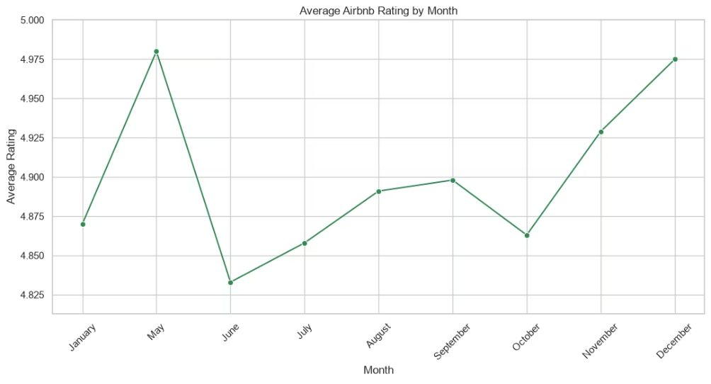
RESEARCH QUESTION 9
Seasonal Patterns in Reviews & Ratings
Peak Review Volume
June recorded the highest number of reviews with 66,386 total — reflecting peak travel season demand.
Highest Average Rating
May achieved the highest average rating at 4.98, suggesting slightly better guest satisfaction just before the busiest month.
Notes:
#RQ9 Result: June recorded the highest total number of reviews, with 66,386 reviews, while May recorded the highest average Airbnb rating at 4.98. However, May contains only one listing, so its average rating should not be treated as a reliable monthly pattern.
#monthly results reveal an important imbalance in the dataset. June alone contains 401 of the 604 listings, while May and January each contain only one listing and December contains only two.
#Conclusion: June has the highest review activity, with 66,386 total reviews. Although May has the highest average rating at 4.98, this result is based on only one listing and should be interpreted cautiously. Among months with a more substantial number of listings, November shows a particularly high average rating of 4.929, although it is represented by only 13 listings.
#Important limitation for RQ9
#Month variable appears to describe the month associated with each listing in the source dataset, while Number of Reviews appears to be the listing's total review count. If that is correct, saying that 66,386 reviews occurred in June would be inaccurate.

Slide 17
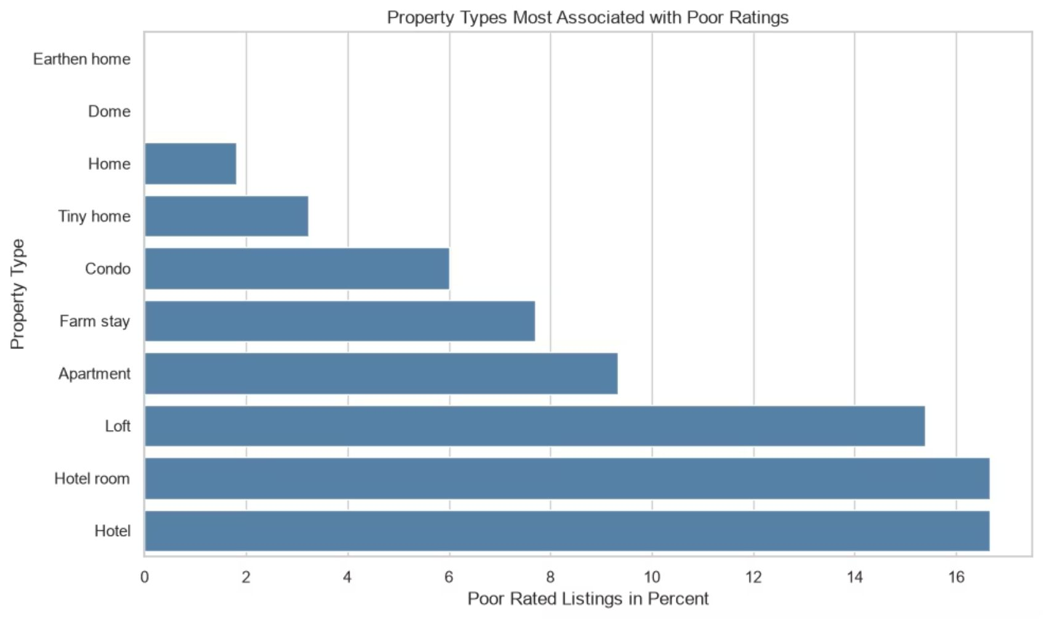

RESEARCH QUESTION 10
How to Improve Poorly Rated Listings
Service Quality
Guest Expectations
Prioritize cleanliness, property condition, and accurate listing descriptions.
Manage expectations proactively — overpromising leads to disappointment.
Smart Pricing
Amenity Quality
Position and price the property competitively relative to its local market.
Amenities should support the experience — quantity alone does not improve ratings.
Notes:
RQ10 Result: Hosts should prioritize the overall guest experience rather than simply increasing the number of amenities. The analysis found that amenities mentioned had only a very weak relationship with guest ratings, while ratings differed significantly across locations and certain property types showed higher proportions of poorly rated listings. Hotel rooms, hotels, lofts, and apartments showed the highest proportions of low rated properties in the dataset. Hosts operating these property types should therefore pay particular attention to factors affecting the guest experience and expectations.
#Conclusion: To improve poorly rated listings, hosts should prioritize service quality, property condition, cleanliness, accuracy of listing information, and management of guest expectations rather than relying solely on adding amenities. Location cannot easily be changed, but hosts can improve how the property is positioned and priced relative to its market. Amenities should support the guest experience, but the analysis does not show that simply mentioning more amenities produces better ratings.

Slide 18

Conclusions
Ratings Are Generally High
76.16% of listings are highly rated; only 3.31% are poorly rated.
Price Matters, But Isn't Everything
Highly rated listings cost more, but price alone doesn't explain ratings.
Property Type & Location Are Key
Both ratings and prices differ significantly by property type and location.
Amenities & Reviews Have Limited Impact
Amenity count and review volume show only weak relationships with ratings.

Slide 19
Recommendations for Hosts
Prioritize Guest Experience
Ensure Value for Money
Benchmark Locally
Focus on quality and consistency of the stay rather than adding more amenities.
Quality and experience should justify the listing price.
Compare against similar listings in the same market and property type.
Curate Useful Amenities
Monitor Guest Feedback
Focus on functional, relevant, and well-maintained amenities — not quantity.
Track recurring complaints to identify specific issues requiring attention.

Slide 20
Thank you for listening!
For queries, you may email us @:
Jan Noel – jannoe.vero@gmail.com
Nadiya – nadiya.alshahaibi@gmail.com

