Slide 1

Thanksgiving Feast Simulator
Janeth Ochoa

Slide 2

How does the number of guest and the amount of food available affect complete plates and leftovers at Thanksgiving dinner?

Slide 3
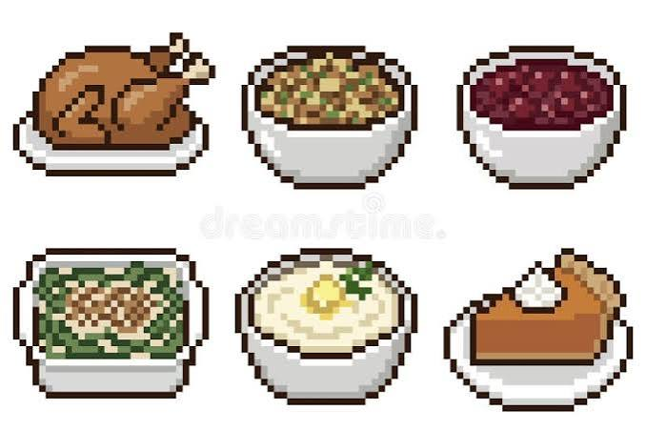
How does the model work?
Each guest randomly chooses three Thanksgiving dishes.
A guest receives a complete plate only if all three dishes are available.
The program updates the leftovers after every guest.
The model tracks turkey, stuffing, mashed potatoes, cranberry sauce, and pie.

Slide 4

Adjustable Inputs
When the program starts, it will ask three questions:
How many guest are coming?
How many servings of each dish is available?
Should debug mode be turned on?
The answers change the simulation without requiring command-line arguments. Debug mode prints what happens for each guest

Slide 5
Code Concepts
numpy randomly chooses three dishes for each guest.
The dishes list stores the names of the foods.
The remaining dictionary stores the number of servings left.
A for loop represents guests arriving one at a time.
if/else statements decide whether a complete plate is possible.
matplotlib creates the bar chart and pie chart.

Slide 6
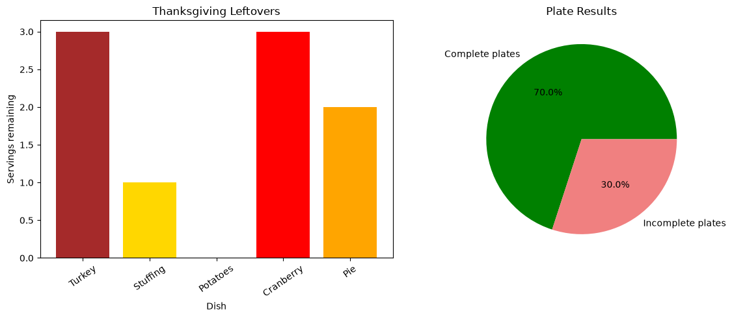
Visualization
Number of guests: 10
Servings of each dish: 6
Debug mode: No
With the current code, this produces:
7 complete plates
3 incomplete plates
Some dishes with leftovers
Some dishes completely used
In this simulation, 10 guests arrived and each dish started with 6 servings. Seven guests received complete plates, while three guests could not because at least one of their selected dishes had run out.

Slide 7
Expected Results
When there are more visitors than portions, the likelihood of incomplete dishes increases. Increased portions each dish should result in more complete plates. The bar chart allows for easy comparison of leftovers, whilst the pie chart allows for straightforward explanation of plate outcomes. Because guests make random choices, the outcomes may vary if the random seed changes.

Slide 8
Limitations
Real guests have different food preferences.
Some guests may take seconds or skip dishes.
Food portions are not always the same size.
The model treats every dish as equally likely to be chosen.

Slide 9
Contributions and Learning
I completed the project on my own by designing, testing, and explaining the Thanksgiving Feast Simulator. I also reorganized the code and README on GitHub. I learnt how to use variables, loops, random numbers, and graphs in Python. The hardest aspect was plainly prompting AI, therefore I requested shorter code that corresponded to our class examples.

Slide 10
Thank You

